Slide 1
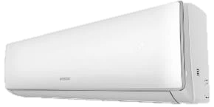
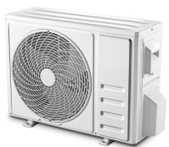
HYUNDAI Air Conditions
Retail File 06/05/2025
Valid until 30/06/2025
I FEEL
4-D AIR FLOW
COMFORTABLE COOLING
SMART AIR FLOW
LOUVER POSITION MEMORY
DISTRIBUTED HEALTHY FILTER SYSTEM
7 FAN SPEEDS
RAPID COOLING IN 30”
RAPID HEATING IN 60”
56◦C HIGH TEMPERATURE SELF-CLEANING & STERILIZATION
REFRIGERANT: R32
WI-FI
Energy Class Cooling | A++
Energy Class Heating | A+++
9K BTU P/N: HYAC-TPNW-09
RRP: € 399.00 (WiFi Ready)
12K BTU P/N: HYAC-TPNWF-12
RRP: € 429.00
18K BTU P/N: HYAC-TPNWF-18
RRP: € 699.00
24K BTU P/N: HYAC-TPNWF-24
RRP: € 889.00
Prices, promotions, specifications, availability and terms of offers may change without notice. Despite our best efforts,
a small number of items may contain pricing, typography, or photography errors. Correct prices and promotions are validated at the time your order is placed. Recycling fees are not included in the Dealer & Retail File. Delivery and installation charges are not included. Products' warranty is the warranty given by the manufacturer. VAT is included
Call now on:
Mail on:

