Slide 1
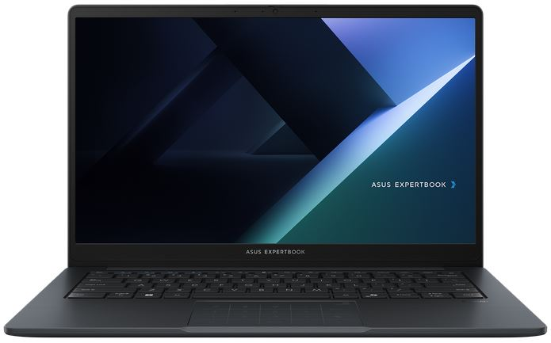
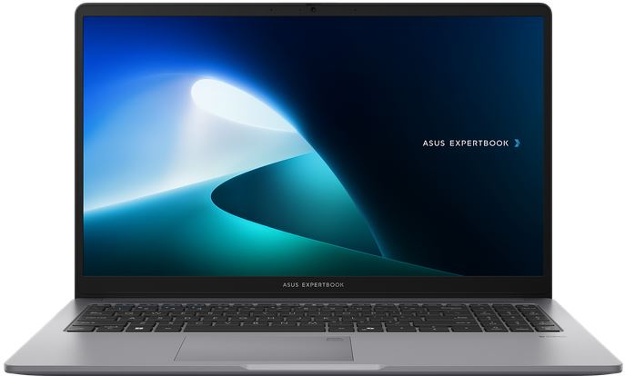
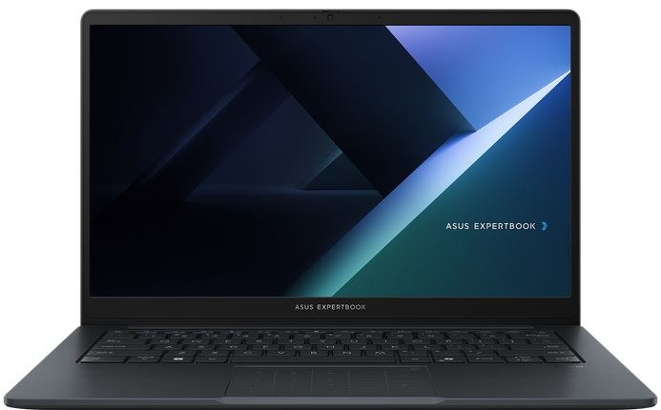
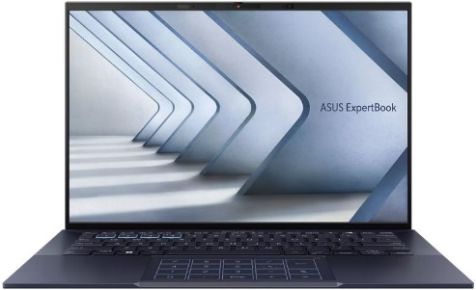
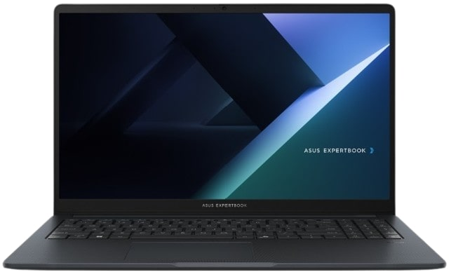
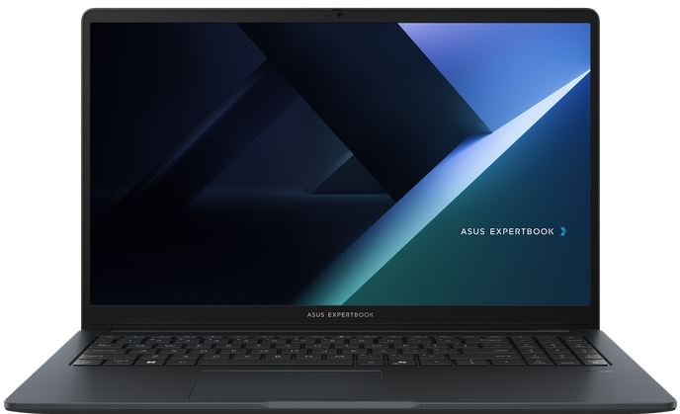
EXPERTBOOK BUSINESS NOTEBOOKS
Retail File June 2025
Special Offers are valid until 31.07 or until stock lasts.
EXPERTBOOK BM1, BM1403CDA
EXPERTBOOK P1
EXPERTBOOK B1, B1403CVA
EXPERTBOOK B9
90NX0831-M00KY0 ASUS NOTEBOOK EXPERTBOOK BM1, BM1403CDA-S60121, AMD RYZEN 5 7535U, 2.9-4.55GHz/16MB, 6C, 16GB, 512GB SSD M.2 2280 NVMe PCIe4, AMD RADEON, 14'' IPS LED FHD 1920x1080 300NITS AG, WIFI6, BT, LAN, USB-A, USB-C, HDMI, DOS, 3YW, GREY € 721
90NX0831-M00KZ0 ASUS NOTEBOOK EXPERTBOOK BM1, BM1403CDA-S60122, AMD RYZEN 7 7735U, 2.7-4.75GHz/16MB, 8C, 16GB, 512GB SSD M.2 2280 NVMe PCIe4, AMD RADEON, 14'' IPS LED FHD 1920x1080 300NITS AG, WIFI6, BT, LAN, USB-A, USB-C, HDMI, DOS, 3YW, GREY € 802
90NX0881-M01BB0 ASUS NOTEBOOK EXPERTBOOK P1, P1503CVA-S70720, INTEL i3-1315U, 3.30-4.50GHz/10MB, 6C, 8GB, 256GB SSD M.2 2280 NVMe PCIe4, INTEL UHD, 15.6'' FHD 1920x1080 300NITS AG, WIFI6, BT, LAN, USB-A, USB-C, HDMI, DOS, 3YW, MISTY GREY € 811
90NX0881-M01BC0 ASUS NOTEBOOK EXPERTBOOK P1, P1503CVA-S70720, INTEL i7-13700H, 2.4-5GHz/24MB, 14C, 16GB, 512GB SSD M.2 2280 NVMe PCIe4, INTEL IRIS X, 15.6'' TN FHD 250NITS AG, WIFI6, BT, LAN, USB-A, USB-C, HDMI, DOS, 3YW, MISTY GREY € 876
90NX0811-M02H40 ASUS NOTEBOOK EXPERTBOOK B1, B1403CVA-S60408, INTEL CORE 5 120U, 1.4-5GHz/12MB, 10C, 16GB, 512GB SSD M.2 2280 NVMe PCIe4, INTEL GRAPHICS, 14'' IPS LED FHD 1920x1080 300NITS AG, WIFI6E, BT, LAN, USB-A, USB-C, HDMI, DOS, 3YW, GREY € 832
90NX0811-M02H50 ASUS NOTEBOOK EXPERTBOOK B1, B1403CVA-S60409, INTEL CORE 7 150U, 1.8-5.4GHz/12MB, 10C, 16GB, 512GB SSD M.2 2280 NVMe PCIe4, INTEL GRAPHICS, 14'' IPS LED FHD 1920x1080 300NITS AG, WIFI6E, BT, LAN, USB-A, USB-C, HDMI, DOS, 3YW, GREY € 959
90NX05W1-M025Y0 ASUS NOTEBOOK EXPERTBOOK B9 OLED, B9403CVAR-KM1327, INTEL CORE 7 150U, 1.8-5.4GHz/12MB, 10C, 32GB, 512GB SSD M.2 2280 NVMe PCIe4, INTEL GRAPHICS, 14'' WQXGA 2880x1800 OLED 400NITS, WIFI6E, BT, USB, USB4, HDMI, DOS, 3YW, BLACK € 1.837
EXPERTBOOK BM1, BM1503CDA
EXPERTBOOK B1, B1503CVA
PROART P16
90NX0801-M022S0 ASUS NOTEBOOK EXPERTBOOK B1, B1503CVA-NJ0144, INTEL CORE 5 120U, 1.4-5GHz/12MB,10C, 16GB, 512GB SSD M.2 2280 NVMe PCIe4, INTEL UHD, 15.6'' TN LED FHD 1920x1080 250NITS AG, WIFI6E, BT, LAN, USB-A, USB-C, HDMI, DOS, 3YW, GENTLE GREY € 846
90NX0801-M022T0 ASUS NOTEBOOK EXPERTBOOK B1, B1503CVA-NJ0145, INTEL CORE 7 150U, 1.8-5.4GHz/12MB, 10C, 16GB, 512GB M.2 2280 NVMe PCIe4, INTEL UHD, 15.6'' TN LED FHD 1920x1080 250NITS AG, WIFI6E, BT, LAN, USB-A, USB-C, HDMI, DOS, 3YW, GENTLE GREY € 965
90NX0821-M00D60 ASUS NOTEBOOK EXPERTBOOK BM1, BM1503CDA-NJ0052, AMD RYZEN 5 7535U, 2.9-4.55GHz/16MB, 6C, 16GB, 512GB SSD M.2 2280 NVMe PCIe4, AMD RADEON, 15.6'' TN LED FHD 1920x1080 250NITS AG, WIFI, BT, LAN, USB-A, USB-C, HDMI, DOS, 3YW, GREY € 728
90NX0821-M00D70 ASUS NOTEBOOK EXPERTBOOK BM1, BM1503CDA-NJ0053, AMD RYZEN 7 7735U, 2.7-4.75GHz/16MB, 8C, 16GB, 512GB M.2 2280 NVMe PCIe4, AMD RADEON, 15.6'' TN LED FHD 1920x1080 250NITS AG, WIFI6,BT, LAN, USB-A, USB-C, HDMI, DOS, 3YW, GENTLE GREY € 817
90NX0801-M01HD0 ASUS NOTEBOOK EXPERTBOOK B1, B1503CVA-NJ0144X, INTEL CORE 5 120U, 1.4-5GHz/12MB, 10C, 16GB, 512GB SSD M.2 2280 NVMe PCIe4, INTEL UHD, 15.6'' TN LED FHD 1920x1080 250NITS AG, WIFI6E,BT, LAN, USB-A, USB-C, HDMI, WIN 11 PRO,3YW, GREY € 1.039
90NX0801-M02T60 ASUS NOTEBOOK EXPERTBOOK B1, B1503CVA-NJ0145X, INTEL CORE 7 150U, 1.8-5.4GHz/12MB,10C, 16GB, 512GB SSD M.2 2280 NVMe PCIe4, INTEL UHD, 15.6'' TN LED FHD 1920x1080 250NITS AG, WIFI6E,BT, LAN, USB-A,USB-C, HDMI, WIN 11 PRO,3YW, GREY € 1.168
90NB15K1-M003B0 ASUS NOTEBOOK PROART P16, H7606WP-OLED-ME011X, AMD RYZEN AI 9 HX 370 2-5.1GHz/36MB, 12C, 64GB, 2x2TB SSD M.2 NVMe, NVIDIA RTX 5070 8GB, 16'', OLED 4K 3840x2400 60Hz 500NITS TOUCH, WIFI7,BT,USB-C,USB-A,HDMI, WIN 11 PRO, 2YW, BLACK €4.009
Call now on:
Mail on:
Prices, promotions, specifications, availability and terms of offers may change without notice. Despite our best efforts, a small number of items may contain pricing, typography, or photography errors. Correct prices and promotions are validated at the time your order is placed. Delivery and installation charges are not included. Products' warranty is the warranty given by the manufacturer. VAT is included

Slide 2
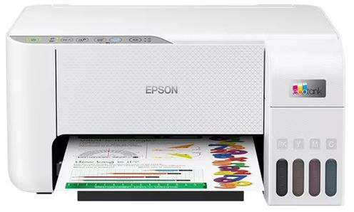
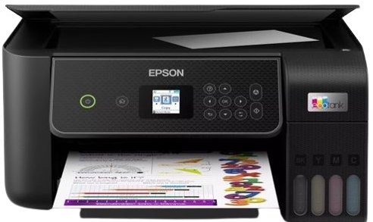
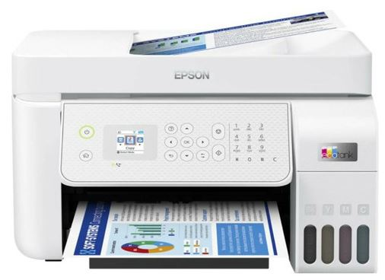
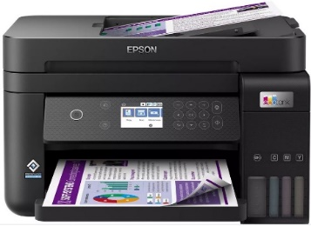
ALL IN ONE BUSINESS PCs
Retail File June 2025
Special Offers are valid until 31.07 or until stock lasts.
A3402WVAK
A5402WVA
A5702WVA
90PT03N1-M022C0 ASUS PC ALL IN ONE A5702WVA, A5702WVARK-BPE0540, 27'', FHD 1920x1080 LCD 250NITS 75Hz AG, INTEL CORE 5 120U 1.4-5GHz/12MB, 10C, 16GB, 512GB SSD M.2 NVMe PCIe4, INTEL IRIS X GRAPH,WIFI6E,BT, LAN,USB-A,USB-C,USB4,HDMI,DOS,3YW,BLACK € 1.159
90PT03N1-M022D0 ASUS PC ALL IN ONE A5702WVA, A5702WVARK-BPE0550, 27'', FHD 1920x1080 LCD 250NITS 75Hz AG, INTEL CORE 7 150U 1.8-5.4GHz/12MB, 10C, 16GB, 512GB SSDM.2 NVMe PCIe4,INTEL IRIS X GRAPH,WIFI6E,BT, LAN, USB-A, USB-C, HDMI, DOS, 3YW, BLACK € 1.278
90PT03T1-M033R0 ASUS PC ALL IN ONE A3402WVA, A3402WVAK-WPC1760, 23.8'', FHD 1920x1080 LCD 250NITS 100Hz AG, INTEL i5-1335U 1.3-4.6GHz/12MB, 10C, 16GB, 512GB SSD M.2 NVMe PCIe4, INTEL IRIS X GRAPH, WIFI6E, BT, LAN,USB-A,USB-C,HDMI, DOS, 3YW, WHITE € 907
90PT03J3-M04B60 ASUS PC ALL IN ONE A5402WVA, A5402WVARK-BPC0320, 23.8'', FHD 1920x1080 LCD 250NITS 100Hz AG, INTEL CORE 5 120U, 1.4-5GHz/12MB, 10C, 16GB,512GB SSD M.2 NVMe PCIe4,INTEL IRIS X GRAPH,WIFI7,BT,LAN,USB-A,USB-C,USB4,HDMI,DOS,3YW,WHITE € 1.129
90PT03J3-M04B50 ASUS PC ALL IN ONE A5402WVA, A5402WVARK-BPC0310, 23.8'', FHD 1920x1080 LCD 250NITS 100Hz AG, INTEL CORE 7 150U 1.8-5.4GHz/12MB, 10C, 16GB, 512GB M.2 NVMe PCIe4, INTEL GRAPHICS, WIFI7,BT, LAN,USB-A,USB-C,USB4,HDMI,DOS,3YW, WHITE € 1.248
90PT03N1-M022J0 ASUS PC ALL IN ONE A5702WVA, A5702WVARK-BPE073X, 27'',FHD 1920x1080 LCD 250NITS 75Hz AG,INTEL CORE 5 120U 1.4-5GHz/12MB,10C,16GB,512GB SSD M.2 NVMe PCIe4,INTEL IRIS X GRAPH,WIFI6E,BT,LAN,USB-A,USB-C,USB4,HDMI,WIN 11 PRO,3YW,BLACK € 1.361
90PT03N1-M022H0 ASUS PC ALL IN ONE A5702WVA, A5702WVARK-BPE072X,27'',FHD 1920x1080 LCD 250NITS 75Hz AG,INTEL CORE 7 150U 1.8-5.4GHz/12MB,10C,16GB,512GB SSD M.2 NVMe PCIe4,INTEL IRIS X GRAPH,WIFI6E,BT,LAN,USB-A,USB-C,USB4,HDMI,WIN 11 PRO,3YW,BLACK € 1.486
90PT03T1-M033S0 ASUS PC ALL IN ONE A3402WVA, A3402WVAK-WPC1770, 23.8'', FHD 1920x1080 LCD 250NITS 100Hz AG, INTEL i7-1355U 1.7-5GHz/12MB, 10C, 16GB, 512GB SSD M.2 NVMe PCIe4, INTEL GRAPHICS, WIFI6E, BT, LAN, USB-A, USB-C, HDMI, DOS, 3YW, WHITE € 980
Optional Printers – Special Offers
C11CJ67436 EPSON PRINTER ALL IN ONE INKJET COLOR HOME- OFFICE ITS L3276 A4 ECO TANK,PRINT,SCAN,COPY,33PPM(B),15 PPM(C),5.760X1.440DPI,USB,WIFI,UP TO8.100PGS IN BL&6.500 IN COL W/ THE INCL.INK,WHITE,4 INK,KCYM&EXTR BLACK € 211
C11CJ66426 EPSON PRINTER ALL IN ONE INKJET COLOR HOME - OFFICE ITS L3280 A4 ECO TANK, PRINT, SCAN, COPY, 10PPM (B), 5PPM (C), 5.760 X 1.440 DPI, USB, WIFI, PRINT UP TO 8.100 PAGES IN BLACK & 6.500 IN COL,BL,4 INK, KCYM&EXTRA BL € 232
C11CJ65413 EPSON PRINTER ALL IN ONE INKJET COLOR BUSINESS ITS L5316 A4 ECO TANK, PRINT, SCAN, COPY, FAX, 10PPM (B), 5PPM (C), 5.760 X 1.440 DPI, ADF 30P, USB, WiFi, LAN, WHITE, 2 YEAR WARRANTY, 4 INK, KCYM AND EXTRA BLACK € 319
C11CJ61403 EPSON PRINTER ALL IN ONE INKJET COLOR HOME - OFFICE ITS L6270 A4 ECO TANK, PRINT, SCAN, COPY, 15PPM (B), 8PPM(C),4.800 X 1.200 DPI, DUPLEX, 30-PAGE ADF, USB, WiFi, WiFi DIRECT, LAN, BLACK € 379
Call now on:
Mail on:
Prices, promotions, specifications, availability and terms of offers may change without notice. Despite our best efforts, a small number of items may contain pricing, typography, or photography errors. Correct prices and promotions are validated at the time your order is placed. Delivery and installation charges are not included. Products' warranty is the warranty given by the manufacturer. VAT is included

Slide 3
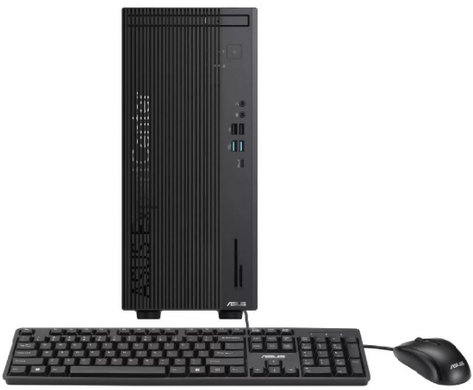
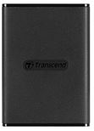
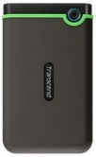
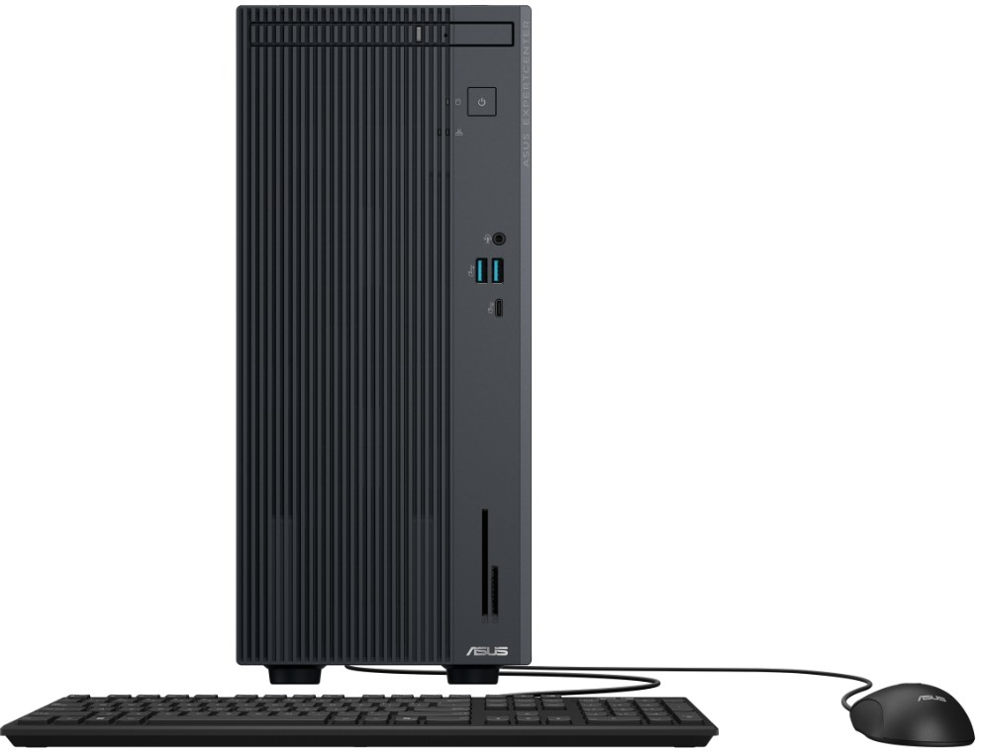
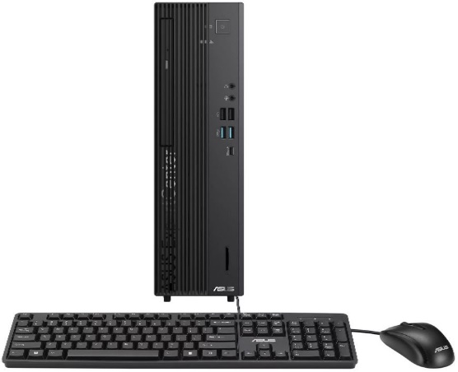
Retail File June 2025
EXPERTCENTER BUSINESS PCs
Retail File June 2025
Special Offers are valid until 31.07 or until stock lasts.
EXPERTCENTER D7 MT, D701MER
Optional
AURORA_1200VA PHOENIXTEC UPS LINE INTERACTIVE 1200VA/600W, 2PCS BATTERY 12V/7Ah, TRANFER TIME: 4-8MS, RECHARGE TIME: 6 HOURS TO 90%, 6X SOCKETS, LED INDICATORS, PHONE LINE SURGE PROTECTION, USB € 141
AURORA_2200VA PHOENIXTEC UPS LINE INTERACTIVE 2200VA/1100W, 2PCS BATTERY 12V/9Ah, TRANSFER TIME: 4-8MS, RECHARGE TIME: 6 HOURS TO 90%, 6X SOCKETS, LED INDICATORS, PHONE LINE SURGE PROTECTION, USB € 192
TS250GESD270C TRANSCEND SSD ESD270C EXTERNAL PORTABLE 250GB, 2.5'', USB 3.1, BLACK, COMPACT AND LIGHT AS A FEATHER, ONE TOUCH BACKUP BUTTON, SUPPORT WINDOWS / MAC / LINUX, 3YW € 54
TS500GESD270C TRANSCEND SSD ESD270C EXTERNAL PORTABLE 500GB, 2.5'', USB 3.1, COMPACT AND LIGHT AS A FEATHER, ONE TOUCH BACKUP BUTTON, SUPPORT WINDOWS, MAC, LINUX, 3YW, BLACK € 78
90PF05J1-M00JA0 ASUS PC EXPERTCENTER D7 MT, D701MER-5145000320, INTEL i5-14500 2.6-5GHz/24MB, 14C, 16GB, 512GB SSD M.2 2280 NVMe PCIe4, INTEL UHD GRAPHICS 770, DVDRW, LAN, USB-A, USB-C, HDMI, DP, VGA, DOS, 5YW, BLACK € 832
90PF05J1-M00YF0 ASUS PC EXPERTCENTER D7 MT, D701MER-514500127X, INTEL i5-14500 2.6-5GHz/24MB, 14C, 16GB, 512GB SSD M.2 2280 NVMe PCIe4, INTEL UHD GRAPHICS 770, DVDRW, LAN, USB-A, USB-C, HDMI, DP, VGA, WIN 11 PRO, 5YW, BLACK € 1.034
90PF05J1-M00JB0 ASUS PC EXPERTCENTER D7 MT, D701MER-7147000480, INTEL i7-14700 2.1-5.3GHz/33MB, 20C, 16GB, 512GB SSD M.2 2280 NVMe PCIe4, INTEL UHD GRAPHICS 770, DVDRW, LAN, USB-A, USB-C, HDMI, DP, VGA, DOS, 5YW, BLACK € 1.084
EXPERTCENTER P500 MT, MINI TOWER
EXPERTCENTER D7 SFF, D701SER
TS1TSJ25M3S TRANSCEND EXTERNAL HDD 25M3 1TB, 2.5'', USB 3.1, RUGGED, SLIMMER, LIGHTER, MILITARY GRADE SHOCK RESISTANCE, RUBBER CASE, ONE TOUCH BACKUP BUTTON, SUPPORT WIN, MAC, LINUX, 3YW, IRON GRAY € 102
TS2TSJ25M3S TRANSCEND EXTERNAL HDD 25M3 2TB, 2.5'', USB 3.1, RUGGED, SLIMMER, LIGHTER, MILITARY GRADE SHOCK RESISTANCE, RUBBER CASE, ONE TOUCH BACKUP BUTTON, SUPPORT WIN, MAC, LINUX, 3YW, IRON GRAY € 136
TS128GJF700 TRANSCEND MEMORY STICK 128GB JETFLASH 700, PROTECTION CAP, USB TYPE-A, USB 3.1, WINDOWS OS AND MAC OS, BLACK € 13
TS256GJF790C TRANSCEND MEMORY STICK 256GB JETFLASH 790C, RETRACTABLE, USB 3.2, USB TYPE-C, WINDOWS OS AND MAC OS, BLACK € 25
90PF05I1-M00PV0 ASUS PC EXPERTCENTER P500 MT, P500MV-13420H1500, INTEL i5-13420H 2.1-4.6GHz/12MB, 8C, 16GB, 512GB SSD M.2 2280 NVMe PCIe4, INTEL UHD GRAPHICS, DVDRW, LAN, USB-A, USB-C, HDMI, DP, DOS, 5YW, GREY € 692
90PF05I1-M00PW0 ASUS PC EXPERTCENTER P500 MT, P500MV-13620H0580, INTEL i7-13620H 2.4-4.9GHz/24MB, 10C, 16GB, 512GB SSD M.2 2280 NVMe PCIe4, INTEL UHD GRAPHICS, DVDRW, LAN, USB-A, USB-C, HDMI, DP, DOS, 5YW, GREY € 796
90PF05N1-M00F60 ASUS PC EXPERTCENTER D7 SFF, D701SER-5145000270, INTEL i5-14500 2.6-5GHz/24MB, 14C, 16GB, 512GB SSD M.2 2280 NVMe PCIe4, INTEL UHD GRAPHICS 770, DVDRW, LAN, USB-A, USB-C, HDMI, DP, VGA, DOS, 5YW, BLACK € 832
TS-HUB5C TRANSCEND HUB 6-IN-1 USB 3.1 GEN 2, USB TYPE-C (USB 3.1 GEN 2), MICROSD CARD SLOT (UHS-I), SD CARD SLOT (UHS-II) , USB TYPE-C (MAX. 60W POWER DELIVERY) , USB TYPE-A X2 (USB 3.1 GEN 1), BLACK, 2YW € 46
Call now on:
Mail on:
Prices, promotions, specifications, availability and terms of offers may change without notice. Despite our best efforts, a small number of items may contain pricing, typography, or photography errors. Correct prices and promotions are validated at the time your order is placed. Delivery and installation charges are not included. Products' warranty is the warranty given by the manufacturer. VAT is included

