Slide 1
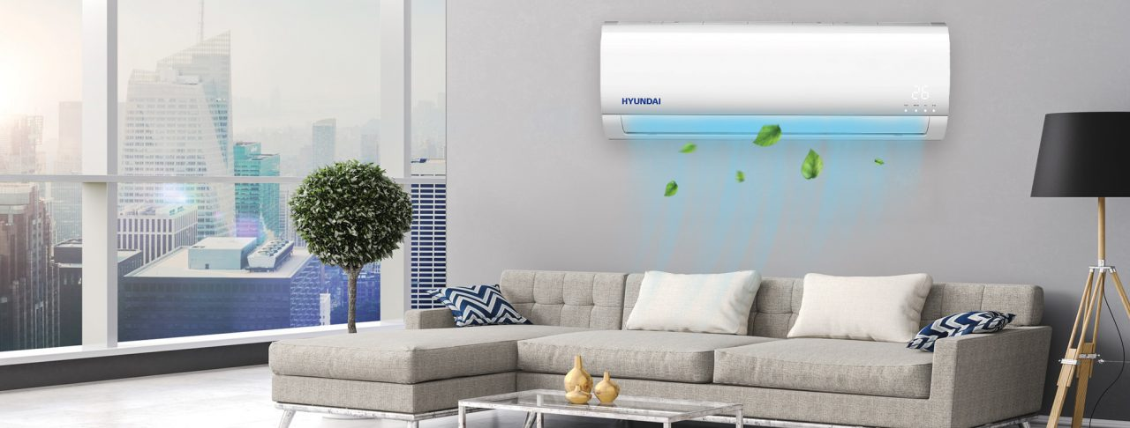
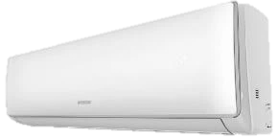

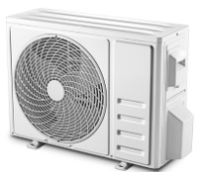
HYUNDAI
Air Conditions
Retail File July 2025
9K BTU P/N: HYAC-TPNWWF-09
RRP: € 389.00
I FEEL
4-D AIR FLOW
COMFORTABLE COOLING
SMART AIR FLOW
LOUVER POSITION MEMORY
DISTRIBUTED HEALTHY FILTER SYSTEM
7 FAN SPEEDS
RAPID COOLING IN 30”
RAPID HEATING IN 60”
56◦C HIGH TEMPERATURE SELF-CLEANING & STERILIZATION
REFRIGERANT: R32
WI-FI
12K BTU P/N: HYAC-TPNWWF-12
RRP: € 419.00
18K BTU P/N: HYAC-TPNWWF-18
RRP: € 699.00
24K BTU P/N: HYAC-TPNWWF-24
RRP: € 879.00
Energy Class Cooling | A++
Energy Class Heating | A+++
Prices, promotions, specifications, availability and terms of offers may change without notice. Despite our best efforts,
a small number of items may contain pricing, typography, or photography errors. Correct prices and promotions are validated at the time your order is placed. Recycling fees are not included in the Dealer & Retail File. Delivery and installation charges are not included. Products' warranty is the warranty given by the manufacturer. VAT is included
Call now on:
Mail on:

Slide 2

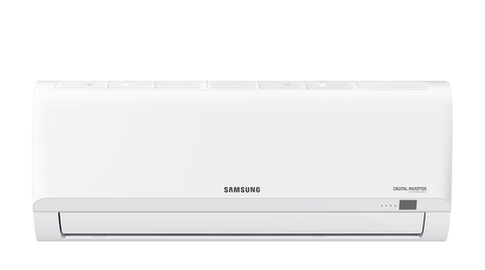
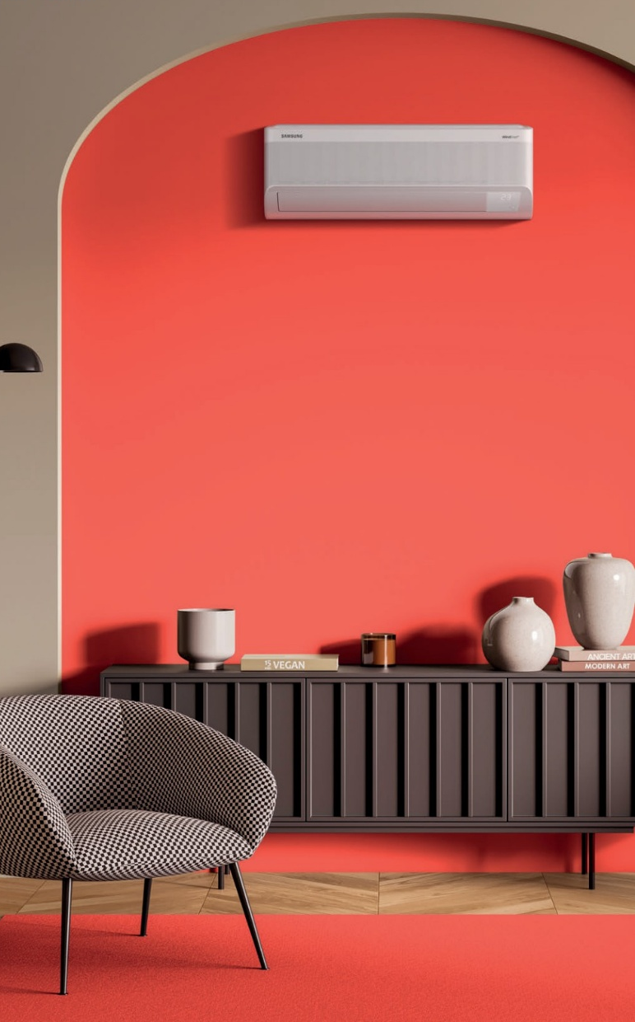
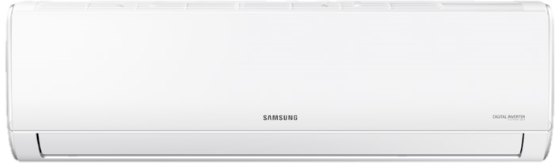
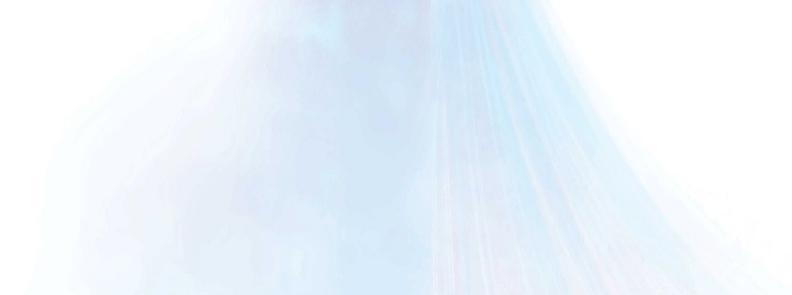

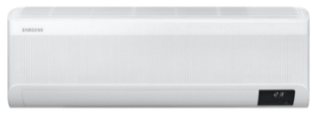
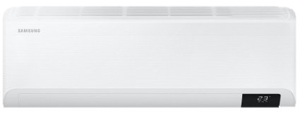

Air Conditions
Retail File July 2025
Samsung AR30
Samsung AR35
SAMSUNG AIR CONDITION, AR30 SERIES, R32, WALL TYPE, INVERTER, A++/A+ CLASS
SAMSUNG AIR CONDITION, AR35 SERIES, R32, WALL TYPE, INVERTER, A++/A+ CLASS
9K BTU: AR09TXHQBWK
AR09TXFYAWKNEU
AR09TXFYAWKXEU
RRP: € 459
12K BTU: AR12TXHQBWK
AR12TXFYAWKNEU
AR12TXFYAWKXEU
RRP: € 489
9K BTU: AR09TXHQASI
AR09TXHQASINEU
AR09TXHQASIXEU
RRP: € 459
18K BTU: AR18BXHQASI
AR18BXHQASINEU
AR18BXHQASIXEU
RRP: € 999
24K BTU: AR24BXHQASI
AR24BXHQASINEU
AR24BXHQASIXEU
RRP: € 1,199
Samsung Wind-Free Comfort
Samsung Cebu
SAMSUNG AIR CONDITION , WIND FREE COMFORT , FJM&RAC , R32 - WALL TYPE,INVERTER, A++/A+ CLASS, WIFI
SAMSUNG AIR CONDITION, CEBU , R32, INVERTER, A++/A+ CLASS, WIFI
9K BTU: AR09TXFCAWK
AR09TXFCAWKNEU
AR09TXFCAWKXEU
RRP: € 699
9K BTU: AR09TXFYAWK
AR09TXFYAWKNEU
AR09TXFYAWKXEU
RRP: € 599
12K BTU: AR12TXFYAWK
AR12TXFYAWKNEU
AR12TXFYAWKXEU
RRP: € 709
18K BTU: AR18TXFCAWK
AR18TXFCAWKNEU
AR18TXFCAWKXEU
RRP: € 1,259
24K BTU: AR24TXFCAWK
AR24TXFCAWKNEU
AR24TXFCAWKXEU
RRP: € 1,599
18K BTU: AR18TXFYAWK
AR18TXFYAWKXEU
AR18TXFYAWKNEU
RRP: € 999
24K BTU: AR24TXFYAWK
AR24TXFYAWKNEU
AR24TXFYAWKXEU
RRP: € 1,439
Prices, promotions, specifications, availability and terms of offers may change without notice. Despite our best efforts,
a small number of items may contain pricing, typography, or photography errors. Correct prices and promotions are validated at the time your order is placed. Recycling fees are not included in the Dealer & Retail File. Delivery and installation charges are not included. Products' warranty is the warranty given by the manufacturer. VAT is included
Call now on:
Mail on:

