Slide 1

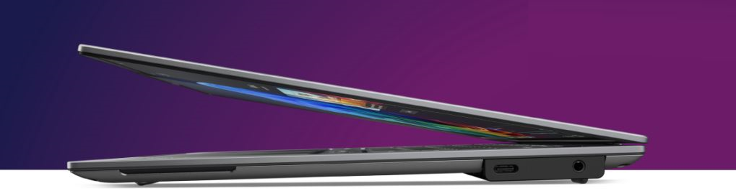

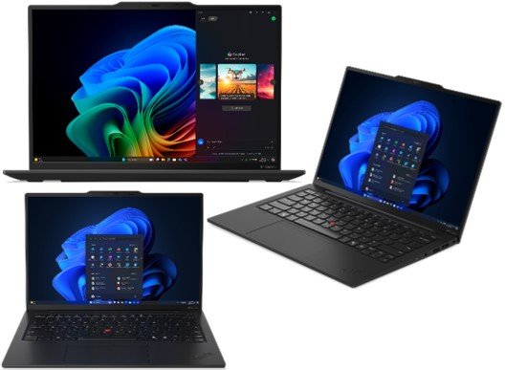

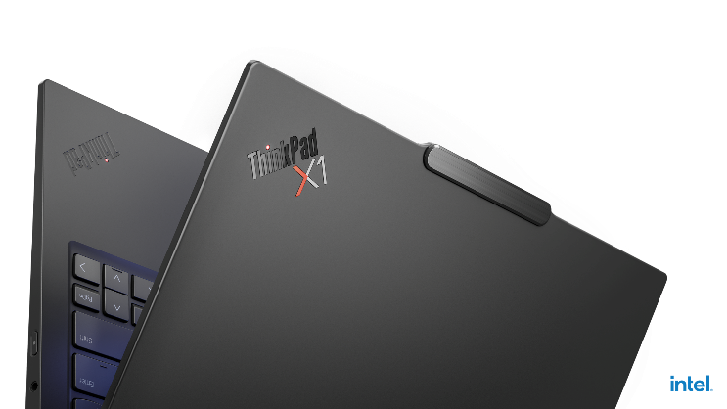





Retail File June 2025
Special Offers are valid until 30.06 or until stock lasts.
X1 Carbon Gen 13 Aura Edition Special Offers
Pre-Order Now
Lenovo is delivering one of the widest and deepest portfolios of AI PCs to provide a work experience that's personalized, productive, and protected for you. The new Lenovo ThinkPad X1 Carbon Gen 13 Aura Edition is the first Intel-powered Lenovo Commercial Copilot+ PC 1 complete with Lenovo Aura Edition experiences that amp up your UX to next-level premium.
21NS004RVU LENOVO NOTEBOOK THINKPAD X1 CARBON G13, INTEL ULTRA 7 258V, 4.8GHz/12MB, 8 CORES, AI 47 TOPS, 32GB, 1TB SSD M.2 2280 PCIe5, ARC 140V, 14' WUXGA 1920x1200 IPS 500NITS TOUCH, 5G, WIFI7, BT, USB-A, USB4, HDMI, WIN 11 PRO, 3YW, BLACK € 3,309
21NS004KVU LENOVO NOTEBOOK THINKPAD X1 CARBON G13, INTEL ULTRA 7 258V, 4.8GHz/12MB, 8 CORES, AI 47 TOPS, 32GB, 2TB SSD M.2 2280 PCIe5, ARC 140V, 14" 2.8K 2880x1800 OLED 500NITS, 5G, WIFI7, BT, USB-A, USB4, HDMI, WIN 11 PRO, 3YW, BLACK € 3,524
Includes Mobile Broadband
Quectel RM520N-GL, 5G Sub-6 GHz, with Embedded eSIM
LENOVO AURA EDITION SMART MODES
Minimal distraction, maximum get-it-done.
SHIELD
POWER
Provides AI-enhanced security features and recommends actions for digital protection.
Optimizes energy efficiency by prioritizing performance, battery life, and fan speed.
ATTENTION
WELLNESS
Suppresses unwanted disruptions, so you can concentrate on the task at hand.
Promotes digital health by encouraging regular eye breaks and fostering good ergonomics.
COLLABORATION
Enhances audiovisual effects with AI for richer collaboration, regardless of platform
Call now on:
Mail on:
Prices, promotions, specifications, availability and terms of offers may change without notice. Despite our best efforts, a small number of items may contain pricing, typography, or photography errors. Correct prices and promotions are validated at the time your order is placed. Delivery and installation charges are not included. Products' warranty is the warranty given by the manufacturer. VAT is included

Slide 2


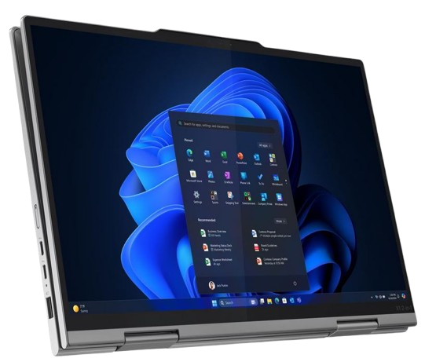
Retail File June 2025
Special Offers are valid until 30.06 or until stock lasts.
ThinkPad X1 2-in-1 Gen 10 Aura Edition Special Offers
This remarkable 2-in-1 device provides an outlet for unleashed creativity. Imagine the power of a premium laptop, the convenience of a touchscreen tablet, and the flexibility of a 360-degree hinge that makes physical screen sharing a cinch. Add to that the magnetic pen option and you can sign documents, sketch designs, take notes, and so much more.
21NU002BVU LENOVO NOTEBOOK THINKPAD X1 2 IN 1 G10, INTEL ULTRA 7 258V, 4.8GHz/12MB, 8 CORES, AI 47 TOPS, 32GB, 1TB SSD M.2 2280 PCIe5, ARC 140V, 14" 2.8K 2880x1800 OLED 500NITS TOUCH, 5G, WIFI7, BT, USB-A, USB4, HDMI, WIN 11 PRO, 3YW, GREY € 3,792
Includes Mobile Broadband
Quectel RM520N-GL, 5G Sub-6 GHz, with Embedded eSIM
LENOVO AURA EDITION SMART MODES
Minimal distraction, maximum get-it-done.
SHIELD
POWER
Provides AI-enhanced security features and recommends actions for digital protection.
Optimizes energy efficiency by prioritizing performance, battery life, and fan speed.
ATTENTION
WELLNESS
Suppresses unwanted disruptions, so you can concentrate on the task at hand.
Promotes digital health by encouraging regular eye breaks and fostering good ergonomics.
COLLABORATION
Enhances audiovisual effects with AI for richer collaboration, regardless of platform
Call now on:
Mail on:
Prices, promotions, specifications, availability and terms of offers may change without notice. Despite our best efforts, a small number of items may contain pricing, typography, or photography errors. Correct prices and promotions are validated at the time your order is placed. Delivery and installation charges are not included. Products' warranty is the warranty given by the manufacturer. VAT is included

