Slide 1
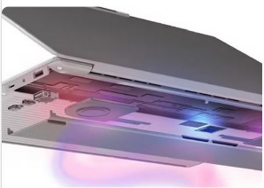
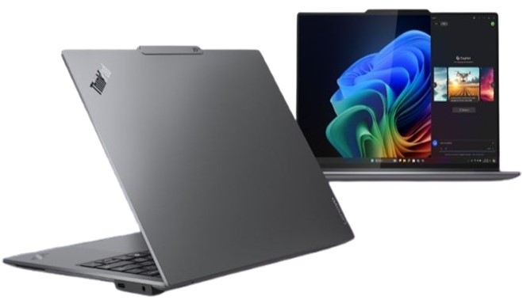
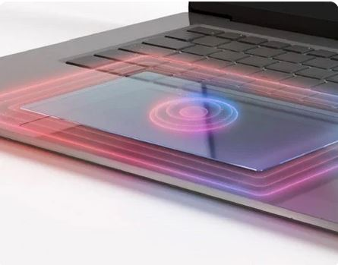
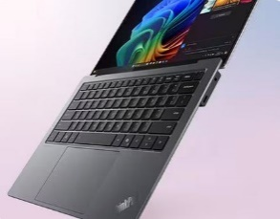
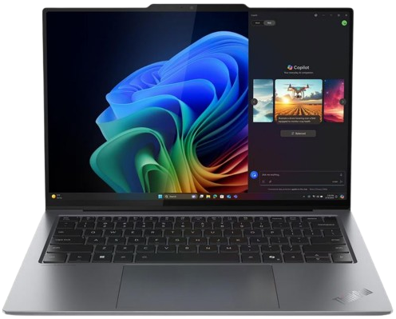
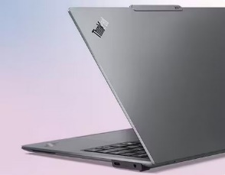
Retail File June 2025
Retail File June 2025
Special Offers are valid until 30.06 or until stock lasts.
X9 14 Gen 1 Aura Edition Special Offers
Special Offers are valid until 30.06 or until stock lasts.
What happens when the already-innovative ThinkPad is reimagined to embody a next- level next-gen AI PC? Introducing Lenovo ThinkPad X9 14 Gen 1 Aura Edition, imagined with Intel, a modern premium device that combines intentional elegance and an extraordinary UX. Delivering extreme thinness, energy efficiency, and personalized AI-accelerated productivity with Copilot+ PC 1 experiences and Lenovo AI Now, Lenovo is setting new industry standards and pushing the boundaries of distinction.
21QA001CVU LENOVO NOTEBOOK THINKPAD X9-14 G1, INTEL ULTRA 7 258V, 2.2-4.8GHz/12MB, 8 CORES, 32GB, 1TB SSD M.2 2242 PCIe, AI NPU 47 TOPS, ARC 140V GRAPHICS, 14' WUXGA 1920x1200 OLED 400NITS, WIFI7, BT, USB-C, HDMI, WIN 11 PRO, 3YW, GREY € 2,459
21QA0048VU LENOVO NOTEBOOK THINKPAD X9-14 G1, INTEL ULTRA 7 258V, 2.2-4.8GHz/12MB, 8 CORES, 32GB, 1TB SSD M.2 2242 PCIe, AI NPU 47 TOPS, ARC 140V GRAPHICS, 14' 2.8K 2880x1800 OLED 500NITS, TOUCH, WIFI7, BT, USB-C, HDMI, WIN 11 PRO, 3YW, GREY € 2,665
Innovation Meets Style
A Modern Keyboard That Feels Great
LENOVO AURA EDITION SMART MODES
Minimal distraction, maximum get-it-done.
SHIELD
POWER
Provides AI-enhanced security features and recommends actions for digital protection.
Optimizes energy efficiency by prioritizing performance, battery life, and fan speed.
ThinkPad Tough
ATTENTION
WELLNESS
Suppresses unwanted disruptions, so you can concentrate on the task at hand.
Promotes digital health by encouraging regular eye breaks and fostering good ergonomics.
COLLABORATION
Seamless Security for Your Business
Enhances audiovisual effects with AI for richer collaboration, regardless of platform
Call now on:
Mail on:
Prices, promotions, specifications, availability and terms of offers may change without notice. Despite our best efforts, a small number of items may contain pricing, typography, or photography errors. Correct prices and promotions are validated at the time your order is placed. Delivery and installation charges are not included. Products' warranty is the warranty given by the manufacturer. VAT is included

Slide 2
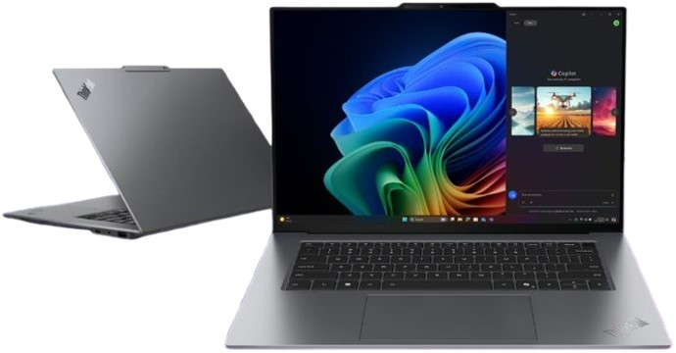
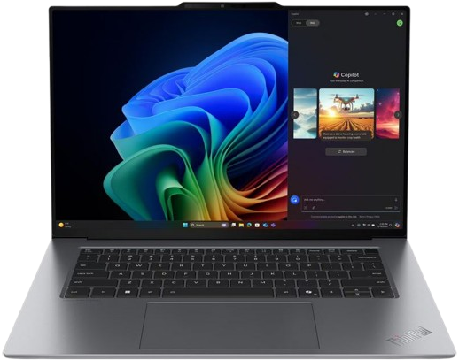
Retail File June 2025
Retail File June 2025
Special Offers are valid until 30.06 or until stock lasts.
X9 15 Gen 1 Aura Edition Special Offers
Special Offers are valid until 30.06 or until stock lasts.
Designed for business users who demand a premium computing experience that's productive, personalized, and protected, the all-new Lenovo ThinkPad X9 15 Aura Edition, imagined with Intel, merges cutting-edge technology with elegant, intentional design. Boasting an elevated UX, along with the AI-accelerated productivity of Copilot+ PC1 experiences and Lenovo AI Now, this next-gen AI PC sets a new industry standard. This is ThinkPad, reimagined.
21Q6001NVU LENOVO NOTEBOOK THINKPAD X9-15 G1, INTEL ULTRA 7 258V, 2.2-4.8GHz/12MB, 8C, 32GB, 1TB SSD M.2 2242 PCIe, AI 47 TOPS, ARC 140V GRAPHICS, 15.3' 2.8K 2880x1800 OLED 500NITS, TOUCH, WIFI7, BT, USB, USB-C, HDMI, WIN 11 PRO, 3YW, GREY € 2,679
Innovation Meets Style
A Modern Keyboard That Feels Great
LENOVO AURA EDITION SMART MODES
Minimal distraction, maximum get-it-done.
SHIELD
POWER
Provides AI-enhanced security features and recommends actions for digital protection.
Optimizes energy efficiency by prioritizing performance, battery life, and fan speed.
ThinkPad Tough
ATTENTION
WELLNESS
Suppresses unwanted disruptions, so you can concentrate on the task at hand.
Promotes digital health by encouraging regular eye breaks and fostering good ergonomics.
COLLABORATION
Seamless Security for Your Business
Enhances audiovisual effects with AI for richer collaboration, regardless of platform
Call now on:
Mail on:
Prices, promotions, specifications, availability and terms of offers may change without notice. Despite our best efforts, a small number of items may contain pricing, typography, or photography errors. Correct prices and promotions are validated at the time your order is placed. Delivery and installation charges are not included. Products' warranty is the warranty given by the manufacturer. VAT is included

