Slide 1
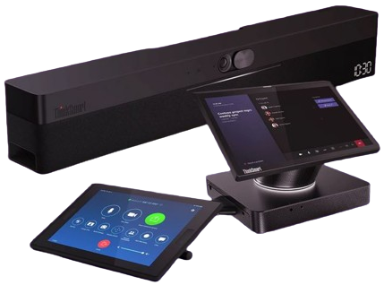
Retail File June 2025
Special Offers are valid until 30.06 or until stock lasts.
ThinkSmart solutions can help your return to the office to be more collaborative and productive.
Offering flexibility across platforms and room sizes so you can redefine your meeting space.
With the ThinkShield, the integrated suite of security solutions, you can trust your data will remain safe and your privacy intact.
Call now on:
Mail on:
Prices, promotions, specifications, availability and terms of offers may change without notice. Despite our best efforts, a small number of items may contain pricing, typography, or photography errors. Correct prices and promotions are validated at the time your order is placed. Delivery and installation charges are not included. Products' warranty is the warranty given by the manufacturer. VAT is included

Slide 2
Retail File June 2025
Special Offers are valid until 30.06 or until stock lasts.
Core
for Microsoft Team Rooms
Controller
Display
Resolution
Ports
Security
10.1" Display, 10-point Multi-touch
HD 1280x800, Up to 340 nits brightness, 16:10 aspect ratio
USB-C® (connect to compute unit, 10m USB-C cable included), 3.5mm headphone / mic combo jack
Kensington Security Slot
Compute
Processor
Operating System
Memory
Storage
Graphics
Wi-Fi
Ports
Security
Dimensions
Intel® Core™ i5-1145G7E (4C / 8T, 1.5 / 4.1GHz, 8MB)
Windows® 11 IoT Enterprise for Collaboration GAC 64, English
1x 16GB Soldered DDR4-3200
256GB SSD M.2 2280 PCIe® 3.0x4 NVMe®
Integrated Intel® Iris® Xe Graphics
Intel® Wi-Fi® 6 AX201, 11ax 2x2 + BT5.0, vPro®
Thunderbolt 4, USB-C 3.2 Gen 1, USB 3.2 Gen 1, USB 3.2 Gen 2, HDMI-in, HDMI-out 1.4, Ethernet
(RJ-45), power connector
Discrete TPM 2.0, TCG certified, Kensington® Security Slot
226 x 200 x 37.5 mm (8.9 x 7.9 x 1.5 inches)
Powerful & secure performance
Collaborate face-to-face
Easy to manage
Security matters
Fits anywhere
ThinkSmart Core + Controller Kit for Microsoft Teams Rooms
11LR000BUK LENOVO THINKSMART CORE + CONTROLLER KIT, 10.1'' TOUCH, INTEL i5-1145G7E 1.5-4.1GHz/8MB, 4 CORES, 8GB, 256GB SSD M.2 NVME, GIGA LAN, WIFI, BT, VESA MOUNT, INTEL V PRO, WIN 10 IoT Enterprise SAC 64, 3YW ONSITE PREMIER SUPPORT, BLACK € 2.229
Call now on:
Mail on:
Prices, promotions, specifications, availability and terms of offers may change without notice. Despite our best efforts, a small number of items may contain pricing, typography, or photography errors. Correct prices and promotions are validated at the time your order is placed. Delivery and installation charges are not included. Products' warranty is the warranty given by the manufacturer. VAT is included

Slide 3
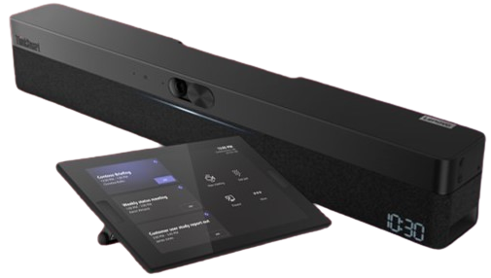
Retail File October 2023
ThinkSmart One with Controller
Retail File June 2025
Special Offers are valid until 30.06 or until stock lasts.
One with Controller
Compute
Processor
Operating System
Memory
Storage
Graphics
Wi-Fi
Ports
Security
Dimensions
11th Gen Intel® Core™ vPro® i5 1145G7E
Windows® 10 IoT Enterprise
8 GB (Dual-Channel) DDR4 3200MHz
256GB PCIe gen4 TLC SSD
Intel® Iris® Xe Graphics
WLAN 802.11 AX (2x2)
Bluetooth® Low Energy (LE) 5.0
1x HDMI In, 2x USB-A 3.2 Gen 1 (DP function), USB-C 2.0 Gen 1 (display only), USB-C 3.2 Gen 1, 2x LAN, 1x DC-IN
TPM 2.0, Kensington™ Mini-saver Lock Slot, Integrated Cable Management
700 x115x89 mm, 27.56 x 4.53 x 3.50 in
Controller
Speakers
Display
Resolution
Ports
Security
10.1" 10-point touch
30˚ and 60˚ rotatable
Anti-glare, anti-fingerprint
1280 x 800 (<340nits)
16:10 aspect ratio
1x USA-C 2.0
1x 3.5mm headphone
Kensington™ MiniSaver Lock Slot
SPL
Rated Power
Speaker Sampling Rate
Impedance
85+/-3dB
15W x2
48k Hz
30hms
Microphones
Number of mics
Pickup range
Sensitivity
8 mics for audio capture
6m
-35dBFS
Powered by a winning combo: Windows & Intel vPro
Premium remote management
One bar that does it all
Collaborate with the touch of a finger
Hang it your way
ThinkSmart One + Controller
12BS0005UK LENOVO THINKSMART ONE, MICROSOFT TEAM ROOMS, 10.1' DISPL CONTR, TOUCH, INTEL i5-1145G7E, 1.5-4.1GHz/8MB, 4C, 8GB, 256GB SSD, INTEL IRIS XE GRAPHICS, LAN, WIFI, USB, USB-C, HDMI, CAM, SPEAKER, MIC, WIN 10 IoT EPRISE 64, 3YW, BLACK € 2.599
Camera
Diagonal Field of view
Horizontal Field of view
Vertical Field of view
125°
100°
68°
Call now on:
Mail on:
Prices, promotions, specifications, availability and terms of offers may change without notice. Despite our best efforts, a small number of items may contain pricing, typography, or photography errors. Correct prices and promotions are validated at the time your order is placed. Delivery and installation charges are not included. Products' warranty is the warranty given by the manufacturer. VAT is included

Slide 4
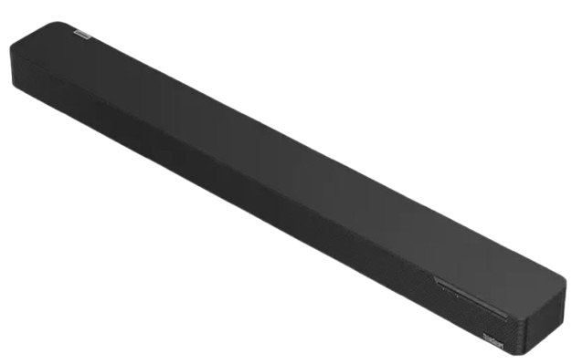
Retail File October 2023
ThinkSmart One with Controller
Retail File June 2025
Special Offers are valid until 30.06 or until stock lasts.
Bar
Speakers
Microphones
Connectivity
4 stereo speakers
Up to 97dB
20+20W power output
Built-in digital signal processing (DSP) for echo- and noise-cancellation
250Hz to 20KHz frequency
4 built-in beamforming mics
180⁰ coverage
Up to 8.5m / 27.9' range*
300Hz to 8KHz frequency
USB-A 2.0
USB-C 2.0
Bluetooth® 5.0 (A2DP, SBC, MPEG-4, AAC)
Dimensions (H x W x D)
Weight
Mounting
55mm x 800mm x 90mm / 2.2" x 31.5" x 3.5"
1.9kg / 4.2lbs
Standalone / tabletop
Certified for Microsoft Teams Rooms and compatible with Zoom Rooms
Purpose-built for meeting room-based video conferencing
Can pair with a computing device or used as a standard plug-and-play device
An enterprise-level sound bar that delivers exceptional sound quality and scalability
Immersive, where remote attendees feel like they are in the same room
ThinkSmart Sound Bar
11RTZ9CAGE LENOVO SOUND BAR XL THINKSMART USB 2.0, USB-C port, UP TO 100DB, 20+ 20W WITH 4 SPEAKERS, BT 5.0, 4 X MICS, DSP, NOICE CANCELLATION, TV MOUNTING, 5m USB A TO USB C CABLE € 564
Call now on:
Mail on:
Prices, promotions, specifications, availability and terms of offers may change without notice. Despite our best efforts, a small number of items may contain pricing, typography, or photography errors. Correct prices and promotions are validated at the time your order is placed. Delivery and installation charges are not included. Products' warranty is the warranty given by the manufacturer. VAT is included

