Slide 1
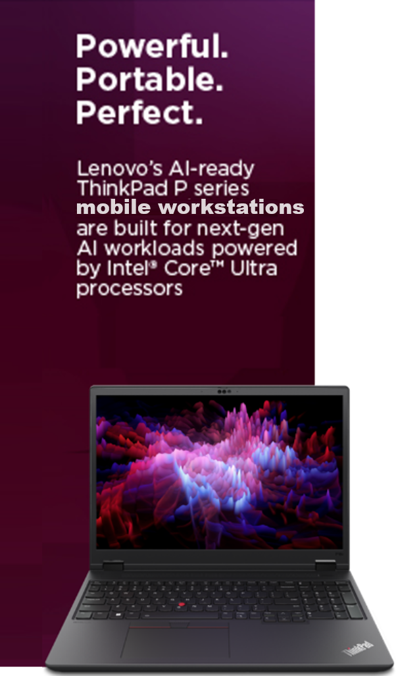
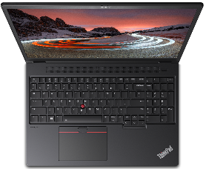
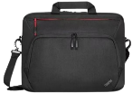
P16v Gen2 Special Offers
Retail File June 2025
Special Offers are valid until 30.06 or until stock lasts.
The all-new ThinkPad P16v Gen 2 balances extreme power, optimum portability and seamless user experience to accelerate workflows. The Intel® Core™ Ultra H Series processor marries productivity and experiential wow of AI without the worry of performance lags and battery drain. The optional NVIDIA® RTX graphics boosts your creation- from editing high-resolution videos to running complex AI simulations. An impressive 90Wh battery and Rapid Charge support elevates productivity, while the MIL-SPEC durability shields it from the everyday knocks and bumps.
21KX000MCY LENOVO NOTEBOOK THINKPAD P16v G2, INTEL ULTRA 7 155H, 4.8GHz/24MB, 16C, 32GB, 1TB SSD M.2 2280 PCIe, AI 11 TOPS, NVIDIA RTX 1000 ADA 6GB, 16' WUXGA 1920x1200 IPS 300NITS, LAN, WIFI6E, USB, USB4, HDMI, WIN 11 PRO, 3YW, BLACK € 2,453
21KX0019CY LENOVO NOTEBOOK THINKPAD P16v G2, INTEL ULTRA 7 155H, 4.8GHz/24MB, 16C, 32GB, 1TB SSD M.2 2280 PCIe, AI 11 TOPS, NVIDIA RTX 2000 ADA 8GB, 16' WUXGA 1920x1200 IPS 300NITS, LAN, WIFI6E, USB, USB4, HDMI, WIN 11 PRO, 3YW, BLACK € 2,749
21KX003MCY LENOVO NOTEBOOK THINKPAD P16v G2, INTEL ULTRA 9 185H, 5.1GHz/24MB, 16C, 32GB, 1TB SSD M.2 2280 PCIe, AI 11 TOPS, NVIDIA RTX 3000 ADA 8GB, 16' WUXGA 1920x1200 IPS 400NITS, LAN, WIFI6E, USB, USB4, HDMI, WIN 11 PRO, 3YW, BLACK € 3,866
Optional
4Y51C21216 LENOVO MOUSE GO USB-C WIRELESS, RECHARGEABLE, SETTING DPI 2400, 1600, 800, BLUE OPTICAL SENSOR, THUNDER BLACK € 39
4Y51C21217 LENOVO MOUSE GO WIRELESS MULTI-DEVICE, RECHARGEABLE, 2400 DPI, BLUE OPTICAL SENSOR, BLACK € 62
4X41A30365 LENOVO CARRY CASE, THINKPAD ESSENTIAL PLUS ECO TOPLOAD,15.6'‘ € 73
Call now on:
Mail on:
Prices, promotions, specifications, availability and terms of offers may change without notice. Despite our best efforts, a small number of items may contain pricing, typography, or photography errors. Correct prices and promotions are validated at the time your order is placed. Delivery and installation charges are not included. Products' warranty is the warranty given by the manufacturer. VAT is included

