Slide 1
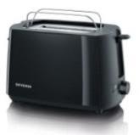
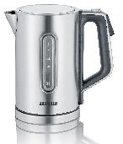
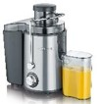
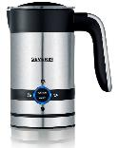
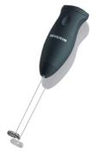
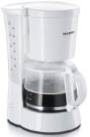
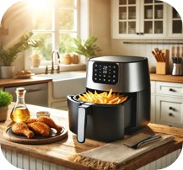
SMALL DOMESTIC APPLIANCES OFFERS
Retail File: June 2025
BREAKFAST
AT 2515
SEVERIN GRILL TABLE WITH STAND 2300W, HIGH QUALITY SURFACE 851 CM2, REMOVABLE WINDSHIELD, VARIABLE THERMOSTAT
RRP: €44.99
AT 2234
SEVERIN TOASTER, 4 SLICES, 1400W, HEAT INSULATED HOUSING WTH BURN WARMER, ELECTRONIC BROWNING CNTRL TEMP.SENSOR, MID-CYCLE CANCEL BUTTON, AUTO SWITCH OFF ,CRUM TRAY, WHITE/GREY
RRP: €44.99
AT 2217
SEVERIN TOASTER, 2 SLICES, 800W, AUTOMATIC,INTEGRADED BUN WARMER, FROZEN BREAD BUTTON WITH PILOT LIGHT,REHEAT FUCTION , RED METTALIC / BLACK RRP: €44.99
960639000
TAURUS TOASTER MY TOAST DUPLO, 1450W, 2 EXTRA LONG VARIABLE SLOTS, 32MM WIDE GROOVES, DEFROST MODE, REHEAT, CANCEL COOK, EXTRA LIFT FOR PICKUP, CRUMB TRAY, CABLE HOUSING, WHITE RRP: €59.99
AT 2287
SEVERIN TOASTER, 2 SLICES, 700W, AUTOMATIC, STAINLESS STEEL, INTEGRATED BREAD ROLL TOASTING, ADJUSTABLE DEGREE, BLACK RRP: €29.99
960650000
TAURUS TOASTER ASTREA, 600W, FLAT TOASTER, QUARTZ HEATING ELEMENTS, 12 TOASTING LEVELS RRP: €29.99
WK 3418
SEVERIN KETTLE JUG, DIGITAL ELECTRIC, 3000W, 1.7L, XXL OPENING, 360° CENTRAL CORDLESS SYSTEM, LEVEL INDICATOR BOTH SIDES, STAINLESS-STEEL
RRP: €69.99
ES 3570
SEVERIN JUICE EXTRACTOR 800W, 19000RPM, REMOVABLE 1100ML PULP CONTAINER, EASYTOCLEAN, SAFETY LOCK, JUICE CONTAINER WTH FOAM, SEPARATOR, APPROX.1000L, WIDE FEED OPENING, S/S MICRO CONTAINER & CUTTER RRP: €99.99
ES 3566
SEVERIN JUICE EXTRACTOR 400W, 2 SPEEDS, MAX 14.150RPM, REMOVABLE 500ML PULP CONTAINER, EASYTOCLEAN, SAFETY LOCK, JUICE CONTAINER WTH FOAM SEPARATOR 450ML, S/S MICRO CONTAINER & CUTTER, FOOD CHUTE
RRP: €59.99
ES 3571
SEVERIN SLOW JUICER,150W,1L JUICE CONTAINER,1.3L PULP CONTAINER,2 FILTER INSERTS AND ADDITIONAL FROZEN FRUITS ATTACHMENT RRP: €149.99
COFFEE
SM 3584
SEVERIN MILK FROTHER WITH PLUG, 100ML COLD OR HOT FROTHING/ 200ML HEATING, 2 PROGRAMS, 450W, NON-STICK, EASY CLEANING, 360° CONNECTOR, HIGH-GRADE, BRUSHED STAINLESS STEEL BLACK RRP: €59.99
SM 3590
SEVERIN MILK FROTHER, STAINLESS STEEL WHISK, MAX. 11.500 R.P.M., INCL. 2 BATTERIES WITH 1,5V EACH RRP: €9.99
KM 3879
SEVERIN COFFEE AND SPICE GRINDER, 150W, 50G, INDIVIDUAL GRIND LEVEL, SAFE OPERATING, BRUSHED STAINLESS STEEL/ BLACK RRP: €34.99
KM 3874
SEVERIN COFFEE GRINDER, 100W, 150GR, ADJUSTABLE GRINDING FILTER LEVEL, SELECT NO.CUPS, START BUTTON, S/S DISK GRINDER, CLEANING BRUSH, BLACK/STAINLESS STEEL RRP: €54.99
908503000
TAURUS COFFEE GRINDER, AROMATIC, 150W, 50G, PULSE BUTTON, CABLE HOUSING, STAINLESS STEEL RRP: €34.99
COOKING
KA 4817
SEVERIN COFFEE MACHINE TYPE 1000W, 10 CUPS, AUTO SWITCH OFF, AUTOMATIC KEEP WARM FUCTION, 1 X 4 SWING FILTER WITH DRIP STOP, ON-OFF BUTTON, RED PAINTED STAINLESS STEEL / BLACK RRP:€59.99
KA 4808
SEVERIN COFFEE MAKER, APPROX. 800 W, UP TO10 CUPS, PIVOTED FILTER HOLDER 1 X 4, TRANSPARENT WATERCONTAINER WITH WATERLEVEL INDICATOR, HOTPLATE, AUTO SHUT OFF RRP: €34.99
KA 4478
SEVERIN COFFEE MAKER, APPROX. 800 W, UP TO10 CUPS, PIVOTED FILTER HOLDER 1 X 4, TRANSPARENT WATERCONTAINER WITH WATERLEVEL INDICATOR, HOTPLATE, AUTO SHUT OFF RRP:€29.99
FR 2446
SEVERIN MULTI HOT AIR FRYER, 2000 W, 11 L, HOT AIR TECHNOLOGY, INTUITIVE LED DISPLAY WITH TOUCH CONTROL, 8 AUTOMATIC PROGRAMMES, ADJUSTABLE TEMPERATURE CONTROL FROM 35 TO 200° C RRP:€189.99
FR 2452
SEVERIN HOT AIR FRYER,1500W, 4.3L, 800GR,CERAMIC COATING BASKET,MANUAL CONTROL,ADJUST TEMP. 80°C-200°C,30 MIN TIMER
RRP: €89.99
Prices, promotions, specifications, availability and terms of offers may change without notice. Despite our best efforts,
a small number of items may contain pricing, typography, or photography errors. Correct prices and promotions are validated at the time your order is placed. Recycling fees are not included in the Dealer & Retail File. Delivery and installation charges are not included. Products' warranty is the warranty given by the manufacturer. VAT included
Call now on:
Mail on:

Slide 2
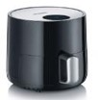
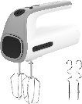
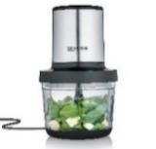
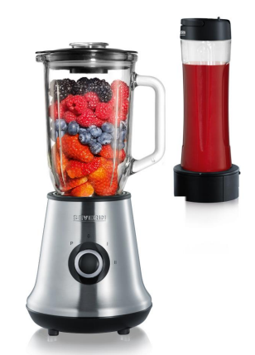
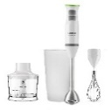
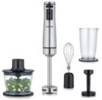
SMALL DOMESTIC APPLIANCES OFFERS
Retail File: June 2025
FR 2455
SEVERIN COMPACT HOT AIR FRYER, 1.8L, 500-600GR,SLIM DESIGN, CERAMIC COATING BASKET, HIGH SCRATCH RESISTANCE, LED DISPLAY, TOUCH CONTROL, ADJUST TEMP. 80°C-200°C, COOKING TIME, AUTO SWITCH, 60 MIN TIMER WITH DEEP, EASY CLEAN, BLACK RRP: €79.99
FR 2445
SEVERIN COMPACT HOT AIR FRYER XXL, 5L, 8 PROGRAMMS, CERAMIC COATING BASKET, HIGH SCRATCH RESISTANCE, LED TOUCH DISPLAY, ADJUST TEMP. 80°C-200°C, COOKING TIME, 60 MIN TIMER WITH DEEP, EASY CLEAN, BLACK RRP: €139.99
KG 2397
SEVERIN GRILL TABLE 2200W, HIGH QUALITY NON STICK XXL COATED PLATE, SURFACE 1919 CM², REMOVABLE CORD WTH VARIABLE THERMOSTAT,S/S STEEL FRONT PANEL, FAT COLLECTION TRAY, SUITABLE FOR TEPAN YAKI RRP: €64.99
RG 2375
SEVERIN RACLETTE GRILL,8 PANS,FULL NON STICK COATED PLATE,ADJUSTABLE THERMOSTAT,REMOVABLE PARTS ,ON / OFF BUTTON,BRUSHED STAINLESS STEEL/BLACK RRP:€79.99
HM 3820
SEVERIN HAND MIXER, 300W, 5 SPEEDS, EXTRA TURBO SPEED, 2 BEATERS, 2DOUGH HOOKS INCL.BLENDER ATTACHMENTS, WHITE / GREY
RRP: €24.99
KM 3867
SEVERIN FOOD CHOPPER, 400W, 1L, 4 BLADE KNIFE, MULTI-WHISKING DISK, MATT BLACK / BRUSHED STAINLESS STEEL / GLASS RRP: €44.99
UZ 3861
SEVERIN FOOD CHOPPER UNIVERSAL, 260W, 250ML, 3900RPM, STAINLESS STEEL BLADE, PULSE SWITCH, SAFETY SWITCH, ANTI-SLIP PROTECTION, WHITE RRP: €29.99
KM 3865
SEVERIN FOOD CHOPPER, 400W, 500ML, 2 LEVELS STAINLESS STEEL KNIFE, MULTI-WHISKING DISK, INOX RRP:€59.99
HM 3827
SEVERIN FOOD MIXER, 5 SPEEDS, 200W, 2 STAINLESS STEEL WHISKS & DOUGH HOOKS, RELEASE BUTTON, TURBO FUNCTION, WHITE
RRP: €23.99
913528000
TAURUS FOOD MIXER STATION GREY, 300W, 5 SPEEDS, TURBO FUNCTION, DETACHABLE ACCESSORIES, BPA FREE, ERGONOMIC, GREY-WHITE
RRP: €31.99
913529000
TAURUS FOOD MIXER STATION INOX, 500W, 5 SPEEDS, TURBO FUNCTION, DETACHABLE ACCESSORIES, BPA FREE, ERGONOMIC, BLACK-WHITE RRP:€36.99
SM 3737
SEVERIN MIXER-MULTI & SMOOTHIE MIX&GO 500W/1L, REMOVABLE GLASS BOWL, REMOVABLE LID, MEASURING CUP,2SPEEDS,PULSE FUNCTION,INCLUDES SMOOTHIE MAKER, MIXER&PRACTICAL DRINK HOLDER,S/S BLADES,POWERFUL MOTOR RRP: €69.99
SM 3707
SEVERIN BLENDER, 1.5L, DRINKS/ CRUSH ICE, SMOOTHIE, 600W, REMOVABLE GLASS BLENDER & KNIFE, POURING SPOUT, MEASURING CUP, S/S KNIFE, BLACK
RRP: €44.99
916381000
TAURUS HAND BLENDER, BAPI 1200 ROCKET COMPLET, 1200W, 20 SPEEDS, TURBO FUNCTION & ROTATION SYST, ICE CRUSHER, BPA FREE, S/S BLADES BLEND&CHOP, DISHWASHER SAFE, CHOPPER JAR & MEASURING CUP, ANTI-SPLASH, ERGONOMIC, BLACK RRP: €60.99
925017000
TAURUS FOOD CHOPPER ELOANE, 200-400W, 1L, DOUBLE S/S BLADE, NON-SLIP BASE, INOX RRP: €49.99
SM 3734
SEVERIN MIXER-MULTI & SMOOTHIE MIX&GO , 500 W,1000 ML REMOVABLE GLASS BOWL,REMOVABLE LID, 600 ML SMOOTHIE MAKER
RRP: €59.99
SM 7971
SEVERIN MIXER-MULTI & SMOOTHIE MIX&GO , 500 W,1000 ML REMOVABLE GLASS BOWL,REMOVABLE LID, 600 ML SMOOTHIE MAKER
RRP: €69.99
SM 3775
SEVERIN HAND BLENDER PREMIUM SET 600W, S/S, 14.000RPM, CORDLESS MODE, ERGONOMIC DESING, REMOVABLE SS STIRRING ROD, EASY CLEANIGN, BPA-FREE, BRUSHED STAINLESS STEEL/BLACK RRP: €89.99
CM 2198
SEVERIN CREPES MAKER 1000W, NON-STIK COATED PAN APPROX/ 30 CM, WOODEN SPATULA & TURNING STICK, PLASTIC HOUSING, VARIABLE THERMOSTAT, PILOT LIGHT, BLACK RRP: €39.99
WA 2103
SEVERIN WAFFLE MAKER, 1300W, HEAT RESISTANT HOUSING WITH S/S COVER, NON-STICK COATING, POWER&READY TO USE INDICATORS, VARIABLEP THERMOSTAT, SPACE-SAVING VERTICAL STORAGE
RRP: €39.99
SM 3771
SEVERIN HAND BLENDER 600W, S/S, 15.000RPM, ERGONOMIC DESING, REMOVABLE SS STIRRING ROD, EASY CLEANIGN, BPA-FREE, BRUSHED STAINLESS STEEL/BLACK RRP: €34.99
SM 3772
SEVERIN HAND BLENDER SET 600W, S/S, 15.000RPM, ERGONOMIC DESING, REMOVABLE SS STIRRING ROD, EASY CLEANIGN, BPA-FREE, BRUSHED STAINLESS STEEL/BLACK RRP: €59.99
916364000
TAURUS HAND BLENDER, BAPI 850 PLUS INOX, 850W, HIGH PERFORMANCE MOTOR, 20 SPEEDS, ICE CRUSHER, BPA FREE, STAINLESS STEEL BLADES BEAT&CHOP, CHOPPER JAR & WHISK & MEASURING CUP, INOX RRP: €
Prices, promotions, specifications, availability and terms of offers may change without notice. Despite our best efforts,
a small number of items may contain pricing, typography, or photography errors. Correct prices and promotions are validated at the time your order is placed. Recycling fees are not included in the Dealer & Retail File. Delivery and installation charges are not included. Products' warranty is the warranty given by the manufacturer. VAT included
Call now on:
Mail on:

Slide 3
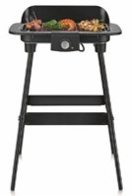
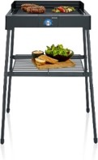
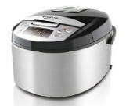
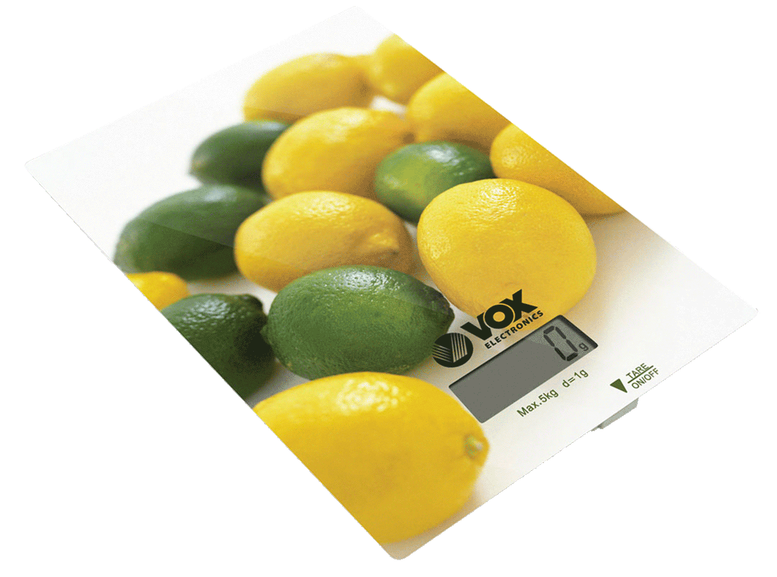
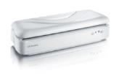
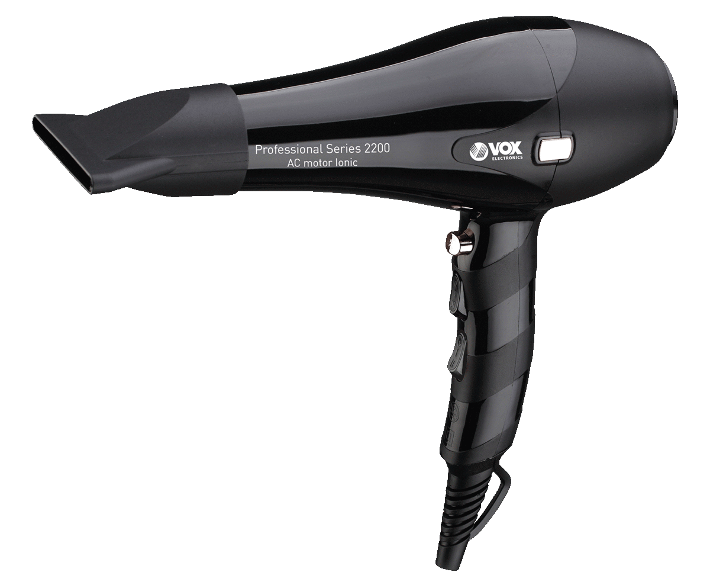
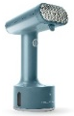
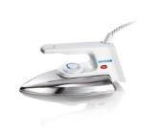
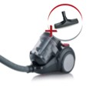
SMALL DOMESTIC APPLIANCES OFFERS
Retail File: June 2025
WA 2106
SEVERIN WAFFLE MAKER DOUBLE, 1200W, HEAT RESISTANT HOUSING, DOUBLE PLATES, NONSTICK COATED, POWER INDICATORS,VARIABLE THERMOSTAT, SPACE-SAVING VERTICAL STORAGE, BLACK
RRP: €44.99
EK 3163
SEVERIN DIGITAL YOGHURT MAKER WITH AUTOMATIC PROGRAMS, 7GLASS JARS 150ML,DISPLAY,AUTO SWITCH OFF, ELECTRONICALLY CONTROLLED TEMPERATURE,BRUSHED STAINLESS STEEL/BLACK RRP: €34.99
JG 3518
SEVERIN JOGHURT MAKER 13W, 7 JARS OF 150ML, 7 JARS WITH LIDS, TRANSPARENT MAIN COVER WITH HANDLE, WH34.99ITE-GREY
RRP: €
PG 8568
SEVERIN GRILL TABLE WITH STAND 2200W, ELECTRIC, QUICK GRILL TIMER, INDOOR/OUTDOOR USE, SAFETOUCH SURFACE, RIBBED GRILL PLATE, REMOVABLE PARTS, THERMOSTAT-CONTROLLED HEATING ELEMENT, EASY CLEAN, STAINLESS STEEL GRILL GRADE RRP: €99.99
PG 8550
SEVERIN GRILL TABLE WITH STAND 2300W, HIGH QUALITY SURFACE 851 CM2, REMOVABLE WINDSHIELD, VARIABLE THERMOSTAT
RRP: €69.99
925011000
TAURUS PROGRAMMABLE KITCHEN ROBOT, TOP CUISINE, 860W, 5L, 12 PROGRAMS, 24H TIMER, NONSTICK REMOVABLE BUCKER
RRP: €89.99
917002000
TAURUS LOW TEMPERATURE COOKING THERMOSTAT, RONER CLIP+, 800 W, DIVING CIRCUIT, DIGITAL, IPX7, 99 HOURS, 18/8 STAINLESS STEEL
RRP: €99.99
968116000
TAURUS COOKER STEAM, SALUTECOOK, 800W, 6L FOOD, 1L TANK, RICE TRAY, 1 HOUR TIMER, WHITE
RRP: €60.99
FS 3604
SEVERIN BAG SEALER, AIR FUNCTION WITH SEALING WIRE & CUTOFF WIRE, VIEWING WINDOW, 2 PILOT LIGHTS VACUUM CONTRL, 1 ROLL FOIL, 28.5CM, CABLE STORAGE RRP: €34.99
902225000
VOX KITCHEN SCALE CAPACITY: 5KG, DIVISION: 1G, TARE FUNCTION, OVERLOAD INDICATOR, WATER-TRANSFER TECHNOLOGY OF PRINTING
RRP: €18.99
PERSONAL
CARE
902225000
TAURUS HAIR CLIPPER HESTIA, HIGH RESISTANCE STAINLESS STEEL BLADES, 5V~1A, 2000 MAH LITHIUM BATTERY, 240 MIN AUTONOMY, CORDED/ CORDLESS USE, LCD DIGITAL SCREEN, PROFESSIONAL DESIGN
RRP: €32.99
902218000
TAURUS HAIR CLIPPERS HC-0150 4.8V 8.000 RPM, HIGH STRENGT STAINLESS STEEL BLADES, TITANIUM BLADES 60 MINUTES USE 3.6.9.12.15Y 18MM RRP:€25.99
903907000
TAURUS HAIR CLIPPER, TRIMMER HADES FOR BEARD, MUSTACHE AND SIDEBURNS, 1-8MM, HIGH STRENGTH STAINLESS STEEL BLADES, 50 MINUTES AUTONOMY BATTERY, INCLUDES LUBRICATING OIL AND CLEANING BRUSH RRP:€21.99
HT 8999
VOX HAIR DRYER POWER 2200W, AC MOTOR, TWO SPEED SETTINGS,THREE TEMPERATURE OPTIONS, IONIC, COOL SHOT, HANGING LOOP, ULTRA –THIN CONCENTRATION FOR STYLING
RRP: €27.99
918694000
TAURUS STEAM IRON VERTICAL STEAMER SLIDING CARE PRO, READY IN 18 SEC, CONTINUOUS 25G/MIN STEAM, AUTO SWITCH OFF AFTER 8 MIN, S/S HEAD, 2 ACCESS. DELICATE/ THICK FABRICS, ECO/MAX, 135ML TANK, VISIBLE WATER LEVEL COMPACT, TIRQUASE
RRP: €49.99
BA 3211
SEVERIN IRON 1200W, DRY, WHITE, POLISHED ALUMINIUM SOLEPLATE, VARIABLE THERMOSTAT, PILOT LIGHT, THERMAL SAFETY CUT-OUT, REVERSIBLE CORD RRP: €24.99
CY 7089
SEVERIN SINGLE CYCLONE CLEANER, 2, 1L, 750W, ADJUSTABLE POWER REGULATION, SOFT TOUCH HANDLE, INCL PARGUET NOZZLE, DARK GREY RRP: €139.99
954512000
TAURUS STEAM CLEANER, RAPIDISSIMO CLEAN PRO, 1050W, 7 ACCESSORIES, 3.5 BAR PRESSURE, 45MIN STEAN FLOW, 350ML TANK, ANTIBACTERIAL, ERGONOMIC HANDLE, CORRECT PRESSURE LEVEL LIGHT INDICATOR, DARK-BLUE RRP: €43.99
Prices, promotions, specifications, availability and terms of offers may change without notice. Despite our best efforts,
a small number of items may contain pricing, typography, or photography errors. Correct prices and promotions are validated at the time your order is placed. Recycling fees are not included in the Dealer & Retail File. Delivery and installation charges are not included. Products' warranty is the warranty given by the manufacturer. VAT included
Call now on:
Mail on:

