Slide 1

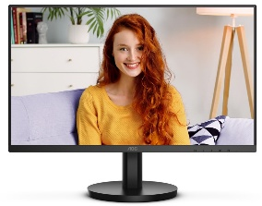
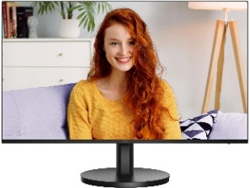
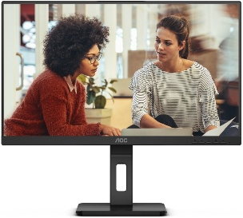
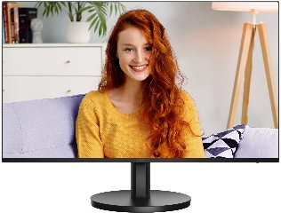
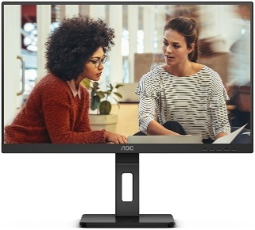
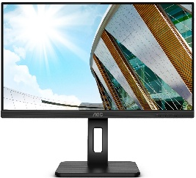
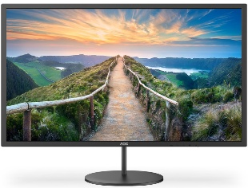
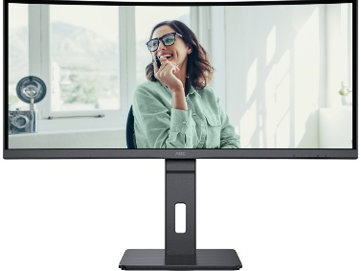
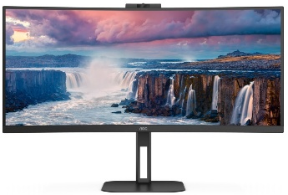
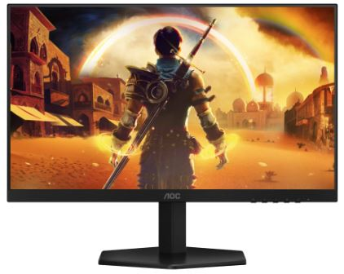
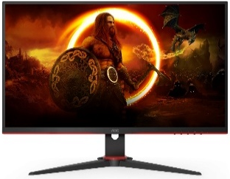
AOC HOME, Business and Gaming PC Monitors
The worldwide Leader in displays
Retail File July 2025
24B3HMA2 AOC MONITOR 23.8'', BUSINESS, E, VA, FHD 1920 X 1080, 100Hz, 1MS, SPEAKERS, 250CD/M2, TILT, VGA, HDMI IN, 3YW, BLACK €97
24B3HA2 AOC MONITOR 23.8'', BUSINESS, E, IPS, FHD 1920 X 1080, 100Hz, 1MS, SPEAKERS, 250CD/M2, TILT, VGA, HDMI IN, 3YW, BLACK €97
27B3HA2 AOC MONITOR 27 BUSINESS , E, IPS, FULL HD, 100 HZ, 1 MS, SPEAKERS, TILT, HDMI AND VGA INPUTS, VESA COMPATIBLE, BLACK €122
24B3CF2 AOC MONITOR 23.8'', BUSINESS, E, IPS, FHD 1920 X 1080, 100Hz, 1MS, SPEAKERS, 250CD/M2, TILT, HEIGHT ADUSTABLE, HDMI, USB-C POWER DELIVERY 65W, USB 3.2 X 2, 3YW, BLACK €134
24E3QAF AOC MONITOR 23.8'', SPEAKERS, IPS, WLED, FHD 1920 X 1080, 20M:1, 300 CD/M2, 4MS, 75HZ, TILT, HEIGHT ADJUSTABLE, SWIVEL, PIVOT, VGA, DP, HDMI, WALLMOUNT, 3YW, BLACK €148
27B3CA2 AOC MONITOR 27'' BUSINESS, F, IPS, FHD, 100HZ, 1920x1080, 1MS, SPEAKERS, TILT, HDMI, USB-C, USB-HUB, VESA COMPATIBLE, BLACK, 3 YW €158
27E3QAF AOC MONITOR 27'', SPEAKERS, IPS, WLED, FHD 1920 X 1080, 20M:1, 300 CD/M2, 4MS, 75HZ, TILT, HEIGHT ADJUSTABLE, SWIVEL, PIVOT, VGA, DP, HDMI, WALLMOUNT, 3YW, BLACK €171
Q24P2Q AOC MONITOR 23.8'‘ BUSINESS, E, WITH SPEAKERS, IPS WLED QHD 2560X1440, 5Hz ,TILT, PIVOT, SWIVEL, H.ADJ. 4xUSB, VGA, HDMI, DP, VESA, 3YW, BLACK, 194
Q32V4 AOC MONITOR 31.5 INCH, G, QHD IPS, 2560 X 1440, 75Hz, 4 MS, FLICKER FREE, LOW BLUE LIGHT, 2W SPEAKERS, WALLMOUNT, TILT, HDMI, DP, BLACK, 3YW, €245
Q27B3CF2 AOC MONITOR 27'' BUSINESS, F, IPS, QHD, 100HZ, 2560x1440, 1MS, SPEAKERS, TILT, HEIGHT ADJUSTABLE, HDMI, USB-C, USB-HUB, VESA COMPATIBLE, BLACK, 3 YW, €250
CU34P3CV AOC MONITOR 34'', BUSINESS CURVED, G, VA, WQHD, 3440x1440, ULTRA WIDE, SPEAKERS, TILT, SWIVEL, H.ADJ., HDMI, DP, USB HUB, USB-C, LAN, VESA, 3YW, BLACK, €399
CU34V5CW/BK AOC MONITOR 34'', BUSINESS CURVED, G, VA, WQHD, 3440x1440, 20M:1, 4MS, 100 Hz, 21:9, ULTRA WIDE, SPEAKERS, CAMERA 2MP, TILT, SWIVEL, HEIGHT ADJUSTABLE, HDMI, DP, USB HUB, USB-C, WALLMOUNT, 3YW, BLACK,€424
24G42E AOC MONITOR 23.8'', GAMING, E, IPS, SPEAKERS, 1920x1080, 80M:1, 1MS, 300 CD/M², TILT, AMD FREESYNC, 180 Hz, 2X HDMI, DISPLAY PORT, 3YW, BLACK €137
27G42E AOC MONITOR 27G42E, GAMING 27'', E, 180HZ, SPEAKERS, IPS LED, 0.5MS, 1920x1080, 80M:1, 300 CD/M², TILT, 1X HDMI, DISPLAY PORT, FRAMELESS , 3YW, BLACK €164
27G2SPAE/BK AOC MONITOR 27'', GAMING, E, IPS, 1920x1080, 80M:1, 1MS, SPEAKERS, 250 CD/M², 165Hz, TILT, DISPLAY PORT, 2 X HDMI, 3Y, BLACK €167
Prices, promotions, specifications, availability and terms of offers may change without notice. Despite our best efforts,
a small number of items may contain pricing, typography, or photography errors. Correct prices and promotions are validated at the time your order is placed. Recycling fees are not included in the Dealer & Retail File. Delivery and installation charges are not included. Products' warranty is the warranty given by the manufacturer. VAT is included
Call now on:
Mail on:

Slide 2
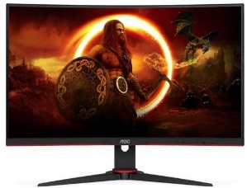
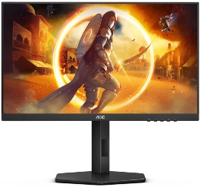
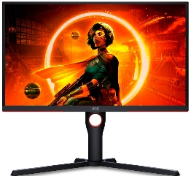
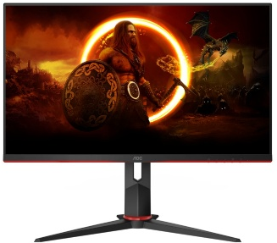
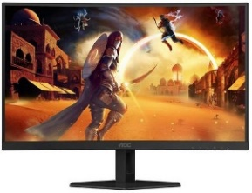
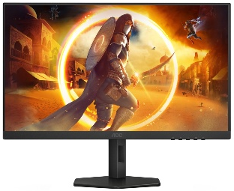
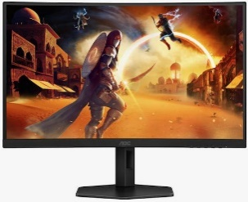
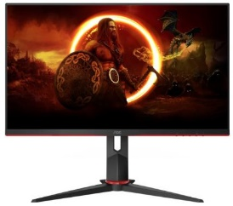
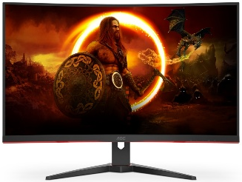
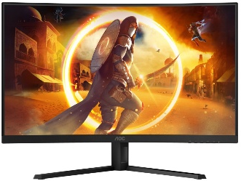
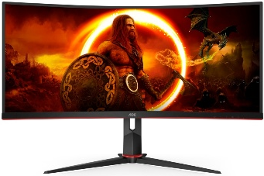

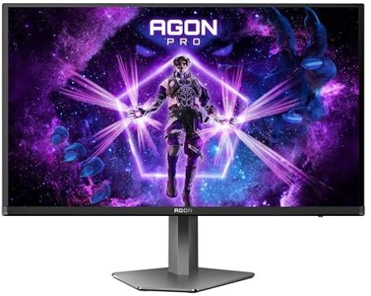
AOC HOME, Business and Gaming PC Monitors
The worldwide Leader in displays
Retail File July 2025
C24G2AE/BK AOC MONITOR 24'', GAMING CURVED, VA LED, 1920x1080, 80M:1, 1MS, 250 CD/M², AMD FREESYNC, 165 Hz, VGA, 2X HDMI, DISPLAY PORT, FRAMELESS 3YW, BLACK-RED €173
24G4X AOC MONITOR 23.8'', GAMING, E, IPS, SPEAKERS, 1920x1080, 80M:1, 1MS, 250 CD/M²,TILT, HEIGHT ADJUSTABLE, SWIVEL, PIVOT, AMD FREESYNC-G-SYNC COMPATIBLE, 180 Hz, 2X HDMI, DISPLAY PORT, 3YW, BLACK €173
25G3ZM/BK AOC MONITOR 24.5'',25G3ZM/BK GAMING, VA, 1920x1080, 80M:1, 0.5MS, 300 CD/M², 240Hz, 2 X HDMI, DISPLAY PORT, HEIGHT ADJUSTABLE, TILT, PIVOT, SWIVEL, VESA, BORDERLESS , 3YW, BLACK €194
27G2ZN3/BK AOC MONITOR 27'', GAMING, E, VA, 1920x1080, 80M:1, 1MS, 300 CD/M², 280Hz, DISPLAY PORT, TILT, PIVOT, SWIVEL, HEIGHT ADJUSTABLE, 2 X HDMI, 3Y, BLACK €230
C27G4ZXE AOC MONITOR 27'', GAMING CURVED, E, VA LED, 1920x1080, 80M:1, 0.3MS, 280HZ, 300 CD/M², TILT, AMD FREESYNC/G-SYNC OMPATIBLE, 2X HDMI, DISPLAY PORT, 3YW, BLACK €230
Q27G4XF AOC MONITOR GAMING 27'', G, 180HZ, IPS LED, 2560x1440, 1 MS, 80M:1, 300 CD/M², HEIGHT ADJUSTABLE, TILT, SWIVEL, PIVOT, 2X HDMI, DISPLAY PORT, 3YW, BLACK-RED €232
CQ27G4X AOC MONITOR, CURVED GAMING 27'', G, 180HZ, VA LED, 2560x1440, 80M:1, 0.5MS, 300 CD/M², AMD FREESYNC, TILT, SWIVEL, HEIGHT ADJUSTABLE, 2X HDMI, DISPLAY PORT, FRAMELESS, 3YW, BLACK €235
Q27G4X AOC MONITOR GAMING 27'', G, 180HZ, SPEAKERS, IPS LED, 2560x1440, 80M:1, 400 CD/M², HEIGHT ADJUSTABLE, TILT, SWIVEL, PIVOT, 2X HDMI, DISPLAY PORT, FRAMELESS , 3YW, BLACK-RED €235
C27G2Z3/BK AOC MONITOR 27'', GAMING CURVED, F, VA LED, 1920x1080, 80M:1, 0.5MS, 300 CD/M², HEIGHT ADJUSTABLE, SWIVEL, TILT, 280 Hz, 2X HDMI, DISPLAY PORT, FRAMELESS , 3YW, BLACK-RED €238
C27G4ZXU AOC MONITOR 27'', GAMING CURVED, E, VA LED, 1920x1080, 80M:1, 0.3MS, 280HZ, 300 CD/M², TILT, SWIVEL, HEIGHT ADJUSTABLE, AMD FREESYNC/G-SYNC COMPATIBLE, 2X HDMI, DISPLAY PORT, 3YW, BLACK €249
C32G2ZE/BK AOC MONITOR 31.5'', GAMING CURVED, F, VA LED, FHD 1920x1080, 80M:1, 0.5MS, FREESYNC, 240 Hz, FLICKERFREE, TILT, HDMIx2, DP, WALLMOUNT, 3YW, BLACK €265
CQ32G4VE AOC MONITOR CURVED GAMING 32'', VA, G, 180HZ, 2560x1440, 80M:1, 300 CD/M², AMD FREESYNC, TILT, 2X HDMI, DISPLAY PORT, FRAMELESS , 3YW, BLACK/RED €275
CU34G2XP/BK AOC MONITOR 34'', GAMING CURVED, G, VA, WQHD, 3440x1440, 80M:1, 1MS, FREESYNC, 180 Hz, 21:9, ULTRA WIDE, TILT,SWIVEL, HEIGHT ADJUSTABLE, HDMIx2, DPx2, USB HUB, WALLMOUNT, 3YW, BLACK €275
Q27G3XMN/BK AOC MONITOR 27'', GAMING, G, VA, MINI LED, 2560 X 1440, 80M:1, 1MS, 1000 CD/M², 180Hz, TILT, HEIGHT ADJUSTABLE, SWIVEL, PIVOT, 2 X HDMI, 1 X DISPLAY PORT, 3YW, BLACK-RED €379
AG276QZD2 AOC MONITOR 27'' GAMING AGON PRO, OLED, 2560x1440, 80M:1, 240Hz, 0.03MS, 1000 CD/M2, SPEAKERS, G-SYNC COMPATIBLE, TILT, SWIVEL, PIVOT, HEIGHT ADJUSTABLE, HDMI X 2, DISPLAY PORT X 2, USB 3.2 X 2, BLACK €677
Prices, promotions, specifications, availability and terms of offers may change without notice. Despite our best efforts,
a small number of items may contain pricing, typography, or photography errors. Correct prices and promotions are validated at the time your order is placed. Recycling fees are not included in the Dealer & Retail File. Delivery and installation charges are not included. Products' warranty is the warranty given by the manufacturer. VAT is included
Call now on:
Mail on:

