Slide 1

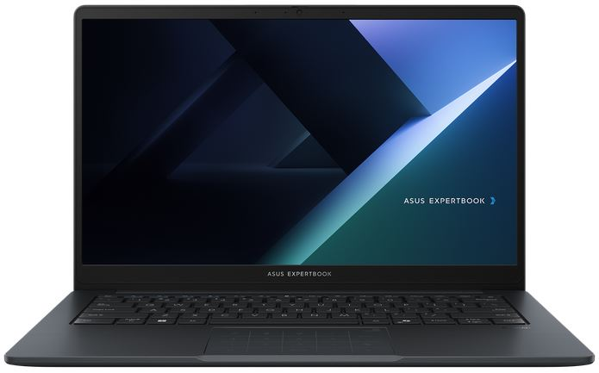
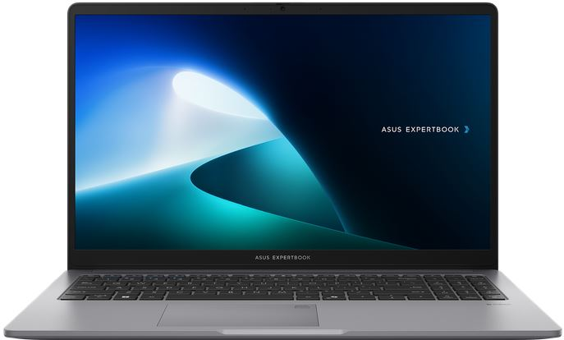
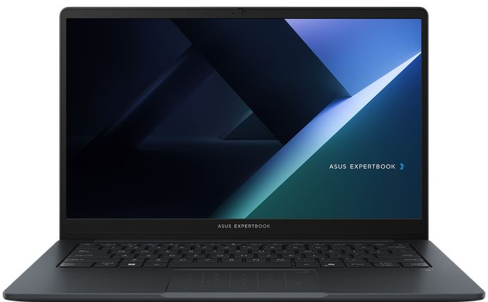
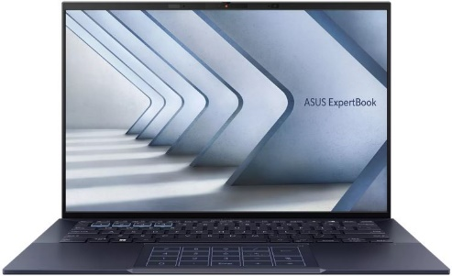
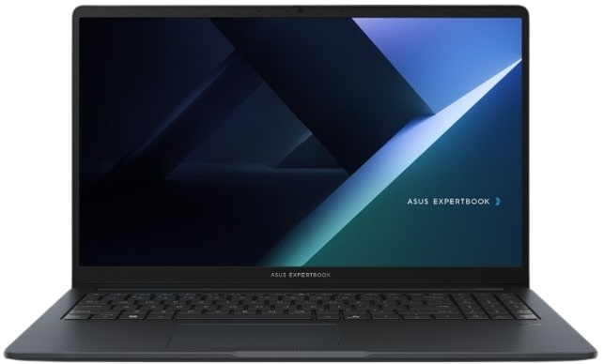
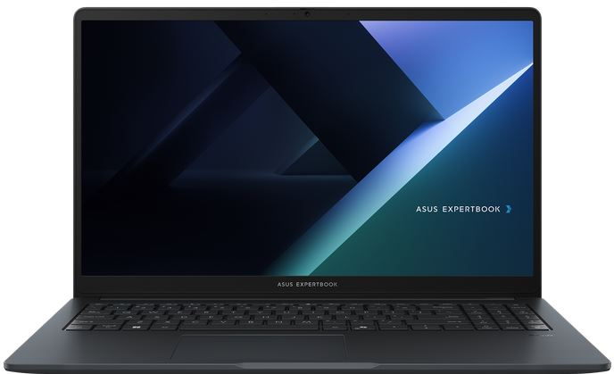
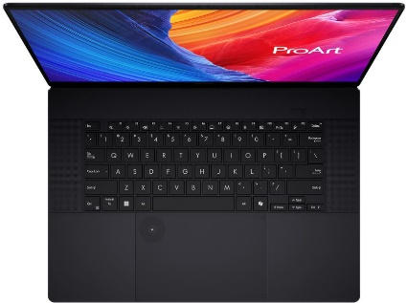

EXPERTBOOK BUSINESS NOTEBOOKS
Retail File July 2025
Special Offers are valid until 31.08 or until stock lasts.
EXPERTBOOK BM1, BM1403CDA
EXPERTBOOK P1
EXPERTBOOK B1, B1403CVA
EXPERTBOOK B9
90NX0831-M00KY0 ASUS NOTEBOOK EXPERTBOOK BM1, BM1403CDA-S60121, AMD RYZEN 5 7535U, 2.9-4.55GHz/16MB, 6C, 16GB, 512GB SSD M.2 2280 NVMe PCIe4, AMD RADEON, 14'' IPS LED FHD 1920x1080 300NITS AG, WIFI6, BT, LAN, USB-A, USB-C, HDMI, DOS, 3YW, GREY € 588-Special Offer
90NX0831-M00KZ0 ASUS NOTEBOOK EXPERTBOOK BM1, BM1403CDA-S60122, AMD RYZEN 7 7735U, 2.7-4.75GHz/16MB, 8C, 16GB, 512GB SSD M.2 2280 NVMe PCIe4, AMD RADEON, 14'' IPS LED FHD 1920x1080 300NITS AG, WIFI6, BT, LAN, USB-A, USB-C, HDMI, DOS, 3YW, GREY € 668-Special Offer
90NX0881-M01BB0 ASUS NOTEBOOK EXPERTBOOK P1, P1503CVA-S70720, INTEL i3-1315U, 3.30-4.50GHz/10MB, 6C, 8GB, 256GB SSD M.2 2280 NVMe PCIe4, INTEL UHD, 15.6'' FHD 1920x1080 300NITS AG, WIFI6, BT, LAN, USB-A, USB-C, HDMI, DOS, 3YW, MISTY GREY € 742-Special Offer
90NX0881-M01BC0 ASUS NOTEBOOK EXPERTBOOK P1, P1503CVA-S70720, INTEL i7-13700H, 2.4-5GHz/24MB, 14C, 16GB, 512GB SSD M.2 2280 NVMe PCIe4, INTEL IRIS X, 15.6'' TN FHD 250NITS AG, WIFI6, BT, LAN, USB-A, USB-C, HDMI, DOS, 3YW, MISTY GREY € 811-Special Offer
90NX0811-M02H40 ASUS NOTEBOOK EXPERTBOOK B1, B1403CVA-S60408, INTEL CORE 5 120U, 1.4-5GHz/12MB, 10C, 16GB, 512GB SSD M.2 2280 NVMe PCIe4, INTEL GRAPHICS, 14'' IPS LED FHD 1920x1080 300NITS AG, WIFI6E, BT, LAN, USB-A, USB-C, HDMI, DOS, 3YW, GREY € 713-Special Offer
90NX0811-M02H50 ASUS NOTEBOOK EXPERTBOOK B1, B1403CVA-S60409, INTEL CORE 7 150U, 1.8-5.4GHz/12MB, 10C, 16GB, 512GB SSD M.2 2280 NVMe PCIe4, INTEL GRAPHICS, 14'' IPS LED FHD 1920x1080 300NITS AG, WIFI6E, BT, LAN, USB-A, USB-C, HDMI, DOS, 3YW, GREY € 885-Special Offer
90NX05W1-M025Y0 ASUS NOTEBOOK EXPERTBOOK B9 OLED, B9403CVAR-KM1327, INTEL CORE 7 150U, 1.8-5.4GHz/12MB, 10C, 32GB, 512GB SSD M.2 2280 NVMe PCIe4, INTEL GRAPHICS, 14'' WQXGA 2880x1800 OLED 400NITS, WIFI6E, BT, USB, USB4, HDMI, DOS, 3YW, BLACK € 1724-Special Offer
EXPERTBOOK BM1, BM1503CDA
EXPERTBOOK B1, B1503CVA
PROART P16
90NX0801-M022S0 ASUS NOTEBOOK EXPERTBOOK B1, B1503CVA-NJ0144, INTEL CORE 5 120U, 1.4-5GHz/12MB,10C, 16GB, 512GB SSD M.2 2280 NVMe PCIe4, INTEL UHD, 15.6'' TN LED FHD 1920x1080 250NITS AG, WIFI6E, BT, LAN, USB-A, USB-C, HDMI, DOS, 3YW, GENTLE GREY € 707-Special Offer
90NX0801-M022T0 ASUS NOTEBOOK EXPERTBOOK B1, B1503CVA-NJ0145, INTEL CORE 7 150U, 1.8-5.4GHz/12MB, 10C, 16GB, 512GB M.2 2280 NVMe PCIe4, INTEL UHD, 15.6'' TN LED FHD 1920x1080 250NITS AG, WIFI6E, BT, LAN, USB-A, USB-C, HDMI, DOS, 3YW, GENTLE GREY € 855-Special Offer
90NX0821-M00D60 ASUS NOTEBOOK EXPERTBOOK BM1, BM1503CDA-NJ0052,AMD RYZEN 5 7535U, 2.9 4.55GHz/16MB, 6C, 16GB, 512GB SSD M.2 2280 NVMe PCIe4, AMD RADEON, 15.6'' TN LED FHD 1920x1080 250NITS AG, WIFI, BT, LAN, USB-A, USB-C, HDMI, DOS, 3YW, GREY € 588-Special Offer
90NX0821-M00D70 ASUS NOTEBOOK EXPERTBOOK BM1, BM1503CDA-NJ0053,AMD RYZEN 7 7735U, 2.7-4.75GHz/16MB, 8C, 16GB, 512GB M.2 2280 NVMe PCIe4, AMD RADEON, 15.6'' TN LED FHD 1920x1080 250NITS AG, WIFI6,BT, LAN, USB-A, USB-C, HDMI, DOS, 3YW, GENTLE GREY € 817
90NX0801-M01HD0 ASUS NOTEBOOK EXPERTBOOK B1, B1503CVA-NJ0144X, INTEL CORE 5 120U, 1.4-5GHz/12MB, 10C, 16GB, 512GB SSD M.2 2280 NVMe PCIe4, INTEL UHD, 15.6'' TN LED FHD 1920x1080 250NITS AG, WIFI6E,BT, LAN, USB-A, USB-C, HDMI, WIN 11 PRO,3YW, GREY € 891-Special Offer
90NX0801-M02T60 ASUS NOTEBOOK EXPERTBOOK B1, B1503CVA-NJ0145X, INTEL CORE 7 150U, 1.8-5.4GHz/12MB,10C, 16GB, 512GB SSD M.2 2280 NVMe PCIe4, INTEL UHD, 15.6'' TN LED FHD 1920x1080 250NITS AG, WIFI6E,BT, LAN, USB-A,USB-C, HDMI, WIN 11 PRO,3YW, GREY € 1049-Special Offer
90NB15K1-M003B0 ASUS NOTEBOOK PROART P16, H7606WP-OLED-ME011X, AMD RYZEN AI 9 HX 370 2-5.1GHz/36MB, 12C, 64GB, 2x2TB SSD M.2 NVMe, NVIDIA RTX 5070 8GB, 16'', OLED 4K 3840x2400 60Hz 500NITS TOUCH, WIFI7,BT,USB-C,USB-A,HDMI, WIN 11 PRO, 2YW, BLACK € 4010
Prices, promotions, specifications, availability and terms of offers may change without notice. Despite our best efforts, a small number of items may contain pricing, typography, or photography errors. Correct prices and promotions are validated at the time your order is placed. Recycling fees are not included in the Dealer & Retail File. Delivery and installation charges are not included. Products' warranty is the warranty given by the manufacturer. VAT is not included
Multitech b2b Place your order on: https://b2b.multitech.com.cy/en Click on any item part number for more specs and place your order online.
In case you don’t have an account yet please register in the below link https://b2b.multitech.com.cy/en/user/register
Prices, promotions, specifications, availability and terms of offers may change without notice. Despite our best efforts, a small number of items may contain pricing, typography, or photography errors. Correct prices and promotions are validated at the time your order is placed. Delivery and installation charges are not included. Products' warranty is the warranty given by the manufacturer. VAT is included
Call now on:
Mail on:
Call now on: 22-711300
Mail on:
orders@multitech.com.cy
A.T Multitech Corporation Ltd
ASUS Authorized Distributor
www.multitech.com.cy

Slide 2
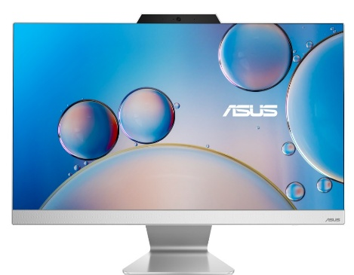

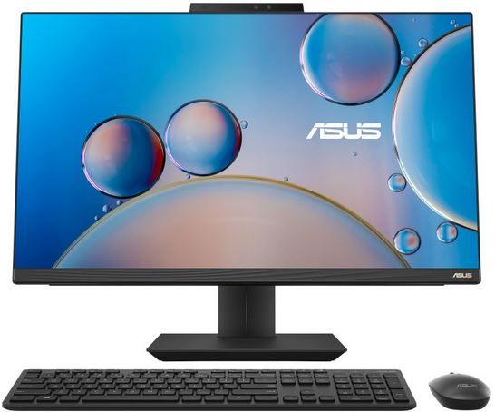
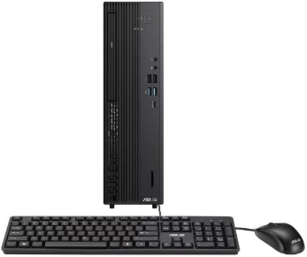
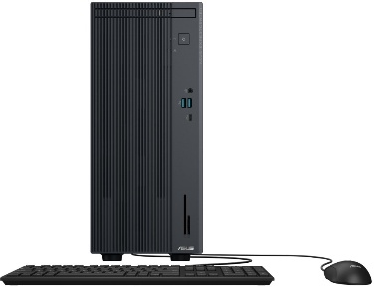
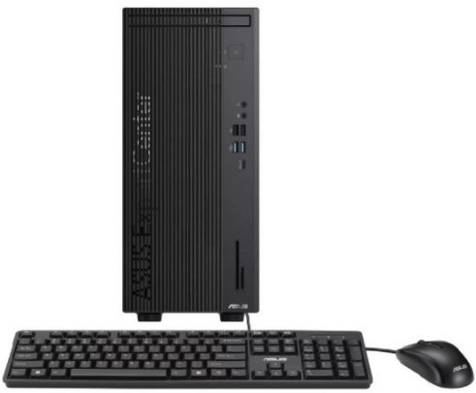
ALL IN ONE & EXPERTCENTER BUSINESS PCs
Retail File July 2025
Special Offers are valid until 31.08 or until stock lasts.
A3402WVAK
A5402WVA
A5702WVA
90PT03N1-M022C0 ASUS PC ALL IN ONE A5702WVA, A5702WVARK-BPE0540, 27'', FHD 1920x1080 LCD 250NITS 75Hz AG, INTEL CORE 5 120U 1.4-5GHz/12MB, 10C, 16GB, 512GB SSD M.2 NVMe PCIe4, INTEL IRIS X GRAPH,WIFI6E,BT, LAN,USB-A,USB-C,USB4,HDMI,DOS,3YW,BLACK
€ 980-Special Offer
90PT03N1-M022D0 ASUS PC ALL IN ONE A5702WVA, A5702WVARK-BPE0550, 27'', FHD 1920x1080 LCD 250NITS 75Hz AG, INTEL CORE 7 150U 1.8-5.4GHz/12MB, 10C, 16GB, 512GB SSDM.2 NVMe PCIe4,INTEL IRIS X GRAPH,WIFI6E,BT, LAN, USB-A, USB-C, HDMI, DOS, 3YW, BLACK € 1278
90PT03T1-M033R0 ASUS PC ALL IN ONE A3402WVA, A3402WVAK-WPC1760, 23.8'', FHD 1920x1080 LCD 250NITS 100Hz AG, INTEL i5-1335U 1.3-4.6GHz/12MB, 10C, 16GB, 512GB SSD M.2 NVMe PCIe4, INTEL IRIS X GRAPH, WIFI6E, BT, LAN,USB-A,USB-C,HDMI, DOS, 3YW, WHITE € 742-Special Offer
90PT03J3-M04B60 ASUS PC ALL IN ONE A5402WVA, A5402WVARK-BPC0320, 23.8'', FHD 1920x1080 LCD 250NITS 100Hz AG, INTEL CORE 5 120U, 1.4-5GHz/12MB, 10C, 16GB,512GB SSD M.2 NVMe PCIe4,INTEL IRIS X GRAPH,WIFI7,BT,LAN,USB-A,USB-C,USB4,HDMI,DOS,3YW,WHITE € 855-Special Offer
90PT03J3-M04B50 ASUS PC ALL IN ONE A5402WVA, A5402WVARK-BPC0310, 23.8'', FHD 1920x1080 LCD 250NITS 100Hz AG, INTEL CORE 7 150U 1.8-5.4GHz/12MB, 10C, 16GB, 512GB M.2 NVMe PCIe4, INTEL GRAPHICS, WIFI7,BT, LAN,USB-A,USB-C,USB4,HDMI,DOS,3YW, WHITE € 945-Special Offer
90PT03N1-M022J0 ASUS PC ALL IN ONE A5702WVA, A5702WVARK-BPE073X, 27'',FHD 1920x1080 LCD 250NITS 75Hz AG,INTEL CORE 5 120U 1.4-5GHz/12MB,10C,16GB,512GB SSD M.2 NVMe PCIe4,INTEL IRIS X GRAPH,WIFI6E,BT,LAN,USB-A,USB-C,USB4,HDMI,WIN 11 PRO,3YW,BLACK € 1041-Special Offer
90PT03N1-M022H0 ASUS PC ALL IN ONE A5702WVA, A5702WVARK-BPE072X,27'',FHD 1920x1080 LCD 250NITS 75Hz AG,INTEL CORE 7 150U 1.8-5.4GHz/12MB,10C,16GB,512GB SSD M.2 NVMe PCIe4,INTEL IRIS X GRAPH,WIFI6E,BT,LAN,USB-A,USB-C,USB4,HDMI,WIN 11 PRO,3YW,BLACK € 1168-Special Offer
90PT03T1-M033S0 ASUS PC ALL IN ONE A3402WVA, A3402WVAK-WPC1770, 23.8'', FHD 1920x1080 LCD 250NITS 100Hz AG, INTEL i7-1355U 1.7-5GHz/12MB, 10C, 16GB, 512GB SSD M.2 NVMe PCIe4, INTEL GRAPHICS, WIFI6E, BT, LAN, USB-A, USB-C, HDMI, DOS, 3YW, WHITE € 861-Special Offer
EXPERTCENTER D7 SFF, D701SER
EXPERTCENTER P500 MT, MINI TOWER
EXPERTCENTER D7 MT, D701MER
90PF05J1-M00JA0 ASUS PC EXPERTCENTER D7 MT, D701MER-5145000320, INTEL i5-14500 2.6-5GHz/24MB, 14C, 16GB, 512GB SSD M.2 2280 NVMe PCIe4, INTEL UHD GRAPHICS 770, DVDRW, LAN, USB-A, USB-C, HDMI, DP, VGA, DOS, 5YW, BLACK
€ 707-Special Offer
90PF05J1-M00YF0 ASUS PC EXPERTCENTER D7 MT, D701MER-514500127X, INTEL i5-14500 2.6-5GHz/24MB, 14C, 16GB, 512GB SSD M.2 2280 NVMe PCIe4, INTEL UHD GRAPHICS 770, DVDRW, LAN, USB-A, USB-C, HDMI, DP, VGA, WIN 11 PRO, 5YW, BLACK
€ 781-Special Offer
90PF05I1-M00PV0 ASUS PC EXPERTCENTER P500 MT, P500MV-13420H1500, INTEL i5-13420H 2.1-4.6GHz/12MB, 8C, 16GB, 512GB SSD M.2 2280 NVMe PCIe4, INTEL UHD GRAPHICS, DVDRW, LAN, USB-A, USB-C, HDMI, DP, DOS, 5YW, GREY € 573-Special Offer
90PF05I1-M00PW0 ASUS PC EXPERTCENTER P500 MT, P500MV-13620H0580, INTEL i7-13620H 2.4-4.9GHz/24MB, 10C, 16GB, 512GB SSD M.2 2280 NVMe PCIe4, INTEL UHD GRAPHICS, DVDRW, LAN, USB-A, USB-C, HDMI, DP, DOS, 5YW, GREY € 727-Special Offer
90PF05N1-M00F60 ASUS PC EXPERTCENTER D7 SFF, D701SER-5145000270, INTEL i5-14500 2.6-5GHz/24MB, 14C, 16GB, 512GB SSD M.2 2280 NVMe PCIe4, INTEL UHD GRAPHICS 770, DVDRW, LAN, USB-A, USB-C, HDMI, DP, VGA, DOS, 5YW, BLACK
€ 594-Special Offer
90PF05J1-M00JB0 ASUS PC EXPERTCENTER D7 MT, D701MER-7147000480, INTEL i7-14700 2.1-5.3GHz/33MB, 20C, 16GB, 512GB SSD M.2 2280 NVMe PCIe4, INTEL UHD GRAPHICS 770, DVDRW, LAN, USB-A, USB-C, HDMI, DP, VGA, DOS, 5YW, BLACK € 921-Special Offer
Prices, promotions, specifications, availability and terms of offers may change without notice. Despite our best efforts, a small number of items may contain pricing, typography, or photography errors. Correct prices and promotions are validated at the time your order is placed. Recycling fees are not included in the Dealer & Retail File. Delivery and installation charges are not included. Products' warranty is the warranty given by the manufacturer. VAT is not included
Multitech b2b Place your order on: https://b2b.multitech.com.cy/en Click on any item part number for more specs and place your order online.
In case you don’t have an account yet please register in the below link https://b2b.multitech.com.cy/en/user/register
Prices, promotions, specifications, availability and terms of offers may change without notice. Despite our best efforts, a small number of items may contain pricing, typography, or photography errors. Correct prices and promotions are validated at the time your order is placed. Delivery and installation charges are not included. Products' warranty is the warranty given by the manufacturer. VAT is included
Call now on:
Mail on:
Call now on: 22-711300
Mail on:
orders@multitech.com.cy
A.T Multitech Corporation Ltd
ASUS Authorized Distributor
www.multitech.com.cy

