Slide 1

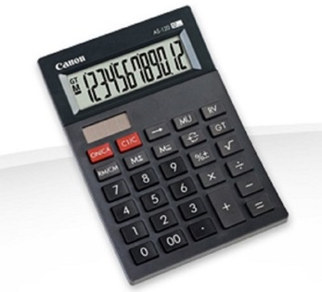
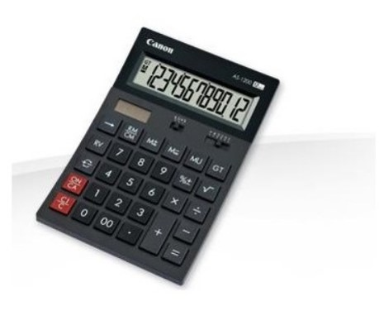
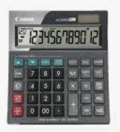
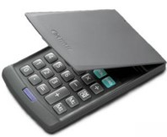
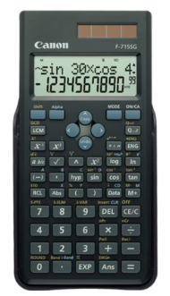
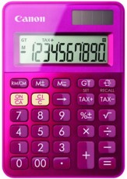
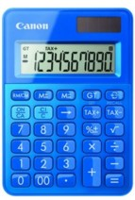
CANON CALCULATOR
Retail File July 2025
CALCULATOR AS-120 EMEA
4722C003AA RRP: €5.50
CALCULATOR AS220RTS with vat button
4898B001AB RRP: €9.60
CALCULATOR LS39E
4046A014AB RRP: €4.50
CALCULATOR AS-1200
HB EMEA
4599B001AB RRP: €7.50
CALCULATOR LS-100K
MPK HWB
0289C003AB RRP: €9.60
CALCULATOR LS-100K
MPK HWB
0289C001AB RRP: €9.60
CALCULATOR F-715, SCIENTIFIC
5730B001AB RRP: €15.65
Call now on:
Fax your order on:
Mail on:
Prices, promotions, specifications, availability and terms of offers may change without notice.
Despite our best efforts, a small number of items may contain pricing, typography, or photography errors.
Correct prices and promotions are validated at the time your order is placed.
Delivery installation charges are not included. VAT is included.
Call now on:
Fax your order on:
Mail on:

