Slide 1

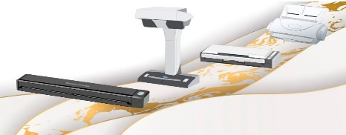

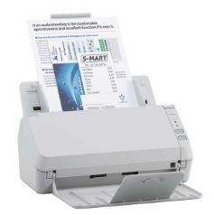
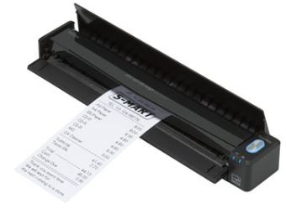
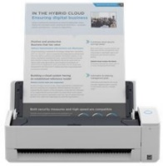
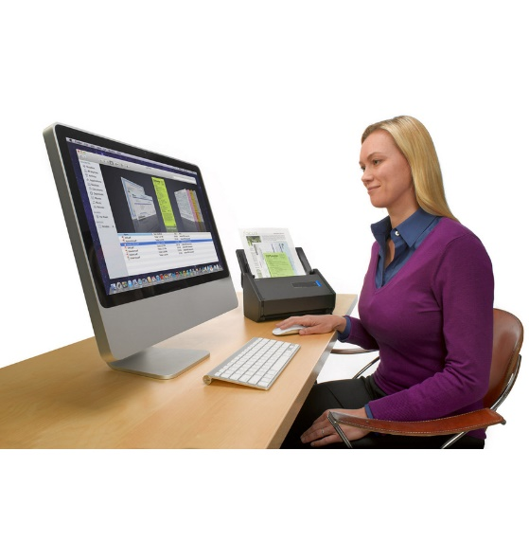
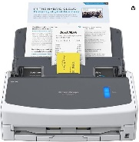
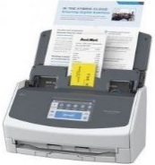
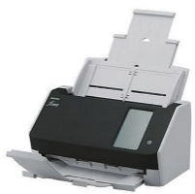
FUJITSU SCANNERS
Retail File July 2025
SP-1120N NETWORK A4 SHEETFEED
SP-1130N NETWORK A4 SHEETFEED
SCANSNAP iX100 A4 SHEETFEED
SCANSNAP IX1300
Simple and network compatible scanner for business. The SP-1120N provides high-value performance as an entry-level model for your business with scanning speeds of 20 ppm/40 ipm (A4 portrait, color, 200 / 300 dpi), ADF capacity of 50 sheets, ability to scan a wide range of documents.
Simple and network compatible scanner for business. SP-1130N scans documents at 30 ppm/60 ipm (A4 portrait 200/300 dpi) and loads up to 50 sheets at a time. With a compact and network compatible design, the unit provides high-value performance as an
entry-level model for all businesses.
The ScanSnap iX100 is the world's fastest battery powered ScanSnap. Whether scanning receipts, contracts, recipes, or plastic cards, the iX100 takes scanning beyond the desktop and into your mobile world. Completely wireless and weighing only 400 g, the iX100 brings mobility and wireless scanning to your PC or Mac as well as iOS or Android device.
ScanSnap iX1300 is a compact, yet powerful solution to all your daily and ad-hoc scanning needs. Being compact and multi-functional, the iX1300 is the perfect model for a hybrid workstyle.
PA03805-B001
FUJITSU SCANNER SCANSNAP IX1300, PORTABLE & MOBILE Α4,30PPM/30IPM, ADF 20 PAGES, RETURN SCAN, FOR PLASTIC CARDS, RECEIPTS, BI-FOLDED A3 DOCUMENTS, SUPPORT WIRELESS SCAN TO iOS, ANDROID FROM PC, USB, WHITE
SP € 350
PA03811-B001
FUJITSU SCANNER SP-1120N NETWORK A4 SHEETFEED, 20PPM / 40IPM, 600 DPI, DUPLEX, ADF 50 PAGES, SOFTWARE: PAPERSTREAM IP, USB, LAN
SP € 311
PA03811-B021
FUJITSU SCANNER SP-1130N NETWORK A4 SHEETFEED, 30PPM / 60IPM, DUPLEX, ADF 50 PAGES, 600DPI, SOFTWARE: PAPERSTREAM IP, USB, LAN
SP € 335
PA03688-B001
FUJITSU SCANNER SCANSNAP iX100 A4 SHEETFEED, PORTABLE AND COMPACT, 600 DPI, WIRELESS, SCAN SPEED: 5 SECONDS/PAGE, LI-ION BATTERY 720mAh, USB
SP € 282
SCANSNAP iX-1400 A4 SHEETFEED
FUJITSU SCANNER FI-8040
SCANSNAP iX-1600 A4 SHEETFEED
ScanSnap iX1400 is the model dedicated to providing a simple, one-touch experience. It scans with a single touch of the button, with no compromises on performance and image quality.
ScanSnap iX1600 comes with a 4.3-inch touch screen and provides ease-of-use so that users can complete scanning to data utilization, with just "one touch".
The fi-8040 combines quality, versatile connectivity and an intuitive user experience. The scanner has multiple options for connecting via a network, or to an individual PC using USB. And its 10.9cm color touchscreen and DirectScan application, enable PC-less scanning directly to workflows or email addresses, saving both time and effort.
PA03820-B001
FUJITSU SCANNER SCANSNAP iX-1400 A4 SHEETFEED, 40PPM / 80IPM, 50 PAGES ADF, DUPLEX, SOFTWARE: SCANSNAP, FINEREADER, USB 3.2
SP € 408
PA03770-B401
FUJITSU SCANNER SCANSNAP iX-1600 A4 SHEETFEED, 40PPM / 80IPM, WIFI SCAN TO PC, TOUCHSCREEN, MAC, IPAD, IPHONE, ANDROID, 50 PAGES ADF, DUPLEX, SOFTWARE: SCANSNAP, FINEREADER, USB 3.0
SP € 514
PA03836-B001
FUJITSU SCANNER FI-8040, 40PPM / 80IPM, 600 DPI, DUPLEX, ADF 50 PAGES, SOFTWARE: ABBYY, USB 3.2 Gen 1, LAN
SP €490
Call now on:
Mail on:
Place your order on:
Please call for models not listed above.
Prices, promotions, specifications, availability and terms of offers may change without notice. Despite our best efforts, a small number of items may contain pricing, typography, or photography errors. Correct prices and promotions are validated at the time your order is placed. Recycling fees are not included in the Dealer & Retail File. Delivery and installation charges are not included. Products' warranty is the warranty given by the manufacturer. VAT is included

Slide 2
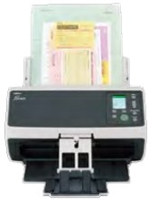

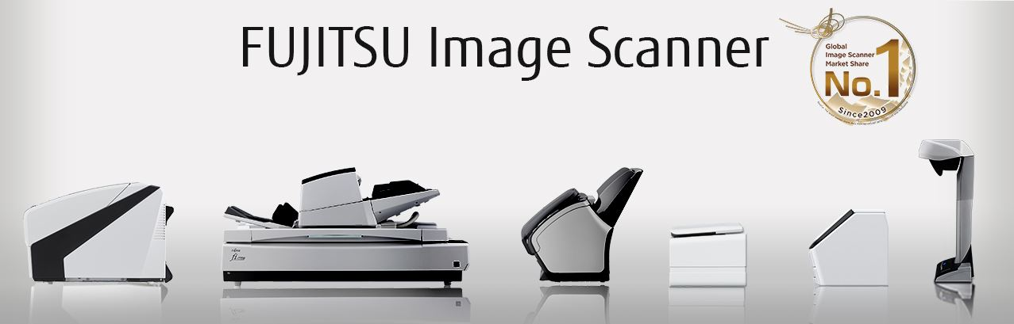
FUJITSU SCANNERS
Retail File July 2025
FUJITSU SCANNER FI-8170
SV600 A3 OVERHEAD
In the “Manual Feed Mode”, the fi-8170 scans copy forms and passports or booklets up to thicknesses of 7 mm without the carrier sheet. Precise multi-feed detection on a wide range of documents like plastic cards and documents with attachments, enable continual scanning with the same profiles. In addition, the “Automatic Separation Control” optimizes paper feed to match the number of sheets loaded, preventing interruptions.
The ScanSnap SV600 Contactless scanner provides a new perspective on document scanning. Easily scan newspapers, magazines, documents or books directly without cutting or damaging them.
PA03810-B051
FUJITSU SCANNER FI-8170, DUAL CIS, Α4, DUPLEX, ADF 100 PAGES, 70PPM/140IPM, 600DPI, FOR PAPER, BOOKLET, PLASTIC CARD, SUPPORTED ON WIN, OS, UBUNTU
SP € 1,039
PA03641-B301
FUJITSU SCANNER SV600 A3 OVERHEAD, SIMPLEX SCANSNAP, 285x283 DPI, A6, B6 POST CARD, BUSINESS CARD, USB
SP € 817
Digital transformation is rapidly changing the needs in all business areas. Scanning is the enabler that allows organizations to digitize, augment, organize and share information to fuel business growth and innovation.
Scanning unlocks the flow of information through the business.
Call now on:
Mail on:
Place your order on:
Please call for models not listed above.
Prices, promotions, specifications, availability and terms of offers may change without notice. Despite our best efforts, a small number of items may contain pricing, typography, or photography errors. Correct prices and promotions are validated at the time your order is placed. Recycling fees are not included in the Dealer & Retail File. Delivery and installation charges are not included. Products' warranty is the warranty given by the manufacturer. VAT is included

