Slide 1


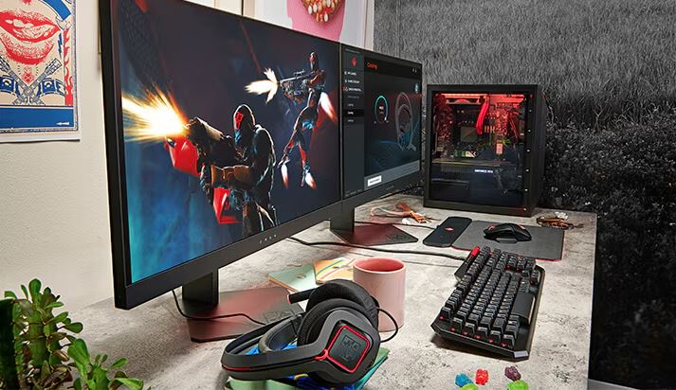
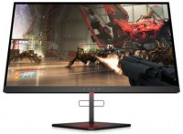
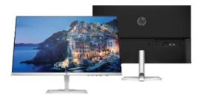
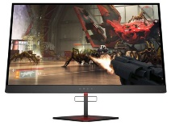
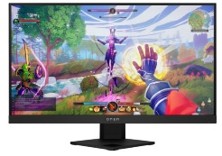
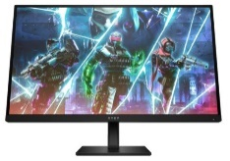
HP Home and Gaming Monitors
OMEN X 25F SERIES – 24.5’’ GAMING MONITOR
Retail File July 2025 Page 1/3
Are you ready for true competition? The OMEN X 25f 240Hz Gaming Display with Adaptive Sync was designed specifically for esports, with specs that give you an almost unfair advantage. A lightning-fast 240Hz refresh rate and a 1ms response time mean your grind to the top just got a whole lot easier.
Promo prices are valid until 31/07 or Until Stock Last.
HOME. M- SERIES 23.8’’ MONITORS
HP M24fd FHD USB-C Monitor. The highest definition of comfort and design. Lose yourself in the picture-perfect immersion of this massive 23.8"canvas that is WWCB certified and is designed to redefine comfort, wellness, and sustainability. Play, work, or simply stare into the new definition of high definition.
4WH47AA HP MONITOR 24.5'', X 25F OMEN GAMING HOME, A, TN LED, FHD 1920 X 1080, 240HZ, 1MS, 400 NITS, AMD FREESYNC & NVIDIA G-SYNC, ADJUSTABLE, SWIVEL, TILT, 2X USB, 2X HDMI, DISPLAY PORT, 1YW, 378.00 €
474U1E9 HP MONITOR 23.8'' M24FD HOME, IPS LED, FHD 1920 X 1080, 5MS, 300 NITS, AMD FREESYNC, TILT, 2 X USB, HDMI, VGA, USB-C, 2YW, SILVER/BLACK , 235.00 €
OMEN 27S FHD 240HZ 27’’ GAMING MONITOR
OMEN X 27 HDR QHD 240HZ – 27’’ GAMING MONITOR
Outclass the competition with the OMEN by HP 27-inch FHD 240Hz Gaming Monitor. Delivering ultra-smooth frames and crisp details, this NVIDIA® G-SYNC® compatible display has what it takes to keep up with you. Speed meets looks with a fun, yet refined design unlike any other so you can enjoy it in and out of the game.
Play at your full potential on a monitor that delivers frames at full-throttle speed. From edge to edge, this 240 Hz monitor brings visuals to the next level, with HDR technology that delivers details and contrast like you've never seen before, so you’re ready to react fast, return fire, and rank up.
OMEN 25I GAMING FHD 24.5’’ MONITOR
React faster, aim better, and zero in every aspect of your game. We've redefined high definition gaming with 165Hz, 1ms response, AMD FreeSync™ Premium Pro, and more colors than ever before.
22J05E9 HP MONITOR 24.5'', 25i OMEN GAMING HOME, F, IPS, FHD 1920 X 1080, 1MS, AMD FREESYNC 165Hz PREMIUM PRO, 400 NITS, TILT, AUDIO OUT, 2 X USB-A 3.2, USB TYPE-B, HDMI, DISPLAY PORT, 2YW, BLACK, 302.00 €
780G5E9 HP MONITOR 27'', 27S OMEN GAMING HOME, E, FHD 1920 X 1080 IPS, 1MS, 400 NITS, 240HZ, AMD RADEON FREESYNC, HEIGHT ADJUSTABLE, TILT, HDMI, DISPLAY PORT, VESA, 2YW, BLACK, 394.00 €
6FN07AA HP MONITOR 27'', X27 OMEN GAMING HOME HDR, C, TN LED, QHD 2560 X 1440, 1MS, 400 NITS, AMD RADEON FREESYNC 240HZ HDR TECHNOLOGY, ADJUSTABLE, PIVOT, SWIVEL, TILT, 2X USB, HDMI, DISPLAY PORT 1.2, 1YW, BLACK, 692.00 €
Prices, promotions, specifications, availability and terms of offers may change without notice. Despite our best efforts,
a small number of items may contain pricing, typography, or photography errors. Correct prices and promotions are validated at the time your order is placed. Recycling fees are not included in the Dealer & Retail File. Delivery and installation charges are not included. Products' warranty is the warranty given by the manufacturer. VAT is included
Call now on:
Mail on:

Slide 2

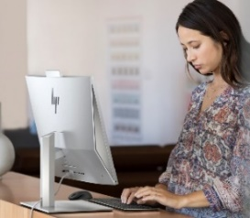
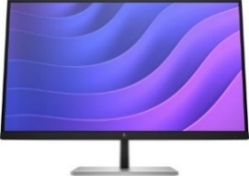
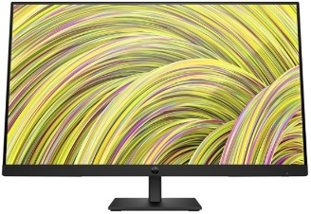
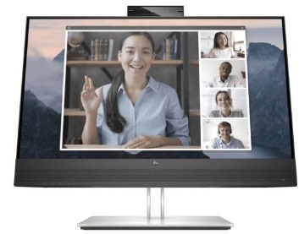
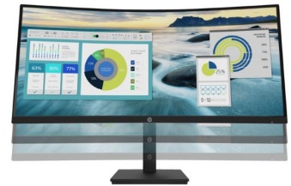
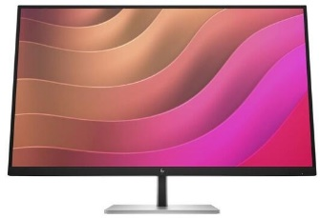
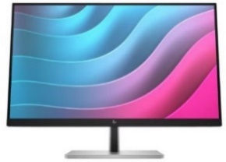
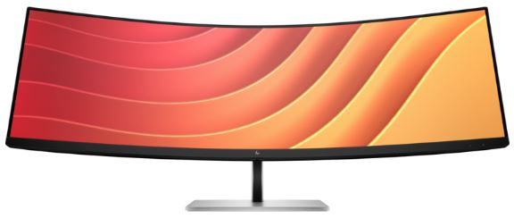
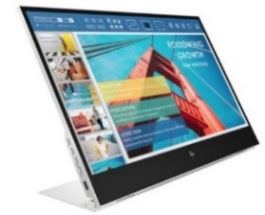
HP E&P Series Business Monitors
E27 G5 27’’ BUSINESS MONITOR
P27H 27’’ G5 FHD MONITOR
Intentionally crafted to deliver crisp visuals, personalized comfort, and true flexibility, the HP Monitor redefines comfort, so there's nothing between you and your best. Stylishly designed with the planet in mind, this display is the perfect fit for both the office and home.
Make hybrid work easy and do more at home or in the office with this 68.6 cm (27-inch) diagonal, FHD monitor through a crisp, smooth screen, built-in audio, and simple design.
Retail File July 2025 Page 2/3
Promo prices are valid until 31/07or Until Stock Last.
6N4E2AA HP MONITOR 27'' E27 G5 BUSINESS D IPS FHD 1920 X 1080 5MS 250 NITS ANTIGLARE EYE EASE HEIGHT ADJUSTABLE PIVOT SWIVEL TILT 4 X USB TYPE-A USB TYPE-B HDMI DISPLAY PORT 3YW BLACK/SILVER, 204.00 €
E24mv G4 23.8’’ FHD MONITOR
Make a great impression on video calls on 23.8-inch full HD conferencing monitor. The integrated, 5MP tilt-adjustable pop-up webcam displays a sharp, detailed picture – even in low light – and the built-in speakers and mic produce clear, life-like sound. Everything you need to present your best self on every call.
6N4C4AA HP MONITOR 27'', E27k G5 BUSINESS, F, IPS, 4K UHD 3840 X 2160, 5MS, 60Hz, 350 NITS, SPEAKERS, HEIGHT ADJUSTABLE, PIVOT, SWIVEL, TILT, HDMI, DISPLAY PORT, USB-C 65W POWER DELIVERY, LAN, 3YW, BLACK/SILVER, 396.00 €
64W41AA HP MONITOR 27'' P27H G5 BUSINESS WITH DUAL SPEAKERS D IPS FHD 1920 X 1080 5MS 250 NITS ANTIGLARE HEIGHT ADJUSTABLE VGA DISPLAY PORT HDMI 3YW BLACK, 173.00 €
P34HC G4 34’’ WQHD CURVED MONITOR
E32k G5 32’’ UHD MONITOR
The HP P series offers a curved display with Ultrawide resolution,
letting you view your projects perfectly on the big screen. You can also have multiple windows open at the same without limiting readability.
The curved design gives you wider viewing angle to look at your documents.
Uniquely designed to deliver incredible visuals and extended flexibility, the HP E32k G5 4K USB-C Monitor redefines precision, so there's nothing between you and your best. Stylishly crafted with your comfort and the planet in mind, this 4K display is a powerhouse of productivity.
169L0AA HP MONITOR 23.8'', E24mv G4 CONFERENCING BUSINESS , E, IPS, FHD 1920 X 1080, 16:9, 5MS, 250 NITS, SPEAKERS, CAMERA 5MP, HEIGHT ADJUSTABLE, PIVOT, SWIVEL, TILT, VGA, HDMI, DISPLAY PORT, 3YW, BLACK/SILVER, 250.00 €
6N4D6AA HP MONITOR 32'', E32k G5 BUSINESS, IPS, 4K UHD 3840 X 2160, 5MS, 350 NITS, 3W SPEAKERS, ANTIGLARE, HEIGHT ADJUSTABLE, PIVOT, SWIVEL, TILT, HDMI, DISPLAY PORT, USB-C 65W POWER DELIVERY, LAN, 3YW, BLACK/SILVER, 533.00 €
E24 G5 23.8’’ FHD MONITOR
21Y56AA HP MONITOR 34'', P34HC G4 BUSINESS CURVED, G, VA LED, WQHD 3440 X 1440, 5MS, 250 NITS, SPEAKER 2 X 3W, ULTRAWIDE, ANTIGLARE, HEIGHT ADJUSTABLE, TILT, USB TYPE-C, 4 X USB 3.2, HDMI, DISPLAY PORT, 3YW, BLACK , 454.00 €
Intentionally crafted to deliver crisp visuals, personalized comfort, and true flexibility, the HP E24 G5 FHD Monitor redefines comfort, so there's nothing between you and your best. Stylishly designed with the planet in mind, this display is the perfect fit for both the office and home.
E45C G5 45’’ DQHD CURVED MONITOR
Uniquely designed to deliver expansive immersion and flexibility, the HP E45c DQHD Curved Monitor augments what’s possible, so there's nothing between you and your best, all while keeping your comfort and the planet in mind.
E14 PORTABLE BUSINESS 14’’ FHD MONITOR
Work anywhere
Portable dual-screen productivity
Conserve your laptop's battery life
1B065AA HP MONITOR 14'' E14 PORTABLE BUSINESS, B, IPS LED, FHD 1920 X 1080, 5MS, 400 CD/M², ANTIGLARE, 2X USB TYPE-C, 3YW, SILVER , 313.00 €
6N6E6AA HP MONITOR 23.8'', E24t G5 BUSINESS, E, IPS, FHD 1920 X 1080 TOUCH, 5MS, 300 NITS, ANTIGLARE, EYE EASE, HEIGHT ADJUSTABLE, PIVOT, SWIVEL, TILT, 4 X USB TYPE-A , USB TYPE-B, HDMI, DISPLAY PORT, 3YW, BLACK/SILVER, 284.00 €
6N4C1AA HP MONITOR 45'', E45c G5 BUSINESS CURVED, G, VA, DQHD 5120 X 1440, 3MS, 400 NITS, 3W SPEAKERS, ANTIGLARE, HEIGHT ADJUSTABLE, SWIVEL, TILT, HDMI, DISPLAY PORT, USB-C, LAN, 3YW, BLACK/SILVER, 922.00 €
Prices, promotions, specifications, availability and terms of offers may change without notice. Despite our best efforts,
a small number of items may contain pricing, typography, or photography errors. Correct prices and promotions are validated at the time your order is placed. Recycling fees are not included in the Dealer & Retail File. Delivery and installation charges are not included. Products' warranty is the warranty given by the manufacturer. VAT is included
Call now on:
Mail on:

Slide 3
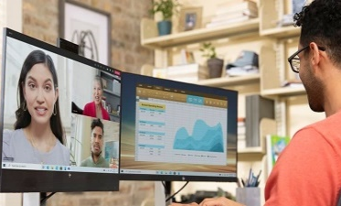
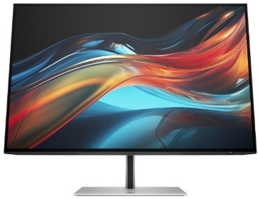
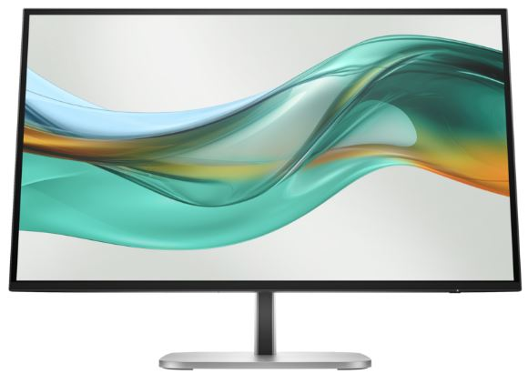
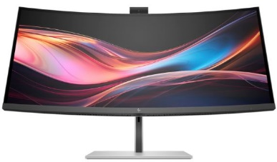
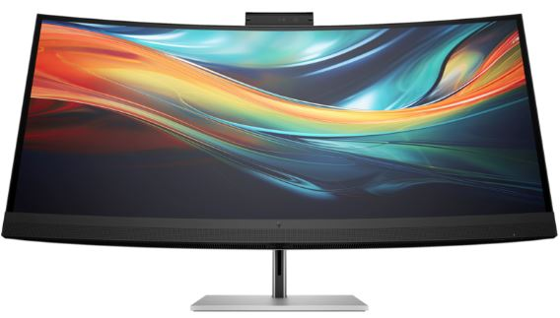
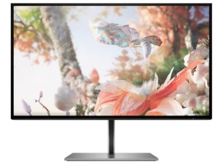
HP S3, S5, S7 and
Z Series Business Monitors
S7 27” & 32” PRO BUSINESS MONITORS
Retail File July 2025 Page 3/3
Create awe-inspiring work with true-to-life clarity on high-performance displays.
Promo prices are valid until 31/07 or Until Stock Last.
8J4D8UT HP MONITOR 27'', HP MONITOR 27'', S7 PRO 727PQ BUSINESS, F, IPS BLACK, QHD 2560x1440 120Hz, 16:9, 5MS, 400 NITS, HEIGHT ADJUSTABLE, PIVOT, SWIVEL, TILT, AMD FREESYNC PREMIUM, USB-C, HDMI, DISPLAY PORT, 3YW, BLACK/SILVER, 460.00 €
S3-S5 23.8” & 27” PRO BUSINESS MONITORS
8J9E6UT HP MONITOR 27'', S7 PRO 727PU BUSINESS, F, IPS BLACK, QHD 2560x1440 120Hz, 16:9, 5MS, 400 NITS, HEIGHT ADJUSTABLE, PIVOT, SWIVEL, TILT, HDMI, DISPLAY PORT, THUNDERBOLT WITH USB-C 100W POWER DELIVERY, LAN, 3YW, BLACK/SILVER, 595.00 €
8J9G2AA HP MONITOR 27'', S7 PRO 727PK BUSINESS, F, IPS BLACK, 4K UHD 3840x2160 60Hz, 16:9, 5MS, 400 NITS, HEIGHT ADJUSTABLE, PIVOT, SWIVEL, TILT, HDMI, DISPLAY PORT, THUNDERBOLT, LAN, 3YW, BLACK/SILVER, 695.00 €
8K135AA HP MONITOR 27'', S7 PRO 727PK BUSINESS, F, IPS BLACK, 4K UHD 3840x2160 60Hz, 16:9, 5MS, 400 NITS, CAMERA, SPEAKERS, HEIGHT ADJUSTABLE, PIVOT, SWIVEL, TILT, HDMI, DISPLAY PORT, THUNDERBOLT WITH USB-C 100W POWER DELIVERY, LAN, 3YW, 870.00 €
8Y2K9AA HP MONITOR 32'', S7 PRO 732PK BUSINESS, G, IPS BLACK, 4K UHD 3840x2160 60Hz, 16:9, 5MS, 400 NITS, HEIGHT ADJUSTABLE, PIVOT, SWIVEL, TILT, HDMI, DISPLAY PORT, THUNDERBOLT WITH USB-C 100W POWER DELIVERY, LAN, 3YW, BLACK/SILVER, 949.00 €
S7 34”, 37.5” & 39.7 PRO BUSINESS CURVED MONITORS
Expand your view and boost productivity with an additional inches of workspace from this monitor. Work in comfort with a crisp, smooth screen and simple design, so you can get more done everyday..
Effortlessly make a great impression through extraordinary collaboration powered by built-in AI conferencing on a dazzling ultrawide display with Thunderbolt.
9U5C1AA HP MONITOR 23.8'', S3 PRO 324PV BUSINESS, VA, FHD 1920 X 1080, 5MS, 100Hz, 250 NITS, ANTIGLARE, TILT, VGA, HDMI, 3YW, BLACK, 125.00 €
8K157UT HP MONITOR 34'', S7 PRO 734PM BUSINESS CURVED, G, IPS BLACK, 4K WQHD 3840x1440 120Hz, 21:9, 5MS, 400 NITS, CAMERA, SPEAKERS, HEIGHT ADJUSTABLE, SWIVEL, TILT, HDMI, DISPLAY PORT, THUNDERBOLT WITH USB-C 100W, LAN, 3YW, BLACK/SILVER, 1159.00 €
9D9L6UT HP MONITOR 23.8'', S5 PRO 524PN BUSINESS, IPS, FHD 1920 X 1080, 5MS, 100Hz, 350 NITS, ANTIGLARE, HEIGHT ADJUSTABLE, SWIVEL, PIVOT, TILT, DISPLAY PORT, HDMI, 3YW, BLACK, 200.00 €
8K167AA HP MONITOR 37.5'', S7 PRO 738PU BUSINESS CURVED, G, IPS BLACK, 4K WQHD+ 3840x1600 60Hz, 21:9, 5MS, 400 NITS, SPEAKERS, HEIGHT ADJUSTABLE, SWIVEL, TILT, HDMI, DISPLAY PORT, THUNDERBOLT WITH USB-C 100W POWER, LAN, 3YW, BLACK/SILVER, 1320.00 €
9D9V7AA HP MONITOR 23.8', S5 PRO 524PU G5 BUSINESS, IPS LED, FHD 1920X1080, 5MS, 350 NITS, ANTIGLARE, PIVOT, SWIVEL, TILT, HEIGHT ADJUSTABLE, LAN, USB-C POWER DELIVERY 100W, HDMI, DP, VESA,JET BLACK,3YW, 264.00 €
For those that need eyes on everything, immerse yourself in the expansive views of the HP Series 7 Pro 39.7" 5K2K Conferencing Monitor. See all of your projects at once and experience true-to-life color and remote collaboration on an ultrawide 5K:2K resolution display with an integrated 4K webcam and audio.
9D9S0UT HP MONITOR 27'', S5 PRO 527PQ BUSINESS, IPS, QHD 2560X1440, 100Hz, 5MS, 350 NITS, ANTIGLARE, PIVOT, SWIVEL, TILT, HEIGHT ADJUSTABLE, HDMI, DISPLAY PORT, 3YW, 286.00 €
8Y2R2AA HP MONITOR 39.7'', S7 PRO 740PM BUSINESS ULTRAWIDE CONFERENCIN CURVED, IPS, 5K2K WUHD 5120x2160 60Hz, 21:9, 5MS, CAMERA, SPEAKERS, HEIGHT ADJUSTABLE, SWIVEL, TILT, HDMI, DISPLAY PORT, THUNDERBOLT WITH USB-C 100W, LAN, 3YW, BL/SILV, 1616.00 €
Seamlessly connect PCs, peripherals, and displays with enhanced 100W power delivery in a sleek, modern monitor perfectly designed to get work done.
9E0G5AA HP MONITOR 27'' S5 PRO 527PU BUSINESS, E, IPS, QHD, 2560 X 1440 100Hz, 5MS, RJ-45, USB-C 100W POWER DELIVERY, HEIGHT ADJUSTABLE, TILT, SWIVEL, PIVOT, HDMI, DISPLAY PORT, 3YW BLACK/SILVER, 344.00 €
Z25XS DREAM COLOUR QHD MONITOR
Collaborate confidently with advanced AI conferencing. Stay comfortable and connected, wherever you work, with a customizable setup.
Remove barriers between designer and design with the HP DreamColor. Create jaw-dropping visuals with over a billion colors and hyper-realistic contrast in QHD and 4K HDR.
9E0G9UT HP MONITOR 23.8'', S5 PRO 524PM BUSINESS, IPS, FHD 1920 X 1080,5MS, 350 NITS,5MS, ANTIGLARE, CAMERA 5MP, HEIGHT ADJUSTABLE, SWIVEL, PIVOT, TILT, DISPLAY PORT, HDMI, USB-C 100W POWER DELIVERY, VESA,BLACK, 3YW, 408.00 €
1A9C9AA HP MONITOR 25'' Z25xs G3 BUSINESS DREAMCOLOR, G, IPS, QHD 2560 X 1440, 14MS, 266 NITS, ADJUSTABLE, PIVOT, SWIVEL, TILT, 3X USB, HDMI, DIPLAY PORT, USB TYPE-C, 3YW, 594.00 €
9E0Y9UT HP MONITOR 27'', S5 PRO 527PM BUSINESS, IPS, QHD 2560 X 1440,5MS, 350 NITS,5MS, ANTIGLARE, CAMERA 5MP, SPEAKERS, HEIGHT ADJUSTABLE, SWIVEL, PIVOT, TILT, DISPLAY PORT, HDMI, USB-C, VESA,BLACK, 3YW, 493.00 €
Prices, promotions, specifications, availability and terms of offers may change without notice. Despite our best efforts,
a small number of items may contain pricing, typography, or photography errors. Correct prices and promotions are validated at the time your order is placed. Recycling fees are not included in the Dealer & Retail File. Delivery and installation charges are not included. Products' warranty is the warranty given by the manufacturer. VAT is included
Call now on:
Mail on:

