Slide 1


Retail File July 2025
Lenovo
Business PCs, Monitors and Notebooks
Special Offers are valid until 29.08 or until stock lasts.
Call now on:
Mail on:
Prices, promotions, specifications, availability and terms of offers may change without notice. Despite our best efforts, a small number of items may contain pricing, typography, or photography errors. Correct prices and promotions are validated at the time your order is placed. Delivery and installation charges are not included. Products' warranty is the warranty given by the manufacturer. VAT is included

Slide 2

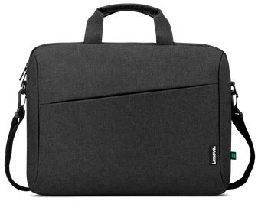
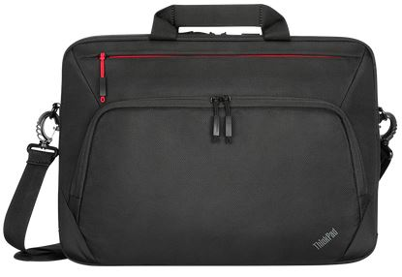
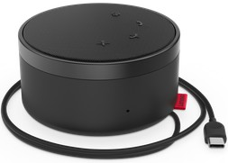
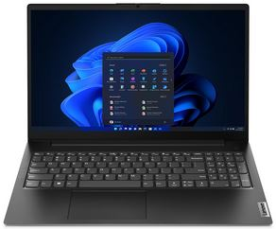
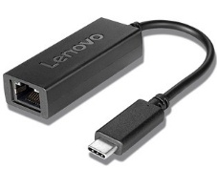
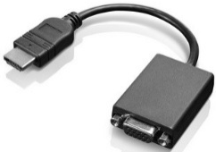
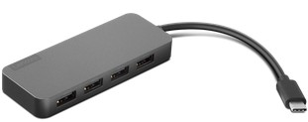
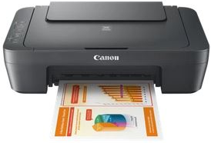
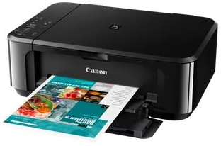
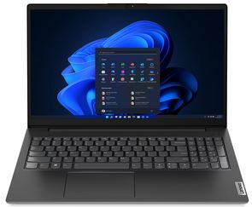
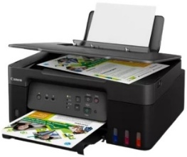
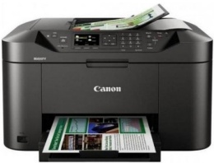
V - Series Notebooks 15.6’’
Retail File July 2025
Special Offers are valid until 29.08 or until stock lasts.
V15 G4 AMN
Optional
4X40T84061 LENOVO CARRY CASE, T210, CASUAL, TOPLOAD 15.6'', BLACK € 27
4X41A30365 LENOVO CARRY CASE, THINKPAD ESSENTIAL PLUS ECO TOPLOAD,15.6‘’ € 83
4XD1C82055 LENOVO GO WIRED SPEAKERPHONE, MS TEAMS, USB-C, USB-A, THUNDER BLACK € 145
82YU00YWCY LENOVO NOTEBOOK V15 G4 AMN, AMD RYZEN 3 7320U, 2.4-4.1GHz/4MB, 4 CORES, 8GB, 256GB SSD M.2 2242 PCIe, AMD RADEON 610M GRAPHICS, 15.6' FHD, TN, ANTIGLARE, LAN, WIFI, BT, HDMI, USB, USB-C, DOS, 3YW, BUSINESS BLACK € 335 - SPECIAL OFFER
82YU00YQCY LENOVO NOTEBOOK V15 G4 AMN, AMD RYZEN 5 7520U, 2.8-4.3GHz/4MB, 4 CORES, 16GB, 512GB SSD M.2 2242 PCIe, AMD RADEON 610M GRAPHICS, 15.6' FHD, TN, ANTIGLARE, LAN, WIFI, BT, HDMI, USB, USB-C, DOS, 3YW, BUSINESS BLACK € 489 - SPECIAL OFFER
4X90S91831 LENOVO ADAPTER USB-C TO ETHERNET € 26 - SPECIAL OFFER
0B47069 LENOVO ADAPTER HDMI TO VGA € 32
4X90X21427 LENOVO HUB USB-C TO 4 PORTS USB-A HUB € 34 - SPECIAL OFFER
V15 G4 IRU
Optional
0727C066AA CANON PRINTER ALL IN ONE INKJET MG2551S A4, PRINT, SCAN, COPY, 4800 X 600, 8iPM (B), 4iPM (C), USB, BLACK € 52
0515C106AA CANON PRINTER ALL IN ONE INKJET MG3650S A4, PRINT, SCAN, COPY, 9iPM (B), 5iPM (C), 4800 X 1200, DUPLEX, AIR PRINT, USB, WIFI, BLACK € 97
83A100ABCY LENOVO NOTEBOOK V15 G4 IRU, INTEL i5-13420H, 2.1-4.6GHz/12MB, 8 CORES, 16GB, 512GB SSD M.2 2242 PCIe, INTEL UHD GRAPHICS, 15.6' FHD, IPS, ANTIGLARE, LAN, WIFI, BT, HDMI, USB, USB-C, DOS, 3YW, BUSINESS BLACK € 632 - SPECIAL OFFER
83A100QNCY LENOVO NOTEBOOK V15 G4 IRU, INTEL i7-13620H, 2.4-4.9GHz/24MB, 10 CORES, 16GB, 512GB SSD M.2 2242 PCIe4, INTEL UHD, 15.6' FHD 1920x1080 IPS 300NITS AG, WIFI6, BT, LAN, USB, USB-C, HDMI, DOS, 3YW, BLACK € 826 - SPECIAL OFFER
5989C009AA CANON PRINTER ALL IN ONE INKJET HOME - OFFICE G3430 A4, Wi-Fi, Print, Scan & Copy, Cloud, 11iPM (B), 6iPM (C), WITH REFILABLE TANKS, USB, WIFI € 147
0959C009AA CANON PRINTER ALL IN ONE INKJET HOME - OFFICE MAXIFY MB2150 A4, PRINT, SCAN, COPY, FAX, 19iPM (B),13 iPM (C), 600 X 1200 DPI, ADF, DUPLEX, SCAN TO USB, AIRPRINT, CLOUD LINK, WI-FI € 164
Call now on:
Mail on:
Prices, promotions, specifications, availability and terms of offers may change without notice. Despite our best efforts, a small number of items may contain pricing, typography, or photography errors. Correct prices and promotions are validated at the time your order is placed. Delivery and installation charges are not included. Products' warranty is the warranty given by the manufacturer. VAT is included

Slide 3
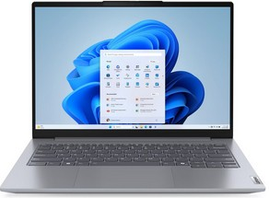
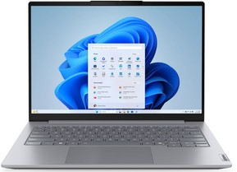
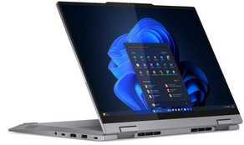
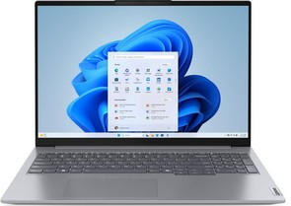
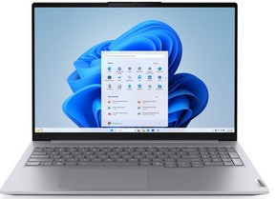
ThinkBook Notebooks 13’’ – 14’’ & 16’’
Retail File July 2025
Special Offers are valid until 29.08 or until stock lasts.
THINKBOOK 14 G7 ARP
THINKBOOK 14 G8 IAL
THINKBOOK 14 G4 IML 2 IN 1
21MV0018CY LENOVO NOTEBOOK THINKBOOK 14 G7 ARP, AMD RYZEN 5 7535HS, 3.3-4.5GHz/16MB, 6 CORES, 16GB, 512GB SSD M.2 2242 PCIe, AMD RADEON GRAPHICS, 14' WUXGA 1920x1200, IPS 300NITS, BL, LAN, WIFI6, USB, USB-C, HDMI, WIN 11 PRO, 3YW, GREY € 889 - SPECIAL OFFER
21SJ008FVU LENOVO NOTEBOOK THINKBOOK 14 G8 IAL, INTEL ULTRA 7 255H, 2-5.1GHz/24MB, 16C, 16GB, 512GB SSD M.2 2242 PCIe, AI 13 TOPS, ARC 140T GRAPHICS, 14' WUXGA 1920x1200 IPS 300NITS, LAN, WIFI6E, USB, USB-C, USB4, HDMI, WIN 11 PRO, 3YW, GREY € 1,293
21SJ008HVU LENOVO NOTEBOOK THINKBOOK 14 G8 IAL, INTEL ULTRA 7 255H, 2-5.1GHz/24MB, 16C, 16GB, 512GB SSD M.2 2242 PCIe, AI NPU 13 TOPS, ARC 140T GRAPHICS, 14' WUXGA 1920x1200, IPS, 300NITS, LAN, WIFI6E, USB, USB-C, USB4, HDMI, DOS, 3YW, GREY € 1,114
21SK00A6VU LENOVO NOTEBOOK THINKBOOK 16 G8 IAL, INTEL ULTRA 7 255H, 2-5.1GHz/24MB, 16C, 16GB, 512GB SSD M.2 2242 PCIe, AI NPU 13 TOPS, ARC 140T GRAPHICS, 16' WUXGA 1920x1200, IPS 300NITS, LAN , WIFI6E, USB, USB-C, USB4, HDMI, DOS, 3YW, GREY € 1,129 - SPECIAL OFFER
21MX0019CY LENOVO NOTEBOOK THINKBOOK 14 G4 IML 2 IN 1, INTEL ULTRA 5 125U, 3.6GHz-4.3GHz/12MB, 12C, 16GB, 512GB SSD M.2 2242 PCIe, INTEL GRAPHICS, 14' WUXGA 1920x1200, IPS 300NITS, TOUCH, WIFI6E, USB, USB4, HDMI, WIN 11 PRO, 3YW, GREY € 1,382 - SPECIAL OFFER
21MX0013CY LENOVO NOTEBOOK THINKBOOK 14 G4 IML 2 IN 1, INTEL ULTRA 7 155U, 3.8GHz-4.8GHz/12MB, 12C, 16GB, 512GB SSD M.2 2242 PCIe, INTEL GRAPHICS, 14' WUXGA 1920x1200, IPS 300NITS, TOUCH, WIFI6E, USB, USB-C, USB4, HDMI, WIN 11 PRO, 3YW, GREY € 1,584 - SPECIAL OFFER
THINKBOOK 16 G7 ARP
THINKBOOK 16 G8 IAL
21MW001XCY LENOVO NOTEBOOK THINKBOOK 16 G7 ARP, AMD RYZEN 5 7535HS, 3.3-4.55GHz/16MB, 6 CORES, 16GB, 512GB SSD M.2 2242 PCIe, AMD RADEON 660M GRAPHICS, 16' WUXGA 1920x1200, IPS, 300NITS, LAN , WIFI6E, USB, USB-C, USB4, HDMI, DOS, 3YW, GREY € 717 - SPECIAL OFFER
21MW001NCY LENOVO NOTEBOOK THINKBOOK 16 G7 ARP, AMD RYZEN 7 7735HS, 3.2-4.75GHz/16MB, 8 CORES, 16GB, 512GB SSD M.2 2242 PCIe, AMD RADEON 680M GRAPHICS, 16' WUXGA 1920x1200, IPS 300 NITS, LAN, WIFI6E, USB, USB-C, USB4, HDMI, DOS, 3YW, GREY € 876 - SPECIAL OFFER
21SK00A9VU LENOVO NOTEBOOK THINKBOOK 16 G8 IAL, INTEL ULTRA 5 225U, 1.5-4.8GHz/12MB, 12C, 16GB, 512GB SSD M.2 2242 PCIe, AI NPU 12 TOPS, INTEL GRAPHICS, 16' WUXGA 1920x1200, IPS 300NITS, LAN, WIFI6E, USB, USB-C, USB4, HDMI, DOS, 3YW, GREY € 959- SPECIAL OFFER
21SK00A4VU LENOVO NOTEBOOK THINKBOOK 16 G8 IAL, INTEL ULTRA 5 225U, 1.5-4.8GHz/12MB, 12C, 16GB, 512GB SSD M.2 2242 PCIe, AI 12 TOPS, INTEL GRAPHICS, 16' WUXGA 1920x1200, IPS 300NITS, LAN, WIFI6E, USB, USB-C, USB4, HDMI, WIN 11 PRO, 3YW, GREY € 1,114 - SPECIAL OFFER
21SK00A0VU LENOVO NOTEBOOK THINKBOOK 16 G8 IAL, INTEL ULTRA 7 255H, 2-5.1GHz/24MB, 16C, 16GB, 512GB SSD M.2 2242 PCIe, AI 13 TOPS, ARC 140T GRAPHICS, 16' WUXGA 1920x1200 IPS 300NITS, LAN, WIFI6E, USB, USB-C, USB4, HDMI, WIN 11 PRO, 3YW, GREY € 1,308
Call now on:
Mail on:
Prices, promotions, specifications, availability and terms of offers may change without notice. Despite our best efforts, a small number of items may contain pricing, typography, or photography errors. Correct prices and promotions are validated at the time your order is placed. Delivery and installation charges are not included. Products' warranty is the warranty given by the manufacturer. VAT is included

Slide 4
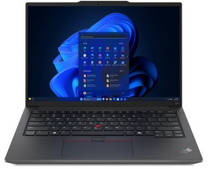
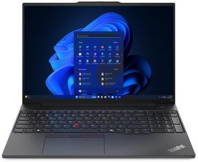
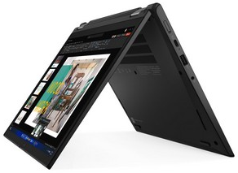
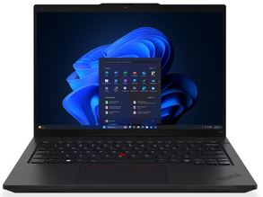
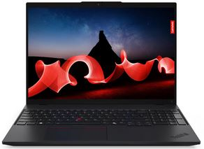
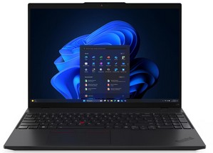
Thinkpad E & L - Series Notebooks 14’’ & 16’’
Retail File July 2025
Special Offers are valid until 29.08 or until stock lasts.
THINKPAD E14 G6
THINKPAD E16 G2
21M70042CY LENOVO NOTEBOOK THINKPAD E14 G6, INTEL ULTRA 5 125U, 3.6GHz-4.3GHz/12MB, 12 CORES, 16GB, 512GB SSD M.2 2242 PCIe, INTEL GRAPHICS, 14' WUXGA 1920x1200, IPS 300NITS, ANTGL, BACKLIT, USB, USB-C, USB4, HDMI, DOS, 3YW, BLACK € 1,039 - SPECIAL OFFER
21M70044CY LENOVO NOTEBOOK THINKPAD E14 G6, INTEL ULTRA 7 155U, 4.8GHz/12MB, 12 CORES, 16GB, 512GB SSD M.2 2242 PCIe, INTEL GPU, INTEGRATED INTEL NPU, AI, 14' WUXGA 1920x1200 IPS, 300NITS, LAN, WIFI6E, USB, USB4, HDMI, DOS, 3YW, BLACK € 1,189 - SPECIAL OFFER
21M7001YCY LENOVO NOTEBOOK THINKPAD E14 G6, INTEL ULTRA 7 155H, 3.8GHz-4.8GHz/24MB, 16 CORES, 16GB, 512GB SSD M.2 2242 PCIe, INTEL ARC GRAPHICS, 14' WUXGA 1920x1200, IPS 300NITS, ANTGL, LAN, WIFI6E, USB, USB-C, USB4, HDMI, WIN 11 PRO, BLACK € 1,367 - SPECIAL OFFER
21MA003NCY LENOVO NOTEBOOK THINKPAD E16 G2, INTEL ULTRA 5 125U, 3.6GHz-4.3GHz/12MB, 12 CORES, 16GB, 512GB SSD M.2 2242 PCIe, INTEL GRAPHICS, 16' WUXGA 1920x1200, IPS 300NITS, ANTGL, LAN, WIFI6E, USB, USB-C, USB4, HDMI, DOS, 3YW, BLACK € 1,055 - SPECIAL OFFER
21MA002YCY LENOVO NOTEBOOK THINKPAD E16 G2, INTEL ULTRA 7 155H, 3.8GHz-4.8GHz/24MB, 16 CORES, 16GB, 512GB SSD M.2 2242 PCIe, INTEL ARC GRAPHICS, 16' WUXGA 1920x1200, IPS 300NITS, ANTGL, LAN, WIFI6E, USB, USB-C, USB4, HDMI, DOS, 3YW, BLACK € 1,218 - SPECIAL OFFER
21MA0020CY LENOVO NOTEBOOK THINKPAD E16 G2, INTEL ULTRA 5 125U, 3.6GHz-4.3GHz/12MB, 12 CORES, 16GB, 512GB SSD M.2 2242 PCIe, INTEL GRAPHICS, 16' WUXGA 1920x1200, IPS 300NITS, ANTGL, LAN, WIFI6E, USB, USB-C, USB4, HDMI, WIN 11 PRO, 3YW, BLACK € 1,242 - SPECIAL OFFER
21MA002WCY LENOVO NOTEBOOK THINKPAD E16 G2, INTEL ULTRA 7 155H, 1.4-4.8GHz/24MB, 16 CORES, 16GB, 1TB SSD M.2 2242 PCIe, AI NPU 11 TOPS, ARC GRAPHICS, 16' WUXGA 1920x1200 IPS 300NITS, LAN, WIFI6E, USB, USB-C, USB4, HDMI, DOS, 3YW, BLACK € 1,278- SPECIAL OFFER
21MA0019CY LENOVO NOTEBOOK THINKPAD E16 G2, INTEL ULTRA 7 155H, 3.8GHz-4.8GHz/24MB, 16C, 16GB, 512GB SSD M.2 2242 PCIe, INTEL ARC GRAPHICS, 16' WUXGA 1920x1200, IPS 300NITS, ANTGL, LAN, WIFI6E, USB, USB-C, USB4, HDMI, WIN 11 PRO, 3YW, BLACK € 1,389 - SPECIAL OFFER
THINKPAD L13 2-in-1 G5
THINKPAD L14 G6
THINKPAD L16 G1
THINKPAD L16 G2
21LM001PCY LENOVO NOTEBOOK THINKPAD L13 2-in-1 G5, INTEL ULTRA 7 155U, UP TO4.8GHz/12MB, 12 CORES, 16GB, 512GB SSD M.2 2280, 13.3' WUXGA, IPS, TOUCH, PEN, INTEL GRAPHICS, WIFI6E, USB-C, USB-A, HDMI, THUNDERBOLT 4, WIN 11 PRO, 3YW, BLACK € 1,748
21S6001FVU LENOVO NOTEBOOK THINKPAD L14 G6, INTEL ULTRA 5 225U, 1.5-4.8GHz/12MB, 12C, AI 12TOPS, 16GB, 512GB SSD, INTEL GRAPH, 14' WUXGA 1920x1200 IPS 400NITS AG 60Hz, WIFI6E, BT, LAN, USB-A, USB4, HDMI, WIN 11 PRO, 3YW, BLACK € 1,529
21S6001WVU LENOVO NOTEBOOK THINKPAD L14 G6, INTEL ULTRA 7 255U, 2-5.2GHz/12MB, 12C, AI 12TOPS, 16GB, 512GB SSD, INTEL GRAPH, 14' WUXGA 1920x1200 IPS 400NITS AG 60Hz, WIFI6E, BT, LAN, USB-A, USB4, HDMI, WIN 11 PRO, 3YW, BLACK € 1,822
21S6001QVU LENOVO NOTEBOOK THINKPAD L14 G6, INTEL ULTRA 7 255U, 2-5.2GHz/12MB, 12C, AI 12TOPS, 32GB, 1TB SSD, INTEL GRAPH, 14' WUXGA 1920x1200 IPS 400NITS AG 60Hz, WIFI6E, BT, LAN, USB-A, USB4, HDMI, WIN 11 PRO, 3YW, BLACK € 1,977
21L3002ECY LENOVO NOTEBOOK THINKPAD L16 G1, INTEL ULTRA 5 125U, 12 C, 2.1-4.3GHz/12MB, 16GB, 512GB SSD M.2 2280 PCIe, INTEL GRAPHICS, AI BOOST, 16' WUXGA 1920x1200 IPS, 300NITS, LAN, WIFI6E, USB, USB-C, USB4, HDMI, WIN 11 PRO, 3YW, BLACK €1,308- SPECIAL OFFER
21L3002RCY LENOVO NOTEBOOK THINKPAD L16 G1, INTEL ULTRA 7 155U, 3.8-4.8GHz/12MB, 12 C, 16GB, 512GB SSD M.2 2280 PCIe, INTEL GPU, INTEL AI, 16' WUXGA 1920x1200, IPS, 300NITS, LAN, WIFI6E, USB, USB-C, USB4, HDMI, WIN 11 PRO, 3YW, BLACK € 1,529 - SPECIAL OFFER
21SA0017VU LENOVO NOTEBOOK THINKPAD L16 G2, INTEL ULTRA 5 225U, 1.5-4.8GHz/12MB, 12C, AI 12TOPS, 16GB, 512GB SSD, INTEL GRAPH, 16' WUXGA 1920x1200 IPS 400NITS AG 60Hz, WIFI6E, BT, LAN, USB-A, USB4, HDMI, WIN 11 PRO, 3YW, BLACK € 1,545
21SA001JVU LENOVO NOTEBOOK THINKPAD L16 G2, INTEL ULTRA 7 255U, 2-5.2GHz/12MB, 12C, AI 17TOPS, 32GB, 1TB SSD, INTEL GRAPH, 16' WUXGA 1920x1200 IPS 400NITS AG 60Hz, WIFI6E, BT, LAN, USB-A, USB4, HDMI, WIN 11 PRO, 3YW, BLACK € 1,992
Call now on:
Mail on:
Prices, promotions, specifications, availability and terms of offers may change without notice. Despite our best efforts, a small number of items may contain pricing, typography, or photography errors. Correct prices and promotions are validated at the time your order is placed. Delivery and installation charges are not included. Products' warranty is the warranty given by the manufacturer. VAT is included

Slide 5
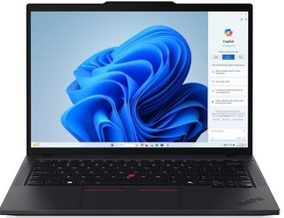
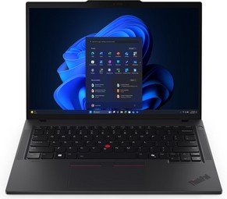
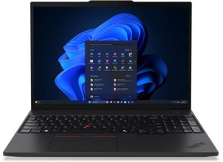
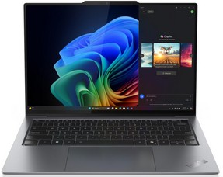
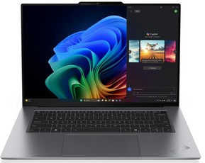
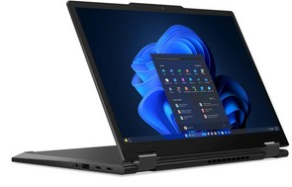
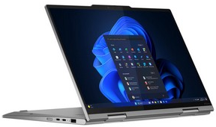
Thinkpad T & X - Series Notebooks 14’’ & 16’’
Retail File July 2025
Special Offers are valid until 29.08 or until stock lasts.
THINKPAD T14 G5
THINKPAD T14 G6
THINKPAD T16 G4
21ML0033CY LENOVO NOTEBOOK THINKPAD T14 G5, INTEL ULTRA 7 155U, 3.8GHz-4.8GHz/12MB, 12 CORES, 16GB, 512GB SSD M.2 2280 PCIe, INTEL GRAPHICS, 14' WUXGA 1920x1200, IPS 400NITS, ANTGL, LAN, WIFI6E, USB, USB4, HDMI, WIN 11 PRO, 3YW, BLACK € 2,007
21QC002TVU LENOVO NOTEBOOK THINKPAD T14 G6, INTEL ULTRA 5 225U, 1.5-4.8GHz/12MB, 12C, AI 12TOPS, 32GB, 512GB SSD, INTEL GRAPH, 14' WUXGA 1920x1200 IPS 400NITS AG 60Hz, WIFI6E, BT, LAN, USB-A, USB4, HDMI, WIN 11 PRO, 3YW, BLACK € 1,932
21QG001PVU LENOVO NOTEBOOK THINKPAD T14 G6, INTEL ULTRA 7 258V, 2.2-4.8GHz/12MB, 8C, AI 47TOPS, 32GB, 1TB SSD, ARC 140V, 14' WUXGA 1920x1200 IPS 400NITS AG 60Hz, WIFI7, BT, LAN, USB-A, USB4, HDMI, WIN 11 PRO, 3YW, BLACK € 2,379
21QE0043VU LENOVO NOTEBOOK THINKPAD T16 G4, INTEL ULTRA 7 255U, 2-5.2GHz/12MB, 12C, AI 12TOPS, 32GB, 1TB SSD, INTEL GRAPH, 16' WUXGA 1920x1200 IPS 500NITS AG, WIFI6E, BT, LAN, USB-A, USB4, HDMI, WIN 11 PRO, 3YW, BLACK € 2,549
THINKPAD X9-14 G1
THINKPAD X9-15 G1
THINKPAD X13 G5 2 IN 1
THINKPAD X1 2 IN 1 G10
21QA0048VU LENOVO NOTEBOOK THINKPAD X9-14 G1, INTEL ULTRA 7 258V, 2.2-4.8GHz/12MB, 8 CORES, 32GB, 1TB SSD M.2 2242 PCIe, AI NPU 47 TOPS, ARC 140V GRAPHICS, 14' 2.8K 2880x1800 OLED 500NITS, TOUCH, WIFI7, BT, USB-C, HDMI, WIN 11 PRO, 3YW, GREY € 2,665
21QA001CVU LENOVO NOTEBOOK THINKPAD X9-14 G1, INTEL ULTRA 7 258V, 2.2-4.8GHz/12MB, 8 CORES, 32GB, 1TB SSD M.2 2242 PCIe, AI NPU 47 TOPS, ARC 140V GRAPHICS, 14' WUXGA 1920x1200 OLED 400NITS, WIFI7, BT, USB-C, HDMI, WIN 11 PRO, 3YW, GREY € 2,459
21Q6001NVU LENOVO NOTEBOOK THINKPAD X9-15 G1, INTEL ULTRA 7 258V, 2.2-4.8GHz/12MB, 8C, 32GB, 1TB SSD M.2 2242 PCIe, AI 47 TOPS, ARC 140V GRAPHICS, 15.3' 2.8K 2880x1800 OLED 500NITS, TOUCH, WIFI7, BT, USB, USB-C, HDMI, WIN 11 PRO, 3YW, GREY € 2,679
21LW000QCY LENOVO NOTEBOOK THINKPAD X13 G5 2 IN 1, INTEL ULTRA 7 155U, 3.8GHz-4.8GHz/12MB, 12 CORES, 32GB, 1TB SSD M.2 2280 PCIe, INTEL GRAPHICS, 13.3' WUXGA 1920x1200, IPS 400NITS, TOUCH, WIFI6E, USB, USB4, HDMI, WIN 11 PRO, 3YW, BLACK € 2,423 - SPECIAL OFFER
21NU002BVU LENOVO NOTEBOOK THINKPAD X1 2 IN 1 G10, INTEL ULTRA 7 258V, 4.8GHz/12MB, 8 CORES, AI 47 TOPS, 32GB, 1TB SSD M.2 2280 PCIe5, ARC 140V, 14' 2.8K 2880x1800 OLED 500NITS TOUCH, 5G, WIFI7, BT, USB-A, USB4, HDMI, WIN 11 PRO, 3YW, GREY € 3,792
Call now on:
Mail on:
Prices, promotions, specifications, availability and terms of offers may change without notice. Despite our best efforts, a small number of items may contain pricing, typography, or photography errors. Correct prices and promotions are validated at the time your order is placed. Delivery and installation charges are not included. Products' warranty is the warranty given by the manufacturer. VAT is included

Slide 6
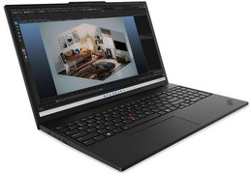
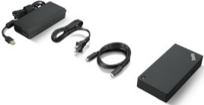
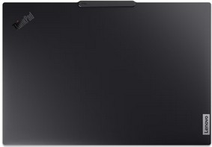
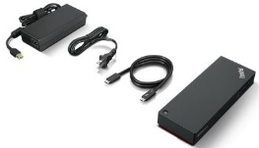
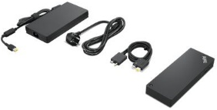
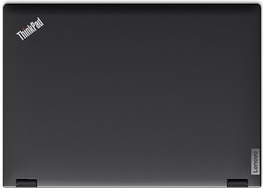
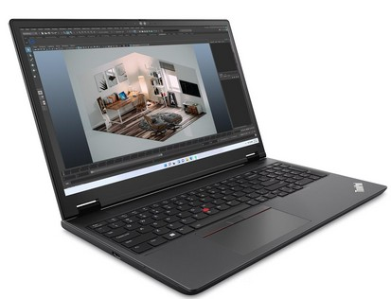



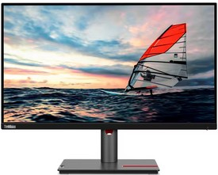
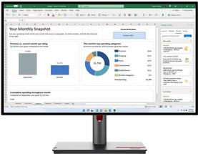

Thinkpad P - Series Notebooks 14’’ & 16’’
Retail File July 2025
Special Offers are valid until 29.08 or until stock lasts.
THINKPAD P16s G3
Optional
40AY0090UK LENOVO DOCKING STATION UNIVERSAL USB-C, 2x DISPLAY PORT, HDMI PORT, GIGA LAN, 3x USB 3.1, 2x USB 2.0, 1x USB-C, 3YW € 219
40B10135EU LENOVO DOCKING STATION SMART THINKPAD UNIVERSAL THUNDERBOLT 4, 135W AC POWER ADAPTER, INPUT 20V/6.75A, OUTPUT 100W, USB4 HOST, USB4 DEVICE CONNECT, HDMI2.1, 2x DP1.4, USB-A, USB-C, AUDIO COMBO JACK 3.5MM, Gb LAN, WIN, UBUNTU, 3YW € 406 - SPECIAL OFFER
21KS0005CY LENOVO NOTEBOOK THINKPAD P16s G3, INTEL ULTRA 7 155H, 4.8GHz/24MB, 16C, 32GB, 1TB SSD M.2 2280 PCIe, AI 11 TOPS, NVIDIA RTX 500 ADA 4GB, 16' WUXGA 1920x1200 IPS 300NITS, LAN, WIFI6E, USB, USB4, HDMI, WIN 11 PRO, 3YW, BLACK € 2,119 - SPECIAL OFFER
40B00300EU LENOVO DOCKING STATION THINKPAD THUNDERBOLT 4 WORKSTATION DOCK, USB4, 4x USB-A, USB-C, HDMI 2.1, 2x DP 1.4, LAN, 3YW,EU PLUG, BLACK RED € 423 - SPECIAL OFFER
THINKPAD P16v G2
4X31N50746 LENOVO KEYBOARD AND MOUSE SET ESSENTIAL WIRELESS COMBO, BLACK GEN 2 € 37 - SPECIAL OFFER
21KX000MCY LENOVO NOTEBOOK THINKPAD P16v G2, INTEL ULTRA 7 155H, 4.8GHz/24MB, 16C, 32GB, 1TB SSD M.2 2280 PCIe, AI 11 TOPS, NVIDIA RTX 1000 ADA 6GB, 16' WUXGA 1920x1200 IPS 300NITS, LAN, WIFI6E, USB, USB4, HDMI, WIN 11 PRO, 3YW, BLACK € 2,423- SPECIAL OFFER
21KX003MCY LENOVO NOTEBOOK THINKPAD P16v G2, INTEL ULTRA 9 185H, 5.1GHz/24MB, 16C, 64GB, 1TB SSD M.2 2280 PCIe, AI 11 TOPS, NVIDIA RTX 3000 ADA 8GB, 16' WUXGA 1920x1200 IPS 400NITS, LAN, WIFI6E, USB, USB4, HDMI, WIN 11 PRO, 3YW, BLACK € 3,865 - SPECIAL OFFER
GY51C21210 LENOVO MOUSE GO USB-C WIRELESS STORM, 2400 DPI, BLUE OPTICAL, GREY € 34
THINKVISION P25i-30
THINKVISION P27h-30
4Y51C21216 LENOVO MOUSE GO USB-C WIRELESS, RECHARGEABLE, SETTING DPI 2400, 1600, 800, BLUE OPTICAL SENSOR, THUNDER BLACK € 44 - SPECIAL OFFER
63F4MAT1UK LENOVO MONITOR 24.5' THINKVISION P25i-30 BUSINESS, D, IPS, WLED, FHD 1920x1080, ANTIGLARE, 16:9, 4MS, 100Hz, 250CD/M², EYESAFE, HEIGHT ADJUST, PIVOT, SWIVEL, TILT, 4xUSB-A, USB-B, HDMI 2.1, DP1.4, DP1.4 OUT, VGA, VESA, 3YW, BLACK € 207
63A1GAT1UK LENOVO MONITOR 27'' THINKVISION P27h-30 BUSINESS, F, IPS, WLED, QHD 2560x1440, ANTIGLARE, 16:9, 4MS, 60Hz, 350CD/M², EYESAFE, HEIGHT ADJUSTABLE, PIVOT, SWIVEL, TILT, 5x USB, 3x USB-C, 1x HDMI, 1x DP, 1x DP OUT,LAN,VESA, 3YW, BLACK € 395 - SPECIAL OFFER
4Y51C21217 LENOVO MOUSE GO WIRELESS MULTI-DEVICE, RECHARGEABLE, 2400 DPI, BLUE OPTICAL SENSOR, BLACK € 71 - SPECIAL OFFER
Call now on:
Mail on:
Prices, promotions, specifications, availability and terms of offers may change without notice. Despite our best efforts, a small number of items may contain pricing, typography, or photography errors. Correct prices and promotions are validated at the time your order is placed. Delivery and installation charges are not included. Products' warranty is the warranty given by the manufacturer. VAT is included

Slide 7
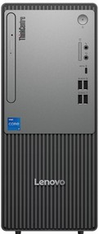








PCs
Retail File July 2025
Special Offers are valid until 29.08 or until stock lasts.
THINKCENTRE NEO 50T G5
THINKCENTRE NEO 30s G5 SFF
12UD005DUK LENOVO PC THINKCENTRE NEO 50T G5, INTEL i5-14400, 2.5-4.7GHz/20MB, 10 CORES, 16GB, 512GB SSD M.2 2280 PCIe, INTEL UHD GRAPHICS 730, DVDRW, WIFI, BT5.2, LAN, USB, USB-C, HDMI, DP, VGA, DOS, 5YW, BLACK € 719 - SPECIAL OFFER
12UD0052UK LENOVO PC THINKCENTRE NEO 50T G5, INTEL i5-14400, 2.5-4.7GHz/20MB, 10 CORES, 16GB, 512GB SSD M.2 2280 PCIe, INTEL UHD GRAPHICS 730, DVDRW, WIFI6, BT5.2, LAN, USB, USB-C, HDMI, DP, VGA, WIN 11 PRO, 5YW, BLACK € 855- SPECIAL OFFER
12UD005CUK LENOVO PC THINKCENTRE NEO 50T G5, INTEL i7-14700, 2.1-5.3GHz/33MB, 20 CORES, 16GB, 512GB SSD M.2 2280 PCIe, INTEL UHD GRAPHICS 770, DVDRW, WIFI6, BT5.2, LAN, USB, USB-C, HDMI, DP, VGA, DOS, 5YW, BLACK € 1,019 - SPECIAL OFFER
12UD0053UK LENOVO PC THINKCENTRE NEO 50T G5, INTEL i7-14700, 2.1-5.3GHz/33MB, 20 CORES, 16GB, 512GB SSD M.2 2280 PCIe, INTEL UHD GRAPHICS 770, DVDRW, WIFI6, BT5.2, LAN, USB, USB-C, HDMI, DP, VGA, WIN 11 PRO, 5YW, BLACK € 1,174 - SPECIAL OFFER
13DK0033UK LENOVO PC THINKCENTRE NEO 30s G5 SFF, INTEL i5-13420H, 2.1-4.6GHz/12MB, 8 CORES, 16GB, 512GB SSD M.2 2280 PCIe, INTEL UHD GRAPHICS, DVDRW, LAN, USB-C, USB-A, HDMI, VGA, DOS, 3YW, BLACK/GREY € 623 - SPECIAL OFFER
12XD007BUK LENOVO PC THINKCENTRE NEO 50s G5 SFF, INTEL i5-14400, 2.5-4.7GHz/20MB, 10 CORES, 16GB, 512GB SSD M.2 2280 PCIe, INTEL UHD GRAPHICS 730, DVDRW, LAN, USB, USB-C, HDMI, DP, VGA, DOS, 5YW, BLACK € 683 - SPECIAL OFFER
12XD007LUK LENOVO PC THINKCENTRE NEO 50s G5 SFF, INTEL i5-14400, 2.5-4.7GHz/20MB, 10 CORES, 16GB, 512GB SSD M.2 2280 PCIe, INTEL UHD GRAPHICS 730, DVDRW, LAN, USB, USB-C, HDMI, DP, VGA, WIN 11 PRO, 5YW, BLACK € 965
THINKCENTRE M70q G5 TINY USFF
THINKCENTRE M70q G6 TINY USFF
THINKCENTRE NEO 50q G4 TINY USFF
THINKSTATION P2
30FR0054UK LENOVO PC WORKSTATION THINKSTATION P2, INTEL i7-14700, 2.1-5.4GHz/33MB, 20C, 32GB, 512GB SSD M.2 2280 PCIe, AI, INTEL UHD 770 GRAPHICS, NVIDIA RTX A400 4GB, LAN, USB-C, USB, HDMI, DP, WIN 11 PRO, 3YW, BLACK € 1,858 - SPECIAL OFFER
30FR003WUK LENOVO PC WORKSTATION THINKSTATION P2, INTEL i7-14700K, 3.4-5.6GHz/33MB, 20C, 32GB, 1TB SSD M.2 2280 PCIe, AI, INTEL UHD 770 GRAPHICS, NVIDIA RTX A2000 12GB, LAN, USB-C, USB, HDMI, DP, WIN 11 PRO, 3YW, BLACK € 2,185 - SPECIAL OFFER
30FR003YUK LENOVO PC WORKSTATION THINKSTATION P2, INTEL i9-14900K, 3.2-6.0GHz/36MB, 24C, 32GB, 1TB SSD M.2 2280 PCIe, AI, INTEL UHD 770 GRAPHICS, NVIDIA RTX A2000 12GB, LAN, USB-C, USB, HDMI, DP, WIN 11 PRO, 3YW, BLACK € 2,506 - SPECIAL OFFER
12TD000VUK LENOVO PC THINKCENTRE M70q G5 TINY USFF, INTEL i7-14700T, 1.3-5.2GHz/33MB, 20 CORES, 16GB, 512GB SSD M.2 2280 PCIe4, INTEL UHD GRAPHICS 770, VESA MOUNT, WIFI6E, BT, LAN, USB-C, USB-A, HDMI, DP, WIN 11 PRO, 3YW, BLACK € 1,248
13A4000SUK LENOVO PC THINKCENTRE M70q G6 TINY USFF, INTEL ULTRA 7 265T, 1.5-5.3GHz/30MB, 20 CORES, AI 13 TOPS, 16GB, 512GB SSD M.2 2280 PCIe4, INTEL GRAPHICS, VESA MOUNT, WIFI6E, BT, LAN, USB-C, USB-A, HDMI, DP, DOS, 3YW, BLACK € 1,174
12LN003UUK LENOVO PC THINKCENTRE NEO 50q G4 TINY USFF, INTEL i5-13420H, 3.4-4.6GHz/12MB, 8 CORES, 16GB, 512GB SSD M.2 2280 PCIe, INTEL UHD GRAPHICS, VESA MOUNT, WIFI6, BT, LAN, USB-C, USB, HDMI, DP, DOS, 5YW, BLACK € 638 - SPECIAL OFFER
12LN004AUK LENOVO PC THINKCENTRE NEO 50q G4 TINY USFF, INTEL i5-13420H, 2.1-4.6GHz/12MB, 8 CORES, 16GB, 512GB SSD M.2 2280 PCIe4, INTEL UHD GRAPHICS, VESA MOUNT, WIFI6, BT, LAN, USB-C, USB, HDMI, DP, WIN 11 PRO, 5YW, BLACK € 832 - SPECIAL OFFER
Optional
AURORA_1200VA PHOENIXTEC UPS LINE INTERACTIVE 1200VA/600W, 2PCS BATTERY 12V/7Ah, TRANFER TIME: 4-8MS, RECHARGE TIME: 6 HOURS TO 90%, 6X SOCKETS, LED INDICATORS, PHONE LINE SURGE PROTECTION, USB € 141
INNOVA_2K PHOENIXTEC UPS ONLINE TOWER 2000VA/1600W, 8PCS BATTERY 12V/7Ah, TRANSFER TIME: 4MS, RECHARGE TIME: 5 HOURS TO 90%, BACKUP TIME: 9MIN, 6 SOCKETS, € 707
INNOVA_3K PHOENIXTEC UPS ONLINE TOWER 3000VA/2400W, 8PCS BATTERY 12V/7Ah, TRANSFER TIME: 4MS, RECHARGE TIME: 5 HOURS TO 90%, BACKUP TIME: 5MIN, 4 SOCKETS € 817
Call now on:
Mail on:
Prices, promotions, specifications, availability and terms of offers may change without notice. Despite our best efforts, a small number of items may contain pricing, typography, or photography errors. Correct prices and promotions are validated at the time your order is placed. Delivery and installation charges are not included. Products' warranty is the warranty given by the manufacturer. VAT is included

Slide 8
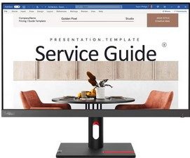
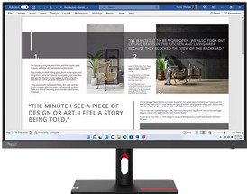
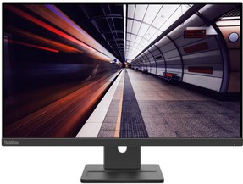
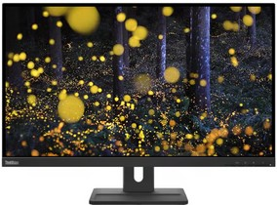
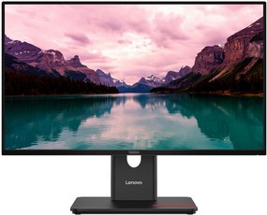
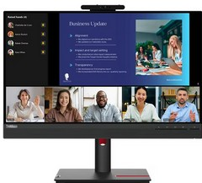
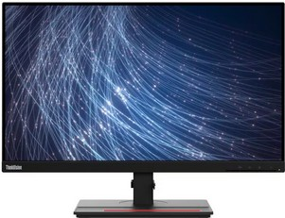
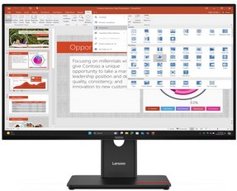
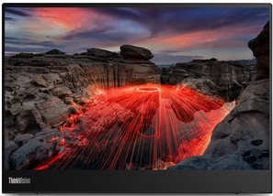
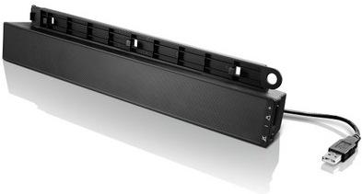
Monitors
Retail File July 2025
Special Offers are valid until 29.08 or until stock lasts.
THINKVISION S24i-30
THINKVISION S27i-30
THINKVISION E24-30
THINKVISION E27q-20
THINKVISION T24-40
63DEKAT3UK LENOVO MONITOR 23.8'', E, THINKVISION S24i-30 BUSINESS, IPS, WLED, FHD 1920x1080, ANTIGLARE, 4MS, 100Hz, 250CD/M², VESA, TILT, HDMI 1.4, VGA, 3YW, RAVEN BLACK € 118 - SPECIAL OFFER
63DFKAT4UK LENOVO MONITOR 27', E, THINKVISION S27i-30 BUSINESS, IPS, WLED, FHD 1920x1080, ANTIGLARE, 4MS, 100Hz, 300CD/M², VESA, TILT, 2x HDMI 1.4, VGA, 3YW, STORM GREY € 147 - SPECIAL OFFER
63EDMAT2UK LENOVO MONITOR 23.8'' THINKVISION E24-30 BUSINESS WITH SPEAKERS, C, IPS, WLED, FHD 1920x1080, ANTIGLARE, 16:9, 4MS, 100Hz, 250CD/M², EYESAFE, HEIGHT ADJUSTABLE, PIVOT, SWIVEL, TILT, 1x HDMI 1.4, 1x DP 1.2, 1x VGA, VESA, 3YW, BLACK € 147 - SPECIAL OFFER
62D0GAT1UK LENOVO MONITOR 27'', F , THINKVISION E27q-20 BUSINESS WITH SPEAKERS, IPS, 2560x1440, ANTIGLARE, 4MS, 75Hz, 300 CD/M2, TILT, SWIVEL, PIVOT, HEIGHT ADJUSTABLE, HDMI, DP, 3YW, RAVEN BLACK € 296 - SPECIAL OFFER
64A4MATXUK LENOVO MONITOR 23.8'', C, THINKVISION T24-40 BUSINESS, IPS, WLED, 1920x1080, 6MS, 120Hz, 250CD/M², ANTIGLARE, HEIGHT ADJUSTABLE, PIVOT, SWIVEL, TILT, HDMI, DP, VGA, USB-A, USB-C, USB-B, 3YW, RAVEN BLACK € 179 - SPECIAL OFFER
THINKVISION T24v-30
THINKVISION T24m-29
THINKVISION T27-40
THINKVISION M14t G2
USB SOUNDBAR
63D8MAT3UK LENOVO MONITOR 23.8'' THINKVISION T24v-30 BUSINESS WITH SPEAKERS AND CAM, IPS, WLED, FHD 1920x1080, AG, 16:9, 4MS, 75Hz, 250CD/M², HEIGHT ADJUST, PIVOT, SWIVEL, TILT, 3xUSB3.2, USB2.0, USB-B3.2, HDMI1.4, DP1.2, VGA, 3YW, BLACK € 279 - SPECIAL OFFER
63A5GAT6UK LENOVO MONITOR 23.8'', D , THINKVISION T24m-29 BUSINESS WITH SPEAKERS, IPS, ANTIGLARE, FHD 1920x1080, 4MS, 60Hz, 250CD/M², HEIGHT ADJUSTABLE, PIVOT, SWIVEL, TILT, HDMI, DP, USB-C 3.2 GEN 1, RJ45, 3YW, RAVEN BLACK € 249 - SPECIAL OFFER
64A5MAT6UK LENOVO MONITOR 27'' THINKVISION T27-40 BUSINESS, IPS, WLED, FHD 1920x1080, AG, 16:9, 4MS, 120Hz, 300CD/M², HEIGHT ADJUST, PIVOT, SWIVEL, TILT, 3xUSB-A, USB-C, USB-B, HDMI 1.4, DP 1.2, VGA, 3YW, ECLIPSE BLACK € 237 - SPECIAL OFFER
63FDUAT6WL LENOVO MONITOR 14'', C, THINKVISION M14t G2, PORTABLE BUSINESS, WLED, IPS, 2240x1400, 6MS, 60Hz, 300 CD/M², TILT, PIVOT, HEIGHT ADJUST STAND, VESA, 2x USB-C, 3YW, RAVEN BLACK € 326 - SPECIAL OFFER
0A36190 LENOVO USB SOUNDBAR FOR THINKVISION MONITORS € 58
Call now on:
Mail on:
Prices, promotions, specifications, availability and terms of offers may change without notice. Despite our best efforts, a small number of items may contain pricing, typography, or photography errors. Correct prices and promotions are validated at the time your order is placed. Delivery and installation charges are not included. Products' warranty is the warranty given by the manufacturer. VAT is included

