Slide 1

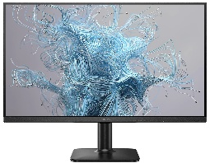
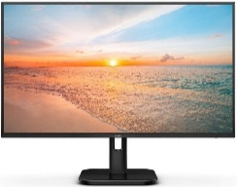
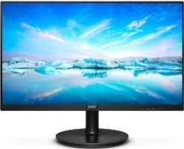
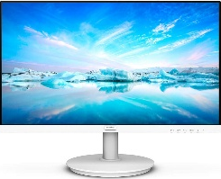
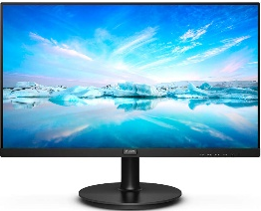

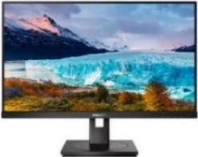
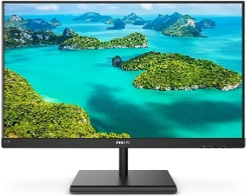
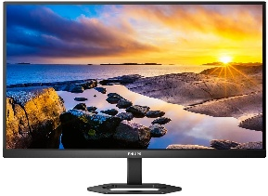
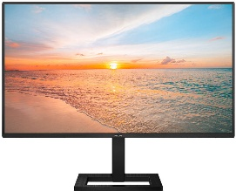
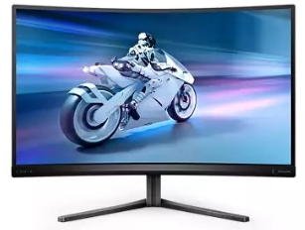
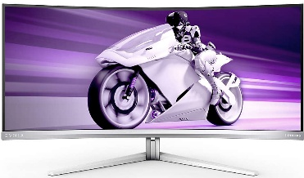
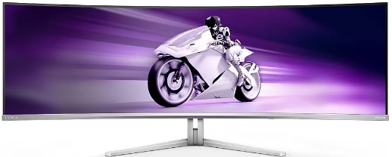
PHILIPS Monitors Home Business Gaming Offers
Check our b2b site, for a full range of more products
Retail File
July 2025
BUS
INESS
24E2N1100LB/00 PHILIPS MONITOR 23.8'', BUSINESS, E, VA, FHD 1920 X 1080, 100Hz, 1MS, 250CD/M2, TILT, VGA, HDMI IN, 3YW, BLACK €97
24E1N1100A/00 PHILIPS MONITOR 23.8'', BUSINESS, E, IPS, FHD 1920 X 1080, 100Hz, 1MS, SPEAKERS, 250CD/M2, TILT, VGA, HDMI IN, 3YW, BLACK €103
243V7QJABF/00 PHILIPS MONITOR 23.8'', BUSINESS, E, IPS, FHD 1920 X 1080, 75Hz, 4MS, SPEAKERS, 250CD/M2, TILT, VGA, HDMI IN, DISPLAY PORT, PC AUDIO IN, HEADPHONE OUT, 3YW, BLACK €109
241V8AW/00 PHILIPS MONITOR 23.8'', BUSINESS, E, IPS, FHD 1920 X 1080, 75Hz, 4MS, SPEAKERS, 250CD/M2, TILT, VGA, HDMI, 3YW, WHITE €113
27E1N1100A/00 PHILIPS MONITOR 27'',BUSINESS, E, IPS, FHD 1920 X 1080, 100Hz, 1MS, SPEAKERS, 250CD/M2, VESA, TILT, HDMI X 1, VGA 3YW, BLACK €127
273V7QJAB/00 PHILIPS MONITOR 27'', BUSINESS, E, IPS, FHD, 1920 X 1080, 75Hz, 4MS, SPEAKERS, 250CD/M2, TILT, VESA, VGA, HDMI IN, DISPLAY PORT 1.2 , PC AUDIO IN, HEADPHONE OUT, 3YW, BLACK €131
271V8AW/00 PHILIPS MONITOR 27'', BUSINESS, CLASS E, IPS, FHD, 1920 X 1080, 75Hz, 4MS, SPEAKERS, 250CD/M2, TILT, VGA, HDMI IN, 3YW, WHITE €137
242S1AE/00 PHILIPS MONITOR 23.8'', BUSINESS, E, IPS, FHD 1920 X 1080, 75Hz, 4MS, SPEAKERS, 300CD/M2, TILT, PIVOT, SWIVEL, HEIGHT ADJUSTABLE, VGA, HDMI IN, DISPLAY PORT, DVI, HEADPHONE OUT, 3YW, BLACK €148
24E1N1300AE/00 PHILIPS MONITOR 23.8'',BUSINESS, E, IPS, FHD 1920 X 1080, 100Hz, 1MS, SPEAKERS, 250CD/M2, VESA, TILT, HEIGHT ADJUSTABLE, HDMI X 1, USB-C, 3YW, BLACK €148
275E1S/00 PHILIPS MONITOR 27'', BUSINESS, CLASS E, IPS, FHD, 2560 x 1440, 75Hz, 4MS, SPEAKERS, 300CD/M2, TILT, VGA, HDMI IN, DVI-D, DP, HEADPHONE OUT,3YW, BLACK €177
27E1N5500LA/00 PHILIPS MONITOR 27'',BUSINESS, E, VA, QHD 2560X1440, 75Hz, 4MS, SPEAKERS, 300CD/M2, VESA, TILT, HEIGHT ADJUSTABLE, PIVOT, HDMI X 2, DP, 3YW, BLACK €183
272S1AE/00 PHILIPS MONITOR 27'', BUSINESS, CLASS E, IPS, FHD, 1920 X 1080, 75Hz, 4MS, SPEAKERS, 300CD/M2, TILT, PIVOT, SWIVEL, HEIGHT ADJUSTABLE, VGA, HDMI IN, DVI-D, DP, HEADPHONE OUT,3YW, BLACK €189
27E1N1600AE/00 PHILIPS MONITOR 27'',BUSINESS, E, IPS, QHD 2560 X 1440, 100Hz, 1MS, SPEAKERS, 350CD/M2, VESA, TILT, HEIGHT ADJUSTABLE, HDMI X 1, USB-C X 1 3YW, BLACK €252
GAMING
27M2C5200W/00 PHILIPS MONITOR 27'', CURVED, GAMING, EVNIA, Ε, VA, FHD 1920 X 1080, 280Hz, 1MS, 300CD/M2, TILT, SWIVEL, HEIGHT ADJUSTABLE, HDMI X2, DISPLAY PORT X1, 3YW, DARK SLATE €199
34M2C8600/00 PHILIPS MONITOR 34'', EVNIA, GAMING, CURVED, CUR QD OLED, G, 3440x1440, 175 Hz, 0.03 MS, 32:9, G-SYNC, AMD FREESYNC™ TECHNOLOGY-PREMIUM PRO, SPEAKERS, HEIGHT ADJUSTABLE, SWIVEL, TILT, HDMI X 2, DP X 1, USB-C, USB HUB, WHITE, 3YW €899
49M2C8900L/00 PHILIPS MONITOR 49'', EVNIA, GAMING, CURVED, CUR QD OLED, G, 5120X1440, 144 Hz, 0.03 MS, 32:9, G-SYNC, AMD FREESYNC™ TECHNOLOGY-PREMIUM PRO, SPEAKERS, HEIGHT ADJUSTABLE, SWIVEL, TILT, HDMI X 2, DP X 1, USB-C, USB HUB, WHITE, 3YW €999
49M2C8900/00 PHILIPS MONITOR 49'', EVNIA, GAMING, CURVED, CUR QD OLED, G, 5120X1440, 240 Hz, 0.03 MS, 32:9, G-SYNC, AMD FREESYNC™ TECHNOLOGY-PREMIUM PRO, SPEAKERS, HEIGHT ADJUSTABLE, SWIVEL, TILT, HDMI X 2, DP X 1, USB-C, USB HUB, WHITE, 3YW €1289
Prices, promotions, specifications, availability and terms of offers may change without notice. Despite our best efforts, a small number of items may contain pricing, typography, or photography errors. Correct prices and promotions are validated at the time your order is placed. Recycling fees are not included in the Dealer & Retail File. Delivery and installation charges are not included. Products' warranty is the warranty given by the manufacturer. VAT is included
Call now on:
Mail on:

