Slide 1

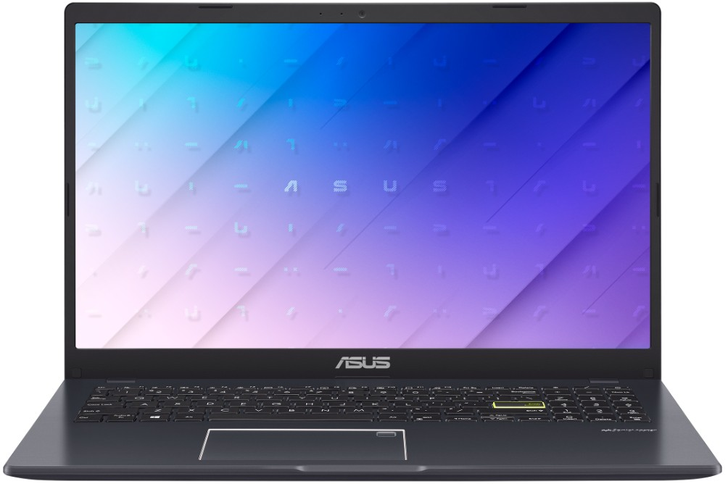
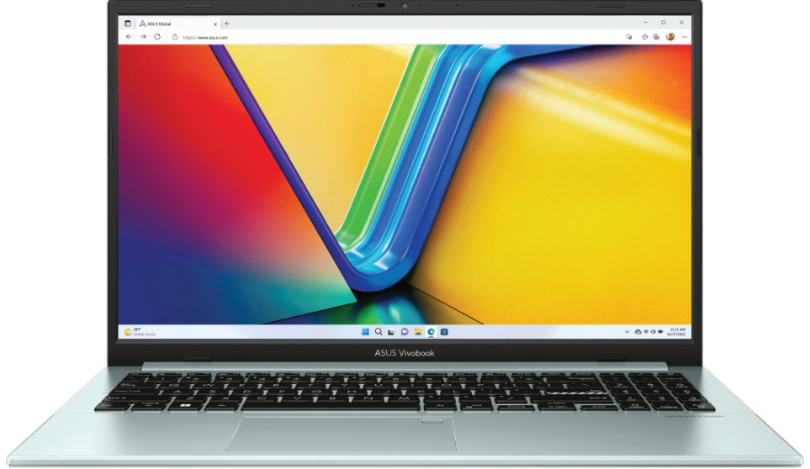
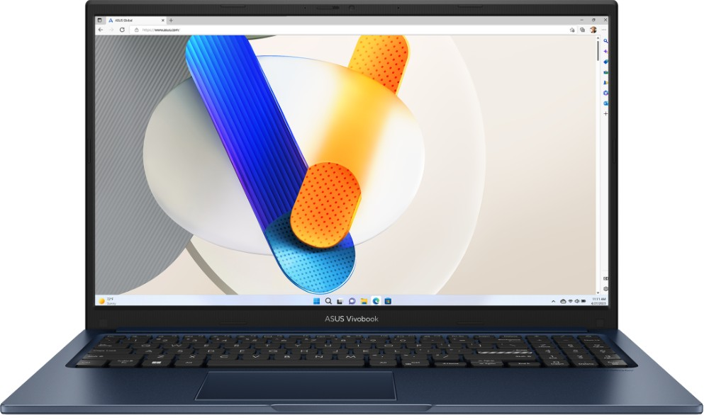
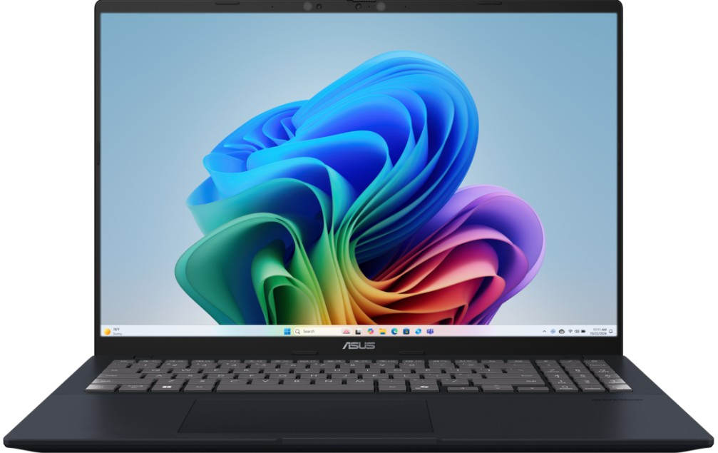
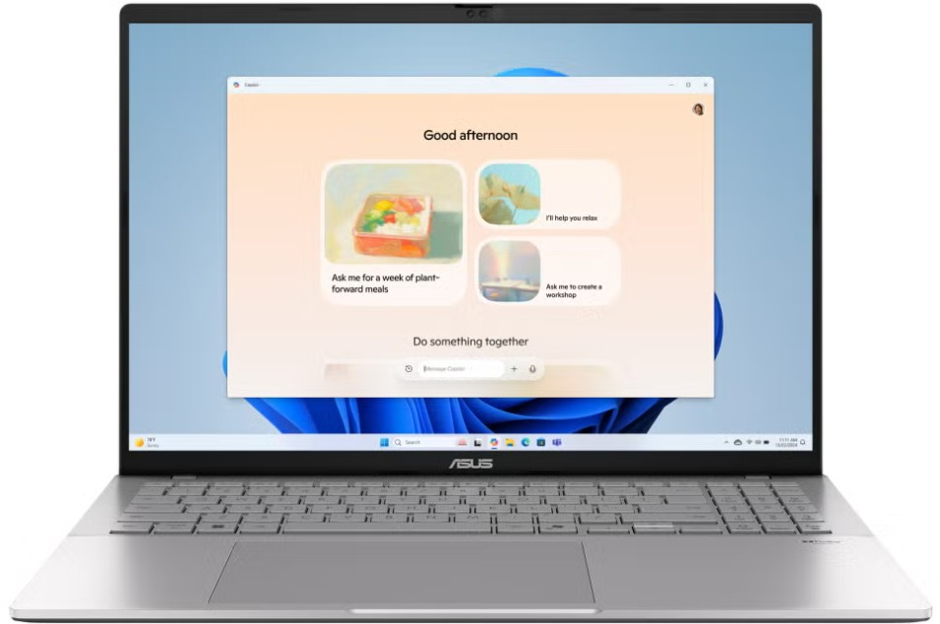
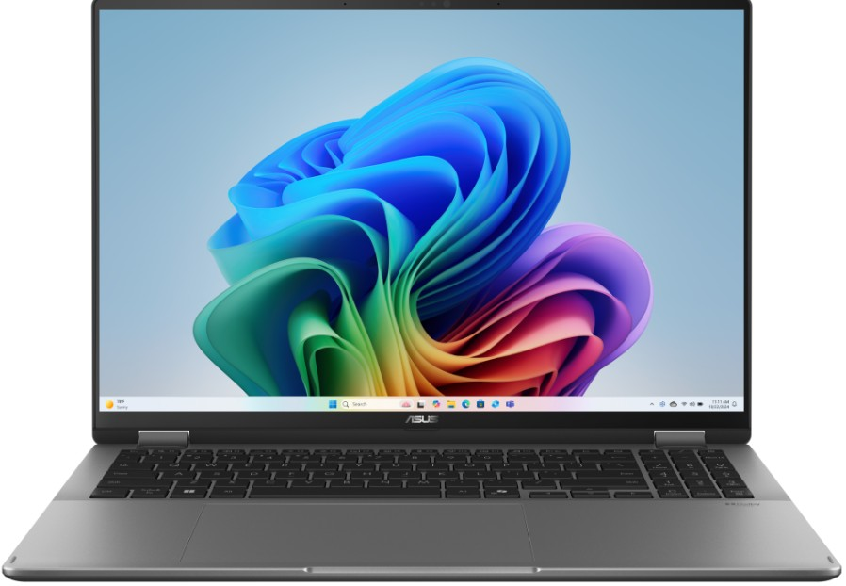

VIVOBOOK CONSUMER NOTEBOOKS
Retail File August 2025
Special Offers are valid until 17.08 or until stock lasts.
90NB0UJ5-M01NX0 ASUS NOTEBOOK VIVOBOOK GO 15, E510KA-BR136WS, INTEL CELERON N4500,1.1-2.8GHz/4MB, 2C, 4GB, 128GB eMMC, INTEL HD GRAPHICS, 15.6'' HD 1366x768 LED 200NITS ANTIGLARE, WIFI5, BT, USB-A, USB-C, HDMI, WIN 11 HOME S MODE, 2YW, STAR BLACK 344 €
90NB0ZR3-M033H0 ASUS NOTEBOOK VIVOBOOK GO 15, E1504FA-NJ936W, AMD RYZEN 3 7320U, 2.4-4.1GHz/6MB, 4 CORES, 8GB, 512GB SSD M.2 NVMe PCIe3, AMD RADEON GRAPHICS, 15.6'' FHD 1920x1080, WIFI6, BT, USB-A, USB-C, HDMI, WIN 11 HOME, 2YW, GREEN GREY 538 €
90NB0ZR3-M033E0 ASUS NOTEBOOK VIVOBOOK GO 15, E1504FA-NJ301W, RYZEN 5 7520U, 2.8-4.3GHz/6MB, 4 CORES, 8GB, 512GB SSD M.2 NVMe PCIe3, AMD RADEON GRAPHICS, 15.6'' FHD 1920x1080, WIFI6, BT, USB-A, USB-C, HDMI, WIN 11 HOME, 2YW, GREEN GREY 574 €
90NB0ZR3-M033F0 ASUS NOTEBOOK VIVOBOOK GO 15, E1504FA-NJ302W, RYZEN 5 7520U, 2.8-4.3GHz/6MB, 4 CORES, 16GB, 512GB SSD M.2 NVMe PCIe3, AMD RADEON GRAPHICS, 15.6'' FHD 1920x1080, WIFI6, BT, USB-A, USB-C, HDMI, WIN 11 HOME, 2YW, GREEN GREY 631 €
90NB10J1-M03670 ASUS NOTEBOOK VIVOBOOK 15, X1504VA-BQ322, INTEL i3-1315U, 1.2-4.50GHz/10MB, 6 CORES, 8GB, 512GB SSD M.2 NVMe PCIe3, INTEL UHD GRAPHICS, 15.6'' FHD 1920x1080 250 NITS, WIFI6, BT, USB-A, USB-C, HDMI, DOS, 2YW, QUIET BLUE 482 €
90NB10J1-M03660 ASUS NOTEBOOK VIVOBOOK 15, X1504VA-BQ1747, INTEL i5-1334U, 3.4-4.6GHz/12MB, 10 CORES, 16GB, 512GB SSD M.2 NVMe PCIe3, INTEL IRIS XE GRAPHICS, 15.6'' FHD 1920x1080 250NITS, WIFI6, BT, USB-A, USB-C, HDMI, DOS, 2YW, QUIET BLUE 598 €
90NB15Z1-M008N0 ASUS NOTEBOOK VIVOBOOK 16, X1607QA-MB084W, SNAPDRAGON X X1-26-100, 2.97GHz/30MB, 8C, 45 TOPS, 16GB, 512GB SSD M.2 NVMe PCIe4, QUALCOMM ADRENO, 16'' WUXGA 1920x1200 IPS 300 NITS, WIFI6E, BT,USB-A,USB-C,HDMI, WIN 11 HOME, 2YW,BLUE 918 €
90NB1671-M004N0 ASUS NOTEBOOK VIVOBOOK S16, S3607VA-RP011W, INTEL i7-13620H, 2.4-4.9GHz/24MB, 10C, 16GB, 1TB SSD M.2 NVMe PCIe4, INTEL UHD, 16'' IPS LED WUXGA 1920x1200 300NITS AG, WIFI6, BT, USB-A, USB-C, HDMI, WIN 11 HOME, 2YW, COOL SILVER 1148 €
90NB1511-M004M0 ASUS NOTEBOOK VIVOBOOK 16 FLIP, TP3607SA-OLED-RJ027W,INTEL ULTRA 7 258V,2.2-4.8GHz/12MB,8C,47TOPS, 32GB, 1TB SSD M.2 NVMe PCIe4, INTEL ARC, 16'' 3K 2880x1800 OLED 500NITS TOUCH, WIFI7,BT,USB-A,USB4,USB-C,HDMI, WIN 11 HOME,2YW,GREY 1837 €
Prices, promotions, specifications, availability and terms of offers may change without notice. Despite our best efforts, a small number of items may contain pricing, typography, or photography errors. Correct prices and promotions are validated at the time your order is placed. Recycling fees are not included in the Dealer & Retail File. Delivery and installation charges are not included. Products' warranty is the warranty given by the manufacturer. VAT is not included
Multitech b2b Place your order on: https://b2b.multitech.com.cy/en Click on any item part number for more specs and place your order online.
In case you don’t have an account yet please register in the below link https://b2b.multitech.com.cy/en/user/register
Prices, promotions, specifications, availability and terms of offers may change without notice. Despite our best efforts, a small number of items may contain pricing, typography, or photography errors. Correct prices and promotions are validated at the time your order is placed. Delivery and installation charges are not included. Products' warranty is the warranty given by the manufacturer. VAT is included
Call now on:
Mail on:
Call now on: 22-711300
Mail on:
orders@multitech.com.cy
A.T Multitech Corporation Ltd
ASUS Authorized Distributor
www.multitech.com.cy

Slide 2
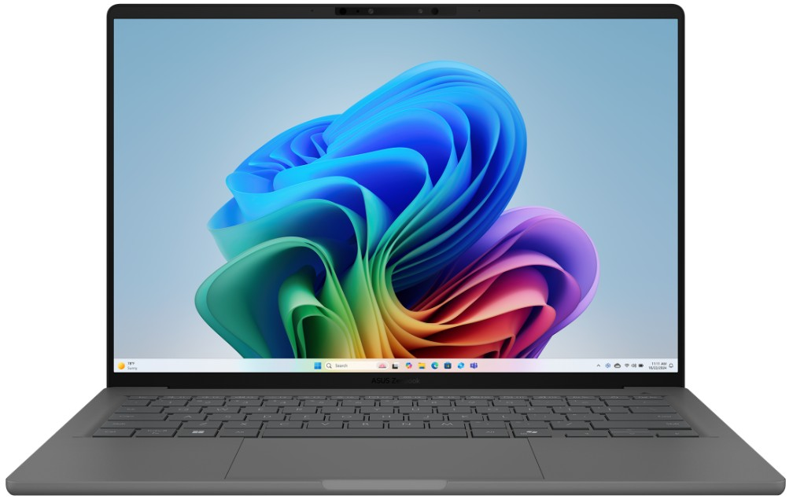
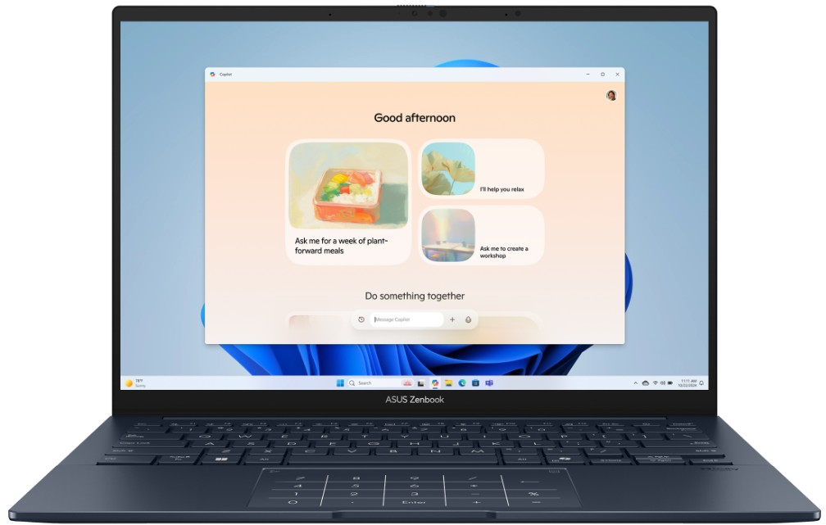
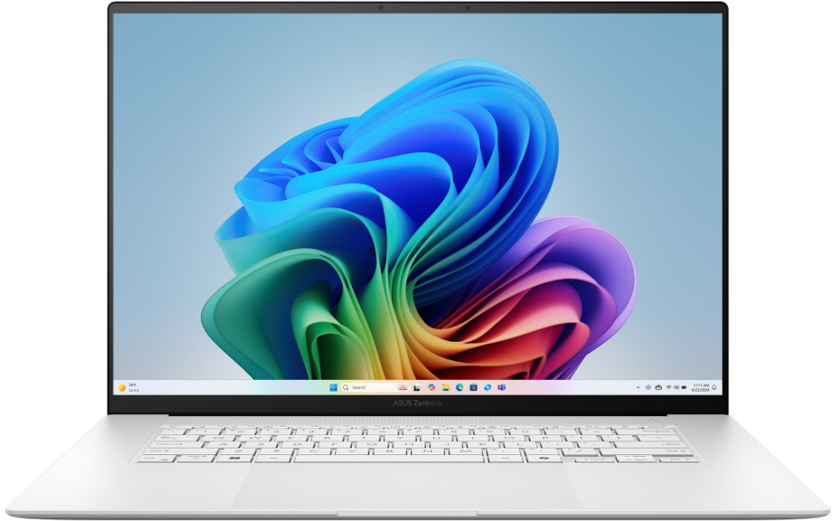
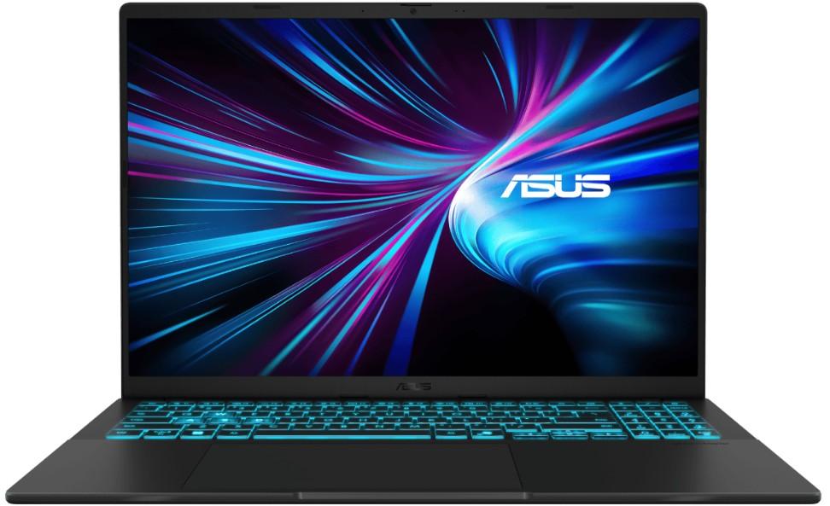
ZENBOOK & V16 CONSUMER NOTEBOOKS
Retail File August 2025
Special Offers are valid until 17.08 or until stock lasts.
90NB16G2-M005V0 ASUS NOTEBOOK ZENBOOK A14, UX3407RA-OLED-QD010W, SNAPDRAGON X1E-78-100/42MB, 3.4GHz, 12C, 45TOPS, 32GB, 1TB SSD M.2 NVMe PCIe4, QC ADRENO, 14'' WUXGA 1920x1200 OLED 600NITS, WIFI7, BT, USB-A, USB4, HDMI, WIN 11 HOME, 2YW, GREY 1837 €
90NB14W3-M00S30 ASUS NOTEBOOK ZENBOOK 14, UX3405CA-OLED-PZ532X, INTEL ULTRA 9 285H 2.9-5.4GHz/24MB, 16C, 13 TOPS, 32GB, 1TB SSD M.2 NVMe PCIe4, INTEL ARC, 14'' OLED 3K 2880x1800 500NITS TOUCH, WIFI7, BT, USB-A, USB4, HDMI, WIN 11 PRO, 2YW, BLUE 1952 €
90NB13M4-M00P20 ASUS NOTEBOOK ZENBOOK S16, UM5606WA-OLED-RJ225X, AMD RYZEN AI 9 HX 370,2-5.1GHz/36MB,12C, 50TOPS, 32GB, 2TB M.2 NVMe PCIe4, AMD RADEON 890M, 16'' 3K 2880x1800 OLED TOUCH 500NITS, WIFI7,BT, USB-A, USB4, HDMI, WIN 11 PRO, 2YW, WHITE 2411 €
90NB16K1-M003B0 ASUS NOTEBOOK V16, V3607VM-RP030WS, INTEL CORE 7 240H, 2.5-5.2GHz/24MB, 10C, 32GB, 1TB SSD M.2 NVMe PCIe4, GeForce RTX 5060 GPU 8GB GDDR7,16'' WUXGA 1920x1200 300NITS AG,WIFI6,BT,USB-A, USB-C, HDMI, WIN 11 HOME, 2YW, MATTE BLACK 2182 €
Prices, promotions, specifications, availability and terms of offers may change without notice. Despite our best efforts, a small number of items may contain pricing, typography, or photography errors. Correct prices and promotions are validated at the time your order is placed. Recycling fees are not included in the Dealer & Retail File. Delivery and installation charges are not included. Products' warranty is the warranty given by the manufacturer. VAT is not included
Multitech b2b Place your order on: https://b2b.multitech.com.cy/en Click on any item part number for more specs and place your order online.
In case you don’t have an account yet please register in the below link https://b2b.multitech.com.cy/en/user/register
Prices, promotions, specifications, availability and terms of offers may change without notice. Despite our best efforts, a small number of items may contain pricing, typography, or photography errors. Correct prices and promotions are validated at the time your order is placed. Delivery and installation charges are not included. Products' warranty is the warranty given by the manufacturer. VAT is included
Call now on:
Mail on:
Call now on: 22-711300
Mail on:
orders@multitech.com.cy
A.T Multitech Corporation Ltd
ASUS Authorized Distributor
www.multitech.com.cy

