Slide 1



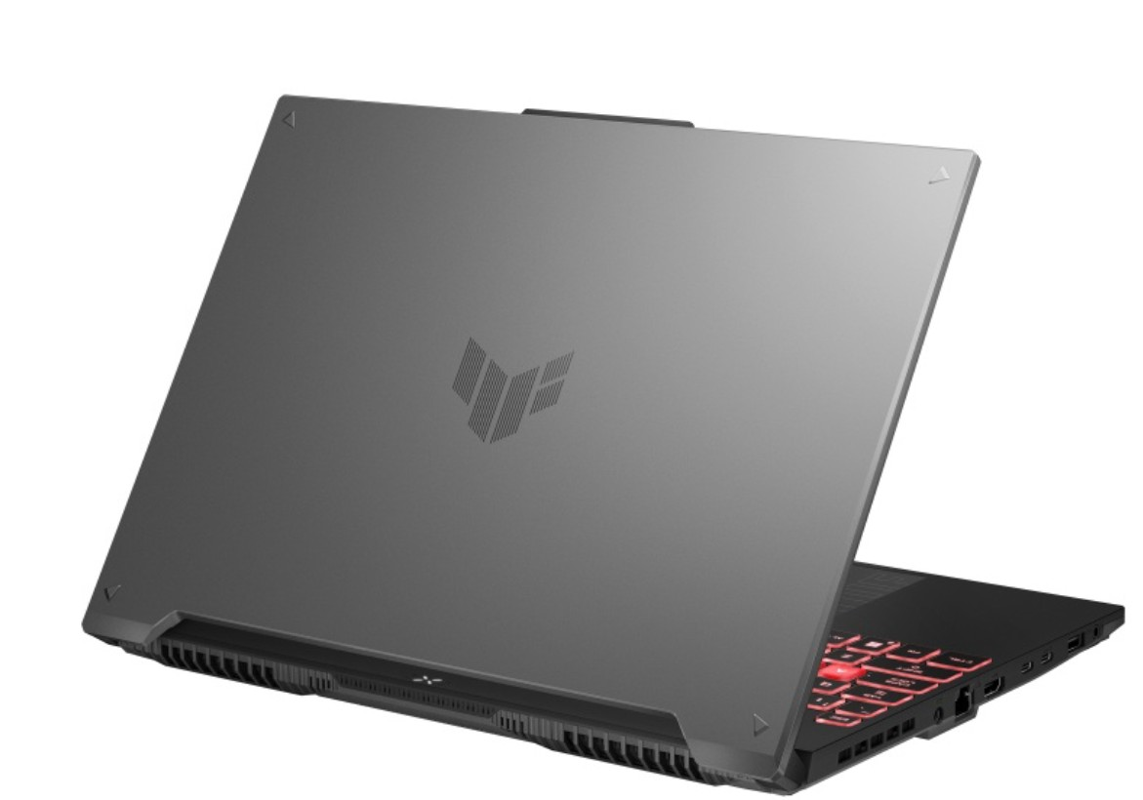
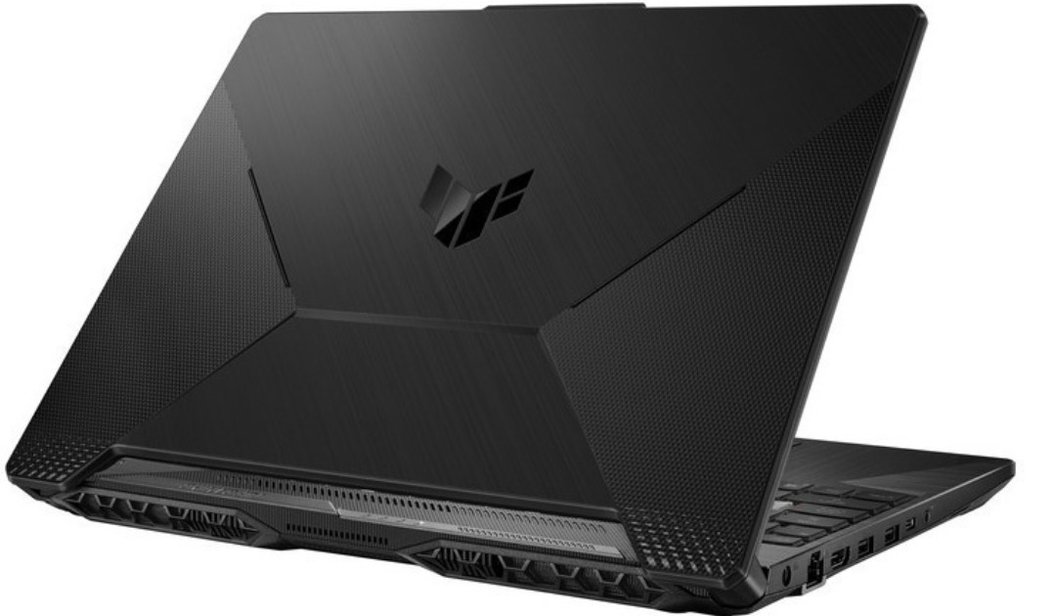

New Arrivals TUF GAMING NOTEBOOKS
Retail File August 2025
Special Offers are valid until 17.08 or until stock lasts.
90NR0JF7-M00EK0 ASUS NOTEBOOK TUF A15 GAMING, FA506NC-HN003W, AMD RYZEN 5 7535HS 3.3-4.55GHz/19MB,6C, 16GB,512GB SSD M.2 NVMe PCIe4,NVIDIA RTX 3050 4GB, 15.6'' FHD 1920x1080 144Hz 250NITS,RGB KB,WIFI6,BT,LAN,USB-C,USB-A,HDMI,WIN 11 HOME,2YW,BLACK 988€
90NR0MU3-M006Y0 ASUS NOTEBOOK TUF A16 GAMING, FA607NU-RL051W, AMD RYZEN 5 7535HS 3.3-4.55GHz/19MB, 6C, 16GB, 512GB M.2 NVMe PCIe3, NVIDIA RTX 4050 6GB, 16'' WUXGA FHD+ 144Hz 300NITS,RGB KB,WIFI6,BT,LAN,USB-A,USB-C,USB4,HDMI,WIN 11 HOME, 2YW, GREY 1069€
Prices, promotions, specifications, availability and terms of offers may change without notice. Despite our best efforts, a small number of items may contain pricing, typography, or photography errors. Correct prices and promotions are validated at the time your order is placed. Recycling fees are not included in the Dealer & Retail File. Delivery and installation charges are not included. Products' warranty is the warranty given by the manufacturer. VAT is not included
Multitech b2b Place your order on: https://b2b.multitech.com.cy/en Click on any item part number for more specs and place your order online.
In case you don’t have an account yet please register in the below link https://b2b.multitech.com.cy/en/user/register
Prices, promotions, specifications, availability and terms of offers may change without notice. Despite our best efforts, a small number of items may contain pricing, typography, or photography errors. Correct prices and promotions are validated at the time your order is placed. Delivery and installation charges are not included. Products' warranty is the warranty given by the manufacturer. VAT is included
Call now on:
Mail on:
Call now on: 22-711300
Mail on:
orders@multitech.com.cy
A.T Multitech Corporation Ltd
ASUS Authorized Distributor
www.multitech.com.cy

