Slide 1



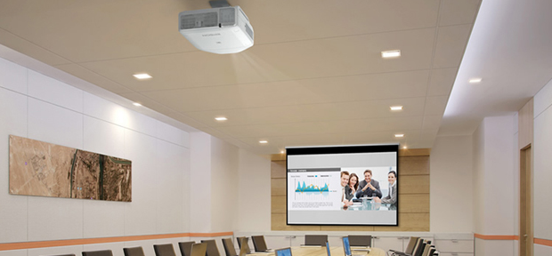

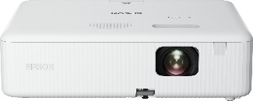
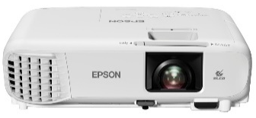
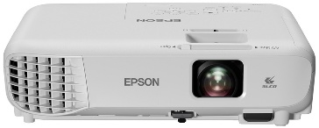
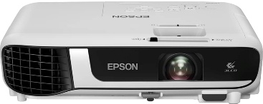
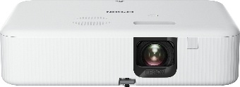
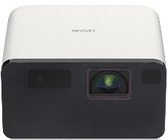
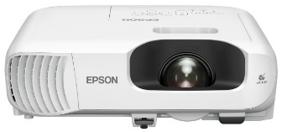
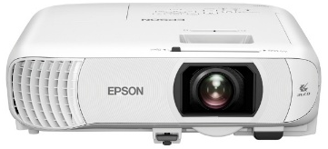
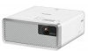
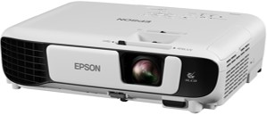
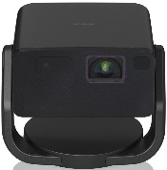
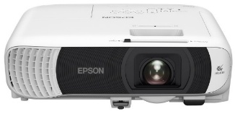
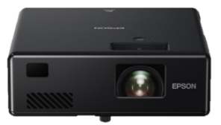
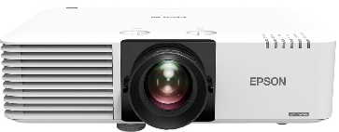
Retail File September, 2025
V11HA86040 EPSON PROJECTOR CO-W01, 3LCD HOME CINEMA, WXGA 1280x800, 16:10, 3000 LUMENS, SPEAKERS 5W, A/V MUTE, MHL AUDIO/VIDEO INTERFACE, QUICK CORNER, USB 2.0 TYPE A, USB 2.0 TYPE B (SERVICE ONLY), HDMI 1.4, 2YW, WHITE €455
V11HB51040 EPSON PROJECTOR EB-E24, 3LCD BUSINESS, XGA 1024X768, 4:3, 3600 LUMENS, SPEAKERS, USB 2.0 TYPE B (SERVICE ONLY), RS-232C, VGA IN (2X), VGA OUT, HDMI IN, COMPOSITE IN, JACK PLUG OUT, JACK PLUG IN (2X), CINCH AUDIO IN, 3YW, WHITE €446
V11HA84040 EPSON PROJECTOR CO-FH01, 3LCD HOME CINEMA, FHD 1920x1080, 16:9, 3000 LUMENS, SPEAKERS 5W, A/V MUTE, MHL AUDIO/VIDEO INTERFACE, QUICK CORNER, USB 2.0 TYPE A, USB 2.0 TYPE B, HDMI 1.4, 2YW, WHITE €519
V11H973040 EPSON PROJECTOR EB-W06 3LCD HOME CINEMA, WXGA 1280x800, 16:10, 16.000:1 CONTRAST, 3700 LUMENS, USB, HDMI, COMPOSITE, VGA, CINCH AUDIO IN, Wi-Fi (OPTIONAL), 2YW, WHITE €558
V11H977040 EPSON PROJECTOR EB-W51 3LCD HOME CINEMA, WXGA 1280x800, 16:10, 16.000:1 CONTRAST, 4000 LUMENS, HDMI, COMPOSITE, VGA, CINCH AUDIO IN, Wi-Fi (OPTIONAL), 2YW, WHITE €612
V11HA85040 EPSON PROJECTOR CO-FH02, 3LCD HOME CINEMA, FHD 1920x1080, 16:10, 3000 LUMENS, SPEAKERS 5W, A/V MUTE, MHL AUDIO/VIDEO INTERFACE, QUICK CORNER, ANDROID TV, USB 2.0 TYPE A, USB 2.0 TYPE B, HDMI 1.4, 2YW, WHITE €718
V11HB35040 EPSON PROJECTOR LASER EF-21W, 3LCD HOME CINEMA, 1920X1080, 16:9, 5.000.000:1 CONTRAST, 200Hz-240Hz, 1000 LUMENS, USB 2.0 TYPE A, USB 2.0 TYPE B, HDMI 1.4, MIRACAST, STEREO MINI JACK AUDIO OUT, BLACK, 5 YEARS €809
V11HB62040 EPSON PROJECTOR EB-W56S, 3LCD BUSINESS, WXGA 1280x800, 16:10, 16.000:1 CONTRAST, 3700 LUMEN, SHORT THROW, HDMI X 2, COMPONENT, COMPOSITE, VGA X 2, S-VIDEO, STEREO MINI JACK, LAN, Wi-Fi (OPTIONAL), WHITE, 2YW €818
V11HB63040 EPSON PROJECTOR EH-TW840, 3LCD BUSINESS, FHD 1920x1080, 16:9, 16.000:1 CONTRAST, 4000 LUMENS,USB 2.0 TYPE B (SERVICE ONLY), HDMI IN (2X), JACK PLUG OUT, USB 2.0-A, WIRELESS LAN(OPTIONAL), MIRACAST, WHITE, 2YW €899
V11H914040 EPSON PROJECTOR LASER EF-100W 3LCD HOME CINEMA, HD READY, RGB, 16:10, 2.500.000:1 CONTRAST, LIGHT SOURCE: LASER, USB, HDMI, STEREO MINI JACK, BLUETOOTH, 5YW, WHITE €966
V11HB38140 EPSON PROJECTOR LASER EF-22B, 3LCD HOME CINEMA, 1920X1080, 16:9, FIXED STAND, 5.000.000:1 CONTRAST, 200Hz-240Hz, 1000 LUMENS, USB 2.0 TYPE A, USB 2.0 TYPE B, HDMI 1.4, MIRACAST, STEREO MINI JACK AUDIO OUT, BLACK, 5 YEARS €999
V11HB59240 EPSON PROJECTOR EB-FH18, 3LCD BUSINESS, FHD 1920x1080, 16:9, 16.000:1 CONTRAST, 4100 LUMENS,USB 2.0-A, USB 2.0 TYPE B (SERVICE ONLY), WIRELESS LAN IEEE 802.11A/B/G/N/AC, HDMI IN (2X), MIRACAST, JACK PLUG OUT, WHITE, 2YW €1019
V11H978040 EPSON PROJECTOR 3LCD EB-FH52, BUSINESS, FHD 1920x1080, 16:10, 16.000:1 CONTRAST, 4000 LUMENS, 2 x HDMI, MHL, COMPOSITE, VGA, CINCH AUDIO IN, MIRACAST, Wi-Fi, WHITE, 2YW €990
V11HA23040 EPSON PROJECTOR LASER EF-11, 3LCD HOME CINEMA, 1920X1080, 16:9, 2.500.000:1 CONTRAST, 1000 LUMENS,USB 2.0 TYPE A, USB 2.0 TYPE B, HDMI 1.4, MIRACAST, STEREO MINI JACK AUDIO OUT, BLACK, 5 YEARS €1338
V11HA27040 EPSON PROJECTOR EB-L530U, 5200 LUMENS, WUXGA, 16:10, LASER, 2.500.000:1, USB, RS-232C, LAN, WI-FI, VGA X 2, HDMI, MIRACAST, WHITE/BLACK, 3 YR €2438
Prices, promotions, specifications, availability and terms of offers may change without notice. Despite our best efforts, a small number of items may contain pricing, typography, or photography errors. Correct prices and promotions are validated at the time your order is placed. Recycling fees are not included in the Dealer & Retail File. Delivery and installation charges are not included. Products' warranty is the warranty given by the manufacturer. VAT is included
Call now on:
Mail on:

