Slide 1


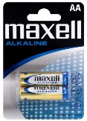
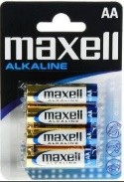
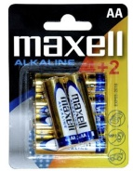
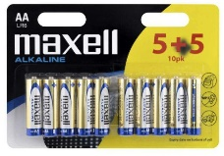
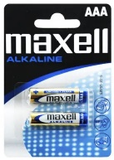
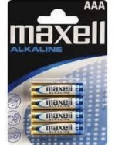
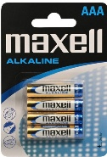
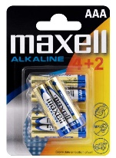
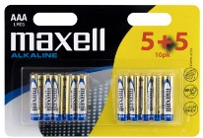
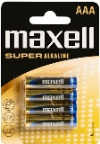
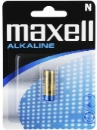
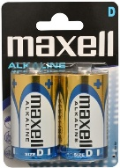
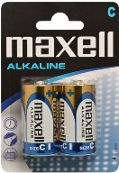
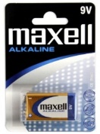
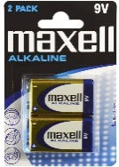
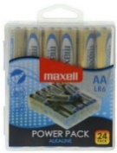
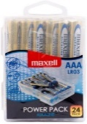
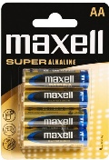
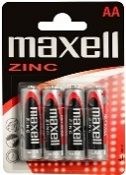
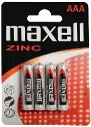


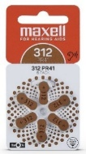





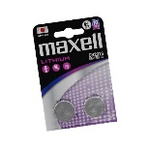
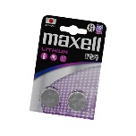
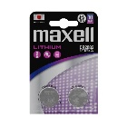
Maxell Batteries New Products Announcement
Retail File September 2025
Alkaline for all your everyday devices
AA LR6 2PK BLIST
AA LR6 4PK BLISTER
AA LR6 4+2PK BLIST
AA LR6 10PK (5+5)
AAA LR03 2PK BLIST
AAA LR03 4PK BLISTER
AAA LR03 4PK BLISTER
AAA LR03 SUPER 4PK BLISTER
AAA LR03 4+2PK BLIST
AAA LR03 10PK (5+5)
790321.04.CN
RRP 0,78 €
723758.04.CN
RRP 1,24 €
790230.04.CN
RRP 2,07 €
790253.00.CN
RRP 3,16 €
723920.04.CN
RRP 0,80 €
723671.04.CN
RRP 1,24 €
723671.05.CN
RRP 1,45 €
790336.04.CN
RRP 1,99 €
790240.04.CN
RRP 2,07 €
790254.00.CN
RRP 3,16 €
Super Alkaline for mid- to high-drain devices.
LR1 1PK BLISTER
D LR20, ALKALINE, 2PK BLISTER
LR-14 2PK BLISTER
9V 6LR61, ALKALINE, 1PK BLISTER
9V 6LR61, ALKALINE, 2PK BLISTER
AA LR06, 24PCS POWER PACK
AAA LR03, 24PCS POWER PACK
AA LR-6 SUPER 4PK BLIST
774409.04.CN
RRP 1,99 €
723031.04.CN
RRP 1,36 €
774410.04.CN
RRP 2,98 €
774417.04.CN
RRP 2,21 €
723761.04.CN
RRP 1,31 €
723924.00.CN
RRP 2,48 €
790269.04.CN
RRP 6,72 €
790268.04.CN
RRP 6,72 €
Zing for powering essential household items
Zinc Air for Hearing Aids
Lithium Coin Cell for family’s everyday devices
AA R6
4PK BLIST
AAA R03 4PK BLIST
PR48 (13) 6BS ZINC AIR
PR44 (675) 6BS ZINC AIR
PR41 (312) 6BS ZINC AIR
CR1220 1PC BLIST PK
CR1216 1PC BLIST PK
CR2016 1PC BLIST PK
CR2025 1PC BLIST PK
CR2032 1PC BLIST PK
CR2016 2PC BLIST PK
CR2025 2PC BLIST PK
CR2032 2PC BLIST PK
774405.04.EU
RRP 0,95 €
774407.04.CN
RRP 0,95 €
790419
RRP 1,99 €
790420
RRP 1,99 €
790421
RRP 1,99 €
11238200
RRP 0,49 €
11238800
RRP 0,49 €
11239110
RRP 0,73 €
11239210
RRP 0,73 €
11238510
RRP 0,73 €
12239100
RRP 1,21 €
12239200
RRP 1,21 €
12238500
RRP 1,21 €
Prices, promotions, specifications, availability and terms of offers may change without notice. Despite our best efforts,
a small number of items may contain pricing, typography, or photography errors. Correct prices and promotions are validated at the time your order is placed. Recycling fees are not included in the Dealer & Retail File. Delivery and installation charges are not included. Products' warranty is the warranty given by the manufacturer. VAT is included
Call now on:
Mail on:

