Slide 1

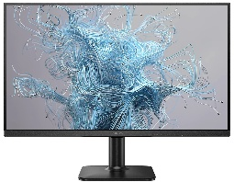
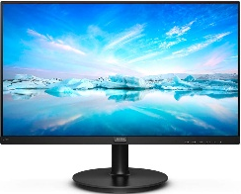
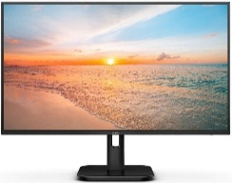
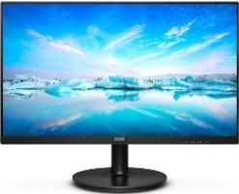
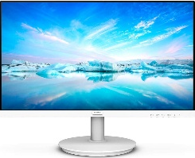

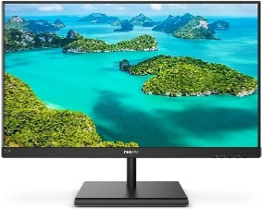
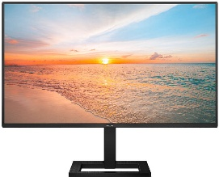
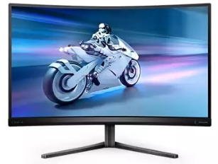
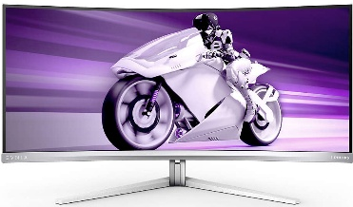
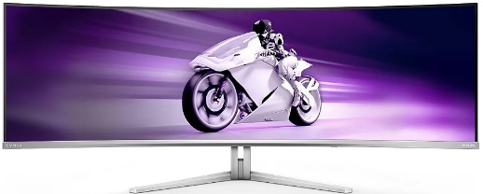
PHILIPS Monitors Home Business Gaming
Back to School Offer
Check our b2b site, for a full range of more products
Retail File
Sept. 2025
BUS
INESS
24E2N1100LB/00 PHILIPS MONITOR 23.8'', BUSINESS, E, VA, FHD 1920 X 1080, 100Hz, 1MS, 250CD/M2, TILT, VGA, HDMI IN, 3YW, BLACK €94
221V8/00 PHILIPS MONITOR 21.5'', HOME, E, VA, FHD 1920 X 1080, 75Hz, 4MS, 250CD/M2, TILT, WALL MOUNT, VGA, HDMI, 3YW, BLACK €98
24E1N1100A/00 PHILIPS MONITOR 23.8'', BUSINESS, E, IPS, FHD 1920 X 1080, 100Hz, 1MS, SPEAKERS, 250CD/M2, TILT, VGA, HDMI IN, 3YW, BLACK €98
243V7QJABF/00 PHILIPS MONITOR 23.8'', BUSINESS, E, IPS, FHD 1920 X 1080, 75Hz, 4MS, SPEAKERS, 250CD/M2, TILT, VGA, HDMI IN, DISPLAY PORT, PC AUDIO IN, HEADPHONE OUT, 3YW, BLACK €107
241V8AW/00 PHILIPS MONITOR 23.8'', BUSINESS, E, IPS, FHD 1920 X 1080, 75Hz, 4MS, SPEAKERS, 250CD/M2, TILT, VGA, HDMI, 3YW, WHITE €107
27E1N1100A/00 PHILIPS MONITOR 27'',BUSINESS, E, IPS, FHD 1920 X 1080, 100Hz, 1MS, SPEAKERS, 250CD/M2, VESA, TILT, HDMI X 1, VGA 3YW, BLACK €122
271V8AW/00 PHILIPS MONITOR 27'', BUSINESS, CLASS E, IPS, FHD, 1920 X 1080, 75Hz, 4MS, SPEAKERS, 250CD/M2, TILT, VGA, HDMI IN, 3YW, WHITE €137
24E1N1300AE/00 PHILIPS MONITOR 23.8'',BUSINESS, E, IPS, FHD 1920 X 1080, 100Hz, 1MS, SPEAKERS, 250CD/M2, VESA, TILT, HEIGHT ADJUSTABLE, HDMI X 1, USB-C, 3YW, BLACK €147
275E1S/00 PHILIPS MONITOR 27'', BUSINESS, CLASS E, IPS, FHD, 2560 x 1440, 75Hz, 4MS, SPEAKERS, 300CD/M2, TILT, VGA, HDMI IN, DVI-D, DP, HEADPHONE OUT,3YW, BLACK €177
27E1N1600AE/00 PHILIPS MONITOR 27'',BUSINESS, E, IPS, QHD 2560 X 1440, 100Hz, 1MS, SPEAKERS, 350CD/M2, VESA, TILT, HEIGHT ADJUSTABLE, HDMI X 1, USB-C X 1 3YW, BLACK €251
GAMING
27M2C5200W/00 PHILIPS MONITOR 27'', CURVED, GAMING, EVNIA, Ε, VA, FHD 1920 X 1080, 280Hz, 1MS, 300CD/M2, TILT, SWIVEL, HEIGHT ADJUSTABLE, HDMI X2, DISPLAY PORT X1, 3YW, DARK SLATE €199
34M2C8600/00 PHILIPS MONITOR 34'', EVNIA, GAMING, CURVED, CUR QD OLED, G, 3440x1440, 175 Hz, 0.03 MS, 32:9, G-SYNC, AMD FREESYNC™ TECHNOLOGY-PREMIUM PRO, SPEAKERS, HEIGHT ADJUSTABLE, SWIVEL, TILT, HDMI X 2, DP X 1, USB-C, USB HUB, WHITE, 3YW €907
49M2C8900/00 PHILIPS MONITOR 49'', EVNIA, GAMING, CURVED, CUR QD OLED, G, 5120X1440, 240 Hz, 0.03 MS, 32:9, G-SYNC, AMD FREESYNC™ TECHNOLOGY-PREMIUM PRO, SPEAKERS, HEIGHT ADJUSTABLE, SWIVEL, TILT, HDMI X 2, DP X 1, USB-C, USB HUB, WHITE, 3YW €1219
Prices, promotions, specifications, availability and terms of offers may change without notice. Despite our best efforts, a small number of items may contain pricing, typography, or photography errors. Correct prices and promotions are validated at the time your order is placed. Recycling fees are not included in the Dealer & Retail File. Delivery and installation charges are not included. Products' warranty is the warranty given by the manufacturer. VAT is included
Call now on:
Mail on:

