Slide 1








TP-LINK
OMADA
Retail File August 2025 Page 1/4
Software Defined Networking (SDN) with Cloud Access
Omada’s Software Defined Networking (SDN) platform integrates network devices, including access points, switches and gateways, providing 100% centralized cloud management. Omada creates a highly scalable network—all controlled from a single interface. Seamless wireless and wired connections are provided, ideal for use in hospitality, education, retail, offices, and more.
Ceiling Mount Access Points
EAP115 TP-LINK ACCESS POINT N300, WIRELESS INDOOR CEILING MOUNT, 2.4 GHz, 1X LAN PORTS, 2 X INTERNAL ANTENNAS, LOAD BALANCE, CAPTIVE PORTAL 45 €
EAP225 TP-LINK ACCESS POINT AC1350, WIRELESS INDOOR POE, DUAL BAND, 1X GIGABIT PORT (POE), 3 X INTERNAL ANTENNAS, MU-MIMO, BAND STEERING, LOAD BALANCE, CAPTIVE PORTAL, OMADA APP, CEILING OR WALLMOUNT 98 €
EAP245 TP-LINK ACCESS POINT AC1750, WIRELESS INDOOR POE, 1X GIGABIT PORTS, 6 X INTERNAL ANTENNAS, BAND STEERING, LOAD BALANCE, CAPTIVE PORTAL, CEILING OR WALLMOUNT 107 €
EAP613 TP-LINK ACCESS POINT AX1800, WIRELESS INDOOR PoE, 1X GIGABIT PORT, 4 X INTERNAL ANTENNAS, MU-MIMO, SEAMLESS ROAMING, AIRTIME FAIRNESS, OMADA APP, CEILING OR WALLMOUNT 109 €
EAP653 TP-LINK ACCESS POINT AX3000, WIRELESS INDOOR PoE, 1X GIGABIT PORT, 4 X INTERNAL ANTENNAS, MU-MIMO, SEAMLESS ROAMING, AIRTIME FAIRNESS, OMADA APP, CEILING OR WALLMOUNT 118 €
EAP610 TP-LINK ACCESS POINT AX1800, WIRELESS INDOOR POE, DUAL BAND, 1X GIGABIT PORTS (POE), 4 X INTERNAL ANTENNAS, MU-MIMO, SEAMLESS ROAMING, AIRTIME FAIRNESS, OMADA APP, CEILING OR WALLMOUNT 123 €
EAP653 UR TP-LINK ACCESS POINT AX3000, WIRELESS INDOOR PoE, 1X GIGABIT PORT, 3 X INTERNAL, MU-MIMO, SEAMLESS ROAMING, OMADA APP, CEILING OR WALLMOUNT 129 €
EAP650 TP-LINK ACCESS POINT AX3000, WIRELESS INDOOR PoE, 1X GIGABIT PORT, 4 X INTERNAL ANTENNAS, MU-MIMO, SEAMLESS ROAMING, AIRTIME FAIRNESS, OMADA APP, CEILING OR WALLMOUNT
141 €
EAP673 TP-LINK ACCESS POINT AX5400, 802.3at POE, 1X 2.5 GIGABIT PORT, INTERNAL OMNI 2.4 GHz: 2× 4 dBi, 5 GHz: 4× 5 dBi, MU-MIMO, SEAMLESS ROAMING, AIRTIME FAIRNESS, OMADA APP, CEILING OR WALLMOUNT 182 €
EAP670 TP-LINK ACCESS POINT AX5400, WIRELESS INDOOR PoE, 1X 2.5 GIGABIT PORT, INTERNAL ANTENNAS 2.4 GHz: 2× 4 dBi, 5 GHz: 4× 5 dBi, MU-MIMO, SEAMLESS ROAMING, AIRTIME FAIRNESS, OMADA APP, CEILING OR WALLMOUNT 190 €
EAP723 TP-LINK ACCESS POINT BE3600, WIRELESS INDOOR PoE, 1X 2.5G PORT, WI-FI 7, INTERNAL ANTENNAS 2.4 GHz: 2× 4 dBi, 5 GHz: 2× 5 dBi, MU-MIMO, SEAMLESS ROAMING, AIRTIME FAIRNESS, OMADA APP, CEILING OR WALLMOUNT 203 €
EAP683 UR TP-LINK ACCESS POINT AX6000, WIRELESS INDOOR PoE, 1X 2.5 GIGABIT PORT, 4 X INTERNAL ANTENNAS, MU-MIMO, SEAMLESS ROAMING, AIRTIME FAIRNESS, OMADA APP, CEILING OR WALLMOUNT 238 €
EAP772 TP-LINK ACCESS POINT BE9300, WIRELESS INDOOR PoE, 1X 2.5G PORT, WI-FI 7, INTERNAL ANTENNAS 2.4 GHz: 2× 4 dBi, 5 GHz: 2× 5 dBi,6 GHz: 2× 5 dBi MU-MIMO, SEAMLESS ROAMING, OMADA APP, CEILING OR WALLMOUNT 258 €
EAP773 TP-LINK ACCESS POINT BE9300, WIRELESS INDOOR PoE, 1X 10G PORT, WI-FI 7, INTERNAL ANTENNAS 2.4 GHz: 2× 4 dBi, 5 GHz: 2× 5 dBi,6 GHz: 2× 5 dBi MU-MIMO, SEAMLESS ROAMING, AIRTIME FAIRNESS, OMADA APP, CEILING OR WALLMOUNT 315 €
Call now on:
Mail on:
Prices, Promotions, specifications, availability and terms of offers may change without notice. Despite our best efforts,
a small number of items may contain pricing, typography, or photography errors. Correct prices and Promotions are validated at the time your order is placed. Recycling fees are not included in the Dealer & Retail File. Delivery and installation charges are not included. Products' warranty is the warranty given by the manufacturer. VAT is included

Slide 2
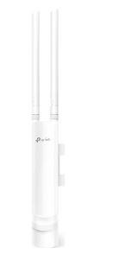
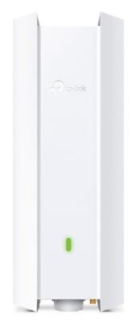
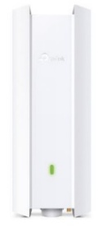
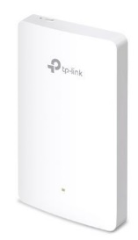
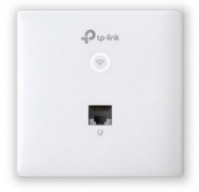
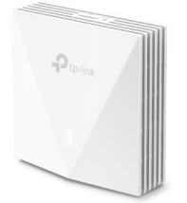
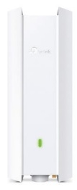
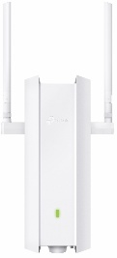
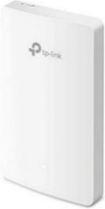
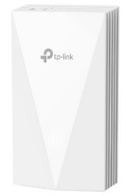
TP-LINK
OMADA
Retail File August 2025 Page 2/4
Software Defined Networking (SDN) with Cloud Access
Omada’s Software Defined Networking (SDN) platform integrates network devices, including access points, switches and gateways, providing 100% centralized cloud management. Omada creates a highly scalable network—all controlled from a single interface. Seamless wireless and wired connections are provided, ideal for use in hospitality, education, retail, offices, and more.
Dealer File July 2025
Page 2/4
Outdoor Access Points
Wall Plate Access Points
EAP115-WALL TP-LINK ACCESS POINT N300, WIRELESS INDOOR WALL PLATE, 2.4 GHz, 2X LAN PORTS, 2 X INTERNAL ANTENNAS, LOAD BALANCE, CAPTIVE PORTAL 40 €
EAP615-WALL TP-LINK ACCESS POINT AX1800, WIRELESS INDOOR WALL PLATE, 4X GIGABIT PORTS, 2 X DUAL BAND ANTENNAS, ONE PORT SUPPORT POE OUT, BAND STEERING, OMADA APP 101 €
EAP225-OUTDOOR
TP-LINK ACCESS POINT AC1200, WIRELESS OUTDOOR POE, DUAL BAND, 1X GIGABIT PORTS, 2 X EXTERNAL ANTENNAS, MU-MIMO, BAND STEERING, LOAD BALANCE, CAPTIVE PORTAL, OMADA APP 97 €
EAP610-OUTDOOR
TP-LINK ACCESS POINT AX1800, WIRELESS OUTDOOR, PoE, DUAL BAND, MU-MIMO, SEAMLESS ROAMING, AIRTIME FAIRNESS, OMADA APP, POLE OR WALLMOUNT 186 €
EAP650-OUTDOOR
TP-LINK ACCESS POINT AX3000, WIRELESS INDOOR/OUTDOOR, PoE, DUAL BAND, MU-MIMO, OFDMA, SEAMLESS ROAMING, AIRTIME FAIRNESS, OMADA APP, 160MHz BANDWIDTH, POLE OR WALLMOUNT 210 €
EAP230-WALL TP-LINK ACCESS POINT AC1200, WIRELESS INDOOR WALL PLATE, DUAL BAND, 2X GIGABIT PORTS, 2 X INTERNAL ANTENNAS, MU-MIMO, BAND STEERING, LOAD BALANCE, OMADA APP 64 €
EAP650-WALL TP-LINK ACCESS POINT AX3000, WIRELESS INDOOR WALL PLATE, 1 X UPLINK GIGABIT PORTS, 1 X DOWNLINK GIGABIT PORT, 2 X DUAL BAND ANTENNAS, BAND STEERING, OMADA APP, 100+ CONCURRENNT USERS 101 €
EAP623-OUTDOOR HD
TP-LINK ACCESS POINT AX1800, WIRELESS OUTDOOR PoE, 1X GIGABIT PORT, 2 X INTERNAL ANTENNAS, MU-MIMO, SEAMLESS ROAMING, AIRTIME FAIRNESS, OMADA APP, CEILING OR WALLMOUNT 207 €
EAP625-OUTDOOR HD
TP-LINK ACCESS POINT AX1800, WIRELESS OUTDOOR PoE, 1X GIGABIT PORT, 2 X EXTERNAL ANTENNAS, MU-MIMO, SEAMLESS ROAMING, AIRTIME FAIRNESS, OMADA APP, CEILING OR WALLMOUNT 226 €
EAP235-WALL TP-LINK ACCESS POINT AC1200, WIRELESS INDOOR WALL PLATE, DUAL BAND, 4X GIGABIT PORTS, 2 X INTERNAL ANTENNAS, ONE PORT SUPPORT POE OUT, BAND STEERING, LOAD BALANCE, AIRTIME FAIRLESS, OMADA APP 76 €
EAP655-WALL TP-LINK ACCESS POINT AX3000, WIRELESS INDOOR WALL PLATE, 1 X UPLINK GIGABIT PORTS, 3 X DOWNLINK GIGABIT PORT, 2 X DUAL BAND ANTENNAS, BAND STEERING, OMADA APP, 100+ CONCURRENNT USERS 112 €
Call now on:
Mail on:
Prices, Promotions, specifications, availability and terms of offers may change without notice. Despite our best efforts,
a small number of items may contain pricing, typography, or photography errors. Correct prices and Promotions are validated at the time your order is placed. Recycling fees are not included in the Dealer & Retail File. Delivery and installation charges are not included. Products' warranty is the warranty given by the manufacturer. VAT is included

Slide 3
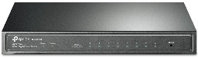
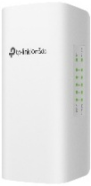
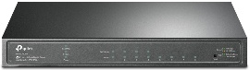
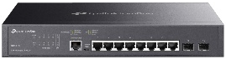
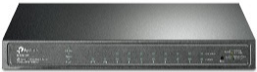
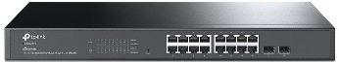
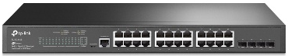
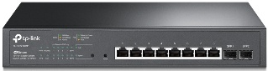
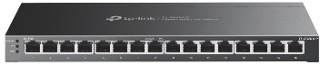
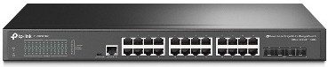
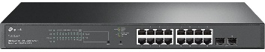
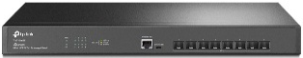
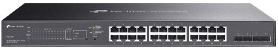
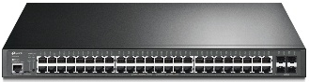
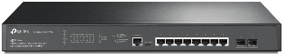
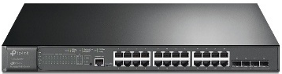
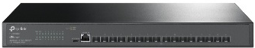
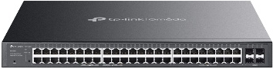
TP-LINK
OMADA
Retail File August 2025 Page 3/4
Switches
SG2005P-PD TP-LINK SWITCH 5PORTS, 4 PORTS PoE+ AND 1 PORTS GIGABIT LAN PORTS, 64W, SMART MANAGED,OUTDOOR, WEATHERPROOF, QOS, L2, VLAN, 104 €
Dealer File July 2025
Page 2/3
TL-SG2008P TP-LINK SWITCH 8PORTS, 4 PORTS PoE+ AND 4 PORTS GIGABIT LAN PORTS, 62W, SMART MANAGED, QOS, L2, VLAN, DESKTOP STEEL CASE, UK PLUG 119 €
TL-SG3210 TP-LINK SWITCH 8PORTS GIGABIT LAN PORTS, 2 SFP PORTS, MANAGED, QOS, L2, VLAN, RACKMOUNT, UK PLUG 136 €
TL-SG2210P TP-LINK SWITCH 8PORTS PoE+ GIGABIT LAN PORTS, 2 SFP PORTS, 61W, SMART MANAGED, QOS, L2, VLAN, DESKTOP, UK PLUG 146 €
TL-SG2218 TP-LINK SWITCH 16PORTS GIGABIT LAN PORTS, 2 SFP PORTS, SMART MANAGED, QOS, L2, VLAN, RACKMOUNT, UK PLUG 162 €
TL-SG2008 TP-LINK SWITCH 8PORTS GIGABIT LAN PORTS, SMART MANAGED, QOS, L2, VLAN 98 €
TL-SG3428 TP-LINK SWITCH 24PORTS GIGABIT LAN PORTS, 4 SFP PORTS, MANAGED, QOS, L2, VLAN, RACKMOUNT, UK PLUG 195 €
TL-SG2210MP TP-LINK SWITCH 10PORTS GIGABIT LAN PORTS PoE+ , 2 SFP PORTS, 150W, SMART MANAGED, QOS, L2-L2+, VLAN, DESKTOP STEEL CASE, UK PLUG 203 €
TL-SG2016P TP-LINK SWITCH 16PORTS GIGABIT LAN PORTS ,+8 POE PORTS, QOS, 120W, DESKTOP/
WALLMOUNT, STEEL CASE, UK PLUG 215 €
TL-SG3428X TP-LINK SWITCH 24PORTS GIGABIT LAN PORTS, 4 10GE SFP+ PORTS, MANAGED, QOS, L2+, VLAN, RACKMOUNT, UK PLUG 269 €
TL-SG2218P TP-INK SWITCH 16PORTS GIGABIT LAN PoE PORTS, 2 SFP PORTS, SMART MANAGED, QOS, L2, VLAN, OMADA CLOUD SOLUTION, RACKMOUNT, UK PLUG 289 €
TL-SX3008F TP-LINK SWITCH 8PORTS 10GE SFP+ PORTS, MANAGED, VLAN, L2+, RACKMOUNT 306 €
SG2428LP TP-LINK SWITCH 28PORTS 16 GIGABIT LAN PORTS PoE+, 8 GIGABIT LAN PORTS, 4 SFP PORTS, 150W, SMART MANAGED, QOS, L2-L2+, VLAN, RACKMOUNT, UK PLUG 336 €
TL-SG2428P TP-LINK SWITCH 28PORTS 24 GIGABIT LAN PORTS PoE+, 4 SFP PORTS, 250W, SMART MANAGED, QOS, L2-L2+, VLAN, RACKMOUNT, UK PLUG 362 €
TL-SG3452 TP-LINK SWITCH 48PORTS GIGABIT LAN PORTS, 4 SFP PORTS, MANAGED, QOS, L2, VLAN, RACKMOUNT, 380 €
TL-SG3452X TP-LINK SWITCH 48PORTS GIGABIT LAN PORTS, 4 10GE SFP+ PORTS, MANAGED, QOS, L2+, VLAN, RACKMOUNT, UK PLUG, 463 €
TL-SG3210XHP-M2 TP-LINK SWITCH 8PORTS 2.5 GIGABIT LAN PORTS PoE+, 2-PORTS 10GE SFP, JETSTREAM, 240W, MANAGED, QOS, L2+, L2 MULTICAST, L3, VLAN, IPV6, MIBs, RACKMOUNT, UK PLUG 488 €
TL-SG3428MP TP-LINK SWITCH 24PORTS GIGABIT LAN PORTS PoE+, 4 SFP PORTS, JETSTREAM, 384W, MANAGED, QOS, L2+, VLAN, RACKMOUNT, UK PLUG 504 €
TL-SX3016F TP-LINK SWITCH 16PORTS 10GE SFP+ PORTS, MANAGED, VLAN, L2, RACKMOUNT, UK PLUG,
645 €
SG2452LP TP-LINK SWITCH 52PORTS 32 GIGABIT LAN PORTS PoE+, 16 GIGABIT LAN PORTS, 4 SFP PORTS, 230W, SMART MANAGED, QOS, L2-L2+, VLAN, RACKMOUNT, 671 €
TL-SG3452P TP-LINK SWITCH 48PORTS GIGABIT LAN PORTS PoE+, 4 SFP PORTS, JETSTREAM, 384W, MANAGED, QOS, L2+, VLAN, RACKMOUNT, UK PLUG
691 €
TL-SG3452XP TP-LINK SWITCH 48PORTS GIGABIT LAN PORTS PoE+, 4 10G SFP PORTS, JETSTREAM, 500W, MANAGED, QOS, L2+, VLAN, RACKMOUNT, UK PLUG. 868 €
Call now on:
Mail on:
Prices, Promotions, specifications, availability and terms of offers may change without notice. Despite our best efforts,
a small number of items may contain pricing, typography, or photography errors. Correct prices and Promotions are validated at the time your order is placed. Recycling fees are not included in the Dealer & Retail File. Delivery and installation charges are not included. Products' warranty is the warranty given by the manufacturer. VAT is included

Slide 4
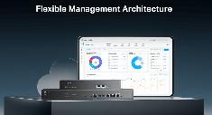

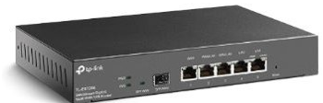







TP-LINK
OMADA
Retail File August 2025 Page 4/4
CONTROLLER
ROUTERS
ER706W TP-LINK AX3000 VPN ROUTER OMADA MULTI-GIGABIT VPN, 1 X WAN PORTS, 1 X LAN PORTS, 4 X GIGABIT WAN/LAN PORTS, 1 X GIGABIT SFP WAN/LAN PORT, 1 X USB 3.0, OMADA APP, DPD, PFS, RESET BUTTON, BLACK 189 €
ER605 TP-LINK ROUTER SAFESTREAM GIGABIT MULTI-WAN VPN ,PORT: 1× GIGABIT WAN PORT + 3× GIGABIT WAN/LAN PORTS + 1× GIGABIT LAN PORT, FEATURE: INTEGRATION WITH OMADA SDN CONTROLLER, SUPPORT 20 IPSEC VPN TUNNELS, 16 PPTP/L2TP VPN TUNNELS 71 €
ER7206 TP-LINK ROUTER SAFESTREAM™ GIGABIT MULTI-WAN VPN PORT: 1× GIGABIT SFP WAN PORT, 1× GIGABIT RJ45 WAN PORT, 2× GIGABIT WAN/LAN RJ45 PORTS, 2× GIGABIT RJ45 LAN PORT SUPPORT 100 IPSEC VPN TUNNELS, 50 PPTP/L2TP VPN TUNNELS, 50 OPENVPN 195 €
OC200 TP-LINK OMADA CLOUD CONTROLLER, CENTRALIZED MANAGEMENT, MARVELL, 2 FAST ETHERNET PORT, 1 USB 2.0 PORT, 1 MIRCO-USB PORT, POWERED BY 802.3AF POE OR MICRO-USB POWER ADAPTER, DESKTOP STEEL CASE, WIRELESS NETWORK CONFIG 99 €
ER707-M2 TP-LINK ROUTER WIRELESS OMADA MULTI-GIGABIT VPN, 1 X WAN PORTS, 1 X LAN PORTS, 4 X GIGABIT WAN/LAN PORTS, 1 X GIGABIT SFP WAN/LAN PORT, 1 X USB 2.0, OMADA APP, DPD, PFS, RESET BUTTON, BLACK 215 €
ER7212PC TP-LINK ROUTER OMADA 3-IN-1 GIGABIT VPN, 2× GIGABIT SFP WAN/LAN PORTS, 1× GIGABIT WAN PORT, 1× GIGABIT WAN/LAN PORT, 8× GIGABIT LAN PORT, BANDWIDTH CONTROL, NAT, ACCESS CONTROL, DESKTOP/WALLMOUNT 215 €
ER706W-4G TP-LINK AX3000 VPN ROUTER OMADA MULTI-GIGABIT VPN, 1 X WAN PORTS, 1 X LAN PORTS, 4 X GIGABIT WAN/LAN PORTS, 1 X GIGABIT SFP WAN/LAN PORT, 1 X NANO SIM CARD, OMADA APP, DPD, PFS, RESET BUTTON, BLACK 396 €
OC300 TP-LINK OMADA CLOUD CONTROLLER, CENTRALIZED MANAGEMENT 2× 10/100/1000 MBPS ETHERNET PORTS, 1× USB 3.0 PORT FEATURE, CLOUD ACCESS, CENTRALIZED MANAGEMENT FOR UP TO 500 OMADA EAPS, JETSTREAM SWITCHS AND SAFESTREAM ROUTERS, RACKMOUNT 223 €
ER8411 TP-LINK ROUTER OMADA GIGABIT VPN ,2× 10GE SFP+ PORTS, 1× 1GE SFP WAN/LAN PORTS, 8× 1GE RJ45 WAN/LAN PORTS, 1× RJ45 CONSOLE PORTS, 2× USB PORTS, BANDWIDTH CONTROL, NAT, ACL, ACCESS CONTROL, RACKMOUNT 595 €
Call now on:
Mail on:
Prices, Promotions, specifications, availability and terms of offers may change without notice. Despite our best efforts,
a small number of items may contain pricing, typography, or photography errors. Correct prices and Promotions are validated at the time your order is placed. Recycling fees are not included in the Dealer & Retail File. Delivery and installation charges are not included. Products' warranty is the warranty given by the manufacturer. VAT is included

