Slide 1



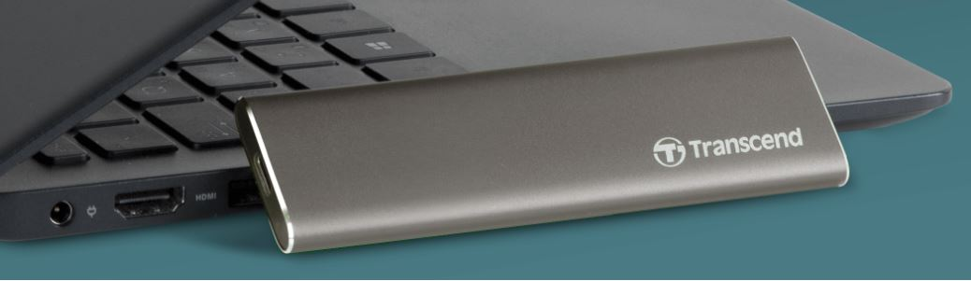
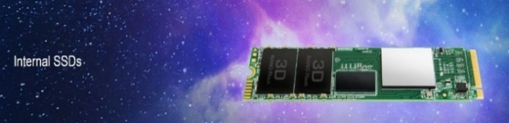






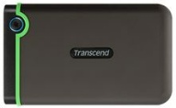

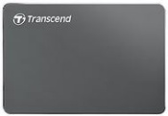
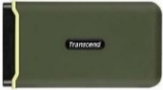

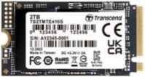
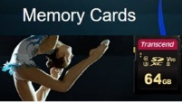


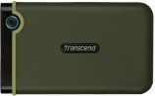
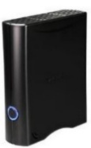

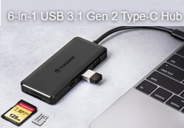



Transcend New Arrivals
Retail File September 2025
Please Call for volume pricing
110S
115S
ESD370C
ESD420
256GB TS256GMTE110S
M.2. 2280 NVMe PCIe, 3D TLC
RRP € 37
512GB TS512GMTE110S
M.2. 2280 NVMe PCIe, 3D TLC
RRP € 62
500GB TS500GMTE115S
SSD M.2 2280, M.2. 2280 NVME PCIe GEN3X4, TLC
RRP € 59
ESD270C
250GB TS250GESD370C
RRP € 85
1TB TS1TESD420G
RRP € 122
25M3
C3N
250GB TS250GESD270C
RRP € 48
500GB TS500GESD270C
RRP € 68
ESD380C
ESD310S
1TB TS1TESD310S
RRP € 132
2TB TS2TESD310S
RRP € 251
245S
410S
2TB TS2TESD380C
RRP € 304
1TB TS1TSJ25M3S
RRP € 113
2TB TS2TSJ25M3S
RRP € 133
2TB TS2TSJ25C3N
RRP € 122
TS16GSDC500S
MEMORY CARD SD 16GB
RRP € 11
1TB TS1TMTE410S
SSD, M.2 2242, PCIe Gen4x4, NVMe, 3D TLC
RRP € 141
1TB TS1TMTE245S
M.2 2280, NVMe PCIe, 3D TLC
RRP € 132
TS64GSDXC10U1
MEMORY CARD SD 64GB
RRP € 44
M3
35T3
TS128GSDXC10U1
MEMORY CARD SD 128GB
RRP € 107
225S
230S
6-in-1 USB 3.1 Gen 2 Type-C Hub
2TB TS2TSJ25M3C
RRP € 129
8TB TS8TSJ35T3
RRP € 352
TS-HUB5C
HUB USB 3.1 GEN 2
RRP € 39
1TB TS1TSSD225S
SSD INTERNAL, 2.5'' SATA III 6Gb/s, 3D NAND FLASH
RRP € 116
2TB TS2TSSD225S
SSD, 2.5'' SATA III, 3D NAND FLASH
RRP € 217
256GB TS256GSSD230S
SSD 2.5'', SATA III 6GB/s, 3D TLC
RRP € 37
2TB TS2TSSD230S
SSD, 2.5'' SATA III 6GB/s, 3D TLC
RRP € 246
Perfect for Type-C mobiles,
6-in-1 expansion
Ultra-fast USB 3.1 Gen 2
SD and microSD card slots
Call now on:
Mail on:
Place your order on:
www.
Prices, promotions, specifications, availability and terms of offers may change without notice.
Despite our best efforts, a small number of items may contain pricing, typography, or photography errors.
Correct prices and promotions are validated at the time your order is placed.
Recycling fees are not included in the Dealer and Retail File. Delivery and installation charges
are not included. Products' warranty is the warranty given by the manufacturer. VAT is included.

Slide 2

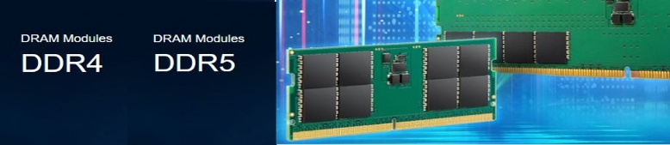


























Transcend New Arrivals
Retail File September 2025
Please Call for volume pricing
TS16GJF700
MEMORY STICK 16GB JETFLASH 700, USB 3.0
RRP € 7
TS64GJF700
MEMORY STICK 64GB JETFLASH 700, PROTECTION CAP, USB TYPE-A, USB 3.1, WINDOWS OS AND MAC OS,
RRP € 8
TS128GJF700
MEMORY STICK 128GB JETFLASH 700, USB 3.1
RRP € 11
TS256GJF700
MEMORY STICK 256GB JETFLASH 700, USB 3.1, PEN DRIVE, CLASSIC, BLACK
RRP € 24
TS64GJF790C MEMORY STICK 64GB JETFLASH 790C, RETRACTABLE, USB 3.2, USB TYPE-C, WINDOWS OS AND MAC OS, BLACK
RRP € 9
TS256GJF790C
MEMORY STICK 256GB JETFLASH 790C, RETRACTABLE, USB 3.2, USB TYPE-C
RRP € 22
TS64GJDG500G
MEMORY STICK 64GB JETDRIVE GO 500, LIGHTNING + USB 3.1 DUAL CONNECTORS
RRP € 73
JM3200HSH-4G
MEMORY MODULE 4GB DDR4 3200Mhz, SO-DIMM RRP € 33
JM5600ASG-8G
MEMORY MODULE 8GB JM DDR5 5600 SO-DIMM RRP € 43
JM3200HLB-8G
MEMORY MODULE 8GB DDR4 3200Mhz, U-DIMM RRP € 35
JM3200HSB-8G
MEMORY MODULE 8GB DDR4 3200Mhz, SO-DIMM RRP € 35
JM4800ALG-8G
MEMORY MODULE 8GB DDR5 4800Mhz, U-DIMM RRP € 41
JM4800ASG-8G
MEMORY MODULE 8GB DDR5 4800Mhz, SO-DIMM RRP € 64
TS512GJF930C
MEMORY STICK 512GB JETFLASH 930C, USB 3.2, GOLD
RRP € 112
TS1GHR72V1H
MEMORY MODULE 8GB DDR4 2133MHz, VLP ( VERY LOW PROFILE ) FOR SERVER RRP € 189
JM3200HLE-16G
MEMORY MODULE 16GB DDR4 3200Mhz, U-DIMM RRP € 67
JM3200HSE-16G
MEMORY MODULE 16GB DDR4 3200Mhz, SO-DIMM RRP € 68
JM4800ASE-16G
MEMORY MODULE 16GB DDR5 4800Mhz, SO-DIMM RRP € 56
JM4800ALE-16G MEMORY MODULE 16GB DDR5 4800Mhz,U-DIMM RRP € 58
JM5600ALE-16G MEMORY MODULE 16GB JM DDR5 5600 U-DIMM RRP € 67
TS16GJF350
MEMORY STICK 16GB JETFLASH 350, USB 2.0
RRP € 6
TS2GLH72V6B MEMORY MODULE 16GB DDR4 2666 ECC LONG-DIMM
RRP € 78
JM5600ASE-16G
MEMORY MODULE 16GB JM DDR5 5600 SO-DIMM RRP € 82
TS2GHR72V2B3 MEMORY MODULE 16GB DDR4 ECC Registered Long-DIMM (SERVER) RRP € 91
JM3200HSE-32G
MEMORY MODULE 32GB DDR4 3200Mhz, SO-DIMM RRP € 126
JM3200HLE-32G
MEMORY MODULE 32GB DDR4 3200Mhz, U-DIMM RRP € 73
JM4800ASE-32G
TRANSCEND MEMORY MODULE 32GB DDR5 4800Mhz, SO-DIMM RRP € 95
JM2666HLE-32G
MEMORY MODULE 32GB, DDR4, 2666MHz U-DIMM RRP € 125
JM4800ALE-32G
TRANSCEND MEMORY MODULE 32GB DDR5 4800Mhz, U-LONG DIMM RRP € 126
TS4GLH72V6E TRANSCEND MEMORY MODULE 32GB DDR4 2666Mhz, ECC-DIMM, 2Rx8 2GBx8 CL19 1.2V RRP € 143
JM5600ASE-32G TRANSCEND MEMORY MODULE 32GB JM DDR5 5600 SO-DIMM
RRP € 124
JM5600ALE-32G
MEMORY MODULE 32GB JM DDR5 5600 U-DIMM RRP € 137
TS4GLH72V6E3
TRANSCEND MEMORY MODULE 32GB DDR4 2666, ECC LONG-DIMM RRP € 234
Call now on:
Mail on:
Place your order on:
www.
Prices, promotions, specifications, availability and terms of offers may change without notice.
Despite our best efforts, a small number of items may contain pricing, typography, or photography errors.
Correct prices and promotions are validated at the time your order is placed.
Recycling fees are not included in the Dealer and Retail File. Delivery and installation charges
are not included. Products' warranty is the warranty given by the manufacturer. VAT is included.

