Slide 1

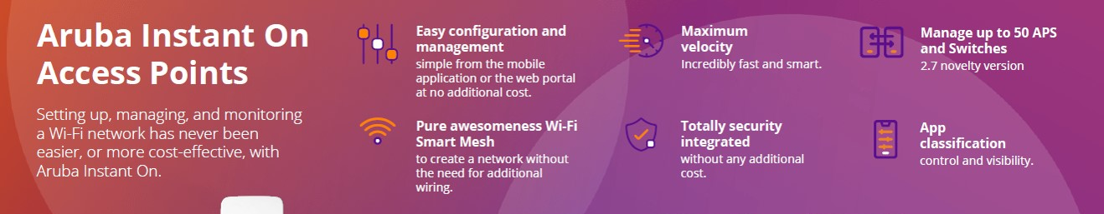




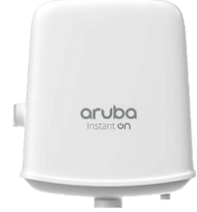
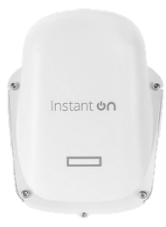



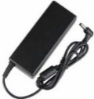
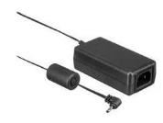
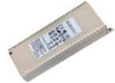
HEWLETT PACKARD
ARUBA ACCESS POINTS
& LAN SWITCHES
Retail File September 2025
Valid Until 30/09
or Until Stock Last
AP21
AP22
AP25
AP17
AP27
AP32
Prices, promotions, specifications, availability and terms of offers may change without notice. Despite our best efforts, a small number of items may contain pricing, typography, or photography errors.
Correct prices and promotions are validated at the time your order is placed. Recycling fees are not included in the Dealer & Retail File. Delivery and installation charges are not included.
Products' warranty is the warranty given by the manufacturer.
VAT is included
S1T09A HPE ARUBA ACCESS POINT INSTANT ON AP21, INDOOR, DUAL-BAND 802.11ax 2X2 2.4-5GHZ MIMO, SMART MESH, POE, 1GbE BASET UPLINK DC POWER CONNECTOR, CEILING/WALL MOUNT CLIP, W/O POWER SUPPLY,
2YW, 107 €
R4W02A HPE ARUBA ACCESS POINT INSTANT ON AP22, 12V/18W, INDOOR, FAST 802.11AX, 2X2:2 WI-FI CERTIFIED 6 (WI-FI 6), 2X2 MIMO, DUAL RADIO, UPLINK GIGABIT PORT WITH POE IN SUPPORT, 2YW, 144 €
R9B28A HPE ARUBA ACCESS POINT INSTANT ON AP25, POWER ADAPTOR NOT INCLUDED, INDOOR, 5GHZ 4X4 MIMO, DUAL RADIO, UPLINK 2.5 GIGABIT ETHERNET PORT, WITH POE-IN SUPPORT ,
WIFI 6, 2YW, 243 €
S1T23A HPE ARUBA ACCESS POINT INSTANT ON AP32, INDOOR, TRI-BAND 2X2 6GHZ, MU-MIMO, SMART MESH, ULTRA-FAST 802.11AX, UPLINK 2.5 GIGABIT ETHERNET PORT, WITH POE-IN SUPPORT, WIFI 6, SUPPORTS OVER 100 DEVICES, 2YW, 222 €
S1T37A HPE ARUBA ACCESS POINT INSTANT ON AP27, OUTDOOR, DUAL RADIO 2X2 5GHZ, MU-MIMO, SMART MESH, ULTRA-FAST 802.11AX, UPLINK 2.5 GIGABIT ETHERNET PORT, WITH POE-IN SUPPORT, WIFI 6, SUPPORTS 75 DEVICES, 2YW, 222 €
S1U76A HPE ARUBA ACCESS POINT INSTANT ON AP22D, INDOOR, DUAL RADIO 2X2 5GHZ, MU-MIMO, SMART MESH, ULTRA-FAST 802.11AX, UPLINK 2.5 GIGABIT ETHERNET PORT, WITH POE-IN SUPPORT, WIFI 6, 2YW , 366 €
Call now on
Mail on:
S1T15A HPE ARUBA ACCESS POINT INSTANT ON AP21 WITH PSU, INDOOR, DUAL-BAND 802.11ax 2X2 2.4-5GHZ MIMO, SMART MESH, POE, 1GbE BASET UPLINK DC POWER CONNECTOR, CEILING/WALL MOUNT CLIP, 2YW, 129 €
S0J34A HPE ARUBA ACCESS POINT INSTANT ON AP22D BUNDLE WITH PSU, INDOOR, DUAL RADIO 2X2 5GHZ, MU-MIMO, SMART MESH, ULTRA-FAST 802.11AX, UPLINK 2.5 GIGABIT ETHERNET PORT, WITH POE-IN SUPPORT, WIFI 6, 2YW 272 €
You can connect your Instant On with a PoE switch or using our power adapters:
R2X20A HPE ARUBA POWER ADAPTER 12V/30W W/O CABLE FOR AP15, 25 €
R9M77A HPE ARUBA POE MIDSPAN INJECTOR 15.4W, 802.3AF FOR AP25 AP11D, AP11, AP12, AP15, AP17, 63 €
R2X21A HPE ARUBA POWER ADAPTER 48V PSU FOR AP11D, 25 €

Slide 2
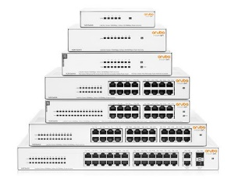
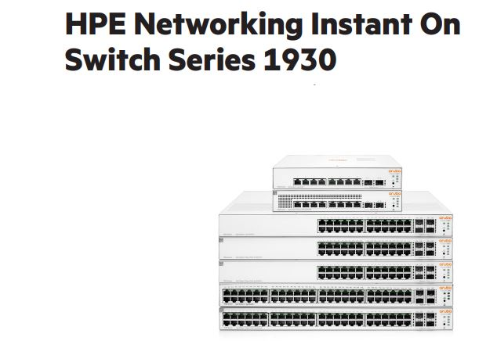
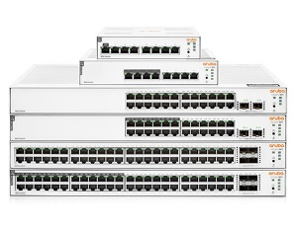
Aruba Instant On 1430 Switches Series. Affordable, plug-and-play, unmanaged series for small businesses looking for simple reliable, and low-cost network connectivity, offering Layer 2 Ethernet switching capabilities to help connect printers and access points, without any complicated network configuration or management needed. With fully automated functions, zero ongoing maintenance, these unmanaged switches deliver simple, reliable connectivity for the smallest SMBs and home offices.
Unmanaged Ethernet switches for simple connectivity.
Delivers reliable connectivity to small and medium-sized businesses.
HEWLETT PACKARD
ARUBA ACCESS POINTS
& LAN SWITCHES
Retail File September 2025
Valid Until 30/09 or
Until Stock Last
R8R44A HPE SWITCH ARUBA INSTANT ON 1430 5G, 5x PORTS GIGABIT, LAYER 2, UNMANAGED, PLUG AND PLAY, FANLESS DESIGN FOR SILENT OPERATION, LIFETIME WARRANTY, 48 €
R8R45A HPE SWITCH ARUBA INSTANT ON 1430 8G, 8x PORTS GIGABIT, LAYER 2, UNMANAGED, PLUG AND PLAY, FANLESS DESIGN FOR SILENT OPERATION, NO UK SNAP-IN PLUG, LIFETIME WARRANTY, 63 €
R8R49A HPE ARUBA SWITCH INSTANT ON 1430 24G, 24x PORTS GIGABIT, LAYER 2, UNMANAGED, PLUG AND PLAY, RACK MOUNTABLE, FANLESS DESIGN FOR SILENT OPERATION, LIFETIME WARRANTY, 147 €
Prices, promotions, specifications, availability and terms of offers may change without notice. Despite our best efforts, a small number of items may contain pricing, typography, or photography errors.
Correct prices and promotions are validated at the time your order is placed. Recycling fees are not included in the Dealer & Retail File. Delivery and installation charges are not included.
Products' warranty is the warranty given by the manufacturer.
VAT is included
R8R50A HPE ARUBA SWITCH INSTANT ON 1430 26G, 26x PORTS GIGABIT, 2 SFP PORTS, LAYER 2, UNMANAGED, PLUG AND PLAY, FANLESS DESIGN FOR SILENT OPERATION, LIFETIME WARRANTY, 177 €
R8R48A HPE SWITCH ARUBA INSTANT ON 1430 16G 124W, 16x PORTS GIGABIT FULL POE, LAYER 2, UNMANAGED, PLUG AND PLAY, FANLESS DESIGN FOR SILENT OPERATION, LIFETIME WARRANTY, 237 €
Aruba Instant On 1930 Switches Series.
The Aruba Instant On 1930 switch series is designed for small and growing businesses that require enhanced performance to support bandwidth-demanding applications. Instant On 1930 switch series seamlessly integrates with existing Instant On indoor / outdoor access points and can be centrally managed with the Instant On mobile app onsite or remotely.
Aruba Instant On 1830 Switches Series. Aruba Instant On 1830 Switch Series provides an easy to use and affordable wired solution for networks supporting IT, mobile, and cloud applications. This affordable and easy-to-deploy smart-managed switch series is ideal for small businesses looking for cost-effective wired infrastructure to keep up with evolving network demands. These entry-level, smart-managed switches offer Layer 2 switching capabilities, Gigabit connectivity, along with flexible management modes - all at an affordable price point. With a flexible management dashboard, Power over Ethernet (PoE) options, and energy-efficient features, these switches deliver a solid business network for SMBs with limited budgets. Rack mountable, Lifetime warranty.
JL680A HPE ARUBA SWITCH INSTANT ON 1930 8G, 8x PORTS GIGABIT, 2x SFP 1GbE PORTS, LAYER 2+ (STATIC ROUTING) , SMART MANAGED, ADVANCE SECURITY FEATURES, LIFETIME WARRANTY, 147 €
Call now on
Mail on:
JL810A HPE SWITCH ARUBA INSTANT ON 1830-8G, 8x PORTS GIGABIT, LAYER 2, SMART MANAGED, QOS, EEE, VLAN, SPANNIG TREE, SNTP, CLOUD MANAGED, 130 €
JL682A HPE SWITCH ARUBA INSTANT ON 1930 24G, 24x PORTS GIGABIT, 4x SFP 1/10 GbE PORTS, LAYER 2+ (STATIC ROUTING), SMART MANAGED, ADVANCE SECURITY FEATURES, RACK MOUNTABLE, LIFETIME WARRANTY, 311 €
JL812A HPE ARUBA SWITCH INSTANT ON 1830 24G, 24x PORTS GIGABIT, 2 SFP, LAYER 2, SMART MANAGED, QOS, EEE, VLAN, SPANNIG TREE, SNTP, CLOUD MANAGED, RACK MOUNTABLE, LIFETIME WARRANTY, 190 €
JL681A HPE ARUBA SWITCH INSTANT ON 1930 8G, 8x PORTS GIGABIT FULL PoE CLASS4 124W, 2x SFP 1GbE PORTS, LAYER 2+ (STATIC ROUTING) , SMART MANAGED, ADVANCE SECURITY FEATURES, RACK MOUNTABLE, LIFETIME WARRANTY , 319 €
An affordable solution for cost-sensitive small businesses.
JL811A HPE ARUBA SWITCH INSTANT ON 1830 8G POE 65W, 8x PORTS GIGABIT (4 PORTS POE), LAYER 2, SMART MANAGED, QOS, EEE, VLAN, SPANNIG TREE, SNTP, CLOUD MANAGED, RACK MOUNTABLE, LIFETIME WARRANTY 194 €
JL683B HPE SWITCH ARUBA INSTANT ON 1930 24G, 24x PORTS GIGABIT FULL PoE CLASS4 195W, 4x SFP+ PORTS, LAYER 2+ (STATIC ROUTING), SMART MANAGED, ADVANCE SECURITY FEATURES, RACK MOUNTABLE, LIFETIME WARRANTY, 326 €
JL814A HPE SWITCH ARUBA INSTANT ON 1830-48G, 48x PORTS GIGABIT, 4 SFP, LAYER 2, SMART
MANAGED, QOS, EEE, VLAN, SPANNIG TREE, SNTP, CLOUD MANAGED, 296 €
JL685A HPE SWITCH ARUBA INSTANT- ON 1930 48G, 48x PORTS GIGABIT, 4x SFP PORTS 1/10 GbE PORTS, LAYER 2+ (STATIC ROUTING), SMART MANAGED, ADVANCE SECURITY FEATURES, RACK MOUNTABLE, LIFETIME WARRANTYS, 466 €
JL813A HPE SWITCH ARUBA INSTANT ON 1830 24G POE 195W, 24x PORTS GIGABIT (12 PORTS POE),
2 SFP, LAYER 2, SMART MANAGED, QOS, EEE, VLAN, SPANNIG TREE, SNTP, CLOUD MANAGED, RACK MOUNTABLE, LIFETIME WARRANTY, 322 €
JL684B HPE SWITCH ARUBA INSTANT ON 1930 24G, 24x PORTS GIGABIT, FULL PoE CLASS4 370W, 4 SFP+ PORTS, LAYER 2+ (STATIC ROUTING), SMART MANAGED, VLAN, ADVANCE SECURITY FEATURES, RACK MOUNTABLE, LIFETIME WARRANTY, 602 €
JL815A HPE ARUBA SWITCH INSTANT ON 1830 48G 370W, 48x PORTS GIGABIT (24 PORTS POE), 4 SFP, LAYER 2, SMART MANAGED, QOS, EEE, VLAN, SPANNIG TREE, SNTP, CLOUD MANAGED, RACK MOUNTABLE, LIFETIME WARRANTY, 638 €

Slide 3

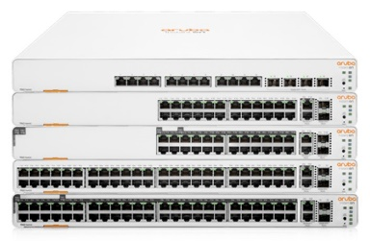
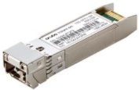

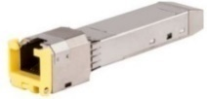
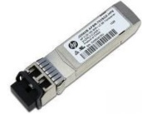



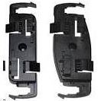


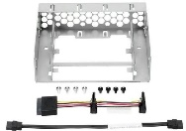
Aruba Instant On 1960 24G 2XGT 2SFP+ Switch. Aruba Instant On 1960 Switches are advanced, smart-managed, fixed configuration Gigabit stackable switches designed for small and growing businesses that are easy to deploy and affordable. These switches are designed to scale as business grows, making adding more employees, devices and applications simple. Aruba Instant On 1960 are made to handle today’s bandwidth-heavy applications like voice and video conferencing, enabling consistent connectivity to improve user experience and application performance. These switches come with flexible management option: local web GUI or Instant On mobile app and cloud-based web portal. Lifetime Warranty.
OPTIONS & ACCESSORIES
HEWLETT PACKARD
ARUBA ACCESS POINTS
& LAN SWITCHES
Retail File September 2025
Valid Until 30/09 or
Until Stock Last
R9D18A HPE ARUBA TRANSCEIVER INSTANT ON 10G SFP+ LC SR 300M OM3 MMF TRANSCEIVER, 88 €
JD096C HPE ARUBA TRANSCEIVER INSTANT ON 10G SFP+ LC SR 300M OM3 MMF TRANSCEIVER, 129 €
Prices, promotions, specifications, availability and terms of offers may change without notice. Despite our best efforts, a small number of items may contain pricing, typography, or photography errors.
Correct prices and promotions are validated at the time your order is placed. Recycling fees are not included in the Dealer & Retail File. Delivery and installation charges are not included.
Products' warranty is the warranty given by the manufacturer.
VAT is included
J8177D HPE ARUBA 1G SFP RJ45 T 100M CAT5E XCVR, 158 €
A scalable solution for growing businesses with heavy bandwidth requirements.
JD092B HPE TRANSCEIVER X130, 10G SFP+ LC DUPLEX SR, 572 €
JL806A HPE SWITCH ARUBA INSTANT- ON 1960 24G, 24x PORTS GIGABIT, SMART MANAGED, LAYER 2+, 2 SFP+ 10GbE PORTS, 2 x 10GBASE-T PORTS, 534 €
JL807A HPE ARUBA SWITCH INSTANT ON 1960 24G, 24x PORTS GIGABIT, 24 PORTS FULL POE CLASS 4 AND 6, 2XGT 10GBE PORTS, 2 SFP+ PORTS, 370W, SMART MANAGED, STACKABLE, LIFETIME WARRANTY, 742 €
R3R57A HPE BRACKET FOR AP17, 7 €
JL808A HPE SWITCH ARUBA INSTANT ON 1960 48G, 48x PORTS GIGABIT, SMART MANAGED, LAYER 2+, 2 SFP+ 10GbE PORTS, 2 x 10GBASE-T PORTS, 2XT 2XF SQ, LIFETIME WARRANTY, 861 €
JW127A HPE UK POWER CORD FOR AP11D, AP11, AP12, AP15, AP17, 9 €
Call now on
Mail on:
JL805A HPE SWITCH ARUBA INSTANT ON 1960 12XGT, 12x PORTS 10GBASE-T, 4 SFP+ PORTS, LAYER 2+, MANAGED, STACKABLE, LIFETIME WARRANTY, 971 €
JL809A HPE ARUBA SWITCH INSTANT ON 1960 48G, 48x PORTS GIGABIT, 48 PORTS FULL POE CLASS 4 AND 6, 2XGT 10GBE PORTS, 2 SFP+ PORTS, 600W, MANAGED, STACKABLE, LIFETIME WARRANTY, 1518 €
R9B36A HPE FLUSH MOUNT SLEEVE FOR AP25, 16 €
JW044A HPE CEILING RAIL MOUNT KIT, FOR AP11, AP12, AP15, AP22, 19 €
J9735A HPE CABLE FOR 2920 1.0M STACKING CABLE, 83 €
870213-B21 HPE MICROSERVER GEN10 NHP SFF CONVERTER KIT, 11 €

