Slide 1

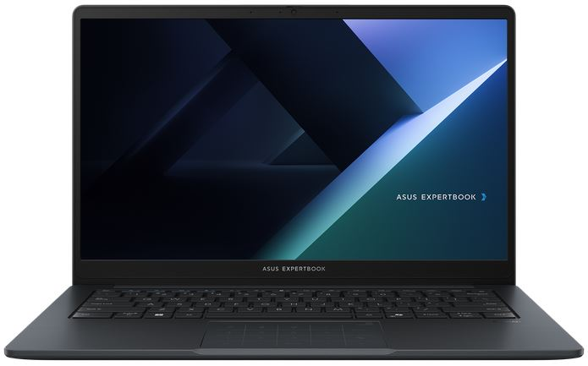
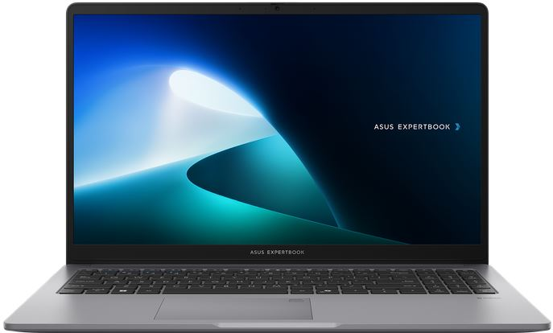
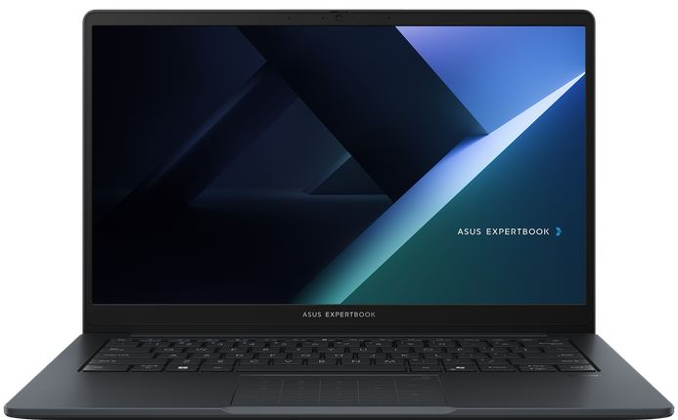
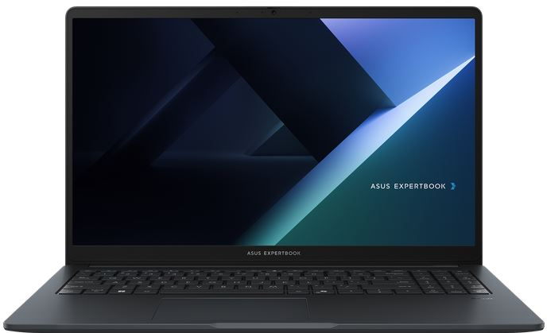
EXPERTBOOK BUSINESS NOTEBOOKS
Retail File September 2025
Promo Offers are valid until 30.09 or until stock lasts.
EXPERTBOOK BM1, BM1403CDA
EXPERTBOOK P1
EXPERTBOOK B1, B1403CVA
EXPERTBOOK B1, B1503CVA
90NX0831-M00KY0 ASUS NOTEBOOK EXPERTBOOK BM1, BM1403CDA-S60121, AMD RYZEN 5 7535U, 2.9-4.55GHz/16MB, 6C, 16GB, 512GB SSD M.2 2280 NVMe PCIe4, AMD RADEON, 14'' IPS LED FHD 1920x1080 300NITS AG, WIFI6, BT, LAN, USB-A, USB-C, HDMI, DOS, 3YW, GREY € 591
90NX0831-M00KZ0 ASUS NOTEBOOK EXPERTBOOK BM1, BM1403CDA-S60122, AMD RYZEN 7 7735U, 2.7-4.75GHz/16MB, 8C, 16GB, 512GB SSD M.2 2280 NVMe PCIe4, AMD RADEON, 14'' IPS LED FHD 1920x1080 300NITS AG, WIFI6, BT, LAN, USB-A, USB-C, HDMI, DOS, 3YW, GREY € 674
90NX0881-M01BB0 ASUS NOTEBOOK EXPERTBOOK P1, P1503CVA-S70720, INTEL i3-1315U, 3.30-4.50GHz/10MB, 6C, 8GB, 256GB SSD M.2 2280 NVMe PCIe4, INTEL UHD, 15.6'' FHD 1920x1080 300NITS AG, WIFI6, BT, LAN, USB-A, USB-C, HDMI, DOS, 3YW, MISTY GREY € 737
90NX0881-M01BC0 ASUS NOTEBOOK EXPERTBOOK P1, P1503CVA-S70720, INTEL i7-13700H, 2.4-5GHz/24MB, 14C, 16GB, 512GB SSD M.2 2280 NVMe PCIe4, INTEL IRIS X, 15.6'' TN FHD 250NITS AG, WIFI6, BT, LAN, USB-A, USB-C, HDMI, DOS, 3YW, MISTY GREY € 807
90NX0811-M02H40 ASUS NOTEBOOK EXPERTBOOK B1, B1403CVA-S60408, INTEL CORE 5 120U, 1.4-5GHz/12MB, 10C, 16GB, 512GB SSD M.2 2280 NVMe PCIe4, INTEL GRAPHICS, 14'' IPS LED FHD 1920x1080 300NITS AG, WIFI6E, BT, LAN, USB-A, USB-C, HDMI, DOS, 3YW, GREY € 720
90NX0811-M02H50 ASUS NOTEBOOK EXPERTBOOK B1, B1403CVA-S60409, INTEL CORE 7 150U, 1.8-5.4GHz/12MB, 10C, 16GB, 512GB SSD M.2 2280 NVMe PCIe4, INTEL GRAPHICS, 14'' IPS LED FHD 1920x1080 300NITS AG, WIFI6E, BT, LAN, USB-A, USB-C, HDMI, DOS, 3YW, GREY € 896
90NX0801-M022S0 ASUS NOTEBOOK EXPERTBOOK B1, B1503CVA-NJ0144, INTEL CORE 5 120U, 1.4-5GHz/12MB,10C, 16GB, 512GB SSD M.2 2280 NVMe PCIe4, INTEL UHD, 15.6'' TN LED FHD 1920x1080 250NITS AG, WIFI6E, BT, LAN, USB-A, USB-C, HDMI, DOS, 3YW, GENTLE GREY € 710
90NX0801-M022T0 ASUS NOTEBOOK EXPERTBOOK B1, B1503CVA-NJ0145, INTEL CORE 7 150U, 1.8-5.4GHz/12MB, 10C, 16GB, 512GB M.2 2280 NVMe PCIe4, INTEL UHD, 15.6'' TN LED FHD 1920x1080 250NITS AG, WIFI6E, BT, LAN, USB-A, USB-C, HDMI, DOS, 3YW, GENTLE GREY € 841
90NX0801-M01HD0 ASUS NOTEBOOK EXPERTBOOK B1, B1503CVA-NJ0144X, INTEL CORE 5 120U, 1.4-5GHz/12MB, 10C, 16GB, 512GB SSD M.2 2280 NVMe PCIe4, INTEL UHD, 15.6'' TN LED FHD 1920x1080 250NITS AG, WIFI6E,BT, LAN, USB-A, USB-C, HDMI, WIN 11 PRO,3YW, GREY € 899
90NX0801-M02T60 ASUS NOTEBOOK EXPERTBOOK B1, B1503CVA-NJ0145X, INTEL CORE 7 150U, 1.8-5.4GHz/12MB,10C, 16GB, 512GB SSD M.2 2280 NVMe PCIe4, INTEL UHD, 15.6'' TN LED FHD 1920x1080 250NITS AG, WIFI6E,BT, LAN, USB-A,USB-C, HDMI, WIN 11 PRO,3YW, GREY € 1036
Call now on:
Mail on:
Prices, promotions, specifications, availability and terms of offers may change without notice. Despite our best efforts, a small number of items may contain pricing, typography, or photography errors. Correct prices and promotions are validated at the time your order is placed. Delivery and installation charges are not included. Products' warranty is the warranty given by the manufacturer. VAT is included

Slide 2



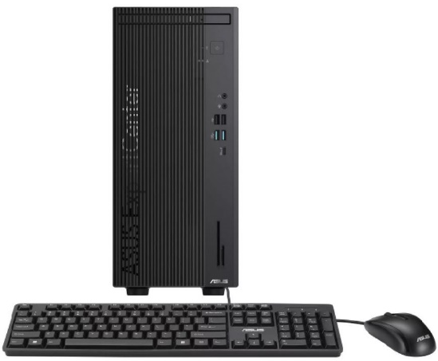
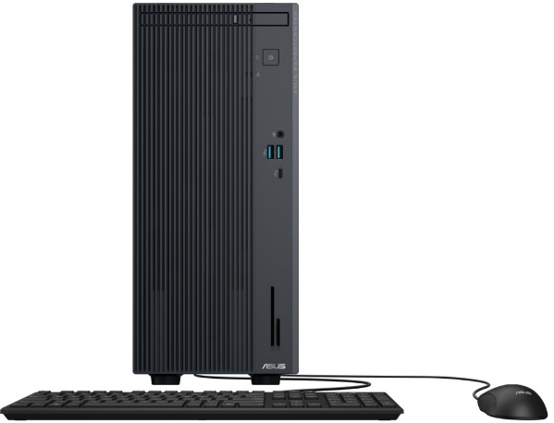
ALL IN ONE BUSINESS PCs
Retail File September 2025
Promo Offers are valid until 30.09 or until stock lasts.
A3402WVAK
A5402WVA
A5702WVA
90PT03T1-M033S0 ASUS PC ALL IN ONE A3402WVA, A3402WVAK-WPC1770, 23.8'', FHD 1920x1080 LCD 250NITS 100Hz AG, INTEL i7-1355U 1.7-5GHz/12MB, 10C, 16GB, 512GB SSD M.2 NVMe PCIe4, INTEL GRAPHICS, WIFI6E, BT, LAN, USB-A, USB-C, HDMI, DOS, 3YW, WHITE € 871
90PT03J3-M04B60 ASUS PC ALL IN ONE A5402WVA, A5402WVARK-BPC0320, 23.8'', FHD 1920x1080 LCD 250NITS 100Hz AG, INTEL CORE 5 120U, 1.4-5GHz/12MB, 10C, 16GB,512GB SSD M.2 NVMe PCIe4,INTEL IRIS X GRAPH,WIFI7,BT,LAN,USB-A,USB-C,USB4,HDMI,DOS,3YW,WHITE € 868
90PT03J3-M04B50 ASUS PC ALL IN ONE A5402WVA, A5402WVARK-BPC0310, 23.8'', FHD 1920x1080 LCD 250NITS 100Hz AG, INTEL CORE 7 150U 1.8-5.4GHz/12MB, 10C, 16GB, 512GB M.2 NVMe PCIe4, INTEL GRAPHICS, WIFI7,BT, LAN,USB-A,USB-C,USB4,HDMI,DOS,3YW, WHITE € 954
90PT03N1-M022J0 ASUS PC ALL IN ONE A5702WVA, A5702WVARK-BPE073X, 27'',FHD 1920x1080 LCD 250NITS 75Hz AG,INTEL CORE 5 120U 1.4-5GHz/12MB,10C,16GB,512GB SSD M.2 NVMe PCIe4,INTEL IRIS X GRAPH,WIFI6E,BT,LAN,USB-A,USB-C,USB4,HDMI,WIN 11 PRO,3YW,BLACK € 1054
D7 MT, D701MER
EXPERTCENTER BUSINESS PCs
P500 MT, MINI TOWER
90PF05J1-M00JA0 ASUS PC EXPERTCENTER D7 MT, D701MER-5145000320, INTEL i5-14500 2.6-5GHz/24MB, 14C, 16GB, 512GB SSD M.2 2280 NVMe PCIe4, INTEL UHD GRAPHICS 770, DVDRW, LAN, USB-A, USB-C, HDMI, DP, VGA, DOS, 5YW, BLACK € 707
90PF05J1-M00JB0 ASUS PC EXPERTCENTER D7 MT, D701MER-7147000480, INTEL i7-14700 2.1-5.3GHz/33MB, 20C, 16GB, 512GB SSD M.2 2280 NVMe PCIe4, INTEL UHD GRAPHICS 770, DVDRW, LAN, USB-A, USB-C, HDMI, DP, VGA, DOS, 5YW, BLACK € 929
90PF05I1-M00PW0 ASUS PC EXPERTCENTER P500 MT, P500MV-13620H0580, INTEL i7-13620H 2.4-4.9GHz/24MB, 10C, 16GB, 512GB SSD M.2 2280 NVMe PCIe4, INTEL UHD GRAPHICS, DVDRW, LAN, USB-A, USB-C, HDMI, DP, DOS, 5YW, GREY € 734
Call now on:
Mail on:
Prices, promotions, specifications, availability and terms of offers may change without notice. Despite our best efforts, a small number of items may contain pricing, typography, or photography errors. Correct prices and promotions are validated at the time your order is placed. Delivery and installation charges are not included. Products' warranty is the warranty given by the manufacturer. VAT is included

