Slide 1

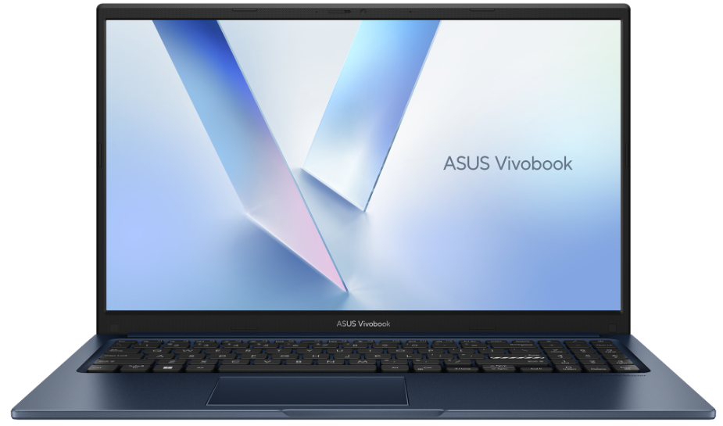
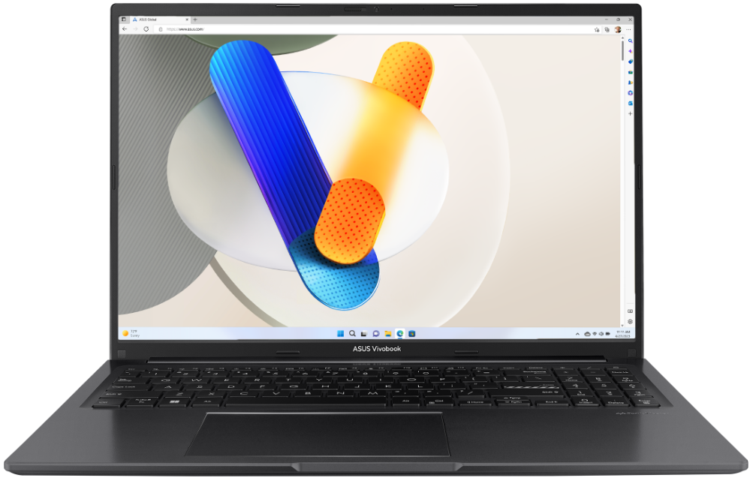
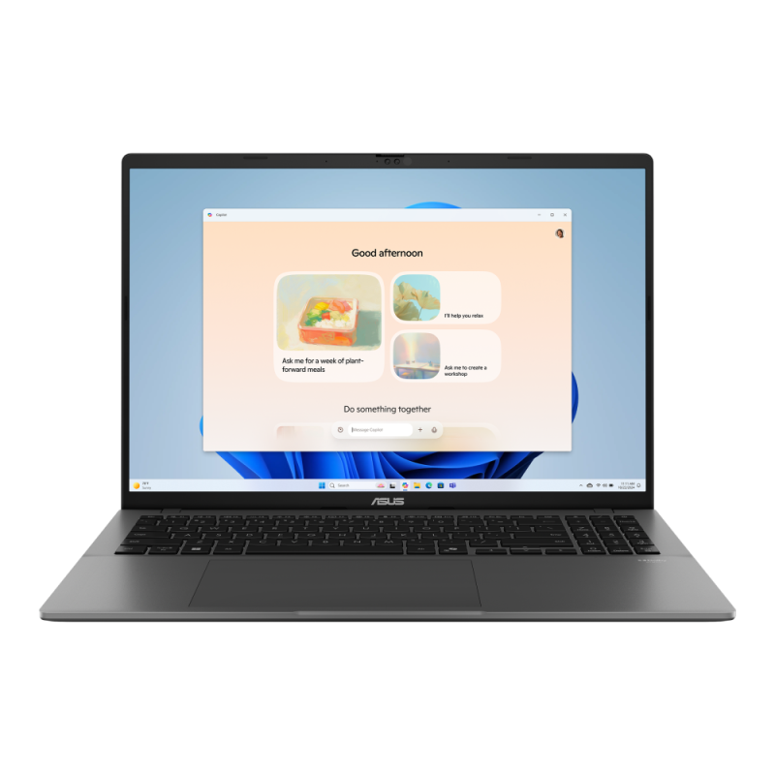
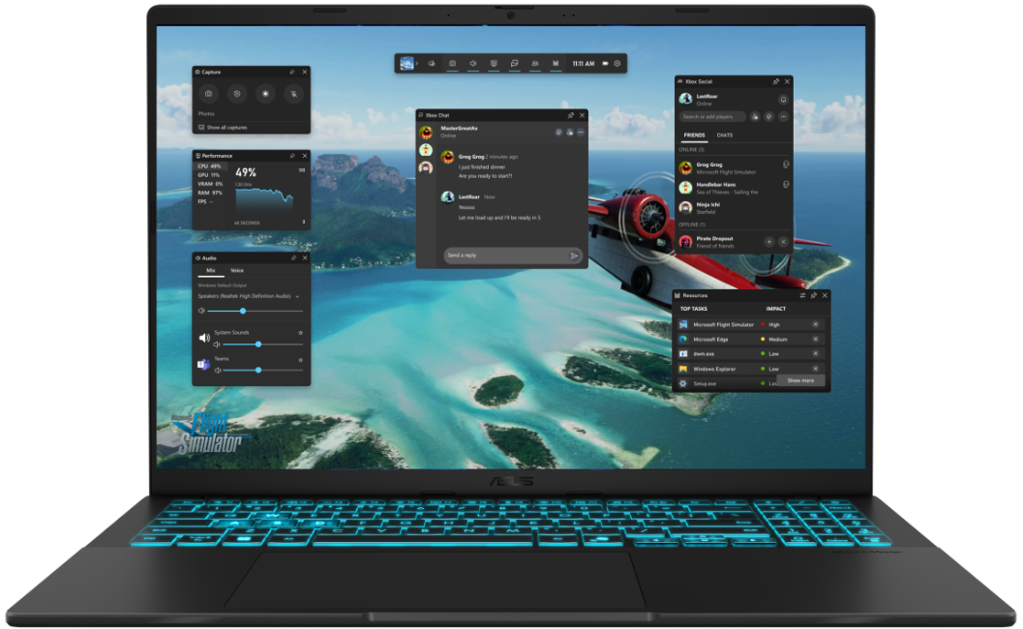
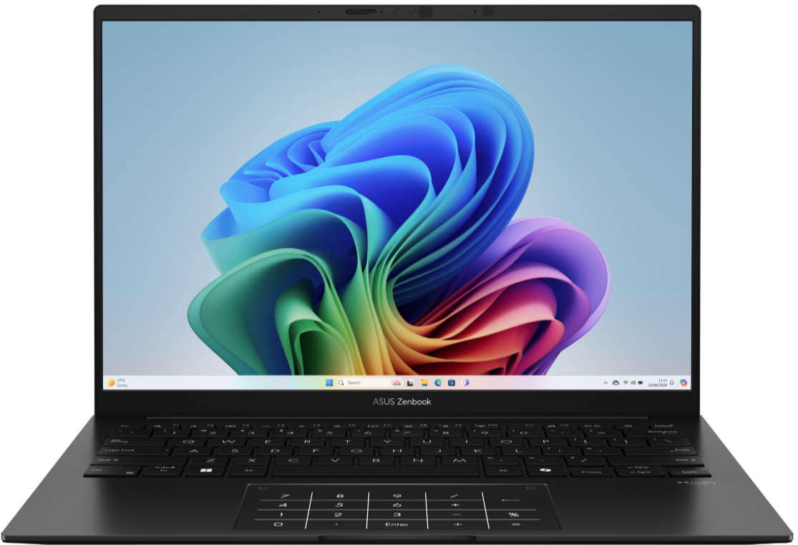

New Arrivals CONSUMER NOTEBOOKS
Retail File September 2025
Special Offers are valid until 05.10 or until stock lasts.
90NB13Y1-M011A0 ASUS NOTEBOOK VIVOBOOK 15, X1504VA-BQ3090W,i3-1315U, 1.2-4.5GHz/10MB, 6CORE, 8GB, 512GB M.2 NVMe™ PCIe4, Intel Graphics, FHD, 15.6''ANTI-GLARE, 250NITS, WIFI6, BT, USB-A, USB-C, HDMI, WIN 11 HOME, 2YW, QUIET BLUE 566 €
90NB10N3-M02TK0 ASUS NOTEBOOK VIVOBOOK 16, X1605VA-OLED-SH2331W, INTEL i7-13620H 2.4 GHz-4.9GHz/24MB, 10CORES,16GB,1TB M.2 NVMe PCIe4, Intel UHD Graph, 16'',300NITS,FHD 1920 x 1200 OLED 16:10,WIFI6E, BT, USB-A, USB-C, HDMI,WIN 11 HOME, 2YW, BLACK 973 €
90NB15Q1-M00TN0 ASUS NOTEBOOK V16, V3607VU-RP038W, INTEL CORE 5 210H, 2.2-4.8GHz/12MB, 8C, 16GB, 512GB M.2 NVMe PCIe4, NVIDIA GeForce RTX 4050 GPU 6GB GDDR6, 16''WUXGA 1920x1200 300NITS AG,WIFI6,BT,USB-A, USB-C, HDMI, WIN 11 HOME, 2YW,BLACK 1089 € - SPECIAL OFFER
90NB16T1-M00500 ASUS NOTEBOOK VIVOBOOK S16, M3607KA-OLED-SH008W,AMD RYZEN AI 7 350 2.0GHz, UP TO 5.0GHz, 8C, 50TOPS, 32GB, 1TB M.2 NVMe PCIe4, AMD RADEON GRAPH, 16' FHD1920x1200 OLED 16:10, Wi-Fi6, BT, USB-A, USB-C, HDMI, WIN 11 HOME, 2YW, GRAY 1442 €
90NB14U1-M00DB0 ASUS NOTEBOOK ZENBOOK 14, UM3406KA-OLED-PP164W, AMD RYZEN AI 7 350, 2-5GHz/24MB, 8C, 50TOPS, 32GB, 1TB SSD M.2 NVMe PCIe4, AMD RADEON, 14'' OLED 3K 2880x1800 600NITS, WIFI6E, BT, USB-A, USB-C, USB4, HDMI, WIN 11 HOME, 2YW, BLACK 1549 € -SPECIAL OFFER
Prices, promotions, specifications, availability and terms of offers may change without notice. Despite our best efforts, a small number of items may contain pricing, typography, or photography errors. Correct prices and promotions are validated at the time your order is placed. Recycling fees are not included in the Dealer & Retail File. Delivery and installation charges are not included. Products' warranty is the warranty given by the manufacturer. VAT is not included
Multitech b2b Place your order on: https://b2b.multitech.com.cy/en Click on any item part number for more specs and place your order online.
In case you don’t have an account yet please register in the below link https://b2b.multitech.com.cy/en/user/register
Prices, promotions, specifications, availability and terms of offers may change without notice. Despite our best efforts, a small number of items may contain pricing, typography, or photography errors. Correct prices and promotions are validated at the time your order is placed. Delivery and installation charges are not included. Products' warranty is the warranty given by the manufacturer. VAT is included
Call now on:
Mail on:
Call now on: 22-711300
Mail on:
orders@multitech.com.cy
A.T Multitech Corporation Ltd
ASUS Authorized Distributor
www.multitech.com.cy

Slide 2
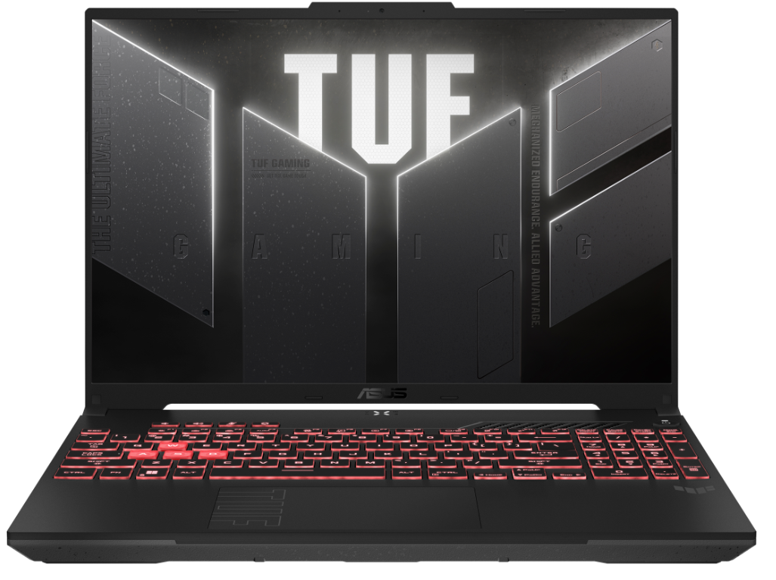
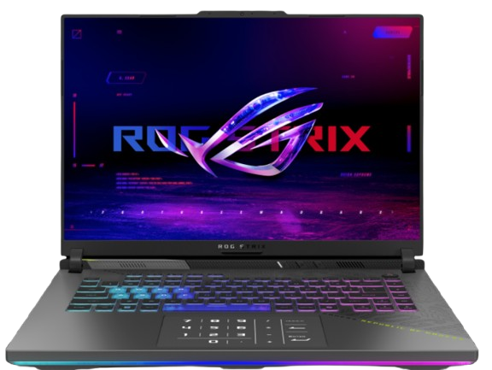
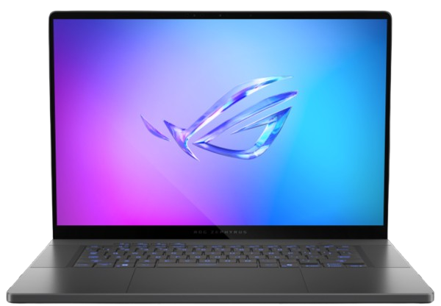
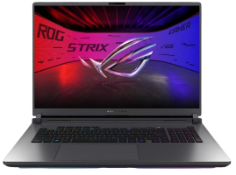
New Arrivals CONSUMER NOTEBOOKS
Retail File September 2025
Special Offers are valid until 05.10 or until stock lasts.
90NR0MU3-M00BN0 ASUS NOTEBOOK TUF A16 GAMING, FA607NUG-RL130W,AMD RYZEN 7 7445HS 3.2-4.7GHz/22MB, 6C, 16GB, 1TB PCIe4 NVMe M.2, NVIDIA GeForce RTX 4050 6GB,16''FHD+ 144Hz 300NITS,RGB,WIFI6,BT,LAN,USB4,USB-A,USB-C,HDMI,WIN 11 HOME, 2YW, MECHA GRAY 1204 € - SPECIAL OFFER
90NR0KW7-M002W0 ASUS NOTEBOOK ROG STRIX G16, G614PM-RV015W, AMD RYZEN 9 8940HX 2.4-5.3GHz/80MB,16C,32GB,1TB SSD M.2 NVMe PCIe4, NVIDIA RTX 5060 8GB, 16'' WUXGA 1920x1200 165Hz 300NITS, 4Z RGB KB,WIFI6E,BT,LAN,USB-C,USB-A,HDMI,WIN 11 HOME,2YW,GREY 2,751 €
90NR0LZ5-M00CF0 ASUS NOTEBOOK ROG ZEPHYRUS G16, GU605CR-QR139X,INTEL ULTRA 9 285H 2.9-5.4GHz/24MB,16C,32GB,1TB SSD M.2 NVMe,NVIDIA RTX 5070Ti 12GB,16'',WQXGA OLED 2.5K 2560x1600 240Hz 500NITS,RGB,WIFI7,BT,USB4,USB-C,USB-A,HDMI,WIN 11 PRO,2YW,GREY 4,238 €
90NR0LT1-M008K0 ASUS NOTEBOOK ROG STRIX G18, G815LR-S9137X, INTEL ULTRA 9 275HX 2.7-5.4GHz/36MB, 24C, 32GB, 2TB M.2 NVMe, NVIDIA RTX 5070Ti 12GB, 18'', WQXGA 2.5K 2560x1600 240Hz 500NITS, RGB/KEY, WIFI7, BT,LAN,USB5,USB-A,HDMI,WIN 11 PRO,2YW,GREY 4,351 €
Call now on:
Mail on:
Prices, promotions, specifications, availability and terms of offers may change without notice. Despite our best efforts, a small number of items may contain pricing, typography, or photography errors. Correct prices and promotions are validated at the time your order is placed. Delivery and installation charges are not included. Products' warranty is the warranty given by the manufacturer. VAT is included

