Slide 1

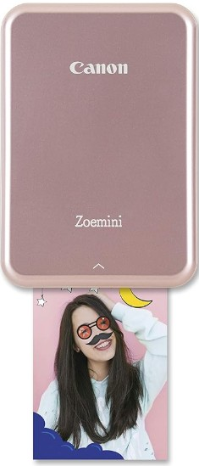



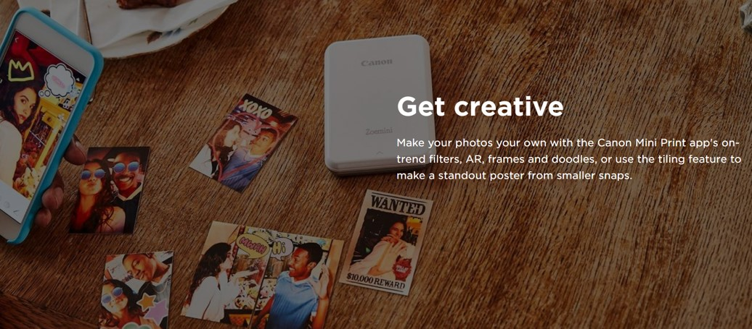
CANON MINI PHOTO PRINTER ZOEMINI
Retail File Sep 2025
CANON MINI PHOTO PRINTER ZOEMINI PV123
p/n: 3204C079AA
RRP: 79,00
Print Technology - ZINKTM
Print Resolution - 314dpi x 400 dpi
Borderless Printing – Yes
Connectivity - Bluetooth 4.0
Battery - Built-in (Rechargeable lithium
polymer - 2 cell, 7.4 V , 500mAh)
Display Type - 2 LED light system
Maximum Paper Size - 2.0” x 3.0”
Body Size (L x W x H) - 118.31 x 82.36 x 18.7mm
RRP: 19,99
CANON PAPER ZINK PAPER ZP-2030 20 SHEETS FOR ZOEMINI PV123P/N 3214C002AB
Get connected
Prices, promotions, specifications, availability and terms of offers may change without notice.
Despite our best efforts, a small number of items may contain pricing, typography, or photography errors.
Correct prices and promotions are validated at the time your order is placed.
Delivery installation charges are not included. VAT is included.
Call now on:
Fax your order on:
Mail on:

