Slide 1


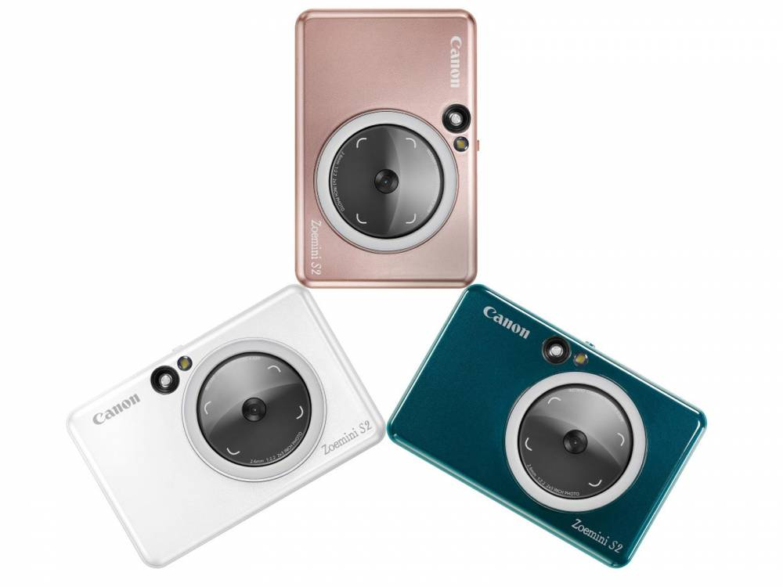
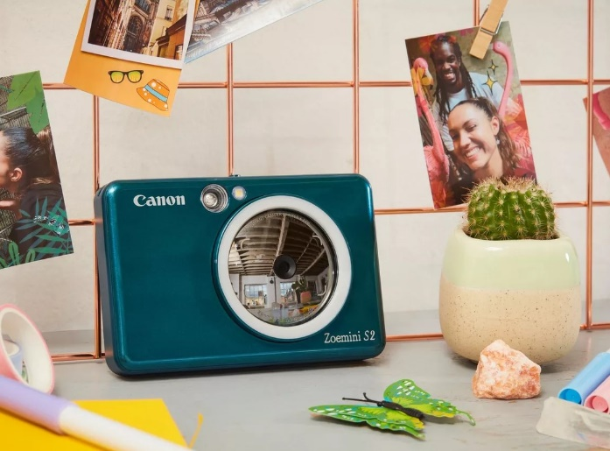

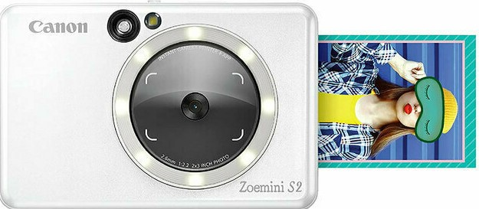
CANON ZOEMINI S2 INSTANT CAMERA
Retail File Sep 2025
CANON INSTANT CAMERA ZV223
p/n: 4519C007AA- 4519C008AA - 4519C006AA
RRP: 189,00
Mini moments, big stories.
Stick and style
Load up with up to 10 sheets
of sticky-backed Zink™ Photo Paper and print,
peel and stick your favourite
shots onto all your stuff, from the phone to the fridge.
Take a selfie with the mirror and ring-light, and check your pose with a live view from the Canon Mini Print app. Out of paper? Save your faves for printing later to the Micro SD card
CANON PAPER ZINK PAPER ZP-2030 20 SHEETS FOR ZOEMINI PV123P/N 3215C002AB
RRP: 35,00
Prices, promotions, specifications, availability and terms of offers may change without notice.
Despite our best efforts, a small number of items may contain pricing, typography, or photography errors.
Correct prices and promotions are validated at the time your order is placed.
Delivery installation charges are not included. VAT is included.
Call now on:
Fax your order on:
Mail on:

