Slide 1





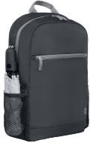
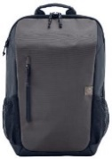





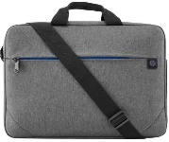




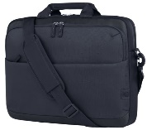




HP ACCESSORIES & OPTIONS CARRY CASES
HP 15.6" PRELUDE BACKPACK
HP 15.6 ‘’ BACKPACK
Retail File September 2025 Page 1/4
1X644A6 HP CARRY CASE PRELUDE PRO RECYCLED 15.6'',
CHARCOAL
28.00 €
2Z8P3AA HP PRELUDE BACKPACK 15.6, GREY, 28.00 €
1E7D6AA
HP PRELUDE BACKPACK 15.6, GREY, 40.00 €
2Z8A3AA HP CARRY CASE TRAVEL 15.6‘’ BACKPACK, GREY, 34.00 €
Promo prices are valid until 30/09 or until stock last
HP 15,6’’ CARRY CASES TRAVEL
HP 16 ‘’ ODYSSEY BACKPACK
6B8U6AA
HP CARRY CASE BACKPACK TRAVEL 15.6'' LIGHT AND STYLISH FORGED IRON 31.00 €
6B8U7AA
HP CARRY CASE TRAVEL 18L 15.6 BACKPACK, BLUE,
31.00 €
6B8U4AA
HP CARRY CASE TRAVEL 25L 15.6 LAPTOP BACKPACK, IRON GRAY 33.00 €
6B8U5AA
HP CARRY CASE TRAVEL 25L 15.6 BACKPACK, BLUE, 42.00 €
A08KLUT HP CARRY CASE BACKPACK EVERYDAY ODYSSEY 16'', GREY, 22.00 €
A08JXAA HP CARRY CASE EVERYDAY 16” ODYSSEY GRAY LAPTOP BACKPACK 31.00 €
9W0Z7AA HP CARRY CASE TRAVEL 15.6 LAPTOP BACKPACK, BLUE NIGHT, 24.00 €
HP PRELUDE PRO 15.6’’ & 17.3” BAGS
HP CARRY CASE CREATOR
2Z8P4AA HP CARRY CASE PRELUDE 15.6'' TOPLOAD ULTRALIGHT COMFORT WATER RESISTANT GREY 24.00 €
4Z514AA HP CARRY CASE BUSINESS PRELUDE PRO TOPLOAD 15.6'', STYLISH, DURABLE CASE, WATER RESISTANT COATING, GREY, 33.00 €
1E7D7A6 HP CARRY CASE PRELUDE TOPLOAD G2 15.6'', GREY, 33.00 €
6M5S4AA
HP CARRY CASE REATOR 13.3’’ SLING, DARK NAVY, 29.00 €
34Y64AA HP CARRY CASE PRELUDE TOPLOAD 17.3'', STYLISH, DURABLE CASE, GREY, 24.00 €
HP BUSINESS 15.6’’ BAG
HP ODYSSEY CARRY CASE 16''
HP PRELUDE PRO 17.3’’
HP BUSINESS 17.3’’
3E5F8AA HP CARRY CASE TOPLOAD 15.6'', BLACK, 31.00 €
A08JWAA HP CARRY CASE EVERYDAY 16 ODYSSEY GREY LAPTOP TOPLOAD, 28.00 €
3E2P1AA HP CARRY CASE TOPLOAD 17.3'', 35.00 €
3E2U6AA HP CARRY CASE TOPLOAD 17.3”, BLACK, 34.00 €
HP POUCH CASES
HP CASE NEOPRENE REVERSIBLE SLEEVE 14’’ & 15.6'', FLEXIBLE STYLE, EVERYDAY PROTECTION FROM BUMPS AND SCRAPES
2F2K6AA HP 15.6’’ CASE GOLD/ BLACK, 14.00 €
2F1W8AA HP 15.6’’ CASE, MAUVE/ BLACK, 14.00 €
2F2L4AA HP14’’ CASE , GREY / BLACK, 14.00 €
2F2L0AA HP 15.6’’ CASE BLACK/ GREY, 14.00 €
14V34AA HP POUCH SPORT, 21 x 14 x 6.5 CM, BLACK. 13.00 €
Prices, promotions, specifications, availability and terms of offers may change without notice. Despite our best efforts,
a small number of items may contain pricing, typography, or photography errors. Correct prices and promotions are validated at the time your order is placed. Recycling fees are not included in the Dealer & Retail File. Delivery and installation charges are not included. Products' warranty is the warranty given by the manufacturer. VAT is included
Call now on:
Mail on:

Slide 2




















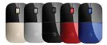








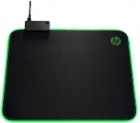


HP ACCESSORIES & OPTIONS MICE
HP PAVILION GAMING MOUSE USB 300 5,000 dpi optical sensor for precision.
HP X220 BACKLIT GAMING MOUSE USB
Retail File September 2025 Page 2/4
Promo prices are valid until 30/09 or until stock last.
4PH30AA, 8 BUTTONS 19.00 €
8DX48AA 7 BUTTONS, 16.00 €
HP MOUSE USB WIRED
HP MOUSE WIRELESS
HP OMEN VECTOR GAMING MOUSE USB, 6 BUTTONS
6VY96AA HP MOUSE 100 WIRED USB 1600DPI EASILY SET UP IN SECONDS WORKS WITH EAITHER HAND USB- A PORT BLACK , 13.00 €
1JR31AA HP MOUSE WIRELESS BLACK 31.00 €
9VA80A6 HP MOUSE 320M, BLACK 11.00 €
8BC52AA, OMEN RADAR 1 SENSOR, CO-DEVELOPED
WITH PIXART, 19.00 €
8BC53AA , OMEN RADAR 3 SENSOR, CO-DEVELOPED
WITH PIXART, CUSTOM LIGHTING THROUGH OMEN COMMAND CENTER,
31.00 €
HP MOUSE 150 WIRELESS
HP MOUSE 480 WIRELESS
HP MOUSE Z5000 BLUETOOTH WIRELESS. Three standard buttons and scroll wheel. Ultra-slim mouse control
HP MOUSE 220 WIRELESS
HP MOUSE 230 WIRELESS
2S9L1AA HP MOUSE 150 WIRELESS, 1600DPI, DESIGNED TO GET YOU CLICKING QUICKLY AND KEEP YOU PRODUCTIVE ALL DAY, 2Y, BLACK , 20.00 €
HP OMEN REACTOR GAMING MOUSE USB – 6 BUTTONS
Light beam detection enables a 0.2ms click response time, 3 times faster than a traditional mechanical mouse switch. Respond quicker in-game and enjoy extended durability with a 50 million click lifetime.
8T6M3AA HP MOUSE 480, COMFORT BLUETOOTH, BLACK, 34.00 €
AJ7C2AA , BLACK, 24.00 €
E5C13AA WHITE 26.00 €
HP 410 SLIM SILVER BLUETOOTH WIRELESS MOUSE
7KX12AA, SNOW WHITE, 15.00 €
7KX11AA LUMIERE BLUE, 16.00 €
HP MOUSE 240 WIRELESS
HP MOUSE 200 WIRELESS
HP MOUSE PRESENTER ELITE, BLUETOOTH
2VP02AA BLACK, 46.00 €
7ZF19AA WHITE, 54.00 €
Low-cost wireless has never been so easy. It gives you the freedom to create without being blocked by cables
HP MOUSE WIRELESS Z3700
4M0X6AA HP MOUSE 410 WHITE , 26.00 €
HP 280 SILENT BLACK WIRELESS MOUE
43N04AA PIKE SILVER 13.00 €
3V0G9AA BLACK 23.00 €
HP MOUSE DUAL MODE
With this dual mode wireless mouse, you can easily connect to two separate PCs via Bluetooth or 2.4 GHz wireless.
HP MOUSE 690 WIRELESS
2CE30AA UP TO 9.4 M TO PC, SLEEK METAL-ACCENTED DEVICE, FAST RECHARGING 59.00 €
V0L82AA RED, 16.00 €
X7Q43AA GOLD, 16.00 €
7UH88AA LUMIERE BLUE 16.00 €
V0L81AA DRAGONFLY BLUE 16.00 €
171D8AA WHITE, 17.00
4VY82AA WHITE/PINK, 18.00 €
758A9AA SILVER, 19.00 €
7M1D4AA HP MOUSE 690 RECHARGEABLE WIRELESS, BLACK, 2YW, 38.00 €
X6W31AA BLACK 22.00 €
2HU82AA RED 15.00 €
2HU84AA PIKE SILVER 15.00 €
2HU83AA SILK GOLD 14.00 €
19U64AA HP MOUSE 280M WIRELESS SILENT 2.4GHZ, 2 BUTTONS, 1200 DPI, 18-MONTHS BATTERY LIFE, GREAT FOR EITHER HAND, HP BLUE OPTICAL TECHNOLOGY, WORK ON ANY SURFACE, ANYTIME, 2YW, BLACK 26.00 €
HP MOUSE 700 SPECTRE RECHARGEABLE, BLUETOOTH WIRELLESS, PAIR WITH 4 DEVISES, WITH 1.200 DPI, THE LASER SENSOR PROVIDES SUPERB ACCURACY AND PRECISION — ON ALMOST EVERY SURFACE
HP MOUSEPAD
5JH72AA
200, SANITIZABLE MAT, 24.00 €
5JH72AA
PAVILION USB, 27.00 €
6CR72AA HP MOUSE WIRELESS, SILVER, 20.,00 €
3NZ70AA
DARK ASH SILVER, 52.00 €
3NZ71AA PIKE SILVER, 52.00 €
Prices, promotions, specifications, availability and terms of offers may change without notice. Despite our best efforts,
a small number of items may contain pricing, typography, or photography errors. Correct prices and promotions are validated at the time your order is placed. Recycling fees are not included in the Dealer & Retail File. Delivery and installation charges are not included. Products' warranty is the warranty given by the manufacturer. VAT is included
Call now on:
Mail on:

Slide 3





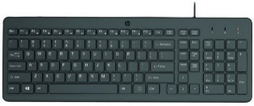
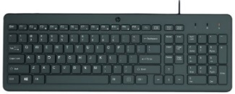

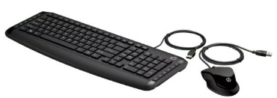
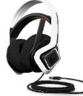
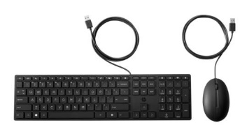

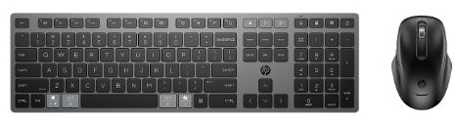





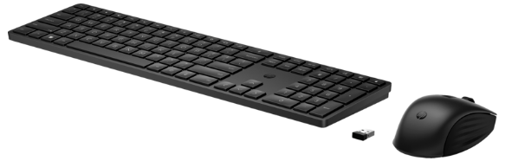

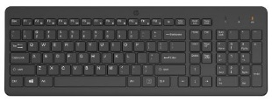
HP ACCESSORIES & OPTIONS
KEYBOARDS & KEYBOARDS /MOUSE SET
HP ACCESSORIES & OPTIONS
HEADPHONES & SPEAKERS
Retail File September 2025 Page 3/4
Go wherever your music takes you with the perfectly portable HP 350 Bluetooth5 speaker. Listen to music or take a call, hands-free, using the built-in mic with noise reduction.
Promo prices are valid until 30/09 or until stock last
HP WIRED KEYBOARDS
Pick up and go with this perfect plug-in-play companion, a comfortable keyboard with all the bells and whistles for wherever your journey takes you.
2D803AA BLUE 19.00 €
2D802AA BLACK 19.00 €
HP PAVILION WIRED KEYBOARD & MOUSE
2D799AA HP SPEAKER 360 BLUETTOTH, WHEREVER YOUR MUSIC TAKES YOU WITH THE PERFECTLY PORTABLE BLUETOOTH SPEAKER, WATER-RESISTANT AND DUST-RESISTANT RATING, BLACK, 19.00 €
664R5AA HP KEYBOARD 150 WIRED, BLACK, 23.00 €
240J7AA HP KEYBOARD AND MOUSE 150, WIRED, BLACK, 24.00 €
HP KEYBOARD & MOUSE WIRED USB
9DF28AA HP KEYBOARD AND MOUSE PAVILION 200, USB WIRED, BLACK , 31.00 €
6MF36AA HP HEADSET OMEN MIND-FRAME PRIME HEADSET, MICROPHONE, BUILT IN VIRTUAL SURROUND SOUND AUDIO CHIP POWERED BY C-MEDIA XEAR, OMEN'S ACTIVE EAR CUP COOLING TECHNOLOGY, COMPATIBLE WITH PCs WITH USB-A PORT, 1YW, WHITE, 124.00 €
9SR36UT HP KEYBOARD AND MOUSE 320MK, WIRED, BLACK, 24.00 €
4CE97AA HP KEYBOARD AND MOUSE PAVILION SLIM 400, USB WIRED BLACK , 40.00 €
HP KEYBOARD & MOUSE WIRELESS
HP KEYBOARD & MOUSE 720 WIRELESS
RECHARGEABLE
Boost your productivity, make a stylish IT choice, and get integrated security features with the HP USB Slim Smartcard Keyboard,
1Y4D0UT HP KEYBOARD AND MOUSE 235, WIRELESS, BLACK 29.,00 €
Z9H48AA HP KEYBOARD BUSINESS CCID WITH SMARTCARD READER BUILT INTO THE KEYBOARD, USB, 33.00 €
2V9E6AA HP KEYBOARD AND MOUSE 330, WIRELESS, BLACK 33.00 €
9T5A9AA HP KEYBOARD AND MOUSE 720 MULTI-DEVICE RECHARCHABLE, WIRELESS, BLACK, 86.00 €
18H24AA HP KEYBOARD AND MOUSE 230, WIRELESS, BLACK 38.00 €
3L1F0AA HP KEYBOARD AND MOUSE 230, WIRELESS, WHITE, 38.00 €
HP KEYBOARD OMEN GAMING BY HP ENCODER
HP KEYBOARD WIRELESS
4R009UT HP KEYBOARD AND MOUSE 655, WIRELESS, BLACK 46.00 €
4R013AA HP KEYBOARD AND MOUSE 650, WIRELESS, BLACK 59.00 €
HP KEYBOARD WIRELESS
3L1E7AA HP KEYBOARD HP KEYBOARD 230 WIRELESS, STYLISH DESIGN WITH COMFORT IN MIND, EASILY ACTIVATES ALL 12 FUNCTION KEYS WITH JUST ONE CLICK, UP TO 16 MONTHS OF POWER, BLACK, 36.00 €
6YW76AA HP KEYBOARD OMEN GAMING BY HP ENCODER, COMMAND A FLAWLESS SYMPHONY OF KEYSTROKES, CHERRY MX RED MECHANICAL SWITCHES DELIVER THE AGILITY YOU NEED TO MANEUVER AHEAD OF THE COMPETITION, RED, 92.00 €
805T2AA HP KEYBOARD 220 WIRELESS, BLACK, 29.00 €
Prices, promotions, specifications, availability and terms of offers may change without notice. Despite our best efforts,
a small number of items may contain pricing, typography, or photography errors. Correct prices and promotions are validated at the time your order is placed. Recycling fees are not included in the Dealer & Retail File. Delivery and installation charges are not included. Products' warranty is the warranty given by the manufacturer. VAT is included
Call now on:
Mail on:

Slide 4







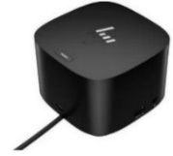




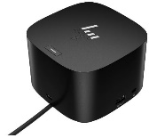







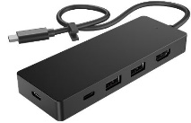





HP ACCESSORIES & OPTIONS
VGA CARDS, DOCKING STATIONS, PEN ,ADAPTORS
HP USB HUBs
Retail File September 2025 Page 4/4
5LX63AA HP HUB ENVY USB-C, HOST PORT (USB 3.0 - TYPE C ALT-MODE W/PD 3.0) WITH CABLE, USB 3.0, USB 2.0, HDMI 2.0, TYPE C POWER PASS THROUGH PORT, CAN CHARGE THE NOTEBOOK, 54.00 €
Promo prices are valid until 30/09 or until Stock last
HP DOCKING STATIONS
5TW10AA HP DOCKING STATION USB-C 100W G5, UNIVERSAL, USB TYPE-C, USB 3.0 (SIDE, CHARGING SS), 3X USB 3.0 (BACK CHARGING), 2X DISPLAY PORT, HDMI, RJ-45, 1 X HEADPHONE AND MICROPHONE, 1YW, 147.00 €
ADAPTOR
N8N14AA - HP ADAPTER 45W USB-C, SUPPORT FOR 4 VOLTAGES WITH A SLIMMER CONNECTOR 33.00 €
9X472UT HP DOCK THUNDERBOLT 100W G6 , 3x USB-A, 2x USB-C, 1x THUNDERBOLT 4, 2x DISPLAY PORT 1.4, 1x HDMI 2.1, 1x RJ45, NANO LOCK SLOT, 3YW, 208.00 €
HP PENS
4J0A2AA HP DOCK THUNDERBOLT 120W G4 , 2X USB 3.2, USB-C, 1 X HDMI, LAN, 2X DISPLAY PORT, 232.00 €
HP OPTIONS FOR PRINTERS AND PLOTTERS
3J122AA HP PEN RECHARGEABLE MPP 2.0 TILTI, BLACK 40.00 €
6TX91A HP STAND FOR PLOTTERS T125, T130, T525, T530, 244.00 €
3C753A - HP STAND FOR PLOTTERS T230, T250 278.00 €
6SG43AA HP PEN RECHARGEABLE ACTIVE PEN G3, 3 BUTTONS, ONSCREEN NOTE-TAKING, USB-C, FOR ELITEBOOK SERIES, DRAGONFLY, 1YW, GREY 75.00 €
4J0G4AA HP DOCK THUNDERBOLT 4 280W G4 W/COMBO CABLE , 2X USB 3.2, USB-C, 1 X HDMI, LAN, 2X DISPLAY PORT, 294.00 €
CF084A HP TRAY 500 SHEET PAPER AND HEAVY MEDIA TRAY FOR M551n, M551dn, M551xh, CP3525, CP3525n, CP3525dn, CP3525x, CM3530, CM3530fs, 352.00 €
B3Q36A HP SPINDLE FOR DESIGNJET PLOTTER T120 / T520 24IN, 83.00 €
LOCK FOR LAPTOPS
HP TRAVEL HU8
HP FAN, STAND & BRACKET
6UW42AA HP SURE KEY CABLE LOCK FOR NOTEBOOK, PCS, THIN CLIENTS, WORKSTATION, 25.00 €
86S97UT HP HUB TRAVEL G3, USB-C x 2, USB-A x 2 and HDMI, DISPLAY SUPPORT HDMI 2.0 UP TO4K -60Hz, WITH CABLE, 48.00 €
2JA32AA HP MOUNT STAND FOR DESKTOP MINI SECURITY & DUAL VESA SLEEVE COMPATIBLE WITH HP PC 260 / 400 / 600 / 700 / 800 MINI SERIES ONLY, 23.00 €
NQ099AA HP OPTICAL BAY HDD MOUNTING BRACKET FOR HP WORKSTATION PCS, 42.00 €
A2Z46AA HP Z4 Z2 FAN AND FRONT CARD GUIDE KIT, 20.00 €
HP DISPLAY ADAPTORS
FH973AA HP ADAPTER DISPLAY PORT TO DVI-D CONVERTER,
12.00 €
P7Z54AA HP ADAPTER USB-C TO VGA DISPLAY ADAPTER, 25.00 €
HP ETHERNET CARD
HP GRAPHICS CARDS – AMD & NVIDIA
1QL49AA HP ETHERNET CARD 10GBASE-T DUAL NIC MODULE FOR HP WORKSTATIONS Z6/Z8 G4 , 198.00 €
9GC16AA HP VGA CARD AMD RADEON PRO W5500 8GB, 4 DISPLAY PORTS CONNECTS UP TO 4 MONITORS FOR Z SERIES WORKSTATIONS, 636.00 €
Prices, promotions, specifications, availability and terms of offers may change without notice. Despite our best efforts,
a small number of items may contain pricing, typography, or photography errors. Correct prices and promotions are validated at the time your order is placed. Recycling fees are not included in the Dealer & Retail File. Delivery and installation charges are not included. Products' warranty is the warranty given by the manufacturer. VAT is included
Call now on:
Mail on:
Notes:
Web Cameras

