Slide 1








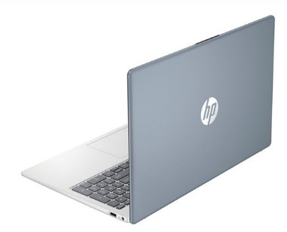

HP Home and Envy Notebooks
Experience seamless connectivity with the HP Envy 16". Combine the creative power of your devices with HP Palette. Enjoy the ultimate color accuracy on a 16" display. Plus, with the Intel® Processor and powerful graphics, it can handle what you throw at it. Look and sound your best on video calls with a 5MP camera with Auto Frame and AI Noise Reduction.
Retail File September 2025 Page 1/6
Promo prices are valid until 30/09 or Until Stock Last.
9W0Z7AA HP CARRY CASE TRAVEL 15.6 LAPTOP BACKPACK, BLUE NIGHT 24.00 €
The HP 15.6" Laptop PC empowers you to do more with the reliable power of an Intel® Processor & AMD Processor plus ample storage, and powerful graphics in a sleek, thoughtfully designed device. Created for wherever the day takes you and built with ocean-bound and post-consumer recycled plastics, it’s easy to show some love for the planet.
A08KLUT HP CARRY CASE BACKPACK EVERYDAY ODYSSEY 16'', GREY 22.00 €
803Y4EA HP NOTEBOOK ENVY 16-H1003NV, INTEL i7-13700H 3.7-5.0GHz/24MB, 14 CORES, 16GB, 512GB PCle SSD, INTEL ARC A370M 4GB, 16'' WQXGA, WIN 11 HOME, 2YW, NATURAL SILVER, 1884.00 €
HP MOUSE WIRELESS Z3700
7UH88AA LUMIERE BLUE 15.80 €
171D8AA WHITE, 16.42 €
758A9AA SILVER, 18.45 €
67U58EA HP NOTEBOOK 15s-EQ2031NV, AMD RYZEN 3 5300U 2.6-3.8GHz/4MB, 4 CORES, 8GB, 256GB PCIe NVMe M.2 SSD, AMD RADEON GRAPHICS, 15.6' FHD, WIN 11 HOME IN S MODE, 2YW, SILVER, 679.00 €
V0L82AA RED, 15.80 €
4VY82AA WHITE/PINK, 17.75 €
588Q2B HP PRINTER ALL IN ONE INKJET COLOR DESKJET HOME 2821e HP+ A4, PRINT, SCAN COPY, 7PPM (B), 5PPM (C), DC:1K, 60P INPUT TRAY, AIR PRINT, USB, WIFI, 1YW 53.00 €
94C21E9 HP MONITOR 23.8'', S5 524SW HOME, E, IPS, FHD 1920x1080, 100Hz, 16:9, 5MS, 300 NITS, ANTIGLARE, TILT, HDMI, VGA, 2YW, WHITE 158.00 €
7P364EA HP NOTEBOOK 15-FD0012NV, INTEL I3-1315U 3.3-4.5GHz /10MB, 6 CORES, 8GB, 512GB PCIe SSD, INTEL IRIS XE GRAPHICS, 15.6'' FHD, WIN 11 HOME, 2YW, MOONLIGHT BLUE, 838.00 €
94F46E9 HP MONITOR 27'', S5 527SW HOME, D, IPS, FHD 1920x1080, 100Hz, 16:9, 5MS, 300 NITS, ANTIGLARE, TILT, 2X HDMI, VGA, 2YW, WHITE 185.00 €
Prices, promotions, specifications, availability and terms of offers June change without notice. Despite our best efforts,
a small number of items June contain pricing, typography, or photography errors. Correct prices and promotions are validated at the time your order is placed. Recycling fees are not included in the Dealer & Retail File. Delivery and installation charges are not included. Products' warranty is the warranty given by the manufacturer. VAT is included
Call now on:
Mail on:

Slide 2

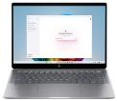




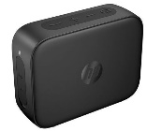




HP Pavilion & Spectre
Home Notebooks
The HP OmniBook Ultra Next Gen AI PC is the ultimate powerhouse for supercharged compute and graphics performance to create and play. With personalized and secure AI tools to amplify your productivity and the best video/audio enhancement tools for authentic connections - all while safeguarding your PC with HP Wolf Security features for consumers.
HP MOUSE 700 SPECTRE RECHARGEABLE, BLUETOOTH WIRELLESS, PAIR WITH 4 DEVISES, WITH 1.200 DPI, THE LASER SENSOR PROVIDES SUPERB ACCURACY AND PRECISION — ON ALMOST EVERY SURFACE
Retail File September 2025 Page 2/6
Promo prices are valid until 30/09 or Until Stock Last.
3NZ70AA
DARK ASH SILVER, 34.87 €
3NZ71AA PIKE SILVER, 34.87 €
Powered by Snapdragon® X Elite, featuring an AI engine with dedicated NPU and with up to 26-hour battery life, the new OmniBook X AI will take your personalized productivity to the next level. A 5MP camera with Windows Studio Effects and the best collaboration tools will enhance your connections without interruptions.
B4ZW7EA HP NOTEBOOK OMNIBOOK ULTRA 14-FD0005NN, AMD RYZEN AI 9HX 375 3.3-5.1GHz/24MB, 12 CORES, 32GB, 1TB PCIe NVMe M.2 SSD, AMD RADEON GRAPHICS, 14'' 2.2K TOUCH, WIN 11 HOME, 3YW, METEOR SILVER, 2056.00 €
HP MOUSE 240 WIRELESS
43N04AA PIKE SILVER 7.57 €
A8TG0EA HP NOTEBOOK OMNIBOOK X 14-FE0000NV, QC SNAPDRAGON X1E-78-100 AI 3.4GHz/12MB, 12 CORES, 32GB, 1TB PCIe NVMe M.2 SSD, QUALCOMM ADRENO 660 GRAPHICS, 14'' 2.2K TOUCH, WIN 11 HOME, 3YW, METEOR SILVER 1784.00 €
HP BACKPACK TRAVEL 15,6’’
PORTABLE WIRELESS BLUETOOTH SPEAKER
2Z8A3AA
HP CARRY CASE BACKPACK TRAVEL 15.6'', WATER RESISTANT, GREY , 34.00 €
2D802AA BLACK 10.90 €
Enjoy power, mobility, and style with the HP OmniBook Ultra Flip Next Gen AI PC. Bring your creations to life with the latest AI accelerating Intel® Core™ Ultra Processor. Do more in less time with private and secure AI tools and extended battery life, all while safeguarding your PC with HP Wolf Security features for consumers.
9DF28AA HP KEYBOARD AND MOUSE PAVILION 200, USB WIRED, GREEK, BLACK, 31.00 €
B17ZNEA HP NOTEBOOK OMNIBOOK ULTRA FLIP 14-FH0002NV, INTEL ULTRA 7-256V 3.7-4.8GHz/12MB, 8 CORES, 16GB, 1TB PCIe GEN 4 NVMe M.2 SSD, INTEL ARC GRAPHICS, 14'' 2.8K OLED TOUCH (2880x1880), W/PEN, WIN 11 HOME, 2YW, ATMOSPHERIC BLUE 1982.00 €
6UW42AA HP SURE KEY CABLE LOCK FOR NOTEBOOK, PCS, THIN CLIENTS, WORKSTATION, 25.00 €
Prices, promotions, specifications, availability and terms of offers June change without notice. Despite our best efforts,
a small number of items June contain pricing, typography, or photography errors. Correct prices and promotions are validated at the time your order is placed. Recycling fees are not included in the Dealer & Retail File. Delivery and installation charges are not included. Products' warranty is the warranty given by the manufacturer. VAT is included
Call now on:
Mail on:

Slide 3

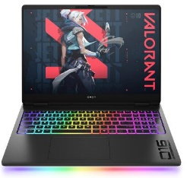

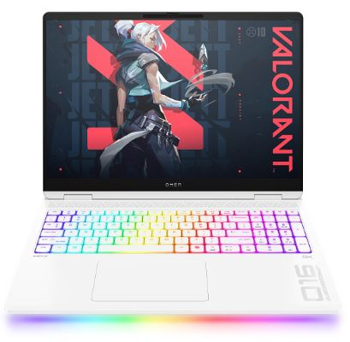

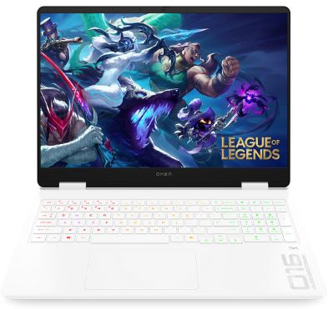

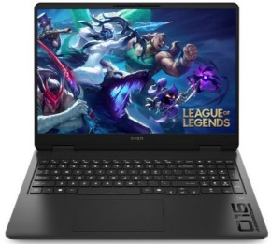
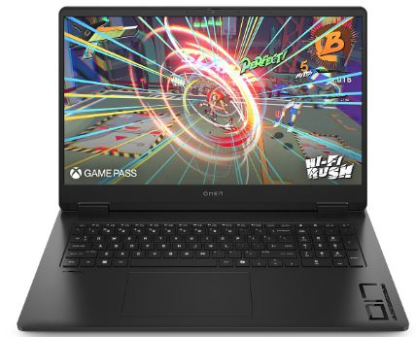

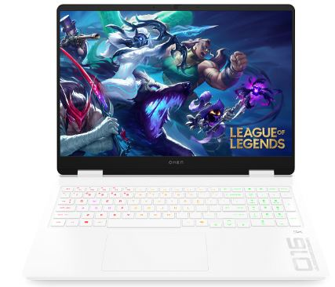


HP Gaming Notebooks
The Omen Transcend 14. Experience a blend of premium design and high performance with our ultra-thin, lightweight all-metal device. Enjoy long-lasting battery life, USB-C™ fast charge, and up to an Intel® Core™ Ultra Processor, NVIDIA® GeForce RTX™ 40 Series graphics, and 2.8K 120Hz OLED display. Ideal for all computing needs, including gaming.
OMEN MAX Gaming Laptops 16. Minimize your efforts with the latest Intel Core™ Ultra processors , next-generation NVIDIA graphics and thermal architecture that can truly keep up with the game
Retail File September 2025 Page 3/6
Promo prices are valid until 30/09 or Until Stock Last.
C0DM6EA HP NOTEBOOK OMEN MAX GAMING 16-AH0032NV,INTEL ULTRA 9-275HX 2.5-5.8GHz/36MB,24 CORES,13 NPU TOPs, 64GB, 2TB PCIe NVMe M.2 SSD, NVIDIA GEFORCE RTX 5070 Ti 12GB,16.0'' OLED2.5K 240Hz,WIN 11 PRO,2YW,BLACK,CASHBACK 150€ UNTIL 31/10 3828.00 €
The HP Victus Laptop is made for peak PC gaming. This sleek machine touts a powerful AMD, Intel processor and NVIDIA graphics​. This laptop’s design is just as impressive as its hardware with plenty of color options, updated thermals and a HD camera with Temporal Noise Reduction.
A3HQ5EA HP NOTEBOOK OMEN GAMING 14-FB0011NV, INTEL CORE ULTRA 7-155H AI 3.8-4.8GHz/24MB, 16 CORES, 16GB, 512GB PCIe NVMe M.2 SSD, NVIDIA GEFORCE RTX 4050 6GB, 14'' 2.8K OLED 120Hz, WIN 11 HOME, 2YW, SHADOW BLACK 2081.00 €
A44M8EA HP NOTEBOOK VICTUS GAMING 16-S1003NV, AMD RYZEN 7-8845HS 3.8-5.1GHz/16MB, 8 CORES, 16GB, 512GB PCIe NVMe M.2 SSD, NVIDIA GEFORCE RTX 4070 8GB, 16.1'' FHD 165Hz, WIN 11 HOME, 2YW, MICA SILVER, 1870.00 €
C0DT9EA HP NOTEBOOK OMEN MAX GAMING 16-AH0052NV,INTEL ULTRA 9-275HX 2.5-5.8GHz/36MB,24 CORES,13 NPU TOPs,32GB,1TB PCIe NVMe M.2 SSD,NVIDIA GEFORCE RTX 5080 16GB,16.0'' OLED2.5K 240Hz,WIN 11 PRO,2YW,CERAMIC WHITE,CASHBACK 150€ UNTIL 31/10, 4195.00 €
The OMEN 16” gaming laptops are engineered to redefine your gaming experience, offering a blend of power, precision, and immersive design. With cutting-edge hardware, high refresh rates, and top-tier graphics, the Omen Gaming laptops 16'' are the ultimate companions for gamers who demand exceptional performance.
B4ZW9EA HP NOTEBOOK VICTUS GAMING 16-S1008NV, AMD RYZEN 7-8845HS 3.8-5.1GHz/16MB, 8 CORES, 16GB, 512GB NVMe M.2 SSD, NVIDIA GEFORCE RTX 4050 6GB, 16.1'' FHD IPS 165Hz, WIN 11 HOME, 2YW, MICA SILVER 1994.00 €
C0DN2EA HP NOTEBOOK OMEN GAMING 16-am0035nv, INTEL i7-14650HX 2.2-5.2GHz/30MB, 16 CORES, 24GB, 1TB PCIe NVMe M.2 SSD, NVIDIA GEFORCE RTX 5060 8GB, 16.0'' 2K 165Hz, WIN 11 HOME, 2YW, CERAMIC WHITE
2150.00 €
BW4Z4EA HP NOTEBOOK OMEN MAX GAMING 16-AH0050NV, INTEL ULTRA 9-275HX 2.5-5.8GHz/36MB,24 CORES,13 NPU TOPs,32GB,2TB PCIe NVMe M.2 SSD,NVIDIA GEFORCE RTX 5080 16GB, 16.0''OLED2.5K 240Hz,WIN 11 PRO,2YW,CERAMIC WHITE,CASHBACK 150€ UNTIL 31/10, 4299.00 €
6YW76AA HP KEYBOARD OMEN GAMING BY HP ENCODER, COMMAND A FLAWLESS SYMPHONY OF KEYSTROKES, CHERRY MX RED MECHANICAL SWITCHES DELIVER THE AGILITY YOU NEED TO MANEUVER AHEAD OF THE COMPETITION, RED 92.00 €
With the new OMEN 17, we didn't waste time loading it with features you'd never use. Instead, with an impressive 17" IPS display with 100% sRGB, new AI-enhanced AMD Ryzen™ 8000 CPUs and NVIDIA® RTX™ 40 Series GPUs, as well as a 1-zone RGB numeric keyboard, it's everything you need for great gaming and nothing you don't.
C0DP1EA HP NOTEBOOK OMEN GAMING 16-ap0017nv, AMD RYZEN AI 7 350 2.0-5.0GHz/16MB, 8 CORES, 50 NPU TOPs, 32GB, 1TB PCIe NVMe M.2 SSD, NVIDIA GEFORCE RTX 5070 8GB, 16.0'' 2.5K 240Hz, WIN 11 HOME, 2YW, SHADOW BLACK,CASHBACK 80€ UNTIL 31/10 2339.00 €
6MF36AA HP HEADSET OMEN MIND-FRAME PRIME HEADSET, MICROPHONE, BUILT IN VIRTUAL SURROUND SOUND AUDIO CHIP POWERED BY C-MEDIA XEAR, OMEN'S ACTIVE EAR CUP COOLING TECHNOLOGY, COMPATIBLE WITH PCs WITH USB-A 1YW, WHITE, 125.00 €
B61P7EA HP NOTEBOOK OMEN GAMING 17-DB0002NV, AMD RYZEN 9-8945HS 4.0-5.2GHz/16MB, 8 CORES, 32GB, 1TB PCIe NVMe SSD, NVIDIA GEFORCE RTX 4060 8GB, 17.3'' FHD 144Hz, WIN 11 HOME, 2YW, SHADOW BLACK 2063.00 €
C0DN1EA HP NOTEBOOK OMEN GAMING 16-am0034nv, INTEL i7-14650HX 2.2-5.2GHz/30MB, 16 CORES, 32GB, 1TB PCIe NVMe M.2 SSD, NVIDIA GEFORCE RTX 5070 8GB, 16.0'' 2.5K 240Hz, WIN 11 HOME, 2YW, CERAMIC WHITE,CASHBACK 80€ UNTIL 31/10 2464.00 €
C0DP4EA HP NOTEBOOK OMEN GAMING 17-db1008nv, AMD RYZEN AI 7 350 2.0-5.0GHz/16MB, 8 CORES, 50 NPU TOPs, 24GB, 1TB PCIe NVMe M.2 SSD, NVIDIA GEFORCE RTX 5060 8GB, 17.3'' FHD 144Hz, WIN 11 HOME, 2YW, SHADOW BLACK
2150.00 €
BV6E4EA HP NOTEBOOK OMEN GAMING 17-db1003nv, AMD RYZEN AI 7 350 2.0-5.0GHz/16MB, 8 CORES, 50 NPU TOPs, 32GB, 1TB PCIe NVMe M.2 SSD, NVIDIA GEFORCE RTX 5060 8GB, 17.3'' FHD 144Hz, WIN 11 HOME, 2YW, SHADOW BLACK,CASHBACK 80€ UNTIL 31/10, 2202.00 €
4PH30AA HP MOUSE PAVILION GAMING 300 USB, 5000 DPI OPTICAL SENCOR, 8 BUTTONS, TOTAL WITH 2 THUMB BUTTONS ON EACH SIDE, MAKING IT IDEAL WHETHER YOU’RE LEFT OR RIGHT-HANDED, BLACK/GREEN 19.00 €
5JH72AA HP MOUSEPAD PAVILION USB, 27.00 €
Prices, promotions, specifications, availability and terms of offers June change without notice. Despite our best efforts,
a small number of items June contain pricing, typography, or photography errors. Correct prices and promotions are validated at the time your order is placed. Recycling fees are not included in the Dealer & Retail File. Delivery and installation charges are not included. Products' warranty is the warranty given by the manufacturer. VAT is included
Call now on:
Mail on:

Slide 4

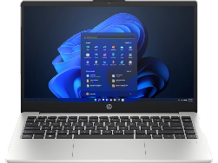
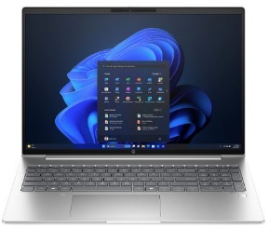
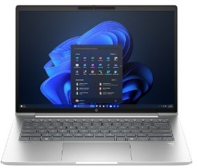

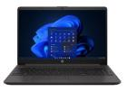






HP 250 & ProBook 400 Series Business Notebooks
The HP 250 G9 /G10 Laptop provides essential business-ready features in a thin and light design that’s easy to take everywhere you go. The 15.6-inch diagonal display with big screen-to-body ratio, powerful Intel® processor, fast memory, and storage is powered for productivity, while the included ports connect your peripherals—all at a price you can value.
The HP ProBook 460/465 16-inch laptop provides growing businesses with commercial-grade performance, multi-layered endpoint security, and durability in an easily upgradeable design. Powered by the latest Intel® processor and long battery life, this feature-rich PC is well-equipped for long-term productivity and helps enable hybrid work.
Retail File September 2025 Page 4/6
Promo prices are valid until 30/09 or Until Stock Last.
The HP ProBook 4 G1iR 14-inch Notebook PC helps businesses advance with a durable, budget-friendly PC featuring essential tools for productivity and multi-layered endpoint security to help tackle your daily tasks.
C4HZ5ET HP NOTEBOOK PROBOOK 4 G1iR 14, INTEL ULTRA 7-150U 4.0-5.4GHz/12MB, 10 CORES, 16GB (1x16GB), 512GB PCIe NVMe SSD, INTEL GRAPHICS, 14'' WUXGA IPS, WIN 11 PRO, 3YW, 1220.00 €
A38H3ET HP NOTEBOOK 250 G9, INTEL CELERON N4500 1.1-2.8GHz/4MB, 2 CORES, 8GB (1x8GB), 256GB PCIe NVMe SSD, INTEL UHD GRAPHICS, USB-C, LAN, 15.6'' FHD, WIN 11 HOME, 1YW, DARK ASH SILVER 365.00 €
A38DTET HP NOTEBOOK PROBOOK 465 G11, AMD RYZEN 5 7535U 2.9–4.55GHZ/16MB, 6 CORES, 16GB, 512GB PCIe NVMe SSD, AMD RADEON 660M GRAPHICS, 16'' WUXGA IPS, WIN 11 PRO, 3YW, SILVER 875.00 €
AK9T9AT HP NOTEBOOK 250 G9, INTEL i5-1335U 3.4-4.6GHz/12MB, 10 CORES, 16GB (1x16GB), 512GB PCIe NVMe SSD, INTEL IRIS XE GRAPHICS, 15.6'' FHD, DOS, 1YW, DARK ASH SILVER, 614.00 €
The HP ProBook 445 14-inch laptop provides growing businesses with commercial-grade performance, advanced multi-layered security, and durability in an easily upgradeable design. Powered by an AMD processor and long battery life, this feature-rich PC is well-equipped for long-term productivity and helps enable hybrid work.
9G1V1ET HP NOTEBOOK PROBOOK 460 G11, INTEL ULTRA 5-125U AI VPRO 1.3-4.3GHZ/12MB, 12 CORES, 16GB (1x16GB), 512GB PCIe NVMe SSD, INTEL GRAPHICS, 16'' WUXGA IPS, TYPE-C, LAN, WIN 11 PRO, 3YW, SILVER 974.00 €
The HP 255 G9/G10 Laptop provides essential business-ready features in a thin and light design that’s easy to take everywhere you go. The 15.6-inch diagonal display with 85 percent screen-to-body ratio, robust AMD Ryzen™ processor, fast memory,
and storage is powered for productivity, while the included ports
connect your peripherals—all at a price you can value.
AL0D5AT HP NOTEBOOK PROBOOK 445 G10, AMD RYZEN 5-7530U 2-4.5GHZ/16MB, 6 CORES, 16GB (1X16GB), 512GB PCIe NVMe SSD, AMD RADEON GRAPHICS, USB-C, HDMI, DP, BT, BACKLIT KEY, FP, 14'' FHD IPS, WIN 11 PRO, 3YW, PIKE SILVER ALUMINIUM, 858.00 €
A37ZMET HP NOTEBOOK PROBOOK 460 G11, INTEL ULTRA 7-155H AI 3.8-4.8GHZ/24MB, 16 CORES, 32GB (2x16GB), 1TB PCIe NVMe SSD, INTEL ARC GRAPHICS, 16'' WUXGA IPS, WIN 11 PRO, 3YW, PIKE SILVER 1382.00 €
9Y713AT HP NOTEBOOK 255 G10, RYZEN 3-7330U 2.3-4.3GHZ/8MB, 4 CORES, 8GB (1x8GB), 512GB PCIe NVMe SSD, AMD RADEON GRAPHICS, 15.6'' FHD IPS, DOS, 1YW, DARK ASH SILVER 335.00 €
A38DSET HP NOTEBOOK PROBOOK 445 G11, AMD RYZEN 7 7735U 2.7–4.75GHZ/16MB, 8 CORES, 16GB, 512GB PCIe NVMe SSD, AMD RADEON 680M GRAPHICS, 14'' WUXGA IPS, WIN 11 PRO, 3YW, SILVER , 997.00
5TW10AA HP DOCKING STATION USB-C G5, UNIVERSAL, USB TYPE-C, 3X USB 3.0, 2X DISPLAY PORT, HDMI, RJ-45, 1 X HEADPHONE AND MIC, 146.00 €
8A672EA HP NOTEBOOK 255 G10, RYZEN 7-7730U 2.0-4.5GHZ/16MB, 8 CORES, 16GB (1x16GB), 1TB PCIe NVMe SSD, AMD RADEON GRAPHICS, USB-C, 15.6'' FHD IPS, WIN 11 PRO, 1YW, DARK ASH SILVER 921.00 €
The HP ProBook 450 15-inch laptop provides growing businesses with the commercial-grade performance, multi-layered endpoint security, and durability in an easily upgradeable design. Powered by the latest Intel® processor and long battery life, this feature-rich PC is well-equipped for long-term productivity and helps enable hybrid work.
3L1F0AA HP KEYBOARD AND MOUSE 230, WIRELESS, EXPERIENCE A KEYBOARD AND MOUSE COMBO THAT’S COMFORTABLE, SLEEK AND QUIET, NOW YOU CAN BE AT YOUR MOST EFFICIENT WITH THE LEAST AMOUNT OF NOISE, WHITE, 38.00 €
AK9M3AT HP NOTEBOOK PROBOOK 450 G10, INTEL i5-1334U 3.4-4.6GHZ/12MB, 10 CORES, 16GB (1x16GB), 512GB PCIe NVMe SSD, INTEL IRIS XE GRAPHICS, 15.6'' FHD IPS, WIN 11 PRO, 3YW, SILVER,CASHBACK 30€ UNTIL 31/10 , 829.00 €
https://partner.hp.com/
Prices, promotions, specifications, availability and terms of offers June change without notice. Despite our best efforts,
a small number of items June contain pricing, typography, or photography errors. Correct prices and promotions are validated at the time your order is placed. Recycling fees are not included in the Dealer & Retail File. Delivery and installation charges are not included. Products' warranty is the warranty given by the manufacturer. VAT is included
Call now on:
Mail on:

Slide 5

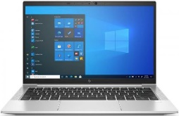
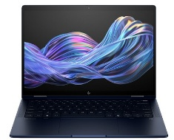


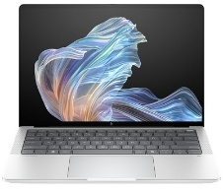

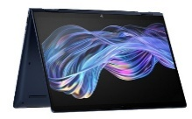

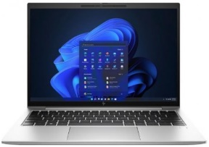
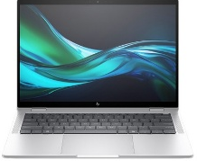
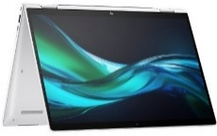

HP Elite Business Notebooks
Take some friction out of working remotely with the HP EliteBook 835. Built to seamlessly fit into enterprise IT, it also comes with features that delight its users. This enterprise business laptop brings new conferencing capabilities powered by HP Presence, productivity, and security that is easily managed in hybrid work environments.
Propel your business forward with AI that uses your own data to make strategic business decisions. Discover what you can do with AI applications, advanced collaboration features, and optimized battery life on the HP EliteBook X G1i Next Gen AI PC.
Retail File September 2025 Page 5/6
Promo prices are valid until 30/09 or Until Stock Last.
401G8EA HP NOTEBOOK ELITEBOOK 835 G8 AMD RYZEN 5 PRO 5650U 2.3-4.2GHZ/3MB 6 CORES 8GB 256GB PCIe NVMe SSD AMD RADEON GRAPHICS 13.3'' FHD IPS TYPE-C WIN 11 PRO 3YW SILVER, 742.00 €
B9ZT4ET HP NOTEBOOK ELITEBOOK X G1i 14, INTEL ULTRA 7-258V AI 3.7-4.8GHZ/12MB, 8 CORES, 32GB, 1TB PCIe NVMe TLC SSD, INTEL ARC GRAPHICS, 14'' WUXGA IPS TOUCH, WIN 11 PRO, 3YW, ATMOSPHERIC BLUE
2102.00 €
The right AI-enhanced PC is essential for any workforce. The secure and easy to manage HP EliteBook 640, 660 provides a wide range of configurable features with the latest Intel® processor, robust memory, and rich collaboration features that allows for easy standardization within
existing IT environments.
5P727EA HP NOTEBOOK ELITEBOOK 835 G9, AMD RYZEN 7 6800U 2.7 - 4.7GHZ / 16MB, 8 CORES, 16GB, 512GB PCIe NVMe SSD, GRAPHICS, CAM, 13.3'' WUXGA IPS, WIN 10 PRO, 3YW, SILVER, 3YW, 1366.00 €
Bring game-changing speed and continuity for faster local LLM-based content generation with the EliteBook X G1a Next Gen AI PC—the tech visionaries’ choice for lightning-fast and secure local AI.Tap into your genius, take ideas from start to finish, and confidently share those ideas with personalized audio and video.
B9ZT7ET HP NOTEBOOK ELITEBOOK X G1a 14, AMD RYZEN 9 HX 375 AI 2.0-5.1GHZ/24MB, 12 CORES, 32GB, 1TB PCIe NVMe TLC SSD, AMD RADEON 890M GRAPHICS, 14'' 2.8K OLED TOUCH IPS, WIN 11 PRO, 3YW, SOFT GREY. 2224.00 €
Equip your high-producing teams with the AI-enhanced PC that delivers the power of the latest Intel® Core™ processor with an NPU, HP Wolf Security, and intuitive collaboration tools they need for working in the office or in a hybrid setting. The HP EliteBook 840 effectively meets the demands of multi-tasking teams across the globe.
A23JFEA HP NOTEBOOK ELITEBOOK 640 G11, INTEL ULTRA 5-125U AI 3.6-4.3GHZ/12MB, 12 CORES, 16GB (1X16GB), 512GB PCIe NVMe SSD, INTEL ARC GRAPHICS, 14'' WUXGA IPS, WIN 11 PRO, 3YW, SILVER,CASHBACK 40€ UNTIL 31/10, 1120.00 €
B9ZT8ET HP NOTEBOOK ELITEBOOK X G1a 14, AMD RYZEN 9 HX 375 AI 2.0-5.1GHZ/24MB, 12 CORES, 64GB, 2TB PCIe NVMe TLC SSD, AMD RADEON 890M GRAPHICS, 14'' 2.8K OLED TOUCH 120Hz IPS, WIN 11 PRO, 3YW, SOFT GREY. 2593.00 €
970S1ET HP NOTEBOOK ELITEBOOK 840 G11,
INTEL ULTRA 7-155H 1.4-4.8GHZ/24MB, 16 CORES, 32GB (1X32GB), 1TB PCIe NVMe SSD, INTEL ARC GRAPHICS, THUNDERBOLT, USB-C, HDMI, DP, BT, BACKLIT KEYB,14'' WUXGA IPS, WIN 11 PRO, 3YW, SILVER 1842.00 €
A37VYET HP NOTEBOOK ELITEBOOK 660 G11, INTEL ULTRA 5-125U AI 3.6-4.3GHZ/12MB, 12 CORES, 16GB (1x16GB), 512GB PCIe NVMe SSD, INTEL GRAPHICS, 16'' WUXGA IPS, WIN 11 PRO, 3YW, SILVER, 1150.00 €
Propel your business forward with AI that uses your own data to make strategic business decisions. Discover what you can do with AI applications, advanced collaboration features, four versatile use modes, and optimized battery life on the HP EliteBook X Flip G1i Next Gen AI PC.
Equip your high-producing teams with the AI-enhanced PC that delivers the power of the latest Intel® Core™ processorwith an NPU, HP Wolf Security, and intuitive collaboration tools they need for working in the office or in a hybrid setting. The HP EliteBook 860 effectively meets the demands of multi-tasking teams
across the globe.
B9ZT5ET HP NOTEBOOK ELITEBOOK X FLIP G1i 14, INTEL ULTRA 7-258V AI 3.7-4.8GHZ/12MB, 8 CORES, 32GB, 1TB PCIe NVMe TLC SSD, INTEL ARC GRAPHICS, 14'' WUXGA IPS TOUCH, WIN 11 PRO, 3YW, ATMOSPHERIC BLUE 2133.00 €
Redefine corporate standards with the HP EliteBook 830 G9 laptop, designed to enhance productivity, collaboration, and security in hybrid work environments. This enterprise-grade business laptop features advanced conferencing capabilities powered by HP Presence, ensuring seamless communication and collaboration wherever you work.
9G0C2ET HP NOTEBOOK ELITEBOOK 860 G11, INTEL ULTRA 7-155H 1.4-4.8GHZ/24MB, 16 CORES, 32GB (2X16GB), 1TB PCIe NVMe SSD, INTEL ARC GRAPHICS, THUNDERBOLT, USB-C, HDMI, DP, FP, 16'' WUXGA IPS, WIN 11 PRO, 3YW, GLACIER SILVER 1565.00 €
Break barriers with the highly secure, ultra-light, and responsibly crafted HP Elite x360 1040 enhanced by AI. This PC dynamically anticipates and adjusts settings for power, audio, and video features to deliver the performance, comfort, and battery life today’s business leaders need.
Reclaim time from mundane tasks to collaborate and do more impactful work with an ultrathin AI PC built for the new AI era. The highly responsive HP EliteBook Ultra G1q AI PC, designed with long battery life, powers AI-applications that unlock creativity and elevate your skills.
5P6Q5EA HP NOTEBOOK ELITEBOOK 830 G9 INTEL i5-1235U 3.3-4.4GHZ/12MB 10 CORES 8GB 256GB PCIe NVMe SSD INTEL IRIS XE GRAPHICS CAM 13.3'' WUXGA IPS TYPE-C LTE-ADVANCED WIN 11 PRO PREINSTALLED WITH WIN 10 DOWNGRADE, 3YW SILVER, 891.00 €
5P794EA HP HP NOTEBOOK ELITEBOOK 830 G9 INTEL i5-1235U 3.3-4.4GHZ/12MB 10 CORES 8GB 256GB PCIe NVMe SSD INTEL IRIS XE GRAPHICS CAM 13.3'' WUXGA IPS TYPE-C WIN 11 PRO PREINSTALLED WITH WIN 10 PRO 3YW SILVER, 89100 €
A37CPET HP NOTEBOOK ELITEBOOK ULTRA G1Q AI
SNAPDRAGON X1E-78-100 AI 3.4GHZ/42MB, 12 CORES, 32GB, 1TB PCIe NVMe TLC SSD, QUALCOMM ADRENO GPU, 14'' 2.2K TOUCH IPS, WIN 11 PRO, 5YW, ATMOSPHERE BLUE 1702.00 €
A36Y0ET HP NOTEBOOK ELITEBOOK x360 CONVERTIBLE 1040 G11, ULTRA 7-155H AI VPRO 3.8-4.8GHZ/24MB, 16 CORES, 16GB, 1TB PCIe NVMe SSD, INTEL ARC GRAPHICS, 14'' WUXGA IPS TOUCH, WIN 11 PRO, 5YW, SILVER,CASHBACK 80€ UNTIL 31/10
1764.00 €
Prices, promotions, specifications, availability and terms of offers June change without notice. Despite our best efforts,
a small number of items June contain pricing, typography, or photography errors. Correct prices and promotions are validated at the time your order is placed. Recycling fees are not included in the Dealer & Retail File. Delivery and installation charges are not included. Products' warranty is the warranty given by the manufacturer. VAT is included
Call now on:
Mail on:

Slide 6



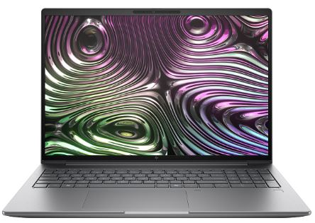


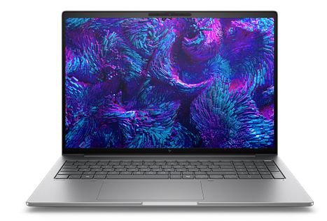


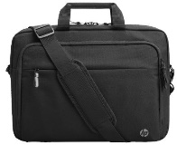
HP ZBook Workstations
Business Notebooks
Retail File September 2025 Page 6/6
Promo prices are valid until 30/09 or Until Stock Last.
HP ZBook Power 16’’ G1iMobile Workstation PC
Upgrade to professional ISV certified performance and pro-grade components at an affordable price.
537P6B HP PRINTER ALL IN ONE INKJET COLOR OFFICEJET PRO BUSINESS 9730e A3, PRINT, SCAN, COPY, 22PPM(B) 18PPM(C), 1200DPI, 512MB, DC:30K, DUPLEX PRINT& SCAN, ADF 35P, 2X TRAYS, USB, WIFI, LAN, 1YW, WHITE, CASHBACK 40€ UNTIL 31/10/25 274.00 €
B72WPET HP NOTEBOOK ZBOOK X G1i 16, INTEL ULTRA 7-255H AI 2.0-5.1GHZ/24MB, 13 NPU TOPS, 16 CORES, 32GB (1x32GB), 1TB PCIe NVMe SSD, NVIDIA RTX PRO 1000 8GB BLACKWELL, 16'' WUXGA, WIN 11 PRO, 3YW, 3722.00 €
5HB09D HP PLOTTER DESIGNJET T630 24'' A1, PRINT, 30 SEC/PAGE, 76 A1 PRINTS PER HOUR, 2400 X 1200 DPI, 1GB, STAND, SHEET FEED, ROLL FEED, ADF, MEDIA BIN, AUTOMATIC CUTTER, 4 INKS, USB, WIFI, WIFI DIRECT, LAN, 1YW, 1330.00 €
1PV65A HP PRINTER ALL IN ONE LASER MONOCHROME ENTERPRISE M528F A4, PRINT, SCAN, COPY, FAX, 43PPM, 1200 DPI, 1.25GB, DC:150K, DUPLEX , ADF 100 SHEETS, 2X TRAYS, No OF USERS: 5-15, USB, LAN, 1YW - GET 3YW FREE EXT, 1779.00 €
5HB10D HP PLOTTER DESIGNJET T650 36'' A0, PRINT, 25 SEC/PAGE, 82 A1 PRINTS PER HOUR, 2400 X 1200 DPI, 1GB, STAND, SHEET FEED, ROLL FEED, ADF, MEDIA BIN, AUTOMATIC CUTTER, 4 INKS, USB, WIFI, WIFI DIRECT, LAN, 2YW, 2380.00 €
Pro-level performance combines with true mobility in this sleek and powerful laptop. Review 3D designs, create with AI tools in pro apps, and work across multiple projects wherever you are. Stay productive with an AI workstation that delivers both performance and long-lasting battery.
6UW42AA HP SURE KEY CABLE LOCK FOR NOTEBOOK, PCS, THIN CLIENTS, WORKSTATION, 24.95 €
6CR72AA HP MOUSE WIRELESS, SILVER, 20.00 €
3V0G9AA HP MOUSE WIRELESS, BLACK, 23.20 €
B72VRET HP NOTEBOOK ZBOOK 8 G1i 14, INTEL ULTRA 7-255H AI 2.0-5.1GHZ/24MB, 16 CORES, 32GB (1x32GB), 1TB PCIe NVMe SSD, NVIDIA RTX 500 ADA 4GB, 14'' WUXGA, WIN 11 PRO, 3YW 2280.00 €
3E5F8AA HP CARRY CASE TOPLOAD 15.6'', 31.00 €
9E0G5AA HP MONITOR 27'' S5 PRO 527PU BUSINESS, E, IPS, QHD, 2560 X 1440 100Hz, 5MS, RJ-45, USB-C 100W POWER DELIVERY, HEIGHT ADJUSTABLE, TILT, SWIVEL, PIVOT, HDMI, DISPLAY PORT, 3YW BLACK/SILVER, 337.00 €
3E2P1AA HP CARRY CASE TOPLOAD 17.3'', 31.00 €
B72S8ET HP NOTEBOOK ZBOOK 8 G1i 16, INTEL ULTRA 7-255H AI 2.0-5.1GHZ/24MB, 16 CORES, 16GB (1x16GB), 1TB PCIe NVMe SSD, NVIDIA RTX 500 ADA 4GB, 16'' WUXGA, WIN 11 PRO, 3YW 2343.00 €
Prices, promotions, specifications, availability and terms of offers June change without notice. Despite our best efforts,
a small number of items June contain pricing, typography, or photography errors. Correct prices and promotions are validated at the time your order is placed. Recycling fees are not included in the Dealer & Retail File. Delivery and installation charges are not included. Products' warranty is the warranty given by the manufacturer. VAT is included
Call now on:
Mail on:

