Slide 1


Retail File September 2025
Lenovo
Business PCs, Monitors and Notebooks
Special Offers are valid until 30.09 or until stock lasts.
Call now on:
Mail on:
Prices, promotions, specifications, availability and terms of offers may change without notice. Despite our best efforts, a small number of items may contain pricing, typography, or photography errors. Correct prices and promotions are validated at the time your order is placed. Delivery and installation charges are not included. Products' warranty is the warranty given by the manufacturer. VAT is included

Slide 2

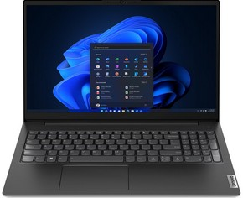
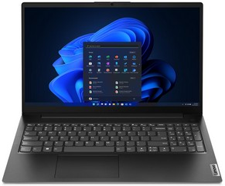
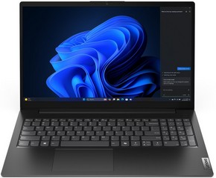
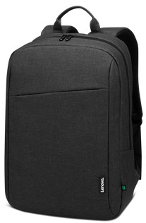
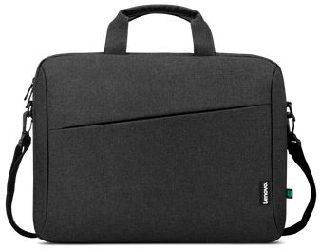
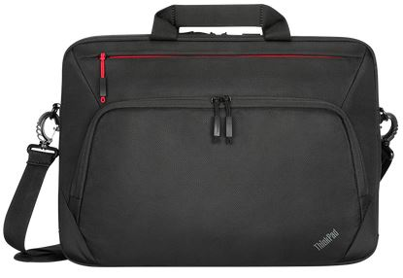
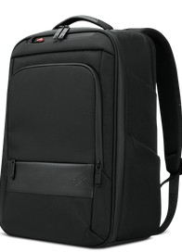



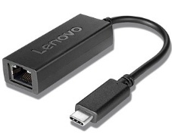
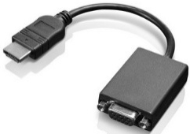
V - Series Notebooks 15.6’’
Retail File September 2025
Special Offers are valid until 30.09 or until stock lasts.
V15 G4 IRU
V15 G4 AMN
V15 G5 IRL
83A100ABCY LENOVO NOTEBOOK V15 G4 IRU, INTEL i5-13420H, 2.1-4.6GHz/12MB, 8 CORES, 16GB, 512GB SSD M.2 2242 PCIe, INTEL UHD GRAPHICS, 15.6' FHD, IPS, ANTIGLARE, LAN, WIFI, BT, HDMI, USB, USB-C, DOS, 3YW, BUSINESS BLACK € 594 - SPECIAL OFFER
83A10077CY LENOVO NOTEBOOK V15 G4 IRU, INTEL i7-1355U, 1.7-5.0GHz/12MB, 10 CORES, 16GB, 512GB SSD M.2 2242 PCIe, INTEL IRIS XE GRAPHICS, 15.6' FHD, IPS, ANTIGLARE, LAN, WIFI, BT, HDMI, USB, USB-C, DOS, 3YW, BUSINESS BLACK € 772 - SPECIAL OFFER
83A100QNCY LENOVO NOTEBOOK V15 G4 IRU, INTEL i7-13620H, 2.4-4.9GHz/24MB, 10 CORES, 16GB, 512GB SSD M.2 2242 PCIe4, INTEL UHD, 15.6' FHD 1920x1080 IPS 300NITS AG, WIFI6, BT, LAN, USB, USB-C, HDMI, DOS, 3YW, BLACK € 802 - SPECIAL OFFER
82YU0100CY LENOVO NOTEBOOK V15 G4 AMN, AMD RYZEN 3 7320U, 2.4-4.1GHz/4MB, 4 CORES, 16GB, 512GB SSD M.2 2242 PCIe, AMD RADEON 610M GRAPHICS, 15.6' FHD, TN, ANTIGL, LAN, WIFI, USB, USB-C, HDMI, DOS, UPGR 3YW, BUSINESS BLACK € 486
82YU00YQCY LENOVO NOTEBOOK V15 G4 AMN, AMD RYZEN 5 7520U, 2.8-4.3GHz/4MB, 4 CORES, 16GB, 512GB SSD M.2 2242 PCIe, AMD RADEON 610M GRAPHICS, 15.6' FHD, TN, ANTIGLARE, LAN, WIFI, BT, HDMI, USB, USB-C, DOS, 3YW, BUSINESS BLACK € 489 - SPECIAL OFFER
83HF00CJVU LENOVO NOTEBOOK V15 G5 IRL, INTEL i5-13420H, 2.1-4.6GHz/12MB, 8C, 16GB, 512GB SSD, INTEL UHD GRAPHICS, 15.6' FHD 1920x1080 IPS 300NITS AG, WIFI6, BT, LAN, USB-A, USB-C, HDMI, DOS, 3YW, BLACK € 659
Optional
4X40T84061 LENOVO CARRY CASE, T210, CASUAL, TOPLOAD 15.6'', BLACK € 27
4X41A30365 LENOVO CARRY CASE, THINKPAD ESSENTIAL PLUS ECO TOPLOAD,15.6‘’ € 83
4X40T84059 LENOVO CARRY CASE, B210, CASUAL, BACKPACK 15.6'', BLACK € 29
4X41M69794 LENOVO THINKPAD PROFESSIONAL16'' BACKPACK GEN 2 € 128
4Y50X88822 LENOVO MOUSE THINKPAD BLUETOOTH SILENT MOUSE, BLUETOOTH 5.0, ADJUSTABLE DPI 2400, 1600, 800, BLUE OPTICAL SENSOR, BLACK € 32
4Y51C21216 LENOVO MOUSE GO USB-C WIRELESS, RECHARGEABLE, SETTING DPI 2400, 1600, 800, BLUE OPTICAL SENSOR, THUNDER BLACK € 54 - SPECIAL OFFER
4Y51C21217 LENOVO MOUSE GO WIRELESS MULTI-DEVICE, RECHARGEABLE, 2400 DPI, BLUE OPTICAL SENSOR, BLACK € 71 - SPECIAL OFFER
4X90S91831 LENOVO ADAPTER USB-C TO ETHERNET € 25 - SPECIAL OFFER
0B47069 LENOVO ADAPTER HDMI TO VGA € 32
Call now on:
Mail on:
Prices, promotions, specifications, availability and terms of offers may change without notice. Despite our best efforts, a small number of items may contain pricing, typography, or photography errors. Correct prices and promotions are validated at the time your order is placed. Delivery and installation charges are not included. Products' warranty is the warranty given by the manufacturer. VAT is included

Slide 3
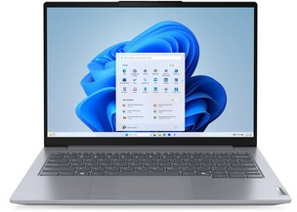
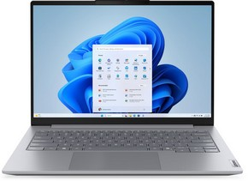
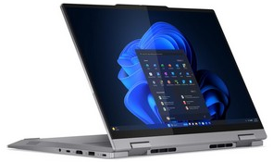
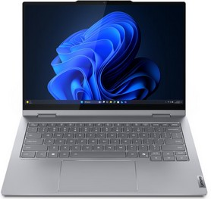
ThinkBook Notebooks 13’’ – 14’’
Retail File September 2025
Special Offers are valid until 30.09 or until stock lasts.
THINKBOOK 14 G7 ARP
THINKBOOK 14 G8 IAL
21MV00DKCY LENOVO NOTEBOOK THINKBOOK 14 G7 ARP, AMD RYZEN 5 7535HS, 3.3-4.55GHz/16MB, 6 CORES, 16GB, 512GB SSD M.2 2242 PCIe4, AMD RADEON 660M, 14' WUXGA 1920x1200 IPS 300NITS AG, WIFI6E, BT, LAN, USB-A. USB-C, USB4, HDMI, DOS, 3YW, GREY € 823
21MV0018CY LENOVO NOTEBOOK THINKBOOK 14 G7 ARP, AMD RYZEN 5 7535HS, 3.3-4.5GHz/16MB, 6 CORES, 16GB, 512GB SSD M.2 2242 PCIe, AMD RADEON GRAPHICS, 14' WUXGA 1920x1200, IPS 300NITS, BL, LAN, WIFI6, USB, USB-C, HDMI, WIN 11 PRO, 3YW, GREY € 891 - SPECIAL OFFER
21MV0022CY LENOVO NOTEBOOK THINKBOOK 14 G7 ARP, AMD RYZEN 7 7735HS,16GB, 512GB SSD M.2 2242 PCIe, AMD RADEON GRAPHICS, 14' WUXGA 1920x1200, IPS 300NITS, BL, LAN, WIFI6, USB, USB-C, HDMI, WIN 11 PRO, 3YW, GREY € 1,084 - SPECIAL OFFER
21SJ0093VU LENOVO NOTEBOOK THINKBOOK 14 G8 IAL, INTEL ULTRA 5 225U, 1.5-4.8GHz/12MB, 12C, AI 12TOPS, 16GB, 512GB SS, INTEL GRAPH, 14' WUXGA 1920x1200 IPS 300NITS AG 60Hz, WIFI6E, BT, LAN, USB-A, USB-C, USB4, HDMI, DOS, 3YW, GREY € 846 - SPECIAL OFFER
21SJ0085VU LENOVO NOTEBOOK THINKBOOK 14 G8 IAL, INTEL ULTRA 5 225U, 1.5-4.8GHz/12MB, 12C, AI 12TOPS, 16GB, 512GB SSD, INTEL GRAPHICS, 14' WUXGA 1920x1200 IPS 300NITS AG 60Hz, WIFI6E, BT, LAN, USB-A, USB-C, USB4, HDMI, DOS, 3YW, GREY € 955
21SJ0090VU LENOVO NOTEBOOK THINKBOOK 14 G8 IAL, INTEL ULTRA 5 225U, 1.5-4.8GHz/12MB, 12C, AI 12TOPS, 16GB, 512GB SSD, INTEL GRAPH, 14' WUXGA 1920x1200 IPS 300NITS AG 60Hz, WIFI6E, BT, LAN, USB-A, USB-C, USB4, HDMI, WIN 11 PRO, 3YW, GREY € 1,010 - SPECIAL OFFER
21SJ008HVU LENOVO NOTEBOOK THINKBOOK 14 G8 IAL, INTEL ULTRA 7 255H, 2-5.1GHz/24MB, 16C, 16GB, 512GB SSD M.2 2242 PCIe, AI NPU 13 TOPS, ARC 140T GRAPHICS, 14' WUXGA 1920x1200, IPS, 300NITS, LAN, WIFI6E, USB, USB-C, USB4, HDMI, DOS, 3YW, GREY € 1,129
21SJ0080VU LENOVO NOTEBOOK THINKBOOK 14 G8 IAL, INTEL ULTRA 5 225U, 1.5-4.8GHz/12MB, 12C, AI 12TOPS, 16GB, 512GB SSD, INTEL GRAPHICS, 14' WUXGA 1920x1200 IPS 300NITS AG 60Hz, WIFI6E, BT, LAN, USB-A, USB-C, USB4, HDMI, WIN 11 PRO, 3YW, GREY € 1,132
21SJ008FVU LENOVO NOTEBOOK THINKBOOK 14 G8 IAL, INTEL ULTRA 7 255H, 2-5.1GHz/24MB, 16C, 16GB, 512GB SSD M.2 2242 PCIe, AI 13 TOPS, ARC 140T GRAPHICS, 14' WUXGA 1920x1200 IPS 300NITS, LAN, WIFI6E, USB, USB-C, USB4, HDMI, WIN 11 PRO, 3YW, GREY € 1,293
THINKBOOK 14 G4 IML 2 IN 1
THINKBOOK 14 2 IN 1 G5 IAU
21MX0013CY LENOVO NOTEBOOK THINKBOOK 14 G4 IML 2 IN 1, INTEL ULTRA 7 155U, 3.8GHz-4.8GHz/12MB, 12C, 16GB, 512GB SSD M.2 2242 PCIe, INTEL GRAPHICS, 14' WUXGA 1920x1200, IPS 300NITS, TOUCH, WIFI6E, USB, USB-C, USB4, HDMI, WIN 11 PRO, 3YW, GREY € 1,456 - SPECIAL OFFER
21MX0019CY LENOVO NOTEBOOK THINKBOOK 14 G4 IML 2 IN 1, INTEL ULTRA 5 125U, 3.6GHz-4.3GHz/12MB, 12C, 16GB, 512GB SSD M.2 2242 PCIe, INTEL GRAPHICS, 14' WUXGA 1920x1200, IPS 300NITS, TOUCH, WIFI6E, USB, USB4, HDMI, WIN 11 PRO, 3YW, GREY € 1,308- SPECIAL OFFER
21SQ0033VU LENOVO NOTEBOOK THINKBOOK 14 2 IN 1 G5 IAU, INTEL ULTRA 7 255U, 2-5.2GHz/12MB, 12C, AI 12TOPS, 16GB, 512GB SSD, INTEL GRAPH, 14' WUXGA 1920x1200 IPS 300NITS TOUCH, WIFI6E, BT, USB-A, USB-C, USB4, HDMI, WIN 11 PRO, 3YW, LUNA GREY € 1,659
Call now on:
Mail on:
Prices, promotions, specifications, availability and terms of offers may change without notice. Despite our best efforts, a small number of items may contain pricing, typography, or photography errors. Correct prices and promotions are validated at the time your order is placed. Delivery and installation charges are not included. Products' warranty is the warranty given by the manufacturer. VAT is included

Slide 4
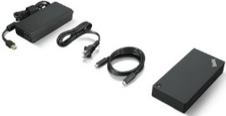
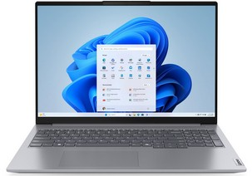
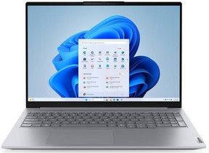
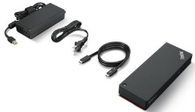
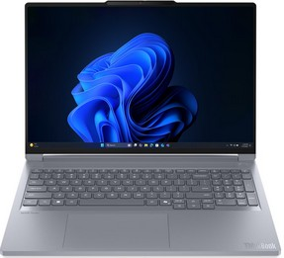
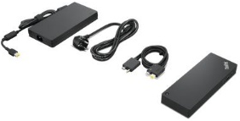
ThinkBook Notebooks 16’’
Retail File September 2025
Special Offers are valid until 30.09 or until stock lasts.
THINKBOOK 16 G7 ARP
THINKBOOK 16 G8 IAL
Optional
21MW001XCY LENOVO NOTEBOOK THINKBOOK 16 G7 ARP, AMD RYZEN 5 7535HS, 3.3-4.55GHz/16MB, 6 CORES, 16GB, 512GB SSD M.2 2242 PCIe, AMD RADEON 660M GRAPHICS, 16' WUXGA 1920x1200, IPS, 300NITS, LAN , WIFI6E, USB, USB-C, USB4, HDMI, DOS, 3YW, GREY € 736 - SPECIAL OFFER
21MW001NCY LENOVO NOTEBOOK THINKBOOK 16 G7 ARP, AMD RYZEN 7 7735HS, 3.2-4.75GHz/16MB, 8 CORES, 16GB, 512GB SSD M.2 2242 PCIe, AMD RADEON 680M GRAPHICS, 16' WUXGA 1920x1200, IPS 300 NITS, LAN, WIFI6E, USB, USB-C, USB4, HDMI, DOS, 3YW, GREY € 855 - SPECIAL OFFER
21SK00A9VU LENOVO NOTEBOOK THINKBOOK 16 G8 IAL, INTEL ULTRA 5 225U, 1.5-4.8GHz/12MB, 12C, 16GB, 512GB SSD M.2 2242 PCIe, AI NPU 12 TOPS, INTEL GRAPHICS, 16' WUXGA 1920x1200, IPS 300NITS, LAN, WIFI6E, USB, USB-C, USB4, HDMI, DOS, 3YW, GREY € 936 - SPECIAL OFFER
21SK008DVU LENOVO NOTEBOOK THINKBOOK 16 G8 IAL, INTEL ULTRA 5 225U, 1.5-4.8GHz/12MB, 12C, AI 12TOPS, 16GB, 512GB SSD, INTEL GRAPHICS, 16' WUXGA 1920x1200 IPS 300NITS AG 60Hz, WIFI6E, BT, LAN, USB-A, USB-C, USB4, HDMI, DOS, 3YW, ARCTIC GREY € 971
21SK00A4VU LENOVO NOTEBOOK THINKBOOK 16 G8 IAL, INTEL ULTRA 5 225U, 1.5-4.8GHz/12MB, 12C, 16GB, 512GB SSD M.2 2242 PCIe, AI 12 TOPS, INTEL GRAPHICS, 16' WUXGA 1920x1200, IPS 300NITS, LAN, WIFI6E, USB, USB-C, USB4, HDMI, WIN 11 PRO, 3YW, GREY € 1,039 - SPECIAL OFFER
21SK008HVU LENOVO NOTEBOOK THINKBOOK 16 G8 IAL, INTEL ULTRA 7 255H, 2-5.1GHz/24MB, 16C, AI 13TOPS, 16GB, 512GB SSD, INTEL ARC 140T, 16' WUXGA 1920x1200 IPS 300NITS AG 60Hz, WIFI6E, BT, LAN, USB-A, USB-C, USB4, HDMI, DOS, 3YW, ARCTIC GREY € 1,116
21SK00A6VU LENOVO NOTEBOOK THINKBOOK 16 G8 IAL, INTEL ULTRA 7 255H, 2-5.1GHz/24MB, 16C, 16GB, 512GB SSD M.2 2242 PCIe, AI NPU 13 TOPS, ARC 140T GRAPHICS, 16' WUXGA 1920x1200, IPS 300NITS, LAN , WIFI6E, USB, USB-C, USB4, HDMI, DOS, 3YW, GREY € 1,132
21SK00A0VU LENOVO NOTEBOOK THINKBOOK 16 G8 IAL, INTEL ULTRA 7 255H, 2-5.1GHz/24MB, 16C, 16GB, 512GB SSD M.2 2242 PCIe, AI 13 TOPS, ARC 140T GRAPHICS, 16' WUXGA 1920x1200 IPS 300NITS, LAN, WIFI6E, USB, USB-C, USB4, HDMI, WIN 11 PRO, 3YW, GREY € 1,310
40AY0090UK LENOVO DOCKING STATION UNIVERSAL USB-C, 2x DISPLAY PORT, HDMI PORT, GIGA LAN, 3x USB 3.1, 2x USB 2.0, 1x USB-C, 3YW € 192
THINKBOOK 16p G6 IAX
40B10135EU LENOVO DOCKING STATION SMART THINKPAD UNIVERSAL THUNDERBOLT 4, 135W AC POWER ADAPTER, INPUT 20V/6.75A, OUTPUT 100W, USB4 HOST, USB4 DEVICE CONNECT, HDMI2.1, 2x DP1.4, USB-A, USB-C, AUDIO COMBO JACK 3.5MM, Gb LAN, WIN, UBUNTU, 3YW € 356 - SPECIAL OFFER
21R00015VU LENOVO NOTEBOOK THINKBOOK 16p G6 IAX, INTEL ULTRA 7 255HX, 2.4-5.2GHz/30MB, 20C, AI 45TOPS, 32GB, 1TB, NVIDIA GEFORCE RTX 5060 8GB, 16' WQXGA 2560x1600 IPS 500NITS AG 240Hz, WIFI7, BT, USB-A, USB4, HDMI, WIN 11 PRO, 3YW, LUNA GREY € 2,652
21R0002HVU LENOVO NOTEBOOK THINKBOOK 16p G6 IAX, INTEL ULTRA 9 275HX, 2.7-5.4GHz/36MB, 24C, AI 13 TOPS, NVIDIA GEFORCE RTX 5060 8GB, 16' 3.2K 3200x2000 IPS 500NITS AG 165Hz, WIFI7, BT, USB-A, USB4, HDMI, WIN 11 PRO, 3YW, LUNA GREY € 2,941
40B00300EU LENOVO DOCKING STATION THINKPAD THUNDERBOLT 4 WORKSTATION DOCK, USB4, 4x USB-A, USB-C, HDMI 2.1, 2x DP 1.4, LAN, 3YW,EU PLUG, BLACK RED € 369 - SPECIAL OFFER
Call now on:
Mail on:
Prices, promotions, specifications, availability and terms of offers may change without notice. Despite our best efforts, a small number of items may contain pricing, typography, or photography errors. Correct prices and promotions are validated at the time your order is placed. Delivery and installation charges are not included. Products' warranty is the warranty given by the manufacturer. VAT is included

Slide 5
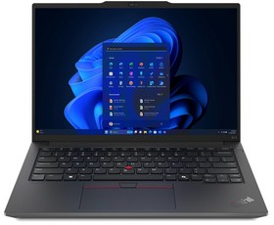
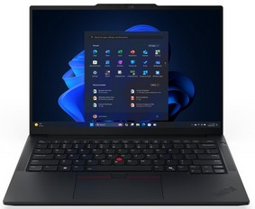
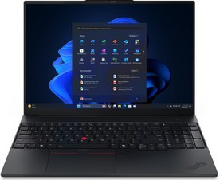
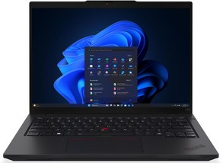
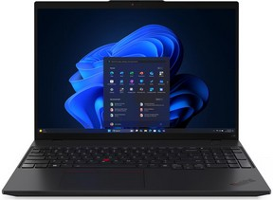
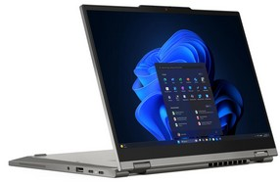
Thinkpad E & L - Series Notebooks 14’’ & 16’’
Retail File September 2025
Special Offers are valid until 30.09 or until stock lasts.
THINKPAD E14 G6
THINKPAD E14 G7
THINKPAD E16 G3
21M70044CY LENOVO NOTEBOOK THINKPAD E14 G6, INTEL ULTRA 7 155U, 4.8GHz/12MB, 12 CORES, 16GB, 512GB SSD M.2 2242 PCIe, INTEL GPU, INTEGRATED INTEL NPU, AI, 14' WUXGA 1920x1200 IPS, 300NITS, LAN, WIFI6E, USB, USB4, HDMI, DOS, 3YW, BLACK € 1,197 - SPECIAL OFFER
21M7001YCY LENOVO NOTEBOOK THINKPAD E14 G6, INTEL ULTRA 7 155H, 3.8GHz-4.8GHz/24MB, 16 CORES, 16GB, 512GB SSD M.2 2242 PCIe, INTEL ARC GRAPHICS, 14' WUXGA 1920x1200, IPS 300NITS, ANTGL, LAN, WIFI6E, USB, USB-C, USB4, HDMI, WIN 11 PRO, BLACK € 1,367 - SPECIAL OFFER
21SX0057VU LENOVO NOTEBOOK THINKPAD E14 G7, INTEL ULTRA 5 225U, 1.5-4.8GHz/12MB, 12C, AI 12TOPS, 16GB, 512GB SSD, INTEL GRAPHICS, 14' WUXGA 1920x1200 IPS 300NITS AG 60Hz, WIFI6E, BT, LAN, USB-A, USB4, HDMI, DOS, 3YW, BLACK € 1,183 - SPECIAL OFFER
21SX004BVU LENOVO NOTEBOOK THINKPAD E14 G7, INTEL ULTRA 5 225U, 1.5-4.8GHz/12MB, 12C, AI 12TOPS, 16GB, 512GB SSD, INTEL GRAPH, 14' WUXGA 1920x1200 IPS 300NITS AG 60Hz, WIFI6E, BT, LAN, USB-A, USB-C, USB4, HDMI, WIN 11 PRO, 3YW, BLACK € 1,346 - SPECIAL OFFER
21SX0055VU LENOVO NOTEBOOK THINKPAD E14 G7, INTEL ULTRA 7 255H, 2-5.1GHz/24MB, 16C, AI 13 TOPS, 16GB, 512GB SSD, ARC 140T, 14' WUXGA 1920x1200 IPS 300NITS AG 60Hz, WIFI6E, BT, LAN, USB-A, USB4, HDMI, DOS, 3YW, BLACK € 1,471
21SX008KVU LENOVO NOTEBOOK THINKPAD E14 G7, INTEL ULTRA 5 225U, 1.5-4.8GHz/12MB, 12C, AI 12TOPS, 32GB, 1TB SSD, INTEL GRAPHICS, 14' WUXGA 1920x1200 IPS 300NITS AG 60Hz, WIFI6E, BT, LAN, USB-A, USB4, HDMI, WIN 11 PRO, 3YW, BLACK € 1,499- SPECIAL OFFER
21SX0049VU LENOVO NOTEBOOK THINKPAD E14 G7, INTEL ULTRA 7 255H, 2-5.1GHz/24MB, 16C, AI 13TOPS, 32GB, 512GB SSD, INTEL ARC 140T, 14' WUXGA 1920x1200 IPS 300NITS AG 60Hz, WIFI6E, BT, LAN, USB-A, USB4, HDMI, WIN 11 PRO, 3YW, BLACK € 1,635 - SPECIAL OFFER
21SR007MVU LENOVO NOTEBOOK THINKPAD E16 G3, INTEL ULTRA 5 225U, 1.5-4.8GHz/12MB, 12C, AI 12TOPS, 16GB, 512GB SSD, INTEL GRAPHICS, 16' WUXGA 1920x1200 IPS 300NITS AG 60Hz, WIFI6E, BT, LAN, USB-A, USB-C, USB4, HDMI, DOS, 3YW, BLACK € 1,197 - SPECIAL OFFER
21MA0020CY LENOVO NOTEBOOK THINKPAD E16 G2, INTEL ULTRA 5 125U, 3.6GHz-4.3GHz/12MB, 12 CORES, 16GB, 512GB SSD M.2 2242 PCIe, INTEL GRAPHICS, 16' WUXGA 1920x1200, IPS 300NITS, ANTGL, LAN, WIFI6E, USB, USB-C, USB4, HDMI, WIN 11 PRO, 3YW, BLACK € 1,242 - SPECIAL OFFER
21MA0019CY LENOVO NOTEBOOK THINKPAD E16 G2, INTEL ULTRA 7 155H, 3.8GHz-4.8GHz/24MB, 16C, 16GB, 512GB SSD M.2 2242 PCIe, INTEL ARC GRAPHICS, 16' WUXGA 1920x1200, IPS 300NITS, ANTGL, LAN, WIFI6E, USB, USB-C, USB4, HDMI, WIN 11 PRO, 3YW, BLACK €1,382- SPECIAL OFFER
21SR007PVU LENOVO NOTEBOOK THINKPAD E16 G3, INTEL ULTRA 7 255H, 2-5.1GHz/24MB, 16C, AI 13TOPS, 16GB, 512GB SSD, INTEL ARC 140T, 16' WUXGA 1920x1200 IPS 300NITS AG 60Hz, WIFI6E, BT, LAN, USB-A, USB-C, USB4, HDMI, DOS, 3YW, BLACK € 1,465
21SR007RVU LENOVO NOTEBOOK THINKPAD E16 G3, INTEL ULTRA 7 255H, 2-5.1GHz/24MB, 16C, AI 13TOPS, 16GB, 1TB SSD, INTEL ARC 140T, 16' WUXGA 1920x1200 IPS 300NITS AG 60Hz, WIFI6E, BT, LAN, USB-A, USB-C, USB4, HDMI, DOS, 3YW, BLACK € 1,514
21SR0045VU LENOVO NOTEBOOK THINKPAD E16 G3, INTEL ULTRA 5 225U, 1.5-4.8GHz/12MB, 12C, AI 12TOPS, 16GB, 512GB SSD, INTEL GRAPHICS, 16' WUXGA 1920x1200 IPS 300NITS AG 60Hz, WIFI6E, BT, LAN, USB-A, USB-C, USB4, HDMI, WIN 11 PRO, 3YW, BLACK € 1,514
THINKPAD L14 G6
THINKPAD L16 G2
THINKPAD L13 2 IN 1 G6
21S6001FVU LENOVO NOTEBOOK THINKPAD L14 G6, INTEL ULTRA 5 225U, 1.5-4.8GHz/12MB, 12C, AI 12TOPS, 16GB, 512GB SSD, INTEL GRAPH, 14' WUXGA 1920x1200 IPS 400NITS AG 60Hz, WIFI6E, BT, LAN, USB-A, USB4, HDMI, WIN 11 PRO, 3YW, BLACK € 1,532
21S6001WVU LENOVO NOTEBOOK THINKPAD L14 G6, INTEL ULTRA 7 255U, 2-5.2GHz/12MB, 12C, AI 12TOPS, 16GB, 512GB SSD, INTEL GRAPH, 14' WUXGA 1920x1200 IPS 400NITS AG 60Hz, WIFI6E, BT, LAN, USB-A, USB4, HDMI, WIN 11 PRO, 3YW, BLACK € 1,822
21S6001QVU LENOVO NOTEBOOK THINKPAD L14 G6, INTEL ULTRA 7 255U, 2-5.2GHz/12MB, 12C, AI 12TOPS, 32GB, 1TB SSD, INTEL GRAPH, 14' WUXGA 1920x1200 IPS 400NITS AG 60Hz, WIFI6E, BT, LAN, USB-A, USB4, HDMI, WIN 11 PRO, 3YW, BLACK € 1,979
21SA0017VU LENOVO NOTEBOOK THINKPAD L16 G2, INTEL ULTRA 5 225U, 1.5-4.8GHz/12MB, 12C, AI 12TOPS, 16GB, 512GB SSD, INTEL GRAPH, 16' WUXGA 1920x1200 IPS 400NITS AG 60Hz, WIFI6E, BT, LAN, USB-A, USB4, HDMI, WIN 11 PRO, 3YW, BLACK € 1.546
21SA001FVU LENOVO NOTEBOOK THINKPAD L16 G2, INTEL ULTRA 5 225U, 1.5-4.8GHz/12MB, 12C, AI 12TOPS, 32GB, 1TB SSD, INTEL GRAPHICS, 16' WUXGA 1920x1200 IPS 400NITS AG 60Hz, WIFI6E, BT, LAN, USB-A, USB4, HDMI, WIN 11 PRO, 3YW, BLACK € 1.705
21SA001JVU LENOVO NOTEBOOK THINKPAD L16 G2, INTEL ULTRA 7 255U, 2-5.2GHz/12MB, 12C, AI 17TOPS, 32GB, 1TB SSD, INTEL GRAPH, 16' WUXGA 1920x1200 IPS 400NITS AG 60Hz, WIFI6E, BT, LAN, USB-A, USB4, HDMI, WIN 11 PRO, 3YW, BLACK € 1.993
21R7003AVU LENOVO NOTEBOOK THINKPAD L13 2 IN 1 G6, INTEL ULTRA 7 255U, 2-5.2GHz/12MB, 12C, AI 12TOPS, 32GB, 1TB SSD, INTEL GRAPHICS, 13.3' WUXGA 1920x1200 IPS 400NITS TOUCH, WIFI6E, BT, USB-A, USB4, HDMI, WIN 11 PRO, 3YW, GREY € 2.111
Call now on:
Mail on:
Prices, promotions, specifications, availability and terms of offers may change without notice. Despite our best efforts, a small number of items may contain pricing, typography, or photography errors. Correct prices and promotions are validated at the time your order is placed. Delivery and installation charges are not included. Products' warranty is the warranty given by the manufacturer. VAT is included

Slide 6
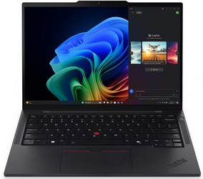
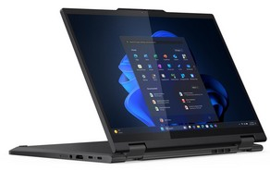
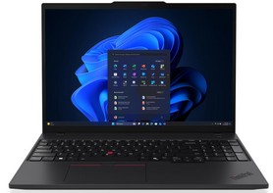
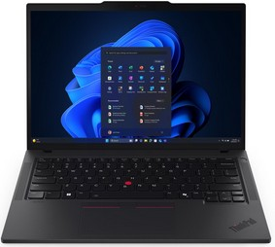
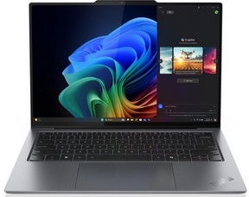

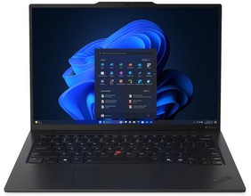
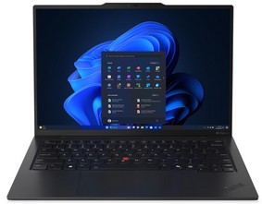
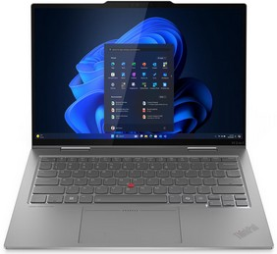
Thinkpad T & X - Series Notebooks 14’’ & 16’’
Retail File September 2025
Special Offers are valid until 30.09 or until stock lasts.
THINKPAD T14s G6
THINKPAD T14s 2 IN 1 G1
THINKPAD T16 G4
THINKPAD T14 G6
21QX00HFVU LENOVO NOTEBOOK THINKPAD T14s G6, INTEL ULTRA 7 258V, 2.2-4.8GHz/12MB, 8C, AI 47TOPS, 32GB, 1TB SSD, INTEL ARC 140V, 14' WUXGA 1920x1200 IPS 400NITS AG 60Hz TOUCH, WIFI7, BT, USB-A, USB4, HDMI, WIN 11 PRO, 3YW, BLACK € 2,712
21R3002AVU LENOVO NOTEBOOK THINKPAD T14s 2 IN 1 G1, INTEL ULTRA 7 255U, 2-5.2GHz/12MB, 12C, AI 12TOPS, 32GB, 512GB SSD, INTEL GRAPHICS, 14' WUXGA 1920x1200 IPS 500NITS TOUCH, WIFI7, BT, USB-A, USB4, HDMI, WIN 11 PRO, 3YW, BLACK € 2,481
21QE0044VU LENOVO NOTEBOOK THINKPAD T16 G4, INTEL ULTRA 7 255U, 2-5.2GHz/12MB, 12C, AI 12 TOPS, 32GB, 1TB SSD, INTEL GRAPHICS, 16' WUXGA 1920x1200 IPS 500NITS AG, WIFI6E, BT, LAN, USB-A, USB4, HDMI, WIN 11 PRO, 3YW, BLACK € 2,478
21QE0043VU LENOVO NOTEBOOK THINKPAD T16 G4, INTEL ULTRA 7 255U, 2-5.2GHz/12MB, 12C, AI 12TOPS, 32GB, 1TB SSD, INTEL GRAPH, 16' WUXGA 1920x1200 IPS 500NITS AG, WIFI6E, BT, LAN, USB-A, USB4, HDMI, WIN 11 PRO, 3YW, BLACK € 2,554
21QC002TVU LENOVO NOTEBOOK THINKPAD T14 G6, INTEL ULTRA 5 225U, 1.5-4.8GHz/12MB, 12C, AI 12TOPS, 32GB, 512GB SSD, INTEL GRAPH, 14' WUXGA 1920x1200 IPS 400NITS AG 60Hz, WIFI6E, BT, LAN, USB-A, USB4, HDMI, WIN 11 PRO, 3YW, BLACK € 1,932
21QC005SVU LENOVO NOTEBOOK THINKPAD T14 G6, INTEL ULTRA 7 255U, 2-5.2GHz/12MB, 12C, AI 12TOPS, 32GB, 1TB SSD, INTEL GRAPH, 14' WUXGA 1920x1200 IPS 400NITS AG 60Hz, WIFI6E, BT, LAN, USB-A, USB4, HDMI, WIN 11 PRO, 3YW, BLACK € 2,341
21QG001PVU LENOVO NOTEBOOK THINKPAD T14 G6, INTEL ULTRA 7 258V, 2.2-4.8GHz/12MB, 8C, AI 47TOPS, 32GB, 1TB SSD, ARC 140V, 14' WUXGA 1920x1200 IPS 400NITS AG 60Hz, WIFI7, BT, LAN, USB-A, USB4, HDMI, WIN 11 PRO, 3YW, BLACK € 2,389
21QG001JVU LENOVO NOTEBOOK THINKPAD T14 G6, INTEL ULTRA 7 258V, 2.2-4.8GHz/12MB, 8C, AI 47TOPS, 32GB, 1TB SSD, INTEL ARC 140V, 14' WUXGA 1920x1200 IPS 400NITS AG 60Hz TOUCH, WIFI7, BT, LAN, USB-A, USB4, HDMI, WIN 11 PRO, 3YW, BLACK € 2,465
THINKPAD X9-14 G1
THINKPAD X9-15 G1
THINKPAD X1 CARBON G13
THINKPAD X1 CARBON G13 AURA EDITION
THINKPAD X1 2 IN 1 G10
21QA001CVU LENOVO NOTEBOOK THINKPAD X9-14 G1, INTEL ULTRA 7 258V, 2.2-4.8GHz/12MB, 8 CORES, 32GB, 1TB SSD M.2 2242 PCIe, AI NPU 47 TOPS, ARC 140V GRAPHICS, 14' WUXGA 1920x1200 OLED 400NITS, WIFI7, BT, USB-C, HDMI, WIN 11 PRO, 3YW, GREY € 2,459
21QA0048VU LENOVO NOTEBOOK THINKPAD X9-14 G1, INTEL ULTRA 7 258V, 2.2-4.8GHz/12MB, 8 CORES, 32GB, 1TB SSD M.2 2242 PCIe, AI NPU 47 TOPS, ARC 140V GRAPHICS, 14' 2.8K 2880x1800 OLED 500NITS, TOUCH, WIFI7, BT, USB-C, HDMI, WIN 11 PRO, 3YW, GREY € 2,666
21Q6001NVU LENOVO NOTEBOOK THINKPAD X9-15 G1, INTEL ULTRA 7 258V, 2.2-4.8GHz/12MB, 8C, 32GB, 1TB SSD M.2 2242 PCIe, AI 47 TOPS, ARC 140V GRAPHICS, 15.3' 2.8K 2880x1800 OLED 500NITS, TOUCH, WIFI7, BT, USB, USB-C, HDMI, WIN 11 PRO, 3YW, GREY € 2,679
21NS004RVU LENOVO NOTEBOOK THINKPAD X1 CARBON G13, INTEL ULTRA 7 258V, 4.8GHz/12MB, 8 CORES, AI 47 TOPS, 32GB, 1TB SSD M.2 2280 PCIe5, ARC 140V, 14' WUXGA 1920x1200 IPS 500NITS TOUCH, 5G, WIFI7, BT, USB-A, USB4, HDMI, WIN 11 PRO, 3YW, BLACK € 3,212 - SPECIAL OFFER
21NS004KVU LENOVO NOTEBOOK THINKPAD X1 CARBON G13, INTEL ULTRA 7 258V, 4.8GHz/12MB, 8 CORES, AI 47 TOPS, 32GB, 2TB SSD M.2 2280 PCIe5, ARC 140V, 14' 2.8K 2880x1800 OLED 500NITS, 5G, WIFI7, BT, USB-A, USB4, HDMI, WIN 11 PRO, 3YW, BLACK € 3,555
21NX0083VU LENOVO NOTEBOOK THINKPAD X1 CARBON G13 AURA EDITION, INTEL ULTRA 7 265U, 2.1-5.3GHz/12MB, 12C, 64GB, 1TB SSD, INTEL GRAPHICS, 14' 2.8K 2880x1800 OLED 500NITS AG 120Hz TOUCH, WIFI7, BT, USB-A, USB4, HDMI, WIN 11 PRO, 3YW, BLACK € 4,069
21NU002BVU LENOVO NOTEBOOK THINKPAD X1 2 IN 1 G10, INTEL ULTRA 7 258V, 4.8GHz/12MB, 8 CORES, AI 47 TOPS, 32GB, 1TB SSD M.2 2280 PCIe5, ARC 140V, 14' 2.8K 2880x1800 OLED 500NITS TOUCH, 5G, WIFI7, BT, USB-A, USB4, HDMI, WIN 11 PRO, 3YW, GREY € 3,809
Call now on:
Mail on:
Prices, promotions, specifications, availability and terms of offers may change without notice. Despite our best efforts, a small number of items may contain pricing, typography, or photography errors. Correct prices and promotions are validated at the time your order is placed. Delivery and installation charges are not included. Products' warranty is the warranty given by the manufacturer. VAT is included

Slide 7
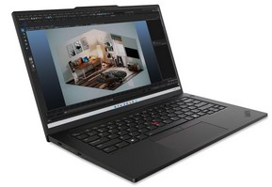
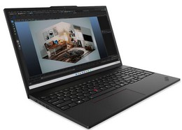
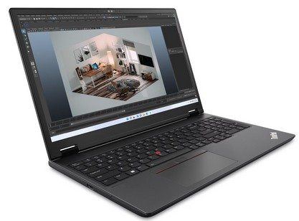
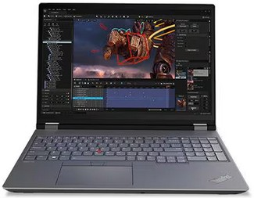
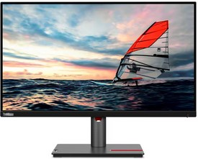
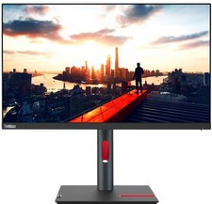
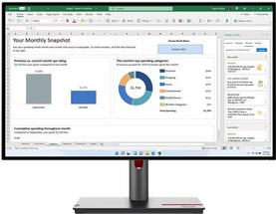
Thinkpad P - Series Notebooks 14’’ & 16’’
Retail File September 2025
Special Offers are valid until 30.09 or until stock lasts.
THINKPAD P14s G5
THINKPAD P16s G3
THINKPAD P16v G2
21G2002JCY LENOVO NOTEBOOK THINKPAD P14s G5, INTEL ULTRA 7 155H, 4.8GHz/24MB, 16C, AI 11TOPS, 64GB, 1TB SSD, NVIDIA RTX 500 ADA 4GB GDDR6, 14.5' WQXGA 2560x1600 IPS 350NITS AG, WIFI6E, BT, LAN, USB-A, USB4, HDMI, WIN 11 PRO, 3YW, BLACK € 2,843
21KS0005CY LENOVO NOTEBOOK THINKPAD P16s G3, INTEL ULTRA 7 155H, 4.8GHz/24MB, 16C, 32GB, 1TB SSD M.2 2280 PCIe, AI 11 TOPS, NVIDIA RTX 500 ADA 4GB, 16' WUXGA 1920x1200 IPS 300NITS, LAN, WIFI6E, USB, USB4, HDMI, WIN 11 PRO, 3YW, BLACK € 2,179 - SPECIAL OFFER
21KS002ECY LENOVO NOTEBOOK THINKPAD P16s G3, INTEL ULTRA 7 155H, 4.8GHz/24MB, 16C, AI 11TOPS, 64GB, 1TB SSD, NVIDIA RTX 500 ADA 4GB GDDR6, 16' WUXGA 1920x1200 IPS 300NITS AG, WIFI6E, BT, LAN, USB-A, USB4, HDMI, WIN 11 PRO, 3YW, BLACK € 2,852
21KX000MCY LENOVO NOTEBOOK THINKPAD P16v G2, INTEL ULTRA 7 155H, 4.8GHz/24MB, 16C, 32GB, 1TB SSD M.2 2280 PCIe, AI 11 TOPS, NVIDIA RTX 1000 ADA 6GB, 16' WUXGA 1920x1200 IPS 300NITS, LAN, WIFI6E, USB, USB4, HDMI, WIN 11 PRO, 3YW, BLACK € 3,234
21KX0019CY LENOVO NOTEBOOK THINKPAD P16v G2, INTEL ULTRA 7 155H, 4.8GHz/24MB, 16C, 32GB, 1TB SSD M.2 2280 PCIe, AI 11 TOPS, NVIDIA RTX 2000 ADA 8GB, 16' WUXGA 1920x1200 IPS 300NITS, LAN, WIFI6E, USB, USB4, HDMI, WIN 11 PRO, 3YW, BLACK € 3,509
THINKPAD P16 G2
THINKVISION P25i-30
THINKVISION P24h-30
THINKVISION P27h-30
21FA004RCY LENOVO NOTEBOOK THINKPAD P16 G2, INTEL i7-14700HX, 2.1-5.5GHz/33MB, 20C, 32GB, 1TB, NVIDIA RTX 1000 ADA 6GB GDDR6, 16' WQXGA 2560x1600 IPS 500NITS AG, WIFI6E, BT, USB-A, USB-C, USB4, HDMI, WIN 11 PRO, 3YW, STORM GREY/VILLI BLACK € 3,372
21FA004PCY LENOVO NOTEBOOK THINKPAD P16 G2, INTEL i7-14700HX, 2.1-5.5GHz/33MB, 20C, 32GB, 1TB, NVIDIA RTX 2000 ADA 8GB GDDR6, 16' WUXGA 1920x1200 IPS 400NITS AG, WIFI6E, BT, USB-A, USB-C, USB4, HDMI, WIN 11 PRO, 3YW, STORM GREY/VILLI BLACK € 3,576
63F4MAT1UK LENOVO MONITOR 24.5' THINKVISION P25i-30 BUSINESS, D, IPS, WLED, FHD 1920x1080, ANTIGLARE, 16:9, 4MS, 100Hz, 250CD/M², EYESAFE, HEIGHT ADJUST, PIVOT, SWIVEL, TILT, 4xUSB-A, USB-B, HDMI 2.1, DP1.4, DP1.4 OUT, VGA, VESA, 3YW, BLACK€ 207
63B3GAT6UK LENOVO MONITOR 23.8', THINKVISION P24h-30 BUSINESS, IPS, WLED, 2560x1440, ANTIGLARE, 4MS, 60Hz, 300CD/M², HEIGHT ADJUSTABLE, PIVOT, SWIVEL, TILT, LAN, HDMI 2.0, DP 1.4, DPOut, 2x USB-C 3.2 G1, 4x USB 3.2 G1, 3YW, RAVEN BLACK € 324
63A1GAT1UK LENOVO MONITOR 27'' THINKVISION P27h-30 BUSINESS, F, IPS, WLED, QHD 2560x1440, ANTIGLARE, 16:9, 4MS, 60Hz, 350CD/M², EYESAFE, HEIGHT ADJUSTABLE, PIVOT, SWIVEL, TILT, 5x USB, 3x USB-C, 1x HDMI, 1x DP, 1x DP OUT,LAN,VESA, 3YW, BLACK € 394 - SPECIAL OFFER
Call now on:
Mail on:
Prices, promotions, specifications, availability and terms of offers may change without notice. Despite our best efforts, a small number of items may contain pricing, typography, or photography errors. Correct prices and promotions are validated at the time your order is placed. Delivery and installation charges are not included. Products' warranty is the warranty given by the manufacturer. VAT is included

Slide 8
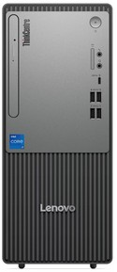







PCs
Retail File September 2025
Special Offers are valid until 30.09 or until stock lasts.
THINKCENTRE NEO 50T G5
THINKCENTRE NEO 30s G5 SFF
THINKCENTRE NEO 50s G5 SFF
12UD005DUK LENOVO PC THINKCENTRE NEO 50T G5, INTEL i5-14400, 2.5-4.7GHz/20MB, 10 CORES, 16GB, 512GB SSD M.2 2280 PCIe, INTEL UHD GRAPHICS 730, DVDRW, WIFI, BT5.2, LAN, USB, USB-C, HDMI, DP, VGA, DOS, 5YW, BLACK € 707- SPECIAL OFFER
12UD0052UK LENOVO PC THINKCENTRE NEO 50T G5, INTEL i5-14400, 2.5-4.7GHz/20MB, 10 CORES, 16GB, 512GB SSD M.2 2280 PCIe, INTEL UHD GRAPHICS 730, DVDRW, WIFI6, BT5.2, LAN, USB, USB-C, HDMI, DP, VGA, WIN 11 PRO, 5YW, BLACK €855- SPECIAL OFFER
12UD005CUK LENOVO PC THINKCENTRE NEO 50T G5, INTEL i7-14700, 2.1-5.3GHz/33MB, 20 CORES, 16GB, 512GB SSD M.2 2280 PCIe, INTEL UHD GRAPHICS 770, DVDRW, WIFI6, BT5.2, LAN, USB, USB-C, HDMI, DP, VGA, DOS, 5YW, BLACK € 1,019 - SPECIAL OFFER
13DK0033UK LENOVO PC THINKCENTRE NEO 30s G5 SFF, INTEL i5-13420H, 2.1-4.6GHz/12MB, 8 CORES, 16GB, 512GB SSD M.2 2280 PCIe, INTEL UHD GRAPHICS, DVDRW, LAN, USB-C, USB-A, HDMI, VGA, DOS, 3YW, BLACK/GREY € 594 - SPECIAL OFFER
13DK000YUK LENOVO PC THINKCENTRE NEO 30s G5 SFF, INTEL i5-13420H, 2.1-4.6GHz/12MB, 8 CORES, 16GB, 512GB SSD M.2 2280 PCIe4, INTEL UHD GRAPHICS, WIFI6, BT, LAN, USB-A, USB-C, HDMI, VGA, WIN 11 PRO, 3YW, BLACK/GREY € 787 - SPECIAL OFFER
12XD007BUK LENOVO PC THINKCENTRE NEO 50s G5 SFF, INTEL i5-14400, 2.5-4.7GHz/20MB, 10 CORES, 16GB, 512GB SSD M.2 2280 PCIe, INTEL UHD GRAPHICS 730, DVDRW, LAN, USB, USB-C, HDMI, DP, VGA, DOS, 5YW, BLACK
€ 683- SPECIAL OFFER
12XD007LUK LENOVO PC THINKCENTRE NEO 50s G5 SFF, INTEL i5-14400, 2.5-4.7GHz/20MB, 10 CORES, 16GB, 512GB SSD M.2 2280 PCIe, INTEL UHD GRAPHICS 730, DVDRW, LAN, USB, USB-C, HDMI, DP, VGA, WIN 11 PRO, 5YW, BLACK € 832 - SPECIAL OFFER
12UD0053UK LENOVO PC THINKCENTRE NEO 50T G5, INTEL i7-14700, 2.1-5.3GHz/33MB, 20 CORES, 16GB, 512GB SSD M.2 2280 PCIe, INTEL UHD GRAPHICS 770, DVDRW, WIFI6, BT5.2, LAN, USB, USB-C, HDMI, DP, VGA, WIN 11 PRO, 5YW, BLACK € 1,174 - SPECIAL OFFER
THINKSTATION P2 TOWER G2
THINKSTATION P3 ULTRA SFF G2
30FR003WUK LENOVO PC WORKSTATION THINKSTATION P2, INTEL i7-14700K, 3.4-5.6GHz/33MB, 20C, 32GB, 1TB SSD M.2 2280 PCIe, AI, INTEL UHD 770 GRAPHICS, NVIDIA RTX A2000 12GB, LAN, USB-C, USB, HDMI, DP, WIN 11 PRO, 3YW, BLACK € 2,229 - SPECIAL OFFER
30JQ003QUK LENOVO PC WORKSTATION THINKSTATION P2 TOWER G2, INTEL ULTRA 7 265, 5.3GHz/30MB, 20C, 32GB, 1TB SSD M.2 2280 PCIe4, NVIDIA GEFORCE RTX 5060 8GB, LAN, USB-C, USB-A, HDMI, DP, WIN 11 PRO, 3YW, BLACK € 2,774
30JQ001UUK LENOVO PC WORKSTATION THINKSTATION P2 G2, INTEL ULTRA 7 265K, 3.9-5.5GHz/30MB, 20 CORES, 64GB, 1TB SSD M.2 2280 PCIe4, AI-READY, INTEL GRAPHICS, NVIDIA RTX A400 4GB, LAN, USB-C, USB-A, HDMI, DP, WIN 11 PRO, 3YW, BLACK € 2,794
30JQ001RUK LENOVO PC WORKSTATION THINKSTATION P2 G2, INTEL ULTRA 7 265K, 3.9-5.5GHz/30MB, 20 CORES, 64GB, 1TB SSD M.2 2280 PCIe4, AI-READY, INTEL GRAPHICS, NVIDIA RTX A1000 8GB,LAN, USB-C, USB-A, HDMI, DP, WIN 11 PRO, 3YW, BLACK € 3,228
30JQ002PUK LENOVO PC WORKSTATION THINKSTATION P2 G2, INTEL ULTRA 7 265K, 3.9-5.5GHz/30MB, 20 CORES, 64GB, 1TB SSD M.2 2280 PCIe4, AI-READY, INTEL GRAPHICS, NVIDIA RTX 2000 16GB, LAN, USB-C, USB-A, HDMI, DP, WIN 11 PRO, 3YW, BLACK € 3,717
30JQ006GUK LENOVO PC WORKSTATION THINKSTATION P2 TOWER G2, INTEL ULTRA 9 285, 5.6GHz/36MB, 24C, 32GB, 1TB SSD M.2 2280 PCIe4, NVIDIA GEFORCE RTX 5070 12GB, LAN, USB-A, HDMI, DP, WIN 11 PRO, 3YW, BLACK € 3,865
30JQ001XUK LENOVO PC WORKSTATION THINKSTATION P2 TOWER G2, INTEL ULTRA 9 285K, 3.7-5.7GHz/36MB, 24 CORES, 64GB, 1TB SSD M.2 2280 PCIe4, AI-READY, INTEL GRAPHICS, NVIDIA RTX 2000 ADA 16GB, LAN, USB-C, USB-A, HDMI, DP, WIN 11 PRO, 2YW, BLACK € 4,111
30J5000VUK LENOVO PC WORKSTATION THINKSTATION P3 ULTRA SFF G2, INTEL ULTRA 9 285, 2.5-5.6GHz/36MB, 24 CORES, 64GB, 1TB SSD M.2 2280 PCIe4, AI-READY INTEL GRAPHICS, NVIDIA RTX 2000 ADA 16GB, LAN, USB-C, USB-A, DP, WIN 11 PRO, 3YW, BLACK € 4,114
Optional
AURORA_1200VA PHOENIXTEC UPS LINE INTERACTIVE 1200VA/600W, 2PCS BATTERY 12V/7Ah, TRANFER TIME: 4-8MS, RECHARGE TIME: 6 HOURS TO 90%, 6X SOCKETS, LED INDICATORS, PHONE LINE SURGE PROTECTION, USB € 141
INNOVA_2K PHOENIXTEC UPS ONLINE TOWER 2000VA/1600W, 8PCS BATTERY 12V/7Ah, TRANSFER TIME: 4MS, RECHARGE TIME: 5 HOURS TO 90%, BACKUP TIME: 9MIN, 6 SOCKETS, € 706
INNOVA_3K PHOENIXTEC UPS ONLINE TOWER 3000VA/2400W, 8PCS BATTERY 12V/7Ah, TRANSFER TIME: 4MS, RECHARGE TIME: 5 HOURS TO 90%, BACKUP TIME: 5MIN, 4 SOCKETS € 817
Call now on:
Mail on:
Prices, promotions, specifications, availability and terms of offers may change without notice. Despite our best efforts, a small number of items may contain pricing, typography, or photography errors. Correct prices and promotions are validated at the time your order is placed. Delivery and installation charges are not included. Products' warranty is the warranty given by the manufacturer. VAT is included

Slide 9


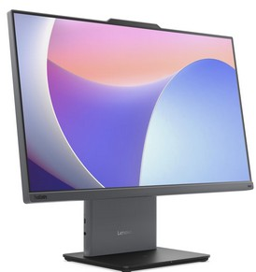
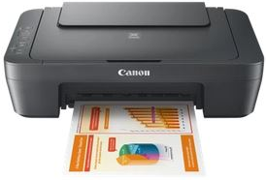
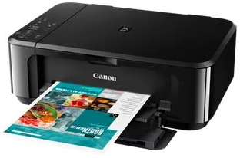

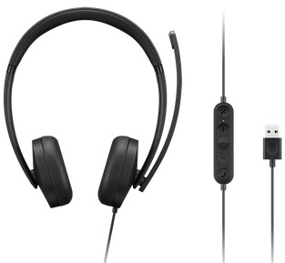
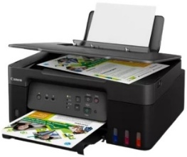
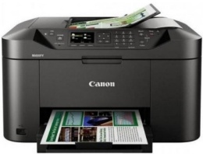
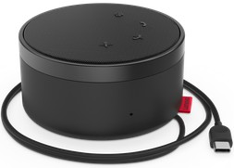
PCs
Retail File September 2025
Special Offers are valid until 30.09 or until stock lasts.
THINKCENTRE NEO 50q G4 TINY
THINKCENTRE M70q G6 TINY
ALL IN ONE THINKCENTRE NEO 50a
12LN003UUK LENOVO PC THINKCENTRE NEO 50q G4 TINY USFF, INTEL i5-13420H, 3.4-4.6GHz/12MB, 8 CORES, 16GB, 512GB SSD M.2 2280 PCIe, INTEL UHD GRAPHICS, VESA MOUNT, WIFI6, BT, LAN, USB-C, USB, HDMI, DP, DOS, 5YW, BLACK € 653 - SPECIAL OFFER
12TD000VUK LENOVO PC THINKCENTRE M70q G5 TINY USFF, INTEL i7-14700T, 1.3-5.2GHz/33MB, 20 CORES, 16GB, 512GB SSD M.2 2280 PCIe4, INTEL UHD GRAPHICS 770, VESA MOUNT, WIFI6E, BT, LAN, USB-C, USB-A, HDMI, DP, WIN 11 PRO, 3YW, BLACK € 1,040
13A4000SUK LENOVO PC THINKCENTRE M70q G6 TINY USFF, INTEL ULTRA 7 265T, 1.5-5.3GHz/30MB, 20 CORES, AI 13 TOPS, 16GB, 512GB SSD M.2 2280 PCIe4, INTEL GRAPHICS, VESA MOUNT, WIFI6E, BT, LAN, USB-C, USB-A, HDMI, DP, DOS, 3YW, BLACK € 1,186
13A4000JUK LENOVO PC THINKCENTRE M70q G6 TINY USFF, INTEL ULTRA 7 265T, 1.5-5.3GHz/30MB, 20 CORES, AI 13 TOPS, 16GB, 512GB SSD M.2 2280 PCIe4, INTEL GRAPHICS, VESA MOUNT, WIFI6E, BT, LAN, USB-C, USB-A, HDMI, DP, WIN 11 PRO, 3YW, BLACK € 1,327
12SC000VUK LENOVO PC ALL IN ONE THINKCENTRE NEO 50a 24 G5, 23.8'', FHD, IPS, ANTIGL, INTEL i5-13420H, 2.1-4.6GHz/12MB, 8 CORES, 16GB, 512GB SSD M.2 2280 PCIe, INTEL UHD GRAPHICS, LAN, WIFI6, USB, USB-C, HDMI, DOS, 5YW, LUNA GREY € 918
12SB0012UK LENOVO PC ALL IN ONE THINKCENTRE NEO 50a 27 G5, 27' FHD, IPS, ANTIGL, INTEL i7-13620H, 2.4-4.9GHz/24MB, 10 CORES, 16GB, 512GB SSD M.2 2280 PCIe, INTEL UHD GRAPHICS, LAN, WIFI6, USB, USB-C, HDMI, HDMI OUT, WIN 11 PRO, UPG 5YW, GREY €1,224
Optional
4X31N50746 LENOVO KEYBOARD AND MOUSE SET ESSENTIAL WIRELESS COMBO, BLACK GEN 2 € 37 - SPECIAL OFFER
0727C066AA CANON PRINTER ALL IN ONE INKJET MG2551S A4, PRINT, SCAN, COPY, 4800 X 600, 8iPM (B), 4iPM (C), USB, BLACK € 52
0515C106AA CANON PRINTER ALL IN ONE INKJET MG3650S A4, PRINT, SCAN, COPY, 9iPM (B), 5iPM (C), 4800 X 1200, DUPLEX, AIR PRINT, USB, WIFI, BLACK € 58
4XD1P83425 LENOVO USB-A WIRED STEREO HEADSET GEN 2 € 34
4XD1C82055 LENOVO GO WIRED SPEAKERPHONE, MS TEAMS, USB-C, USB-A, THUNDER BLACK € 144
0959C009AA CANON PRINTER ALL IN ONE INKJET HOME - OFFICE MAXIFY MB2150 A4, PRINT, SCAN, COPY, FAX, 19iPM (B),13 iPM (C), 600 X 1200 DPI, ADF, DUPLEX, SCAN TO USB, AIRPRINT, CLOUD LINK, WI-FI € 164
5989C009AA CANON PRINTER ALL IN ONE INKJET HOME - OFFICE G3430 A4, Wi-Fi, Print, Scan & Copy, Cloud, 11iPM (B), 6iPM (C), WITH REFILABLE TANKS, USB, WIFI € 147
Call now on:
Mail on:
Prices, promotions, specifications, availability and terms of offers may change without notice. Despite our best efforts, a small number of items may contain pricing, typography, or photography errors. Correct prices and promotions are validated at the time your order is placed. Delivery and installation charges are not included. Products' warranty is the warranty given by the manufacturer. VAT is included

Slide 10
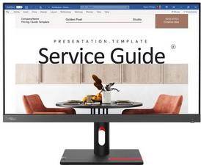
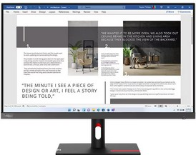










Monitors
Retail File September 2025
Special Offers are valid until 30.09 or until stock lasts.
THINKVISION S24i-30
THINKVISION S27i-30
THINKVISION E24-30
THINKVISION E24-40
63DEKAT3UK LENOVO MONITOR 23.8'', E, THINKVISION S24i-30 BUSINESS, IPS, WLED, FHD 1920x1080, ANTIGLARE, 4MS, 100Hz, 250CD/M², VESA, TILT, HDMI 1.4, VGA, 3YW, RAVEN BLACK € 112 - SPECIAL OFFER
63DFKAT4UK LENOVO MONITOR 27', E, THINKVISION S27i-30 BUSINESS, IPS, WLED, FHD 1920x1080, ANTIGLARE, 4MS, 100Hz, 300CD/M², VESA, TILT, 2x HDMI 1.4, VGA, 3YW, STORM GREY € 147 - SPECIAL OFFER
63EDMAT2UK LENOVO MONITOR 23.8'' THINKVISION E24-30 BUSINESS WITH SPEAKERS, C, IPS, WLED, FHD 1920x1080, ANTIGLARE, 16:9, 4MS, 100Hz, 250CD/M², EYESAFE, HEIGHT ADJUSTABLE, PIVOT, SWIVEL, TILT, 1x HDMI 1.4, 1x DP 1.2, 1x VGA, VESA, 3YW, BLACK € 147 - SPECIAL OFFER
64BAMAT1UK LENOVO MONITOR THINKVISION E24-40 BUSINESS WITH SPEAKERS, C, 23.8'', IPS, WLED, FHD 1920x1080, 4MS, 100Hz, 250CD/M2, ANTIGLARE, HEIGHT ADJUSTABLE, TILT, SWIVEL, PIVOT, VESA, HDMI, DP, VGA, 3YW, RAVEN BLACK € 171
THINKVISION E27-40
THINKVISION E27q-20
THINKVISION T24-40
THINKVISION T24D-40
64BCMAT4UK LENOVO MONITOR THINKVISION E27-40 BUSINESS WITH SPEAKERS, D, 27'', IPS, WLED, FHD 1920x1080, 4MS, 300CD/M2, ANTIGLARE, HEIGHT ADJUSTABLE, TILT SWIVEL, PIVOT, VESA, HDMI, DP, 3YW, RAVEN BLACK € 237
62D0GAT1UK LENOVO MONITOR 27'', F , THINKVISION E27q-20 BUSINESS WITH SPEAKERS, IPS, 2560x1440, ANTIGLARE, 4MS, 75Hz, 300 CD/M2, TILT, SWIVEL, PIVOT, HEIGHT ADJUSTABLE, HDMI, DP, 3YW, RAVEN BLACK € 281 - SPECIAL OFFER
64A4MATXUK LENOVO MONITOR 23.8'', C, THINKVISION T24-40 BUSINESS, IPS, WLED, 1920x1080, 6MS, 120Hz, 250CD/M², ANTIGLARE, HEIGHT ADJUSTABLE, PIVOT, SWIVEL, TILT, HDMI, DP, VGA, USB-A, USB-C, USB-B, 3YW, RAVEN BLACK € 178 - SPECIAL OFFER
64B9GAT1UK LENOVO MONITOR THINKVISION T24D-40 BUSINESS WITH SPEAKERS, C, 23.8'', IPS, WLED, FHD 1920x1080, 4MS, 250CD/M2, ANTIGLARE, HEIGHT ADJUSTABLE, TILT SWIVEL, PIVOT, VESA, USB-C, HDMI, DP, LAN, 3YW, ECLIPSE BLACK € 296
THINKVISION T27-40
THINKVISION T24v-30
THINKVISION M14t G2
63FDUAT6WL LENOVO MONITOR 14'', C, THINKVISION M14t G2, PORTABLE BUSINESS, WLED, TOUCH, IPS, 2240x1400, 6MS, 60Hz, 300 CD/M², TILT, PIVOT, HEIGHT ADJUST STAND, VESA, 2x USB-C, 3YW, RAVEN BLACK
€ 326 - SPECIAL OFFER
64A5MAT6UK LENOVO MONITOR 27'' THINKVISION T27-40 BUSINESS, IPS, WLED, FHD 1920x1080, AG, 16:9, 4MS, 120Hz, 300CD/M², HEIGHT ADJUST, PIVOT, SWIVEL, TILT, 3xUSB-A, USB-C, USB-B, HDMI 1.4, DP 1.2, VGA, 3YW, ECLIPSE BLACK € 237 - SPECIAL OFFER
63D8MAT3UK LENOVO MONITOR 23.8'' THINKVISION T24v-30 BUSINESS WITH SPEAKERS AND CAM, IPS, WLED, FHD 1920x1080, AG, 16:9, 4MS, 75Hz, 250CD/M², HEIGHT ADJUST, PIVOT, SWIVEL, TILT, 3xUSB3.2, USB2.0, USB-B3.2, HDMI1.4, DP1.2, VGA, 3YW, BLACK € 281
Call now on:
Mail on:
Prices, promotions, specifications, availability and terms of offers may change without notice. Despite our best efforts, a small number of items may contain pricing, typography, or photography errors. Correct prices and promotions are validated at the time your order is placed. Delivery and installation charges are not included. Products' warranty is the warranty given by the manufacturer. VAT is included

