Slide 1

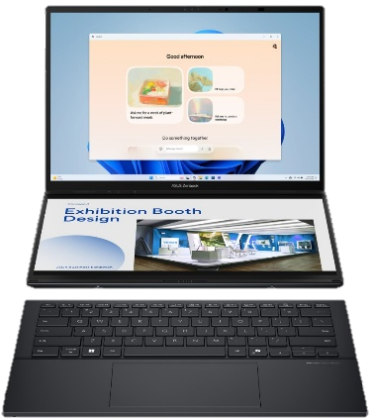
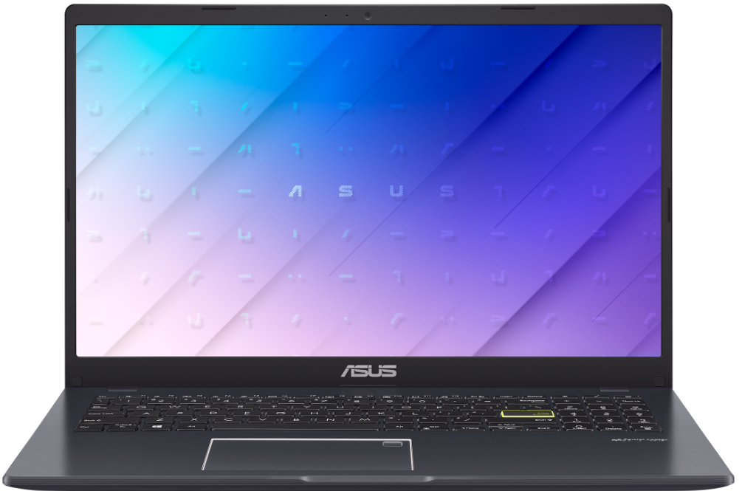
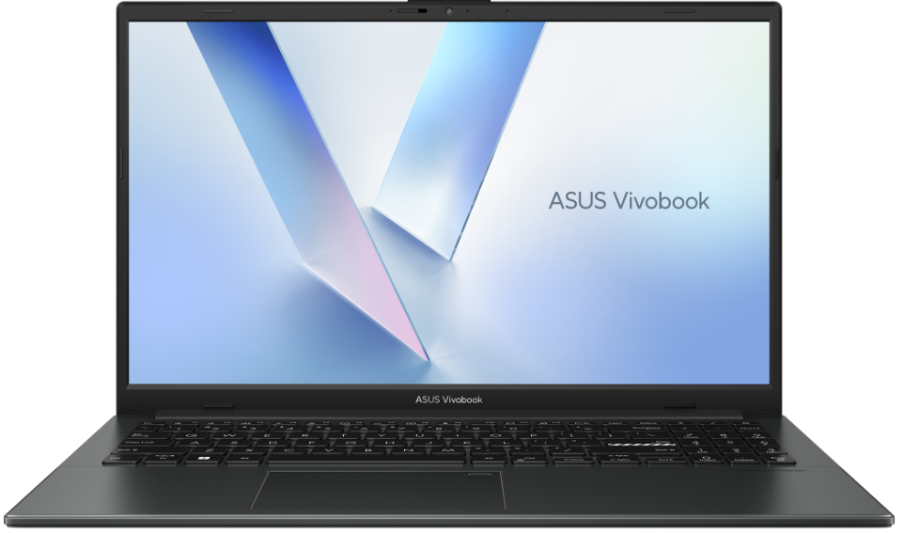
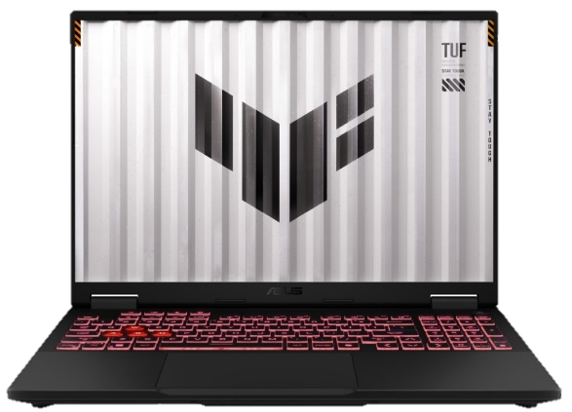
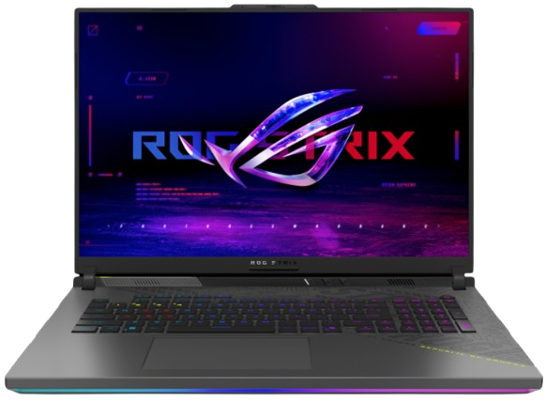
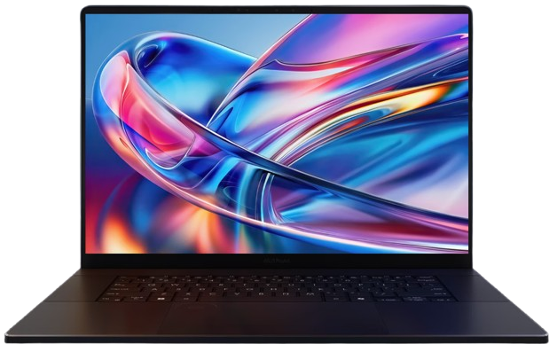
New Arrivals CONSUMER NOTEBOOKS
Retail File October 2025
90NB0UJ5-M01V50 ASUS NOTEBOOK VIVOBOOK GO 15, E510KA-BR1256WS , INTEL CELERON N4500 1.1 GHz-2.8GHz/4MB,2C,4GB,128GB, M.2 2280 PCIe3x2,INTEL HD GRAPHICS,200NITS,HD1366x768 16:9 ASPECT RATIO,WIFI5,BT,USB-A,USB-C,HDMI,WIN 11 HOME S MODE,2YW,BLACK 354 €
90NB0ZR2-M04260 ASUS NOTEBOOK VIVOBOOK GO 15,E1504FA-BQ2425W,AMD RYZEN 3 7320U 2.4-4.1GHz/6MB,4C,8GB,512GB M.2 NVMe PCIe3 SSD,AMD RADEON,250NITS,FHD 1920x1080 16:9 ASPECT RATIO,ANTI-GLARE,WIFI6E,BT,USB-A,USB-C, HDMI,WIN 11 HOME,BLACK 534 €
90NB0ZR2-M04820 ASUS NOTEBOOK VIVOBOOK GO 15,E1504FA-BQ1903,AMD RYZEN 5 7520U 2.8-4.3GHz/6MB,4C,16GB,512GB M.2 NVMe PCIe3SSD,AMD RADEON GRAPHICS,250NITS,FHD1920x1080 16:9 ASPECT RATIO,ANTI-GLARE, WIFI6E,BT,USB-A,USB-C, HDMI,DOS,2YW,BLACK 580 €
90NB14X1-M00DH0 ASUS NOTEBOOK ZENBOOK DUO UX8406CA-OLED-PZ068X, INTEL ULTRA 9 285H, 2.5-5.4GHz/24MB, 16 CORES, 32GB, 2TB PCIe G4 SSD, INTEL ARC GRAPHICS, 14'' WQXGA 2880x1800, OLED, TOUCH, WIFI7, BT, WIN 11 PRO, GREY 2,982 €
90NR0KS1-M00490 ASUS NOTEBOOK TUF A16 GAMING, FA608UH-RV015W, AMD RYZEN 7 260 3.8-5.1GHz/24MB, 8C, 16GB, 512GB SSD M.2 NVMe PCIe4, NVIDIA RTX 5050 8GB, 16'' WUXGA 1920x1200 300NITS 165Hz, RGB KB,WIFI6E,BT,LAN,USB-A,USB-C,HDMI,WIN 11 HOME,2YW,GREY 2,007 €
90NR0KV1-M00500 ASUS NOTEBOOK TUF A16 GAMING, FA608UM-RV010W, AMD RYZEN 7 260 3.8-5.1GHz/24MB,8C, 16GB, 1TB SSD M.2 NVMe PCIe4, NVIDIA RTX 5060 8GB, 16'' WUXGA 1920x1200 165Hz 300NITS, RGB KB, WIFI6E,BT,LAN,USB-C,USB-A,HDMI, WIN 11 HOME,2YW, GREY 2,175 €
90NR0L28-M001Z0 ASUS NOTEBOOK ROG STRIX G18, G814PM-S9025W, AMD RYZEN 9 7940HX 2.4-5.2GHz/64MB,16C,32GB,1TB SSD M.2 NVMe PCIe4,NVIDIA RTX 5060 8GB,18'',WQXGA 2.5K 2560x1600 240Hz 500NITS,4Z RGB,WIFI6E,BT,LAN,USB-C,USB-A,HDMI,WIN 11 HOME,2YW,GREY 3,093 €
90NB15K1-M003B0 ASUS NOTEBOOK PROART P16, H7606WP-OLED-ME011X, AMD RYZEN AI 9 HX 370 2-5.1GHz/36MB, 12C, 64GB, 2x2TB SSD M.2 NVMe, NVIDIA RTX 5070 8GB, 16'', OLED 4K 3840x2400 60Hz 500NITS TOUCH, WIFI7,BT,USB-C,USB-A,HDMI, WIN 11 PRO, 2YW, BLACK 4,010 €
Call now on:
Mail on:
Prices, promotions, specifications, availability and terms of offers may change without notice. Despite our best efforts, a small number of items may contain pricing, typography, or photography errors. Correct prices and promotions are validated at the time your order is placed. Delivery and installation charges are not included. Products' warranty is the warranty given by the manufacturer. VAT is included

