Slide 1



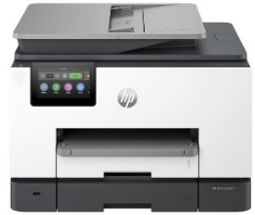
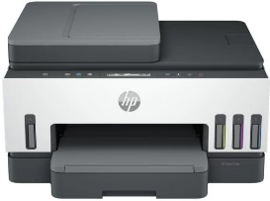


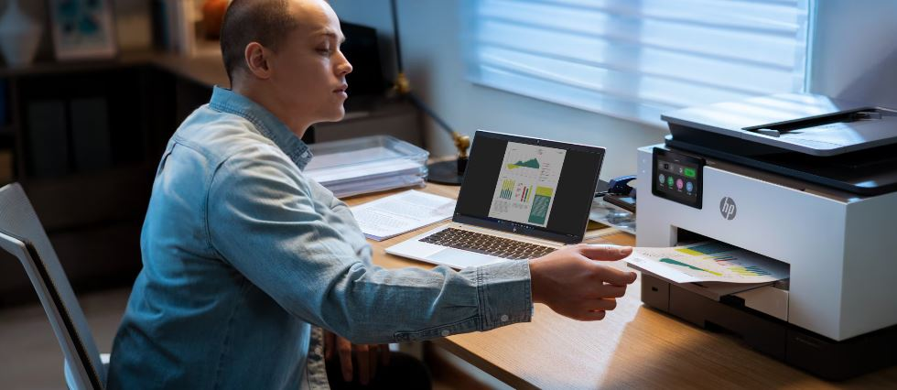
HP Officejet Pro, MFPs & Mobile Printers
HP OFFICE JET PRO BUSINESS MULTIFUNCTION PRINTERS
HP SMART TANK BUSINESS MULTIFUNCTION PRINTERS
Retail File October 2025 Page 1/7
The smart printer that gets works done. Save time with Shortcuts and get automatic two-sided printing. Print and scan from your phone.
Boost productivity with mobile setup, two-sided printing, Magic touch panel, and fax, so you can connect, work, and print intuitively. Get outstanding quality and value – up to three years of Original HP Ink included in the box.
Prices are valid until 31/10 or Until Stock Last.
HP OFFICEJET MOBILE PRINTERS
Make the world your office with powerful, quick & quiet portable printing – No network necessary.
405U3B HP PRINTER ALL IN ONE INKJET COLOR OFFICEJET PRO 8122e A4, PRINT, SCAN COPY, 20PPM (B) & 10PPM (C) , 1200x1200 DPI, DC:20K, DUPLEX, ADF 35P, LAN, USB, WIFI, 1YW, WHITE+BASALT, 115 €
CZ993A HP PRINTER INKJET COLOR OFFICEJET PRO MOBILE 200 A4, 20PPM (B), 19PPM (C), 525 MHz, 128MB, DC:500, 2 INKS, USB, WIFI DIRECT, WIFI, 1YW, BLACK, 295 €
6UU47A HP PRINTER ALL IN ONE INKJET COLOR SMART TANK BUSINESS 750 A4, PRINT, SCAN, COPY, 23PPM (B), 22PPM (C), 4800x1200 DPI, DC:5K, DUPLEX, ADF, 250P TRAY, USB, BT, WIFI, LAN, 1YW, GET 3YW EXT. FREE, 322 €
CZ992A HP PRINTER ALL IN ONE INKJET COLOR OFFICEJET MOBILE 250 A4, PRINT, SCAN, COPY, 20 PPM (B), 19 PPM (C), 4800x1200 DPI, 700MHZ, 256MB, DC:500, 2 INKS, USB, WIFI, 1YW, BLACK, 345 €
40Q45B HP PRINTER ALL IN ONE INKJET COLOR OFFICEJET PRO 8132e A4, PRINT, SCAN, COPY, FAX, 20PPM (B) & 10PPM (C) DC:20K, DUPLEX, ADF 35P, USB, WIFI, LAN, 1YW, WHITE+BASALT, 125 €
HP OFFICE JET PRO BUSINESS MULTIFUNCTION PRINTERS
4WF66A HP PRINTER ALL IN ONE INKJET COLOR SMART TANK BUSINESS 790 A4, PRINT, SCAN, COPY, FAX, 23PPM (B), 22PPM (C) 4800 x 1200 DPI, DC:6K, DUPLEX, ADF, 250P TRAY, USB, BT, WIFI, LAN, 1YW, GET 3YW EXT. FREE, 382 €
A3
Wide format professional color inkjet printer.
403X8B HP PRINTER ALL IN ONE INKJET COLOR OFFICEJET PRO BUSINESS 9120e A4, PRINT, SCAN, COPY, FAX, 22PPM (B) 18PPM (C), 1200X1200 DPI, DC:25K, DUPLEX PRINT & SCAN, ADF 35P, TRAY 250P, WIFI, LAN, USB, 1YW , BASALT, 241 €
404M5B HP PRINTER ALL IN ONE INKJET COLOR OFFICEJET PRO 9132e HP+ A4, PRINT, SCAN, COPY, FAX, 25PPM (B) 20PPM (C), DC:30K, DUPLEX, ADF 35P, 2X TRAYS 500 SHEET, AIR PRINT, USB, WIFI, LAN, 1YW, BASALT, 310 €
537P6B HP PRINTER ALL IN ONE INKJET COLOR OFFICEJET PRO BUSINESS 9730e A3, PRINT, SCAN, COPY, 22PPM(B) 18PPM(C), 1200DPI, 512MB, DC:30K, DUPLEX PRINT& SCAN, ADF 35P, 2X TRAYS, USB, WIFI, LAN, 1YW, WHITE, 274 €
Prices, Promotions, specifications, availability and terms of offers may change without notice. Despite our best efforts,
a small number of items may contain pricing, typography, or photography errors. Correct prices and Promotions are validated at the time your order is placed. Recycling fees are not included in the Dealer & Retail File. Delivery and installation charges are not included. Products' warranty is the warranty given by the manufacturer. VAT is included
Call now on:
Mail on:

Slide 2

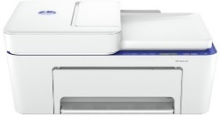

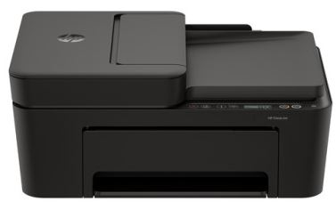

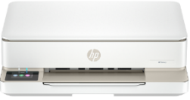
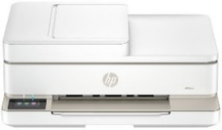

HP Home , Envy , Smart Tank, MFPs Printers
HP DESKJET HOME INKJET MULTIFUNCTION PRINTERS
Effortlessly print, scan, and copy with this compact, wireless printer with an automatic document feeder, paired with the easiest-to-use print app. From labels to recipes, enjoy a seamless experience from the World’s #1 Printer Company.
Retail File October 2025 Page 2/7
Prices are valid until 31/10 or Until Stock Last.
588Q2B HP PRINTER ALL IN ONE INKJET COLOR DESKJET HOME 2821e HP+ A4, PRINT, SCAN COPY, 7PPM (B), 5PPM (C), DC:1K, 60P INPUT TRAY, AIR PRINT, USB, WIFI, 1YW, 46 €
60K30B HP PRINTER ALL IN ONE INKJET COLOR DESKJET HOME 4230e HP+ A4, PRINT, SCAN COPY, 8PPM (B), 5PPM (C), DC:1K, 60P INPUT TRAY, ADF 35P, AIR PRINT, USB, WIFI, 1YW, 57 €
HP SMART TANK PRINTERS– HOME OFFICE
Enjoy everyday reliability with the HP Smart Tank 585 All-in-One Printer that delivers HP quality you expect and savings that are anything but expected.
This printer is intended to work only with cartridges that have new or reused HP electronic circuitry, and it uses dynamic security measures to block cartridges using modified or non-HP circuitry. Periodic firmware updates will maintain the effectiveness of these measures and block cartridges that previously worked. Reused HP electronic circuitry enables the use of reused, remanufactured, and refilled cartridges.
A24HPB HP PRINTER ALL IN ONE INKJET COLOR DESKJET HOME 4310 A4, PRINT, SCAN COPY, 8.5PPM (B), 5.5PPM (C), DC:1K, 60P INPUT TRAY, ADF 35P, AIR PRINT, USB, WIFI, 1YW 72 €
A24HMB HP PRINTER ALL IN ONE INKJET COLOR DESKJET HOME 4320 A4, PRINT, SCAN COPY, 8.5PPM (B), 5.5PPM (C), DC:1K, 60P INPUT TRAY, ADF 35P, AIR PRINT, USB, WIFI, 1YW 72 €
1F3Y4A HP PRINTER ALL IN ONE INKJET COLOR SMART TANK HOME - OFFICE 585 A4, PRINT, SCAN, COPY, 22PPM (B), 16PPM (C), 4800 x 1200 DPI, 100P TRAY, DC: 3K, 4 BOTTLES INK, BT, WIFI, 1YW, BLUE SCANNER PLATE, 167 €
Simplify at-home printing with mobile setup, two-sided printing, smart-guided buttons, Low on Ink sensors, and fewer interruptions. Plus, get more value from high-volume ink – up to three years of Original HP Ink included in the box.
Elevate your home printing! HP's wireless all-in one-color photo printer, paired with the easiest-to-use print app, offers vivid color scanning, copying, duplex printing, and borderless photos.
714L8B HP PRINTER ALL IN ONE INKJET COLOR ENVY DESKJET HOME 6120e A4, PRINT, SCAN COPY, 10PPM (B), 7PPM (C), DC:1K, DUPLEX, USB, WIFI, 1YW, CEMENT, 92 €
714N9B HP PRINTER ALL IN ONE INKJET COLOR ENVY DESKJET HOME 6520e A4, PRINT, SCAN COPY, 10PPM (B), 7PPM (C), DC:1K, DUPLEX, ADF 35P, USB, WIFI, 1YW, CEMENT, 113 €
6UU48A HP PRINTER ALL IN ONE INKJET COLOR SMART TANK HOME - OFFICE 670 A4, PRINT, SCAN, COPY, 22PPM (B), 21PPM (C), 4800x1200 DPI, DC:3K, DUPLEX, 150P TRAY, USB, BT, WIFI, 1YW, GET 3YW EXT. FREE, 228 €
Work, learn and create with the printer that prints everything so you can tackle anything – from high-quality photos to documents. Choose HP+ and get the smart printing system that keeps you connected and ready to print from virtually anywhere
242Q0B HP PRINTER ALL IN ONE INKJET COLOR ENVY DESKJET HOME 7920e HP+ A4, PRINT, SCAN COPY, PHOTO, 15PPM (B), 10PPM (C), DC:1K, TRAY 125P, DUPLEX, ADF, WIFI, 1YW, WHITE+CEMENT, 156 €
6UU46A HP PRINTER ALL IN ONE INKJET COLOR SMART TANK HOME - OFFICE 720 A4, PRINT, SCAN, COPY, 23PPM (B), 22PPM (C), 4800x1200 DPI, DC:5K, DUPLEX, 250P TRAY, USB, BT, WIFI, 1YW, GET 3YW EXT. FREE, 292 €
Prices, Promotions, specifications, availability and terms of offers may change without notice. Despite our best efforts,
a small number of items may contain pricing, typography, or photography errors. Correct prices and Promotions are validated at the time your order is placed. Recycling fees are not included in the Dealer & Retail File. Delivery and installation charges are not included. Products' warranty is the warranty given by the manufacturer. VAT is included
Call now on:
Mail on:

Slide 3

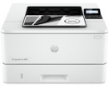
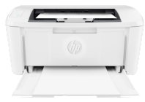
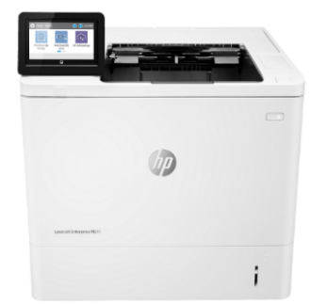

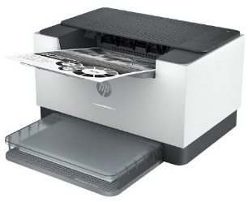
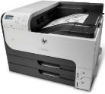
HP Monochrome Single Function Laser Printers
This modern printer is built for maximum productivity with fast speeds and reliable hardware, delivering effortless everyday use so you can focus more on your business.
Retail File October 2025 Page 3/7
Prices are valid until 31/10 or Until Stock Last.
2Z605F HP PRINTER LASER MONOCHROME BUSINESS 4002DN A4, PRINT, 40PPM, 1200 X 1200 DPI, 256MB, DC:80K, 250P TRAY, NUMBER OF USERS: 3-10, USB, LAN, 1YW, WHITE, GET 3YW FREE EXT, 244 €
An efficient, high-quality laser printer that fits your space and budget. Get fast printing from HP's smallest laser in its class, plus the time-saving HP Smart app. Count on professional-quality laser printing and
seamless setup.
2Z606F HP PRINTER LASER MONOCHROME BUSINESS 4002DW A4, PRINT, 40PPM, 1200 X 1200 DPI, 256MB, DC:80K, 250P TRAY, NUMBER OF USERS: 3-10, DUPLEX, USB, LAN, WIFI, 1YW, GET 3YW FREE EXT, 284 €
7MD66F HP PRINTER LASER MONOCHROME BUSINESS M110W A4, PRINT, 20PPM, 600 X 600 DPI, 32MB, DC:8K, 1-3 USERS, AIR PRINT, USB, WIFI, 2YW, WHITE, 115 €
Designed to handle business solutions securely and efficiently, and helps conserve energy with HP EcoSmart black toner. Keep up with the demands of growing business with a printer you can rely on.
1PV87A HP PRINTER LASER MONOCHROME PRO ENTERPRISE M507DN A4, 43PPM, 1200 x 1200 DPI, 1.2GHZ, 512MB, DC:150K, DUPLEX, 2X TRAYS 650 SHEETS, NUMBER OF USERS: 5-15, USB, LAN, 1YW, GET 3YW EXT. FREE 626 €
Built for powerful productivity with fast speeds and reliable hardware, delivering effortless everyday use from wherever work happens so you can focus more on your business.
3G651F HP PRINTER LASER MONOCHROME BUSINESS 3002DN A4, 33PPM, 1200 x 1200 DPI, 800MHz, 256MB, DC:50K, DUPLEX, 1X TRAY, NUMBER OF USERS:1-5 USERS, USB, LAN, 1YW, 152 €
This HP LaserJet Printer with JetIntelligence combines exceptional performance and energy efficiency with professional-quality documents right when you need them – all while protecting your network from attacks with the industry’s deepest security
3G652F HP PRINTER LASER MONOCHROME BUSINESS 3002DW A4, 33PPM, 1200 x 1200 DPI, 800MHz, 256MB, DC:50K, DUPLEX, 1X TRAY, NUMBER OF USERS:1-5 USERS, USB, LAN, WIFI, 1YW, 161 €
7PS84A HP PRINTER LASER MONOCHROME ENTERPRISE M611DN A4, 61PPM, 1200 X 1200 DPI, 1.2GHZ, 512MB, DC:275K, DUPLEX, 2X TRAYS, NUMBER OF USERS: 10-30, USB, LAN, 1YW, GET 3YW EXT. FREE, 857 €
A high-productivity compact mono laser printer with the fastest two-sided printing in its class 1 and the time-saving HP app. 2 3 Count on more reliable connections and a worry-free experience, 4 5 and get legendary HP quality.
A3
6GW62F HP PRINTER LASER MONOCHROME BUSINESS M209DW A4, PRINT, 29PPM, 600 X 600 DPI, 64MB, DC:20K, 1-5 USERS, DUPLEX, AIR PRINT, USB, LAN, WIFI, BLUETOOTH, 1YW, WHITE + BASALT, 144 €
Enable high-volume, black-and-white printing on paper sizes up to A3, Control costs with energy-saving features and two-sided printing. Protect sensitive business data and centrally manage printing policies.
CF236A HP PRINTER LASER MONOCHROME ENTERPRISE M712DN A3, 41PPM A4 / 20 PPM A3, 1200 X 1200 DPI, 800MHZ, 512MB, 8GB SSD, DC:100K, NUMBER OF USERS: 10-30, DUPLEX, 3X TRAYS 600 SHEETS, USB, LAN, 1YW, 1,867 €
Prices, Promotions, specifications, availability and terms of offers may change without notice. Despite our best efforts,
a small number of items may contain pricing, typography, or photography errors. Correct prices and Promotions are validated at the time your order is placed. Recycling fees are not included in the Dealer & Retail File. Delivery and installation charges are not included. Products' warranty is the warranty given by the manufacturer. VAT is included
Call now on:
Mail on:

Slide 4
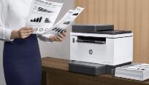

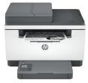

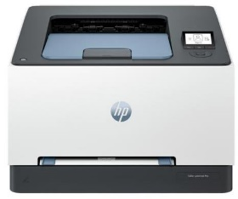



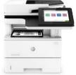
HP Monochrome All in One MFP Laser Printers
A high-productivity MFP with the fastest two-sided printing in its class, an automatic feeder, and the time-saving HP Smart app. Count on peace of mind from more reliable connections, and a worry-free experience with simplified setup.
Retail File October 2025 Page 4/7
Prices are valid until 31/10 or Until Stock Last.
An efficient, high-quality multifunction printer that fits your space and your budget. Get fast printing from HP's smallest laser, plus the time-saving HP Smart app.
6GW99F HP PRINTER ALL IN ONE LASER MONOCHROME BUSINESS M234DW A4, PRINT, SCAN, COPY, 29PPM, 600 X 600 DPI, 64MB, DC:20K, 1-5 USERS, DUPLEX, USB, WIFI, LAN, 1YW, WHITE + BASALT 165 €
Dynamic security enabled printer. Contains technology that may prevent cartridges with non-HP chips or circuitry from working now or in the future.
7MD72F HP PRINTER ALL IN ONE LASER MONOCHROME BUSINESS M140W A4, PRINT, SCAN, COPY, 20PPM, 600 X 600 DPI, 64MB, DC:8K, 1-3 USERS, AIR PRINT, USB, WIFI, 2YW, WHITE 156 €
6GX00F HP PRINTER ALL IN ONE LASER MONOCHROME BUSINESS M234SDN A4, PRINT, SCAN, COPY, 29PPM, 600 X 600 DPI, 64MB, DC:20K, 1-5 USERS, DUPLEX, ADF, USB, LAN, 1YW, WHITE + BASALT 176 €
499R0F HP PRINTER LASER COLOR PRO BUSINESS 3202DW A4, 25PPM (B&C), 600X600 DPI, 1.2GHz, 256MB, DC:40K, DUPLEX, AIRPRINT, USB, WIFI, LAN, 1YW, GET 3YW EXT. FREE, CASHBACK 30€ UNTIL 31/10, 310 €
6GX01F HP PRINTER ALL IN ONE LASER MONOCHROME BUSINESS M234SDW A4, PRINT, SCAN, COPY, 29PPM, 600 X 600 DPI, 64MB, DC:20K, 1-5 USERS, DUPLEX, ADF, USB, LAN, WIFI, 1YW, WHITE + BASALT 208 €
Discover business-ready capabilities and savings with HP LaserJet Tank MFP 1604w All-in-One Printer pre-filled with up to 5,000 pages of Original HP Toner
381L0A HP PRINTER ALL IN ONE LASER TANK MONOCHROME BUSINESS 1604W, A4, PRINT, SCAN, COPY, 22PPM, 600 X 600 DPI, 64MB, DC:25K, 1-5 USERS, USB, WIFI, BASALT, 1YW, PRE-FILLED WITH UP TO 5K PAGES OF HP TONER, 244 €
This modern printer is built for maximum productivity with fast speeds and reliable hardware, delivering effortless everyday use so you can focus more on your business. And with HP+, printers have never been easier to manage and use from anywhere.
This printer is built for powerful productivity with fast speeds and reliable hardware, delivering effortless everyday use from wherever work happens so you can focus more on your business.
Choose an HP LaserJet Enterprise MFP designed to handle business solutions securely and efficiently.
1PV65A HP PRINTER ALL IN ONE LASER MONOCHROME ENTERPRISE M528F A4, PRINT, SCAN, COPY, FAX, 43PPM, 1200 DPI, 1.25GB, DC:150K, DUPLEX , ADF 100 SHEETS, 2X TRAYS, No OF USERS: 5-15, USB, LAN, 1YW - GET 3YW FREE EXT, 1,779 €
3G629F HP PRINTER ALL IN ONE LASER MONOCHROME BUSINESS 3102FDN, A4, PRINT, SCAN, COPY, FAX, 33PPM, 1200 X 1200 DPI, 800MHz, DC:50K, DUPLEX, ADF 50 SHEETS, 1X TRAY, USB, LAN, 1YW, 290 €
2Z623F HP PRINTER ALL IN ONE LASER MONOCHROME BUSINESS 4102FDN A4, PRINT, SCAN, COPY, FAX, 40PPM, 1200 X 1200 DPI, 512MB, DC:80K, DUPLEX, ADF 50P, 2X TRAYS 350 SHEETS, NUMBER OF USERS: 3-10, USB, LAN, 1YW,
WHITE, GET 3YW FREE EXT, 418 €
3G630F HP PRINTER ALL IN ONE LASER MONOCHROME BUSINESS 3102FDW, A4, PRINT, SCAN, COPY, FAX, 33PPM, 1200 DPI, 800MHz, DC:50K, DUPLEX, ADF 50 SHEETS, 1X TRAY, USB, LAN, WIFI, 1YW, 338 €
2Z624F HP PRINTER ALL IN ONE LASER MONOCHROME BUSINESS 4102FDW A4, PRINT, SCAN, COPY, FAX, 40PPM, 1200 X 1200 DPI, 512MB, DC:80K, DUPLEX, ADF 50P, 2X TRAYS 350 SHEETS, NUMBER OF USERS: 3-10, USB, LAN, WIFI, 1YW, WHITE, GET 3YW FREE EXT, 451 €
Prices, Promotions, specifications, availability and terms of offers may change without notice. Despite our best efforts,
a small number of items may contain pricing, typography, or photography errors. Correct prices and Promotions are validated at the time your order is placed. Recycling fees are not included in the Dealer & Retail File. Delivery and installation charges are not included. Products' warranty is the warranty given by the manufacturer. VAT is included
Call now on:
Mail on:

Slide 5

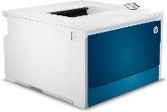
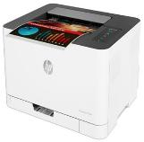
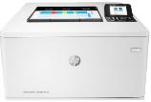
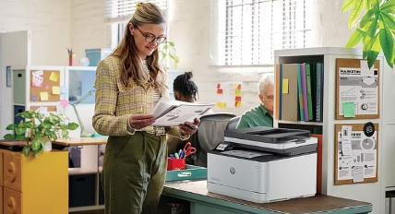
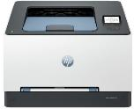
HP Colour Single Function Laser Printers
Designed for high-volume, high-speed document printing packed with best-in-class security features. Perfect for Office.
Retail File October 2025 Page 5/7
Prices are valid until 31/10 or Until Stock Last.
4RA88F HP PRINTER LASER COLOR PRO BUSINESS 4202DW A4, 35PPM (B&C), 600 X 600 DPI,512MB,DC:50K,DUPLEX,USERS 3-10,USB,WIFI,LAN,1YW, GET3YW EXT. FREE, 451 €
Designed for maximum productivity in limited spaces, the HP Color Laser 150nw A4 Color Laser Printer is a reliable and enduring device that fits any office.
Designed for business work teams that need professional performance with fast, high-quality two-sided color printing, laser productivity, and award-winning reliability in a space-saving design.
3PZ95A HP PRINTER LASER COLOR ENTERPRISE M455DN A4, 27PPM (B) & 24PPM (C), 600 X 600 DPI, 800MHz, 1.25GB, DC:55K, DUPLEX, 2X TRAYS 300 SHEETS TOTAL, 3-10 USERS, LAN, 1YW, GET 3YW EXT. FREE 616 €
4ZB95A HP PRINTER LASER COLOR BUSINESS 150NW A4, 18PPM (B), 4PPM (C), 600 X 600 DPI, 400MHZ, 64MB, DC:20K, USB, WIFI, LAN, 1YW. WORK EFFICIENTLY WITH A SMALL, COMPACT PRINTER – WORLD'S SMALLEST IN-CLASS. 235 €
Designed for business work teams that need professional performance with fast, high-quality two-sided color printing, laser productivity, and award-winning reliability in a space-saving design.
8D7L0A HP PRINTER LASER COLOR PRO BUSINESS 3202DN A4, 25PPM (B&C), 600X600 DPI, 1.2GHz, 256MB, DC:40K, DUPLEX, AIRPRINT, USB, LAN, 1YW, GET 3YW EXT. FREE, 301 €
Prices, Promotions, specifications, availability and terms of offers may change without notice. Despite our best efforts,
a small number of items may contain pricing, typography, or photography errors. Correct prices and Promotions are validated at the time your order is placed. Recycling fees are not included in the Dealer & Retail File. Delivery and installation charges are not included. Products' warranty is the warranty given by the manufacturer. VAT is included
Call now on:
Mail on:

Slide 6

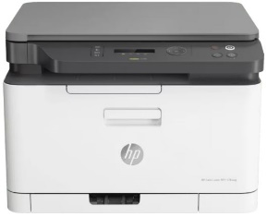
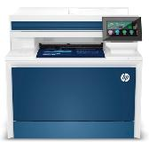
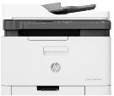

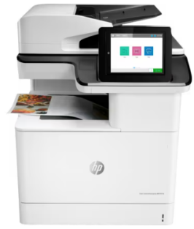
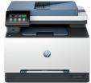
HP Colour All In One MFP Laser Printers
Get productive MFP performance – world's smallest in-class. Print, scan, copy, and fax, produce high-quality colour results, and print and scan from your phone.
Retail File October 2025 Page 6/7
Prices are valid until 31/10 or Until Stock Last.
4ZB96A HP PRINTER ALL IN ONE LASER COLOR BUSINESS 178NW A4, PRINT, SCAN, COPY, 18PPM (B), 4PPM (C), 600 X 600 DPI, 1-5 USERS, DC:20K, USB, WIFI, LAN, 1YW 317 €
The HP Color LaserJet Pro Bussiness is designed to let you focus your time where it’s most effective-growing your business and staying ahead of the competition.
4RA83F HP PRINTER ALL IN ONE LASER COLOR PRO BUSINESS 4302DW A4, PRINT, SCAN, COPY, 35PPM (B&C), 600 X 600 DPI, 512MB, DC:50K, DUPLEX, ADF 50 PAGES, USERS 3-10, USB, WIFI, LAN, 1YW, GET 3YW EXT. FREE, 484 €
Get productive MFP performance – world's smallest in-class. Print, scan, copy, and fax, produce high-quality colour results, and print and scan from your phone.
4RA84F HP PRINTER ALL IN ONE LASER COLOR PRO BUSINESS 4302FDN A4, PRINT, SCAN, COPY, FAX, 35PPM (B&C), 600 X 600 DPI, 512MB, DC:50K, DUPLEX, ADF 50 PAGES, USERS 3-10, USB, LAN, 1YW, GET 3YW EXT. FREE, 614 €
4ZB97A HP PRINTER ALL IN ONE LASER COLOR BUSINESS 179FNW A4, PRINT, SCAN, COPY, FAX, 18PPM (B), 4PPM (C), 600 X 600 DPI, DC:20K, ADF, USB, WIFI, LAN, 1YW 396 €
5HH64F HP PRINTER ALL IN ONE LASER COLOR PRO BUSINESS 4302FDW A4, PRINT, SCAN, COPY, FAX, 35PPM (B&C), 600 X 600 DPI, 512MB,DC:50K,DUPLEX,ADF 50 PAGES, USERS 3-10,USB,WIFI,LAN,1YW,GET 3YW EXT. FREE, 641 €
Designed for business work teams that need professional performance with fast, high-quality two-sided printing with scanning, copying and fax, plus award-winning reliability in a compact design.
Expect brilliant colour prints from advanced MFPs, equipped with JetIntelligence technology. Offering the world’s most secure printing 1 and a wide range of paper handling features, this is printing that helps save time and simplifies workflows.
499Q7F HP PRINTER ALL IN ONE LASER COLOR PRO BUSINESS 3302FDN A4, PRINT, SCAN, COPY, FAX, 25PPM (B&C), 600 X 600 DPI, 1.2GHz, 512MB, DC:40K, DUPLEX, ADF, AIRPRINT, USB, LAN, 1YW, GET 3YW EXT. FREE, 405 €
T3U55A HP PRINTER ALL IN ONE LASER COLOR ENTERPRISE M776DN A3, PRINT, SCAN, COPY, 46PPM, DC:200K, 5-20 USERS, 1200x1200 DPI, 3GB MEMORY, 2X TRAY, DUPLEX, ADF, USB, LAN, 1YW 3,836 €
499Q8F HP PRINTER ALL IN ONE LASER COLOR PRO BUSINESS 3302FDW A4, PRINT, SCAN, COPY, FAX, 25PPM (B&C), 600 X 600 DPI,1.2GHz, 512MB, DC:40K, DUPLEX, ADF, AIRPRINT, USB, WIFI, LAN, 1YW, GET 3YW EXT. FREE, 445 €
Prices, Promotions, specifications, availability and terms of offers may change without notice. Despite our best efforts,
a small number of items may contain pricing, typography, or photography errors. Correct prices and Promotions are validated at the time your order is placed. Recycling fees are not included in the Dealer & Retail File. Delivery and installation charges are not included. Products' warranty is the warranty given by the manufacturer. VAT is included
Call now on:
Mail on:

Slide 7

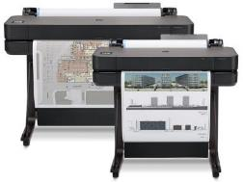

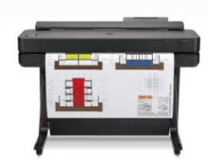
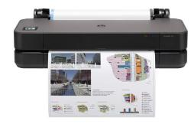
HP DesignJet
Large-Format Printers
Promos will be announced soon and for specific part numbers
Extreme simplicity The HP DesignJet T200, T600 and Studio series are the world’s easiest large-format print job submission plotters, intuitive and easy to print, so that as Architects, Engineers and Construction professionals, you can give your attention to what is important.
Retail File October 2025 Page 7/7
Prices are valid until 31/10 or Until Stock Last.
The world's smallest plotters, including a built-in stand, are designed to fit your office, budget, and the way you work. Print multi-size projects automatically. Avoid waiting with high-speed printing as fast as 25/30 seconds per A1/D plot. Ideal for office working professionals
With its compact design and user-friendly operation, this plotter is ideal for offices with limited space--without compromising on performance. The HP DesignJet T230 delivers high-quality prints, allowing you to produce precise and detailed documents with ease. Ideal for home working professionals
5HB09D HP PLOTTER DESIGNJET T630 24'' A1, PRINT, 30 SEC/PAGE, 76 A1 PRINTS PER HOUR, 2400 X 1200 DPI, 1GB, STAND, SHEET FEED, ROLL FEED, ADF, MEDIA BIN, AUTOMATIC CUTTER, 4 INKS, USB, WIFI, WIFI DIRECT, LAN, 1YW 1,330 €
5HB07D HP PLOTTER DESIGNJET T230 24'' A1, PRINT, 35 SEC/PAGE, 68 A1 PRINTS PER HOUR, 2400 X 1200 DPI, 512 MB, SHEET FEED, ROLL FEED, AUTOMATIC CUTTER, 4 INKS, USB, WIFI, WIFI DIRECT, LAN, 1YW, 2YW 863 €
5HB11A HP PLOTTER DESIGNJET T630 36'' A0, PRINT, 30 SEC/PAGE, 76 A1 PRINTS PER HOUR, 2400 X 1200 DPI, STAND, SHEET FEED, ROLL FEED, ADF, MEDIA BIN, AUTOMATIC CUTTER, 4 INKS, USB, WIFI, WIFI, WIFI DIRECT, LAN, 1YW, 2,069 €
The world's smallest wide-format printer with a built-in stand, is designed to fit your office, budget, and the way you work. Print multi-size projects with ease. Print your A1 plot as fast as 26 seconds. 1 GB memory. Ideal for office working professionals
Designed to fit your office, budget, and the way you work, the world's smallest plotters provide extreme simplicity. Send multiple files in one click. Avoid waiting by the printer with high-speed printing as fast as 30/35 seconds per A1/D plot. Ideal for home working professionals
5HB08D HP PLOTTER DESIGNJET T650 24'' A1, PRINT, 26 SEC/PAGE, 81 A1 PRINTS PER HOUR, 2400 X 1200 DPI, 1GB, STAND, SHEET FEED, ROLL FEED, ADF, MEDIA BIN, AUTOMATIC CUTTER, 4 INKS, USB, WIFI, WIFI DIRECT, LAN, 2YW, 1,479 €
5HB06D HP PLOTTER DESIGNJET T250 24'' A1, PRINT, 30 SEC/PAGE, 76 A1 PRINTS PER HOUR, 2400 X 1200 DPI, 512MB, SHEET FEED, ROLL FEED, AUTOMATIC CUTTER, 4 INKS, USB, WIFI, WIFI DIRECT, LAN, 2YW 985 €
5HB10D HP PLOTTER DESIGNJET T650 36'' A0, PRINT, 25 SEC/PAGE, 82 A1 PRINTS PER HOUR, 2400 X 1200 DPI, 1GB, STAND, SHEET FEED, ROLL FEED, ADF, MEDIA BIN, AUTOMATIC CUTTER, 4 INKS, USB, WIFI, WIFI DIRECT, LAN, 2YW, 2,380 €
Prices, Promotions, specifications, availability and terms of offers may change without notice. Despite our best efforts,
a small number of items may contain pricing, typography, or photography errors. Correct prices and Promotions are validated at the time your order is placed. Recycling fees are not included in the Dealer & Retail File. Delivery and installation charges are not included. Products' warranty is the warranty given by the manufacturer. VAT is included
Call now on:
Mail on:

