Slide 1

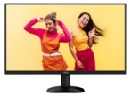
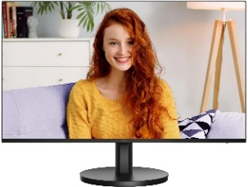
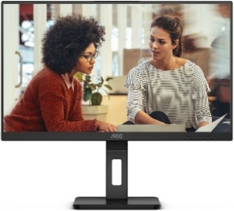
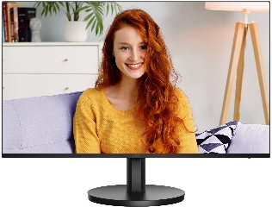
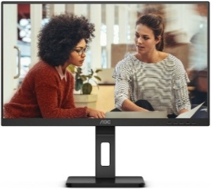
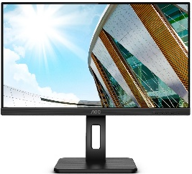
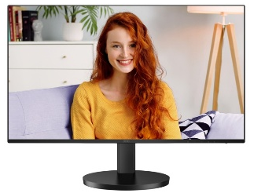
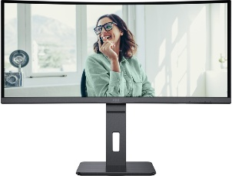
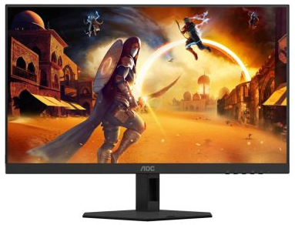
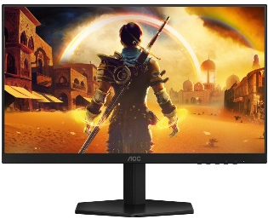
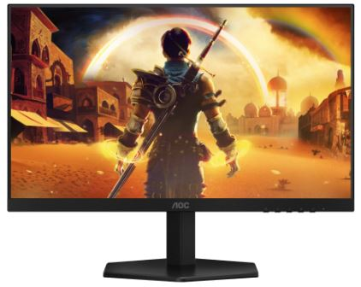
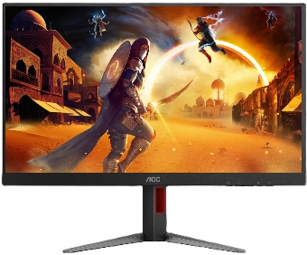
AOC HOME, Business and Gaming PC Monitors New Lower Prices call for BF pricing
Retail File
November 2025
The worldwide Leader in displays
Q27B35E AOC MONITOR 27'' BUSINESS, F, IPS, QHD, 75HZ, 2560x1440, 1MS, TILT, HDMI, DP, VESA COMPATIBLE, BLACK, 3 YW ACK €119
24B3CF2 AOC MONITOR 23.8'', BUSINESS, E, IPS, FHD 1920 X 1080, 100Hz, 1MS, SPEAKERS, 250CD/M2, TILT, HEIGHT ADUSTABLE, HDMI, USB-C POWER DELIVERY 65W, USB 3.2 X 2, 3YW, BLACK €119
24E3QAF AOC MONITOR 23.8'', SPEAKERS, IPS, WLED, FHD 1920 X 1080, 20M:1, 300 CD/M2, 4MS, 75HZ, TILT, HEIGHT ADJUSTABLE, SWIVEL, PIVOT, VGA, DP, HDMI, WALLMOUNT, 3YW, BLACK €145
27B3CA2 AOC MONITOR 27'' BUSINESS, F, IPS, FHD, 100HZ, 1920x1080, 1MS, SPEAKERS, TILT, HDMI, USB-C, USB-HUB, VESA COMPATIBLE, BLACK, 3 YW €158
27E3QAF AOC MONITOR 27'', SPEAKERS, IPS, WLED, FHD 1920 X 1080, 20M:1, 300 CD/M2, 4MS, 75HZ, TILT, HEIGHT ADJUSTABLE, SWIVEL, PIVOT, VGA, DP, HDMI, WALLMOUNT, 3YW, BLACK €171
Q24P2Q AOC MONITOR 23.8'‘ BUSINESS, E, WITH SPEAKERS, IPS WLED QHD 2560X1440, 5Hz ,TILT, PIVOT, SWIVEL, H.ADJ. 4xUSB, VGA, HDMI, DP, VESA, 3YW, BLACK, €208
Q27B3CF2 AOC MONITOR 27'' BUSINESS, F, IPS, QHD, 100HZ, 2560x1440, 1MS, SPEAKERS, TILT, HEIGHT ADJUSTABLE, HDMI x 2, USB-C, USB-HUB, VESA COMPATIBLE, BLACK, 3 YW €232
CU34P3CV AOC MONITOR 34'', BUSINESS CURVED, G, VA, WQHD, 3440x1440, 20M:1, 4MS, 100 Hz, 21:9, ULTRA WIDE, SPEAKERS, TILT, SWIVEL, HEIGHT ADJUSTABLE, HDMI, DP, USB HUB, USB-C, LAN, WALLMOUNT, 3YW, BLACK €385
24G4HRE AOC MONITOR 23.8'', 24G4HRE, GAMING, E, IPS, SPEAKERS, 200 Hz, 1920x1080, 80M:1, 0.5MS, 300 CD/M², TILT, AMD FREESYNC, 200 Hz, 2X HDMI, DISPLAY PORT, 3YW, BLACK €119
24G42E AOC MONITOR 23.8'', 24G42E, GAMING, E, IPS, 1920x1080, 80M:1, 1MS, 300 CD/M², TILT, AMD FREESYNC, 180 Hz, 2X HDMI, DISPLAY PORT, 3YW, BLACK €132
27G42E AOC MONITOR 27G42E, GAMING 27'', E, 180HZ, SPEAKERS, IPS LED, 0.5MS, 1920x1080, 80M:1, 300 CD/M², TILT, 1X HDMI, DISPLAY PORT, FRAMELESS , 3YW, BLACK €164
27G4HA AOC MONITOR 27G4HA, GAMING 27'', E, 200HZ, SPEAKERS, IPS LED, 0.5MS, 1920x1080, 80M:1, 300 CD/M², TILT, 2X HDMI, DISPLAY PORT, FRAMELESS , 3YW, BLACK €164
Prices, promotions, specifications, availability and terms of offers may change without notice. Despite our best efforts,
a small number of items may contain pricing, typography, or photography errors. Correct prices and promotions are validated at the time your order is placed. Recycling fees are not included in the Dealer & Retail File. Delivery and installation charges are not included. Products' warranty is the warranty given by the manufacturer. VAT is included
Call now on:
Mail on:

Slide 2
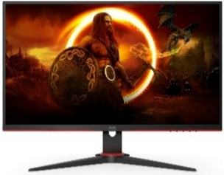
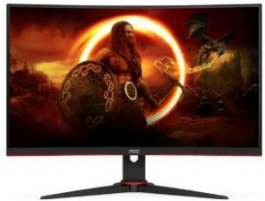
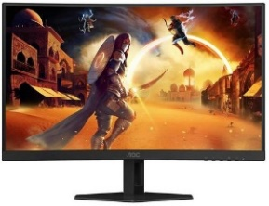
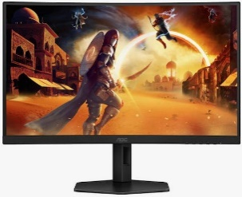
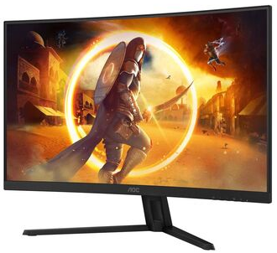
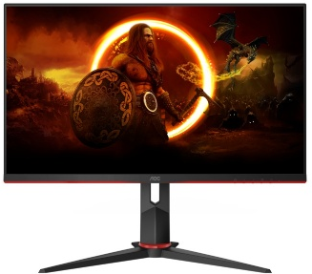
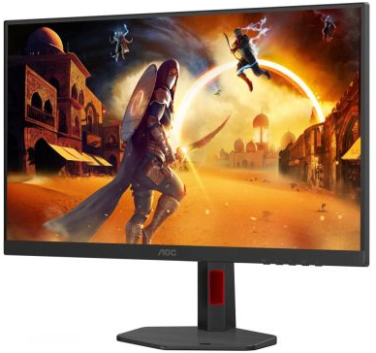
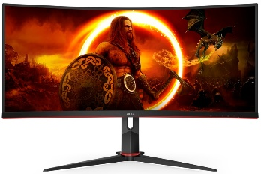
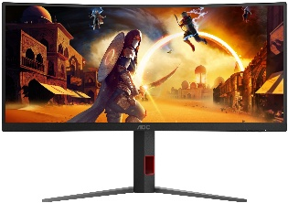
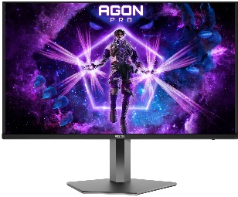
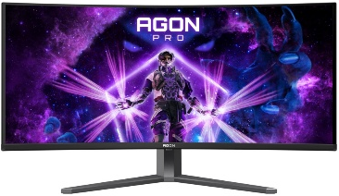
AOC HOME, Business and Gaming PC Monitors New Lower Prices call for BF pricing
Retail File
November 2025
The worldwide Leader in displays
27G2SPAE/BK AOC MONITOR 27'', GAMING, E, IPS, 1920x1080, 80M:1, 1MS, SPEAKERS, 250 CD/M², 165Hz, TILT, DISPLAY PORT, 2 X HDMI, 3Y, BLACK €167
C24G2AE/BK AOC MONITOR 24'', GAMING CURVED, VA LED, 1920x1080, 80M:1, 1MS, 250 CD/M², AMD FREESYNC, 165 Hz, VGA, 2X HDMI, DISPLAY PORT, FRAMELESS 3YW, BLACK-RED €167
C27G4ZXE AOC MONITOR 27'', GAMING CURVED, E, VA LED, 1920x1080, 80M:1, 0.3MS, 280HZ, 300 CD/M², TILT, AMD FREESYNC/G-SYNC OMPATIBLE, 2X HDMI, DISPLAY PORT, 3YW, BLACK €179
CQ27G4X AOC MONITOR, CURVED GAMING 27'', G, 180HZ, VA LED, 2560x1440, 80M:1, 0.5MS, 300 CD/M², AMD FREESYNC, TILT, SWIVEL, HEIGHT ADJUSTABLE, 2X HDMI, DISPLAY PORT, FRAMELESS, 3YW, BLACK €215
C27G4ZXU AOC MONITOR 27'', GAMING CURVED, E, VA LED, 1920x1080, 80M:1, 0.3MS, 280HZ, 300 CD/M², TILT, SWIVEL, HEIGHT ADJUSTABLE, AMD FREESYNC/G-SYNC COMPATIBLE, 2X HDMI, DISPLAY PORT, 3YW, BLACK €249
CQ32G4VE AOC MONITOR CQ32G4VE, CURVED GAMING 32'', VA, G, 180HZ, 2560x1440, 80M:1, 300 CD/M², AMD FREESYNC, TILT, 2X HDMI, DISPLAY PORT, FRAMELESS , 3YW, BLACK/RED €252
27G2ZN3/BK AOC MONITOR 27'', GAMING, E, VA, 1920x1080, 80M:1, 1MS, 300 CD/M², 280Hz, DISPLAY PORT, TILT, PIVOT, SWIVEL, HEIGHT ADJUSTABLE, 2 X HDMI, 3Y, BLACK €252
U27G4R AOC MONITOR 27'', GAMING, F, FAST IPS, 3840x2160, 80M:1, 0.5MS/0.3MS, 400 CD/M², 160Hz/320Hz, TILT, HEIGHT ADJUSTABLE, SWIVEL, PIVOT, 2 X HDMI, 1 X DISPLAY PORT, USB HUB, 3YW, BLACK-RED €327
CU34G2XP/BK AOC MONITOR 34'', CU34G2XP/BK, GAMING CURVED, G, VA, WQHD, 3440x1440, 80M:1, 1MS, FREESYNC, 180 Hz, 21:9, ULTRA WIDE, TILT,SWIVEL, HEIGHT ADJUSTABLE, HDMIx2, DPx2, USB HUB, WALLMOUNT, 3YW, BLACK €365
CU34G4 AOC MONITOR 34'', CU34G4, GAMING CURVED, G, VA, WQHD, 3440x1440, 80M:1, 0.5MS, FREESYNC, 180 Hz, 21:9, ULTRA WIDE, TILT, SWIVEL, HEIGHT ADJUSTABLE, HDMIx2, DPx2, WALLMOUNT, 3YW, BLACK €372
AG326UD AOC MONITOR 32'' GAMING AGON PRO, OLED, 3840 X 2160, 80M:1, 165Hz, 0.03MS, 1000 CD/M2, SPEAKERS, G-SYNC COMPATIBLE, TILT, SWIVEL, PIVOT, HEIGHT ADJUSTABLE, HDMI X 2, DISPLAY PORT, USB 3.2 X 2, BLACK €745
AG346UCD AOC MONITOR 34'', GAMING CURVED, G, OLED, WQHD, 3440x1440, 15M:1, 0.03MS, 175 Hz, 21:9, ULTRA WIDE, SPEAKERS, TILT, SWIVEL, HEIGHT ADJUSTABLE, HDMI X 2, DP, USB HUB, USB-C, WALLMOUNT, 3YW, MATT €780
Prices, promotions, specifications, availability and terms of offers may change without notice. Despite our best efforts,
a small number of items may contain pricing, typography, or photography errors. Correct prices and promotions are validated at the time your order is placed. Recycling fees are not included in the Dealer & Retail File. Delivery and installation charges are not included. Products' warranty is the warranty given by the manufacturer. VAT is included
Call now on:
Mail on:

