Slide 1

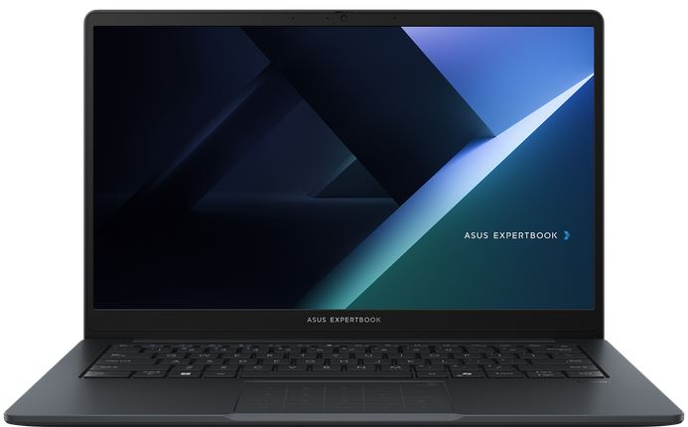
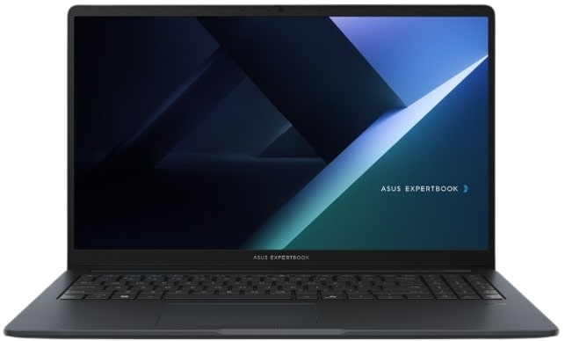
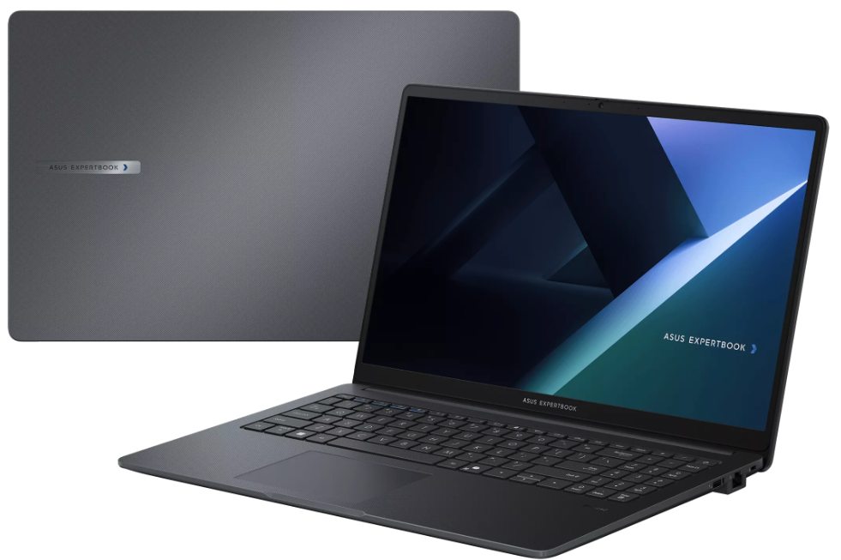
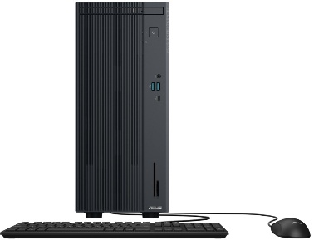
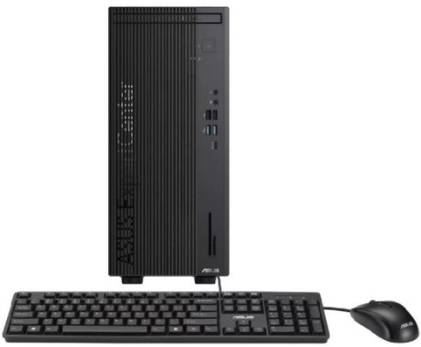


Commercial NOTEBOOKS,PC’s & AIO
Retail File November 2025
Special Offers are valid until 30.11 or until stock lasts.
EXPERTBOOK B1, B1403CVA
EXPERTBOOK BM1, BM1503CDA
EXPERTBOOK B1, B1503CVA
90NX0811-M02H40 ASUS NOTEBOOK EXPERTBOOK B1, B1403CVA-S60408, INTEL CORE 5 120U, 1.4-5GHz/12MB, 10C, 16GB, 512GB SSD M.2 2280 NVMe PCIe4, INTEL GRAPHICS, 14'' IPS LED FHD 1920x1080 300NITS AG, WIFI6E, BT, LAN, USB-A, USB-C, HDMI, DOS, 3YW, GREY € 643
90NX0811-M02H50 ASUS NOTEBOOK EXPERTBOOK B1, B1403CVA-S60409, INTEL CORE 7 150U, 1.8-5.4GHz/12MB, 10C, 16GB, 512GB SSD M.2 2280 NVMe PCIe4, INTEL GRAPHICS, 14'' IPS LED FHD 1920x1080 300NITS AG, WIFI6E, BT, LAN, USB-A, USB-C, HDMI, DOS, 3YW, GREY € 853
90NX0821-M00D70 ASUS NOTEBOOK EXPERTBOOK BM1, BM1503CDA-NJ0053,AMD RYZEN 7 7735U, 2.7-4.75GHz/16MB, 8C, 16GB, 512GB M.2 2280 NVMe PCIe4, AMD RADEON, 15.6'' TN LED FHD 1920x1080 250NITS AG, WIFI6,BT, LAN, USB-A, USB-C, HDMI, DOS, 3YW, GENTLE GREY € 696
90NX0801-M01HD0 ASUS NOTEBOOK EXPERTBOOK B1, B1503CVA-NJ0144X, INTEL CORE 5 120U, 1.4-5GHz/12MB, 10C, 16GB, 512GB SSD M.2 2280 NVMe PCIe4, INTEL UHD, 15.6'' TN LED FHD 1920x1080 250NITS AG, WIFI6E,BT, LAN, USB-A, USB-C, HDMI, WIN 11 PRO,3YW, GREY € 805
90NX0801-M022T0 ASUS NOTEBOOK EXPERTBOOK B1, B1503CVA-NJ0145, INTEL CORE 7 150U, 1.8-5.4GHz/12MB, 10C, 16GB, 512GB M.2 2280 NVMe PCIe4, INTEL UHD, 15.6'' TN LED FHD 1920x1080 250NITS AG, WIFI6E, BT, LAN, USB-A, USB-C, HDMI, DOS, 3YW, GENTLE GREY € 827
EXPERTCENTER P500 MT, MINI TOWER
EXPERTCENTER D7 MT, MINI TOWER
ALL IN ONE A5402WVA -A5702WVA
90PT03J3-M04B60 ASUS PC ALL IN ONE A5402WVA, A5402WVARK-BPC0320, 23.8'', FHD 1920x1080 LCD 250NITS 100Hz AG, INTEL CORE 5 120U, 1.4-5GHz/12MB, 10C, 16GB,512GB SSD M.2 NVMe PCIe4,INTEL IRIS X GRAPH,WIFI7,BT,LAN,USB-A,USB-C,USB4,HDMI,DOS,3YW,BLACK € 778
90PT03N1-M022D0 ASUS PC ALL IN ONE A5702WVA, A5702WVARK-BPE0550, 27'', FHD 1920x1080 LCD 250NITS 75Hz AG, INTEL CORE 7 150U 1.8-5.4GHz/12MB, 10C, 16GB, 512GB SSDM.2 NVMe PCIe4,INTEL IRIS X GRAPH,WIFI6E,BT, LAN, USB-A, USB-C, HDMI, DOS, 3YW, BLACK € 948
90PT03J3-M04B50 ASUS PC ALL IN ONE A5402WVA, A5402WVARK-BPC0310, 23.8'', FHD 1920x1080 LCD 250NITS 100Hz AG, INTEL CORE 7 150U 1.8-5.4GHz/12MB, 10C, 16GB, 512GB M.2 NVMe PCIe4, INTEL GRAPHICS, WIFI7,BT, LAN,USB-A,USB-C,USB4,HDMI,DOS,3YW, BLACK € 954
90PF05I1-M00PW0 ASUS PC EXPERTCENTER P500 MT, P500MV-13620H0580, INTEL i7-13620H 2.4-4.9GHz/24MB, 10C, 16GB, 512GB SSD M.2 2280 NVMe PCIe4, INTEL UHD GRAPHICS, DVDRW, LAN, USB-A, USB-C, HDMI, DP, DOS, 5YW, GREY € 732
90PF05J1-M00JB0 ASUS PC EXPERTCENTER D7 MT, D701MER-7147000480, INTEL i7-14700 2.1-5.3GHz/33MB, 20C, 16GB, 512GB SSD M.2 2280 NVMe PCIe4, INTEL UHD GRAPHICS 770, DVDRW, LAN, USB-A, USB-C, HDMI, DP, VGA, DOS, 5YW, BLACK € 920
Prices, promotions, specifications, availability and terms of offers may change without notice. Despite our best efforts, a small number of items may contain pricing, typography, or photography errors. Correct prices and promotions are validated at the time your order is placed. Recycling fees are not included in the Dealer & Retail File. Delivery and installation charges are not included. Products' warranty is the warranty given by the manufacturer. VAT is not included
Multitech b2b Place your order on: https://b2b.multitech.com.cy/en Click on any item part number for more specs and place your order online.
In case you don’t have an account yet please register in the below link https://b2b.multitech.com.cy/en/user/register
Prices, promotions, specifications, availability and terms of offers may change without notice. Despite our best efforts, a small number of items may contain pricing, typography, or photography errors. Correct prices and promotions are validated at the time your order is placed. Delivery and installation charges are not included. Products' warranty is the warranty given by the manufacturer. VAT is included
Call now on:
Mail on:
Call now on: 22-711300
Mail on:
orders@multitech.com.cy
A.T Multitech Corporation Ltd
ASUS Authorized Distributor
www.multitech.com.cy

