Slide 1

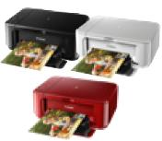

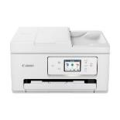
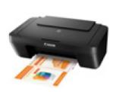



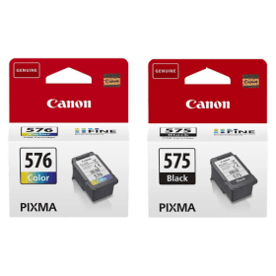
CANON SFP/MFP Home & Photo Printers
Retail File
Wi-Fi, Print, Scan & Copy, Cloud
Pixma TS3750i
TR 4755i
Pixma TS7750i
Pixma MG2551S
Pixma MG3650S
Pixma TR4755i
Pixma TS3752i
SKU:0727C066AA RRP:49,00€
SKU: 0515C106AA RRP:85,00€
SKU: 6671C056AA RRP:69,00€ SKU: 6671C006AA RRP:69,00€
5072C006AA RRP:99,00€
SKU:6258C006AA RRP: 175,00€
Available Functions
Print, Scan & Copy
Wi-Fi, Print, Scan & Copy, Cloud
Wi-Fi, Print, Scan & Copy, Cloud
Wi-Fi Print, Scan, Copy,
Fax, ADF & Cloud Link
Wi-Fi, Print, Scan, Cloud, Direct
Print Resolution
4800 x 600 dpi
4800 x 1200 dpi
4800 x 1200 dpi
4800 x 1200 dpi
1200 x 1200 dpi
ADF/Scanner Resolution (max.)
600 x 1200 dpi
600 x 1200 dpi
600 x 1200 dpi
20-sheet ADF
600 x 1200 dpi
100-sheet ADF
1200 x 2400 dpi
Auto 2-sided Print (Duplex)
-
Yes
-
Yes
Yes
A4 colour documents printing
Black: 180 pages
Black XL: 400 pages
Colour: 180 pages
Colour XL: 300 pages
A4 colour documents printing
Black: 180 pages
Black XL: 600 pages
Colour: 180 pages
Colour XL: 400 pages
A4 colour documents printing
Black: 110/180 pages
Black XL: 400 pages
Colour: 100/180 pages
Colour XL: 300 pages
A4 colour documents printing
Black: 110/180 pages
Black XL: 400 pages
Colour: 100/180 pages
Colour XL: 300 pages
A4 colour documents printing
Black: 180 pages
Black XL: 300 pages
Colour: 180 pages
Colour XL: 300 pages
Ink Bottle Yield
A4 doc print speed(pages /min)
8.0 ipm mono
4.0 ipm colour
9.9 ipm mono
5.7 ipm colour
7.7 ipm mono
4.0 ipm colour
8.8ipm mono
4.4ipm colour
15 ipm mono
10 ipm colour
Display – Connectivity – Supported OS
USB,Windows, Mac & Chrome OS
USB, Wi-Fi, Wireless Direct, Windows, Mac & Chrome OS
3.8cm LCD, USB, Wi-Fi, Wireless Direct, Windows, Mac & Chrome OS
Full-dot LCD, USB, Wi-Fi, Wireless Direct, Windows, Mac & Chrome OS
2.7 touch screen, USB, Wi-Fi, Wireless Direct, Windows, Mac & Chrome OS
Paper Input (max.)
Rear Tray: Max. 60 sheets (plain paper)
Front Tray: Max. 100 sheets (plain paper)
Rear Tray: Max. 100 sheets (plain paper)
Front Tray: Max. 100 sheets (plain paper)
Rear Tray: Max. 100 sheets (A4 paper)
Cassette: Max. 100 sheets (A4 paper)
Compatible Ink Bottles
(ink included in box)
Prices, promotions, specifications, availability and terms of offers may change without notice.
Despite our best efforts, a small number of items may contain pricing, typography, or photography errors.
Correct prices and promotions are validated at the time your order is placed.
Delivery installation charges are not included. VAT is included
Call now on:
Fax your order on:
Mail on:

Slide 2
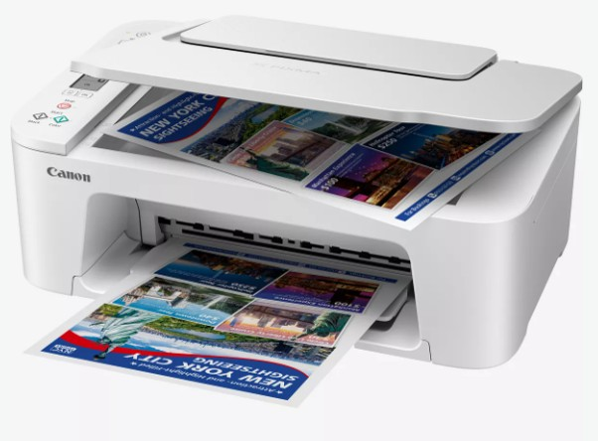
CANON SFP/MFP Home & Photo Printers
Retail File
Pixma - TS3751i
SKU:6671C026AA
RRP:49,00€
Available Functions
Wi-Fi, Print, Scan & Copy, Cloud
Print Resolution
4800 x 1200 dpi
ADF/Scanner Resolution (max.)
600 x 1200 dpi
Auto 2-sided Print (Duplex)
A4 colour documents printing
Black: 110/180 pages
Black XL: 400 pages
Colour: 100/180 pages
Colour XL: 300 pages
-
Ink Bottle Yield
A4 doc print speed(pages /min)
7.7 ipm mono
4.0 ipm colour
Display – Connectivity – Supported OS
3.8cm LCD, USB, Wi-Fi, Wireless Direct, Windows, Mac & Chrome OS
Paper Input (max.)
Rear Tray: Max. 100 sheets (plain paper)
Compatible Ink Bottles
(ink included in box)
Prices, promotions, specifications, availability and terms of offers may change without notice.
Despite our best efforts, a small number of items may contain pricing, typography, or photography errors.
Correct prices and promotions are validated at the time your order is placed.
Delivery installation charges are not included. VAT is included
Call now on:
Fax your order on:
Mail on:

Slide 3


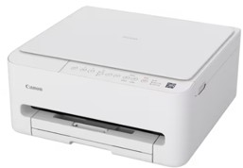
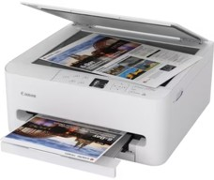
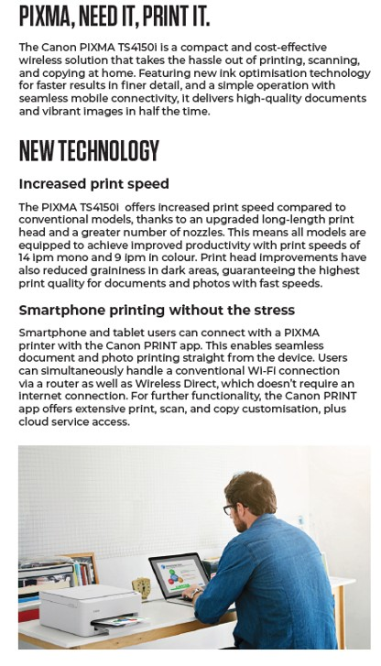


CANON SFP/MFP Home & Photo Printers
Retail File
7.7 ipm mon
SKU:7181C006AA RRP:99,00€
SKU:7179C006AA RRP:119,00€
Available Functions
Wi-Fi, Print, Scan & Copy, Cloud
Wi-Fi, Print, Scan & Copy, Cloud
Print Resolution
1200 x 1200 dpi
1200 x 1200 dpi
Flatbet/Scanner Resolution (max.)
1200 x 2400 dpi
1200 x 2400 dpi
Auto 2-sided Print (Duplex)
YES
YES
A4 colour documents printing
Black: 180 pages
Black XL: 300 pages
Colour: 180 pages
Colour XL: 300 pages
A4 colour documents printing
Black: 180 pages
Black XL: 300 pages
Colour: 180 pages
Colour XL: 300 pages
Ink Yield
A4 doc print speed(pages /min)
Approx. 14.0 ipm mono/Approx. 9.0 ipm color
Standard, Photo, Borderless
Approx. 14.0 ipm Mono/Approx. 9.0 ipm Color
Standard, Photo, Borderless, 2-sided, 2-on-1 and 4-on-1, Frame Erase (Flatbed only), ID
Display – Connectivity – Supported OS
USB, Wi-Fi, Wireless Direct, Windows, Mac & Chrome OS, Mobile app
3.6 OLED Mono, USB, Wi-Fi, Wireless Direct, Windows, Mac & Chrome OS, Mobile app
Paper Input (max.)
Cassette: Max. 100 sheets (plain paper)
Cassette: Max. 100 sheets (plain paper)
Compatible Ink Bottles
(ink included in box)
PG-595/595XL (Black)
CL-586/586XL (Colour)
PG-595/595XL (Black)
CL-586/586XL (Colour)
Prices, promotions, specifications, availability and terms of offers may change without notice.
Despite our best efforts, a small number of items may contain pricing, typography, or photography errors.
Correct prices and promotions are validated at the time your order is placed.
Delivery installation charges are not included. VAT is included
Call now on:
Fax your order on:
Mail on:

Slide 4
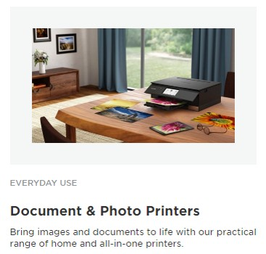

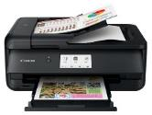

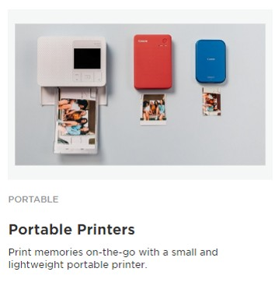
CANON SFP/MFP Home & Photo Printers
Retail File
Wi-Fi, Print, Scan & Copy, Cloud
Pixma TS5350i
Pixma TS9550a
Pixma ix6850
Photo Printer
Photo Printer
SKU:3773C006AA RRP:95,00€
SKU: 2988C036AA RRP:€369
SKU: 8747B006AA RRP:309€
Available Functions
Wi-Fi, Print, Scan & Copy, Cloud
Print A4,A3+, Scan,Copy A4 ChromaLife100+ inks Copy & Cloud Link
Print A3+ ChromaLife100+ inks Copy & Cloud Link
Print Resolution
4800 x 1200 dpi
4800 x 1200 dpi
9600 x 2400 dpi
ADF/Scanner Resolution (max.)
1200 x 2400 dpi
1200 x 2400 dpi
-
Auto 2-sided Print (Duplex)
Yes
Yes
-
A4 colour documents printing
Black: 180 pages
Black XL: 400 pages
Colour: 180 pages
Colour XL: 300 pages
Pigment Black XL: 400 pages
Photo Blue/Black XL: 3120 pages
Cyan XL: 515 pages
Magenta XL: 474 pages
Yellow XL: 514 pages
PG BK XL: 620 A4 Doc/4720 Photos
Black XL: 5000 A4 Doc/845 Photos
Cyan XL: 700 A4 Doc/283 Photos
Magenta XL: 670 Doc/340 Photos
Yellow XL: 700 Doc/293 Photos
Ink Bottle Yield
A4 doc print speed(pages /min)
13 ipm mono
6.8 ipm colour
15 ipm mono
10 ipm colour
14.5 ipm mono
10.4 ipm colour
Display – Connectivity – Supported OS
3.7cm OLED, USB, Wi-Fi, Wireless Direct, Windows, Mac & Chrome OS
10.8cm TouchScreen, USB, Wi-Fi, Wireless Direct, Ethernet, Windows, Mac & Chrome OS
USB, Wi-Fi, Apple Print, Ethernet, Windows, Mac & Chrome OS
Paper Input (max.)
Rear tray: Max.100 sheets (plain paper)
Cassette: Max.100 sheets (plain paper)
Rear Tray: Max. 100 sheets (A4 paper)
Cassette: Max. 250 sheets (A4 paper)
ADF Tray: 35 sheets (A4 paper)
Rear Tray: Max. 150 sheets (plain paper)
Compatible Ink Bottles
(ink included in box)
Prices, promotions, specifications, availability and terms of offers may change without notice.
Despite our best efforts, a small number of items may contain pricing, typography, or photography errors.
Correct prices and promotions are validated at the time your order is placed.
Delivery installation charges are not included. VAT is included
Call now on:
Fax your order on:
Mail on:

Slide 5

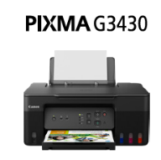


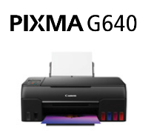

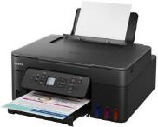
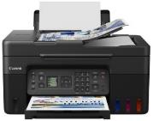



CANON SFP/MFP Home & Office MEGATANK Printers
Retail File
Wi-Fi, Print, Scan & Copy, Cloud
Photo Printer
SKU: 5989C009AA RRP:125€
SKU:6708C009AA RRP:235€
SKU:5807C009AA RRP:299€
SKU:4467C009AA RRP:229€
Available Functions
Wi-Fi, Print, Scan & Copy, Cloud
Wi-Fi, Print, Scan & Copy, Cloud
Wi-Fi, Print, Scan , Fax & Copy, Cloud
Wi-Fi, Print, Scan,
Copy & Cloud Link
Print Resolution
4800 x 1200 dpi
4800 x 1200 dpi
4800 x 1200 dpi
4800 x 1200 dpi
ADF/Scanner Resolution (max.)
600 x 1200 dpi
600 x 1200 dpi
600 x 1200 dpi
600 x 1200 dpi
Auto 2-sided Print (Duplex)
-
YES
-
-
High Yield Ink Bottles
Black: 6,000 pages
(Economy mode 7,600 pages)
Colour: 7,700 pages
(Economy mode 8,100 pages)
A4 colour documents printing
Black: 6,000 pages
(Economy mode 7,600 pages)
Colour: 7,700 pages
A4 colour documents printing
Black: 6,000 pages per ink bottle
Colour: 7700 pages
Maintenance Cartridge MC-G04
4”x6” Photo : 3,800 photos
A4 colour documents printing
Black bottle: 3,700 pages
Colour ink bottle: 8,000 pages
Ink Bottle Yield
A4 doc print speed(pages /min)
11 ipm mono
6.0 ipm colour
11 ipm mono
6 ipm colour
11 ipm mono
6 ipm colour
3.9ipm mono
3.9ipm colour
Display – Connectivity – Supported OS
USB, Wi-Fi, Wireless Direct, Windows, Mac & Chrome OS
1.35” LCD, USB, Wi-Fi, Wireless Direct, Windows, Mac & Chrome OS
1.3” LCD, USB, Wi-Fi, Wireless Direct, Windows, Mac & Chrome OS
Full-dot LCD, USB, Wi-Fi, Wireless Direct, Windows, Mac & Chrome OS
Paper Input (max.)
Rear Tray: Max. 100 sheets (plain paper)
Rear Tray: Max. 100 sheets (plain paper)
Rear tray: Max. 100 sheets (plain paper)
ADF: Max. 35 sheets (plain paper)
Rear Tray: Max. 100 sheets (plain paper)
Compatible Ink Bottles
(ink included in box)
Prices, promotions, specifications, availability and terms of offers may change without notice.
Despite our best efforts, a small number of items may contain pricing, typography, or photography errors.
Correct prices and promotions are validated at the time your order is placed.
Delivery installation charges are not included. VAT is included
Call now on:
Fax your order on:
Mail on:

Slide 6






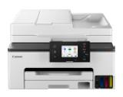
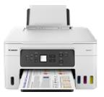
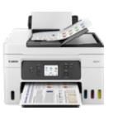
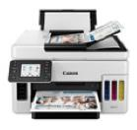
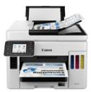



CANON MFP Small/Medium Business - Office
Megatank Printers
Retail File
Wi-Fi, Print, Scan & Copy, Cloud
SKU:6171C007AA RRP:349€
SKU: 5777C009AA RRP:320€
SKU:5779C009AA RRP:469€
SKU:4471C009AA RRP:609€
SKU:4467C009AA RRP:769€
Available Functions
Wi-Fi, Ethernet, Print, Copy, Scan, Fax & Cloud
Wi-Fi, Print, Scan,
Copy & Cloud Link
Wi-Fi, Ethernet,Print, Scan,
Copy, Fax,Cloud Link & ADF
Wi-Fi, Ethernet, Print, Scan, Copy, Cloud Link & ADF
Wi-Fi, Ethernet, Print, Scan, Copy,Fax,Cloud & D-ADF
Print Resolution
600 x 1200 dpi
600 x 1200 dpi
600 x 1200 dpi
600 x 1200 dpi
600 x 1200 dpi
ADF/Scanner Resolution (max.)
35-sheet ADF
600 x 1200 dpi
No ADF
600 x 1200 dpi
35-sheet ADF
600 x 1200 dpi
50-sheet ADF
1200 x 1200 dpi
50-sheet ADF
1200 x 1200 dpi
Auto 2-sided Print (Duplex)
Yes
Yes
Yes
Yes
Yes
A4 colour documents printing
Black: 3,000 pages (Eco 4,500)
Colour: 3,000 pages(Eco 4,500)
Duty Cycle: up to 27,000 pages
A4 colour documents printing
Black: 5,000 pages
Colour: 5,000 pages)
Duty Cycle: up to 33,000 pages
A4 colour documents printing
Black: 5,000 pages
Colour: 5,000 pages)
Duty Cycle: up to 33,000 pages
A4 colour documents printing
Full set of bottles: 14,000 pages
(Economy mode full set of bottles 21,000)
Duty Cycle: up to 45,000 pages
A4 colour documents printing
Full set of bottles: 14,000 pages
(Economy mode full set of bottles 21,000)
Duty Cycle: up to 45,000 pages
Ink Bottle Yield
A4 doc print speed(pages /min)
15 ipm mono
10 ipm colour
18 ipm mono
13 ipm colour
18 ipm mono
13 ipm colour
24 ipm mono
15.5 ipm colour
24 ipm mono
15.5ipm colour
Display – Connectivity – Supported OS
2.7” inch LCD Touch, USB, Ethernet, Wi-Fi, Wireless Direct
1.35” inch LCD, USB, Wi-Fi, Wireless Direct
2.7” inch LCD Touch, USB, Ethernet, Wi-Fi, Wireless Direct
2.7” inch LCD Touch, USB, Ethernet, Wi-Fi, Wireless Direct
2.7” inch LCD Touch, USB, Ethernet, Wi-Fi, Wireless Direct
Paper Input (max.)
Cassette: Max.250 sheets
(plain paper)
Rear Tray: Max. 100 sheets (A4 paper)
Cassette: Max. 250 sheets (A4 paper)
Rear Tray: Max. 100 sheets (A4 paper)
Cassette: Max. 250 sheets (A4 paper)
Rear Tray: Max.100 sheets (A4 paper)
Cassette: Max.250 sheets (A4 paper)
Rear Tray: Max. 100 sheets (plain paper)
Cassette 1: Max.250 sheets (A4 paper)
Cassette 2: Max.250 sheets (A4 paper)
Compatible Ink Bottles
(ink included in box)
Prices, promotions, specifications, availability and terms of offers may change without notice.
Despite our best efforts, a small number of items may contain pricing, typography, or photography errors.
Correct prices and promotions are validated at the time your order is placed.
Delivery installation charges are not included. VAT is included
Call now on:
Fax your order on:
Mail on:

Slide 7
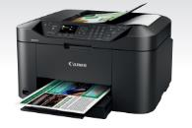
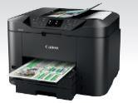
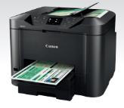

CANON MFP Small/Medium Business-Office Printers
Retail File
Wi-Fi, Print, Scan & Copy, Cloud
MAXIFY MB2150
MAXIFY MB2750
MAXIFY MB5150
MAXIFY MB5450
SKU:0959C009AA RRP:189€
SKU: 0958C009AA RRP:219€
SKU:0960C009AA RRP:269€
SKU:0971C009AA RRP: 329€
Available Functions
Wi-Fi, Ethernet,Print, Scan,
Copy, Fax,Cloud Link & ADF
Wi-Fi, Ethernet,Print, Scan,
Copy, Fax,Cloud Link & ADF
Wi-Fi, Ethernet,Print, Scan,
Copy, Fax,Cloud Link & D-ADF
Wi-Fi, Ethernet,Print, Scan,
Copy, Fax,Cloud Link & D-ADF
Print Resolution
600 x 1200 dpi
600 x 1200 dpi
600 x 1200 dpi
600 x 1200 dpi
ADF/Scanner Resolution (max.)
50-sheet ADF
1200 x 1200 dpi
50-sheet ADF
1200 x 1200 dpi
50-sheet ADF
1200 x 1200 dpi
50-sheet ADF
1200 x 1200 dpi
Auto 2-sided Print (Duplex)
Yes
Yes
Yes
Yes
PGI-1500XL BK (1200 pages)
PGI-1500XL C (1020 pages)
PGI-1500XL M (780 pages)
PGI-1500XL Y (935 pages)
Duty Cycle: up to 20,000 pages
PGI-1500XL BK (1200 pages)
PGI-1500XL C (1020 pages)
PGI-1500XL M (780 pages)
PGI-1500XL Y (935 pages)
Duty Cycle: up to 20,000 pages
PGI-2500XL BK (2500 pages)
PGI-2500XL C (1755 pages)
PGI-2500XL M (1295 pages)
PGI-2500XL Y (1520 pages)
Duty Cycle: up to 30,000 pages
PGI-2500XL BK (2500 pages)
PGI-2500XL C (1755 pages)
PGI-2500XL M (1295 pages)
PGI-2500XL Y (1520 pages)
Duty Cycle: up to 30,000 pages
Ink Bottle Yield
A4 doc print speed(pages /min)
19 ipm mono
13 ipm colour
24 ipm mono
15.5 ipm colour
24 ipm mono
15.5 ipm colour
24 ipm mono
15.5 ipm colour
Display – Connectivity – Supported OS
2.5” inch TFT Touch, USB, Ethernet, Wi-Fi, Wireless Direct
3” inch TFT Touch, USB, Ethernet, Wi-Fi, Wireless Direct
3” inch LCD Touch, USB, Ethernet, Wi-Fi, Wireless Direct
3” inch LCD Touch, USB, Ethernet, Wi-Fi, Wireless Direct
Paper Input (max.)
Cassette: Max.250 sheets
(plain paper)
Cassette 1: Max.250 sheets (A4 paper)
Cassette 2: Max.250 sheets (A4 paper)
Cassette: Max. 250 sheets (A4 paper)
Cassette 1: Max.250 sheets (A4 paper)
Cassette 2: Max.250 sheets (A4 paper)
Compatible Ink Bottles
(ink included in box)
Prices, promotions, specifications, availability and terms of offers may change without notice.
Despite our best efforts, a small number of items may contain pricing, typography, or photography errors.
Correct prices and promotions are validated at the time your order is placed.
Delivery installation charges are not included. VAT is included.
Call now on:
Fax your order on:
Mail on:

Slide 8
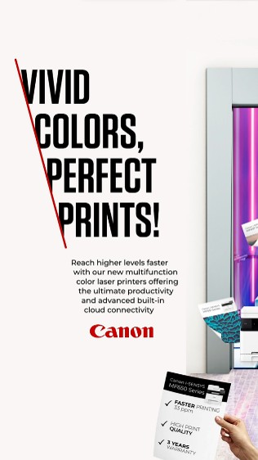
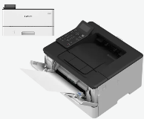
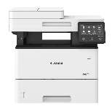
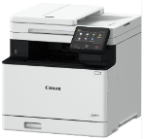

CANON i-Sensys SFP/MFP Laser Printers
Retail File
LBP246DW
MF553DW
MF754CDW
SKU: 5952C006AA RRP:€179
SKU:5160C010AA RRP:€445
SKU:5455C009AA RRP:€559
Available Functions
Mono Print, Suitable for Workgroups, Wifi, Ethernet, Airprint
Mono Wi-Fi, Ethernet,Print, Scan,
Copy, Fax,Cloud Link & D-ADF
Colour Wi-Fi, Ethernet,Print, Scan,
Copy, Fax,Cloud Link & D-ADF
Print Resolution
1200 x 1200 dpi
1200 x 1200 dpi
1200 x 1200 dpi
ADF/Scanner Resolution (max.)
No
50-sheet ADF
600 x 600 dpi
50-sheet ADF
1200 x 1200 dpi
Auto 2-sided Print (Duplex)
Yes
Yes
Yes
Cartridge 070 (Yield : 3,000 pg)
Cartridge 070H (Yield : 10,200 pg)
Duty cycle per month: 80,000
Recommended pages/month 750-4000
Cartridge 056L (5,100 pages)
Cartridge 056H (21,000 pages)
Duty Cycle: up to 150,000 pages
Cartridge 069H Black (7,600pgs)
Cartridge 069 Cyan (1,900 pgs)
Cartridge 069 Magenda (1,900 pgs)
Cartridge 069 Yellow (1,900 pgs)
Duty Cycle: up to 50,000 pages
Ink Bottle Yield
A4 doc print speed(pages /min)
Single sided: Up to 40 ppm (A4)
Double sided: Up to 34 ppm (A4)
Single sided (A4): Up to 43 ppm
Double sided (A4): Up to 36 ipm
Single sided (A4): Up to 33 ppm
Double sided (A4): Up to 29 ipm
Display – Connectivity – Supported OS
LCD Screen, USB, Ethernet, Wi-Fi, Wireless Direct, Scan to email/usb/FTP/Cloud/Airprint
12.7cm Touch Screen, USB, Ethernet, Wi-Fi, Wireless Direct, Scan to email/usb/FTP/Cloud
12.7cm Touch Screen, USB, Ethernet, Wi-Fi, Wireless Direct, Scan to email/usb/FTP/Cloud
Paper Input (max.)
Tray: Max.100 sheets (A4 paper)
Cassette 1: Max.250 sheets (A4 paper)
Tray: Max.50 sheets (A4 paper)
Cassette 1: Max.550 sheets (A4 paper)
Tray: Max.50 sheets (A4 paper)
Cassette 1: Max.250 sheets (A4 paper)
Printer Languages
UFRII, PCL5e, PCL6 + Adobe
PostScript3
UFRII, PCL 5c, PCL6, Adobe PostScript
UFRII, PCL 5e, PCL6, Adobe PostScript3, PCL Fonts
Call now on:
Fax your order on:
Mail on:
Prices, promotions, specifications, availability and terms of offers may change without notice.
Despite our best efforts, a small number of items may contain pricing, typography, or photography errors.
Correct prices and promotions are validated at the time your order is placed.
Delivery installation charges are not included. VAT is included.

Slide 9

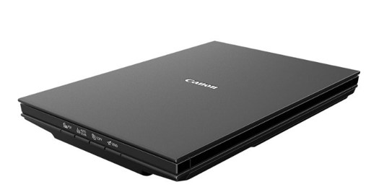
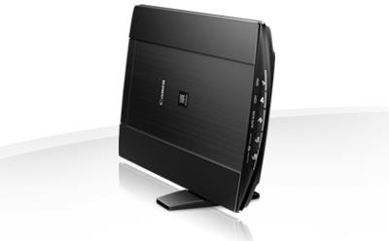
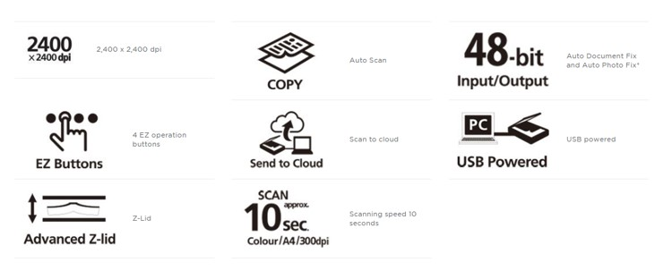
Canon Flatbet Scanners
Retail File
Canon CanoScan LiDE 300
SKU: 2995C010AA
Canon CanoScan LiDE 400
SKU: 2996C010AA
RRP: 99,00€
With a sleek, compact and stylish design, this lightweight A4 flatbed scanner is fitted with 4 operation buttons for easy use and hassle-free scanning. Perfect for high-resolution scanning at home or in the office.
RRP: 119,00€
Benefits
Enjoy high resolution scans up to 4800 x 4800 dpi with CIS sensor
Capture photos with exceptional detail and accurate colours thanks to 48-bit internal colour depth, USB Type-C
Save time with 300 dpi A4 colour scans delivered in just 10 seconds
Experience the freedom to scan directly to cloud services using your PC
Free up valuable desk space thanks to a neat upright stand
Operate effortlessly thanks to 5 one-touch buttons
Create multipage PDF documents instantly from the scanner using PDF buttons
Enhance text, graphics and images separately in scanned documents using
Auto Document and Photo Fix technology
Power and connect using a single USB cable to minimise desk clutter
Prices, promotions, specifications, availability and terms of offers may change without notice.
Despite our best efforts, a small number of items may contain pricing, typography, or photography errors.
Correct prices and promotions are validated at the time your order is placed.
Delivery installation charges are not included. VAT is included.
Call now on:
Fax your order on:
Mail on:

Slide 10
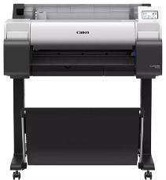

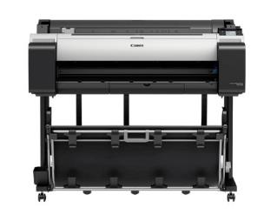
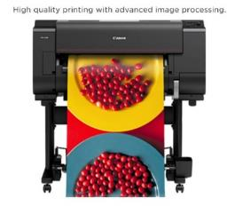

CANON WIDE FORMAT PRINTERS
CAD & GIS Plotters
Retail File
Canon imagePROGRAF TM-240 CAD PRINTER
Canon imagePROGRAF TM-340 CAD PRINTER
Canon imagePROGRAF PRO-2600 PHOTO PRINTER
Specification
12 Colour 24"/610mm
Print Resolution 2,400 x 1200 dpi
Canon Bubblejet on Demand 12 colours integrated type
(12 chips per print head x 1 print head)
18,432 nozzles (1536 nozzles x 12 colours)
Standard Memory 3 GB, HD 500GB (Encrypted HDD)
USB, Ethernet, Wireless
Printing Speed A1 (sec):
(Plain paper) 0:58 - (Coated paper) 1:38
(Glossy photo paper) 3:11
User Replacement items
Ink Tank: PFl-2100/3100 (160ml), PFl-2300/3300 (330ml), PFl-2700/3700
Print Head: PF-10
Cutter Blade: CT-07
Maintenance Cartridge: MC-30
Printer Language
SG Raster (Swift Graphic Raster), PDF (Ver.1.7), JPEG (Ver. JFIF 1.02)
Specification
5 Colour 24"/610mm
Print Resolution 2,400 x 1,200 dpi
Standard Memory 2 GB
Maximum Media Roll Diameter 150 mm, 1 Roll
USB, Ethernet, Wireless, AirPrint
Cad/Poster Drawing Plain Paper A1 speed(sec):
(Fast Economy Mode) 0:23
(Fast) 0:25
(Standard) 0:51
User Replacement items
Ink Tank: MBK/BK/C/M/Y PFI-030(55ml)
Print Head: PF-06
Cutter Blade: CT-08
Maintenance Cartridge: MC-31
Printer Language
HP-GL/2, HP RTL, JPEG (Ver. JFIF 1.02),
CALS G4 (submission via FTP only)
Specification
5 Colour 36"/914mm
Print Resolution 2,400 x 1,200 dpi
Standard Memory 2 GB
Maximum Media Roll Diameter 150 mm, 1 Roll
USB, Ethernet, Wireless, AirPrint
Cad/Poster Drawing Plain Paper A0 speed (sec):
(Fast Economy Mode) 0:41
(Fast) 0:42
(Standard) 1:25
User Replacement items
Ink Tank: MBK/BK/C/M/Y PFI-030(55ml)
Print Head: PF-06
Cutter Blade: CT-08
Maintenance Cartridge: MC-31
Printer Language
HP-GL/2, HP RTL, JPEG (Ver. JFIF 1.02),
CALS G4 (submission via FTP only)
6242C003AA Printer TM-240
3085C004AA Printer stand SD-24
RRP: € 1200,00
6248C003AA Printer TM-340
Printer stand is included.
3867C003AA – Printer PRO-2600
Printer Stand SD-21 included.
RRP: € 2199,00
RRP: € 3300,00
Prices, promotions, specifications, availability and terms of offers may change without notice.
Despite our best efforts, a small number of items may contain pricing, typography, or photography errors.
Correct prices and promotions are validated at the time your order is placed.
Delivery installation charges are not included. VAT is included
Call now on:
Fax your order on:
Mail on:

Slide 11
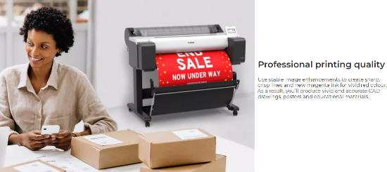
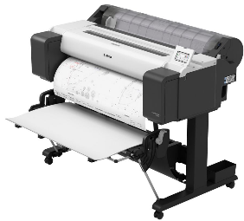

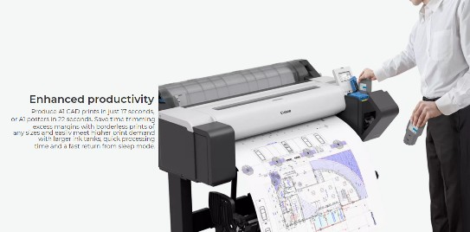
CANON WIDE FORMAT PRINTERS
CAD & GIS Plotters
Retail File
Canon imagePROGRAF TM-255 CAD PRINTER
Canon imagePROGRAF TM-350 CAD PRINTER
Specification
5 Colour 24"/610mm
Print Resolution 2,400 x 1,200 dpi
Standard Memory 2 GB / Hard drive 500GB
Maximum Media Roll Diameter 150 mm, 1 Roll
USB, Ethernet, Wireless, AirPrint
Cad/Poster Drawing Plain Paper A1 speed(sec):
(Fast Economy Mode) 0:20
(Fast) 0:23
(Standard) 0:40
User Replacement items
Ink Tank: MBK/BK/C/M/Y PFI-120/PFI-121(130ml)
Print Head: PF-06
Cutter Blade: CT-08
Maintenance Cartridge: MC-31
Printer Language
HP-GL/2, HP RTL, PDF (Ver. 1.7), JPEG (Ver. JFIF 1.02), CALS G4 (submission via FTP only)
Specification
5 Colour 36"/914mm
Print Resolution 2,400 x 1,200 dpi
Standard Memory 2 GB
Maximum Media Roll Diameter 150 mm, 1 Roll
USB, Ethernet, Wireless, AirPrint
Cad/Poster Drawing Plain Paper A0 speed (sec):
(Fast Economy Mode) 0:17
(Fast) 0:41
(Standard) 1:08
User Replacement items
Ink Tank: MBK/BK/C/M/Y PFI-120/PFI121(130ml)
Print Head: PF-06
Cutter Blade: CT-08
Maintenance Cartridge: MC-31
Printer Language
HP-GL/2, HP RTL, JPEG (Ver. JFIF 1.02),
CALS G4 (submission via FTP only)
6238C003AA Printer TM-255
Printer stand SD-24 included.
RRP: € 1400,00
6246C003AA Printer TM-350
Printer stand is included.
RRP: € 2200,00
Prices, promotions, specifications, availability and terms of offers may change without notice.
Despite our best efforts, a small number of items may contain pricing, typography, or photography errors.
Correct prices and promotions are validated at the time your order is placed.
Delivery installation charges are not included. VAT is included
Call now on:
Fax your order on:
Mail on:

Slide 12
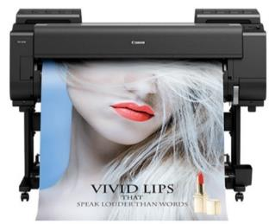
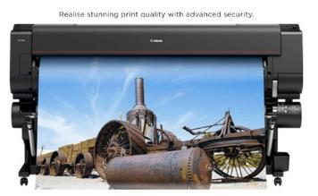
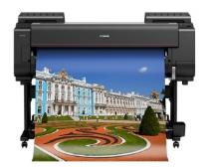
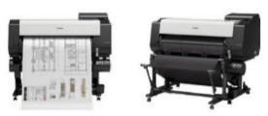
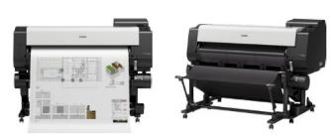
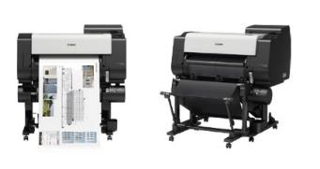
CANON WIDE FORMAT PRINTERS
CAD & PHOTO Plotters
Retail File
Canon imagePROGRAF PRO-4600S PHOTO PRINTER
SKU: 3873C003AA
Canon imagePROGRAF PRO-6600 PHOTO PRINTER
SKU: 3871C003AA
Print Resolution
2,400 x 1200 dpi
Standard Memory
3 GB
Hard Drive
500GB (Encrypted HDD
Ink Tank: PFl-1100 (160ml),
PFl-1300 (330ml), PFl-1700 (700ml)
Print Head: PF-10
Cutter Blade: CT-07
Maintenance Cartridge: MC-30
Print Resolution 2,400 x 1200 dpi
Canon Bubblejet on Demand 12 colours
integrated type
(12 chips per print head x 1 print head)
Standard Memory 3 GB
Hard Drive 500GB (Encrypted HDD)
Special Price: €4999,00
RRP: €8599,00
Canon imagePROGRAF TX3100 36” (A0) CAD PRINTER
SKU: 4600C003AA
Canon imagePROGRAF PRO-4600 PHOTO PRINTER
SKU: 3869C003AA
CAD Series
2,400 x 1,200 dpi
5 Colour - 36"/914.4mm
Pigment ink: 5 colour MBK/BK/C/M/Y
Printer Stand Included
Canon Bubblejet on Demand 12 colours integrated type
(12 chips per print head x 1 print head)
Print Resolution 2,400 x 1200 dpi
Standard Memory 3 GB
Hard Drive 500GB (Encrypted HDD)
RRP: €3339,00
RRP: €5655,00
Canon imagePROGRAF TX4100 44” (A0) CAD PRINTER
SKU: 4602C003AA
4598C003AA Canon imagePROGRAF TX2100 24” (A1) CAD PRINTER RRP: €3300,00
1151C001AA Canon TX2000 Stand SD-21 (mandatory) RRP: €349,00
CAD Series Printer Stand Included
2,400 x 1,200 dpi
128GB (Physical memory 2GB)
5 Colour - 44"/1117.6mm
CAD Series
2,400 x 1,200 dpi
5 Colour - 24"/609.6mm
Bundled Starter Ink: 330ml (MBK)/160ml
(BK,C,M,Y)
Sales Ink: 160ml/330ml/700ml
RRP: €3800,00
Prices, promotions, specifications, availability and terms of offers may change without notice.
Despite our best efforts, a small number of items may contain pricing, typography, or photography errors.
Correct prices and promotions are validated at the time your order is placed.
Delivery installation charges are not included. VAT is included
Call now on:
Fax your order on:
Mail on:

