Slide 1




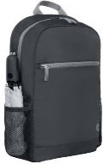
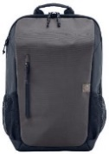


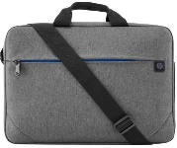
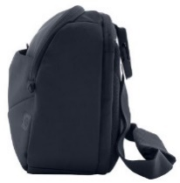
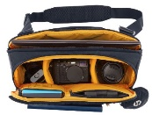
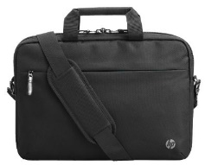
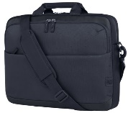



HP ACCESSORIES & OPTIONS CARRY CASES
HP 15.6" PRELUDE BACKPACK
Retail File November 2025 Page 1/4
1X644A6 HP CARRY CASE PRELUDE PRO RECYCLED 15.6'',
CHARCOAL 27 €
Promo prices are valid until 28/11 or until stock last
2Z8P3AA HP PRELUDE BACKPACK 15.6, GREY, 27 €
HP 15,6’’ CARRY CASES TRAVEL
6B8U6AA
HP CARRY CASE BACKPACK TRAVEL 15.6'' LIGHT AND STYLISH FORGED IRON 31 €
6B8U7AA
HP CARRY CASE TRAVEL 18L 15.6 BACKPACK, BLUE,
31 €
6B8U4AA
HP CARRY CASE TRAVEL 25L 15.6 LAPTOP BACKPACK, IRON GRAY, 41 €
9W0Z7AA HP CARRY CASE TRAVEL 15.6 LAPTOP BACKPACK, BLUE NIGHT, 24 €
HP PRELUDE PRO 15.6’’ & 17.3” BAGS
HP CARRY CASE CREATOR
2Z8P4AA HP CARRY CASE PRELUDE 15.6'' TOPLOAD ULTRALIGHT COMFORT WATER RESISTANT GREY 24 €
6M5S4AA
HP CARRY CASE REATOR 13.3’’ SLING, DARK NAVY, 37 €
34Y64AA HP CARRY CASE PRELUDE TOPLOAD 17.3'', STYLISH, DURABLE CASE, GREY, 25 €
1E7D7A6 HP CARRY CASE PRELUDE TOPLOAD G2 15.6'', GREY, 31 €
HP PROFESSIONAL LAPTOP BAG 14.1''
HP ODYSSEY CARRY CASE 16''
HP PRELUDE PRO 17.3’’
500S8AA HP CARRY CASE PROFESSIONAL TOPLOAD 14.1'', EASY TO CLEAN, DESIGNED FOR COMFORT, 1YW, BLACK, 32 €
A08JWAA HP CARRY CASE EVERYDAY 16 ODYSSEY GREY LAPTOP TOPLOAD, 27 €
3E2P1AA HP CARRY CASE TOPLOAD 17.3'', 34 €
HP POUCH CASES
HP CASE NEOPRENE REVERSIBLE SLEEVE 14’’ & 15.6'', FLEXIBLE STYLE, EVERYDAY PROTECTION FROM BUMPS AND SCRAPES
2F2L4AA HP14’’ CASE , GREY / BLACK, 21 €
2F2L0AA HP 15.6’’ CASE BLACK/ GREY, 21 €
14V34AA HP POUCH SPORT, 21 x 14 x 6.5 CM, BLACK. 17 €
Prices, promotions, specifications, availability and terms of offers may change without notice. Despite our best efforts,
a small number of items may contain pricing, typography, or photography errors. Correct prices and promotions are validated at the time your order is placed. Recycling fees are not included in the Dealer & Retail File. Delivery and installation charges are not included. Products' warranty is the warranty given by the manufacturer. VAT is included
Call now on:
Mail on:

Slide 2



























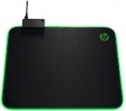
HP ACCESSORIES & OPTIONS MICE
HP PAVILION GAMING MOUSE USB 300 5,000 dpi optical sensor for precision.
HP MOUSE WIRELESS
Retail File November 2025 Page 2/4
1JR31AA HP MOUSE WIRELESS BLACK 32 €
Promo prices are valid until 28/11 or until stock last.
4PH30AA, 8 BUTTONS 29 €
HP MOUSE USB WIRED
HP OMEN VECTOR GAMING MOUSE USB, 6 BUTTONS
9VA80A6 HP MOUSE 320M, BLACK 11 €
6VY96AA HP MOUSE 100 WIRED USB 1600DPI EASILY SET UP IN SECONDS WORKS WITH EAITHER HAND USB- A PORT BLACK , 13 €
8BC52AA, OMEN RADAR 1 SENSOR, CO-DEVELOPED WITH PIXART, 19 €
8BC53AA , OMEN RADAR 3 SENSOR, CO-DEVELOPED WITH PIXART, CUSTOM LIGHTING THROUGH OMEN COMMAND CENTER, 39 €
HP MOUSE Z5000 BLUETOOTH WIRELESS. Three standard buttons and scroll wheel. Ultra-slim mouse control
HP MOUSE 220 WIRELESS
HP MOUSE 230 WIRELESS
HP MOUSE 480 WIRELESS
HP OMEN REACTOR GAMING MOUSE USB – 6 BUTTONS
Light beam detection enables a 0.2ms click response time, 3 times faster than a traditional mechanical mouse switch. Respond quicker in-game and enjoy extended durability with a 50 million click lifetime.
8T6M3AA HP MOUSE 480, COMFORT BLUETOOTH, BLACK, 34 €
AJ7C2AA , BLACK, 23 €
E5C13AA WHITE 37 €
7KX11AA LUMIERE BLUE, 22 €
HP 410 SLIM SILVER BLUETOOTH WIRELESS MOUSE
HP MOUSE 240 WIRELESS
HP MOUSE PRESENTER ELITE, BLUETOOTH
2VP02AA BLACK, 56 €
7ZF19AA WHITE, 69 €
HP MOUSE 700 SPECTRE RECHARGEABLE, BLUETOOTH WIRELLESS, PAIR WITH 4 DEVISES, WITH 1.200 DPI, THE LASER SENSOR PROVIDES SUPERB ACCURACY AND PRECISION — ON ALMOST EVERY SURFACE
HP MOUSE 200 WIRELESS
4M0X6AA HP MOUSE 410 WHITE, 37 €
HP MOUSE WIRELESS Z3700
43N04AA PIKE SILVER 23 €
3V0G9AA BLACK 23 €
Low-cost wireless has never been so easy. It gives you the freedom to create without being blocked by cables
HP MOUSE DUAL MODE
With this dual mode wireless mouse, you can easily connect to two separate PCs via Bluetooth or 2.4 GHz wireless.
HP MOUSE 690 WIRELESS
2CE30AA UP TO 9.4 M TO PC, SLEEK METAL-ACCENTED DEVICE, FAST RECHARGING 51 €
V0L82AA RED, 22 €
7UH88AA LUMIERE BLUE 22 €
V0L81AA DRAGONFLY BLUE 22 €
171D8AA WHITE, 23 €
4VY82AA WHITE/PINK, 24 €
758A9AA SILVER, 26 €
7M1D4AA HP MOUSE 690 RECHARGEABLE WIRELESS, BLACK, 2YW, 48 €
3NZ70AA
DARK ASH SILVER, 67 €
X6W31AA BLACK 22 €
2HU82AA RED 18 €
HP MOUSEPAD
3NZ71AA PIKE SILVER, 67 €
This desk mat is built for the long haul. It's durable and comfy with anti-fray stitching. Plus it's sanitizable 2 and spill-resistant to easily wipe away germs or accidental spills. .
5JH72AA
PAVILION USB, 39 €
6CR72AA HP MOUSE WIRELESS, SILVER, 26 €
8X596AA
200, SANITIZABLE DESK MAT, 24 €
Prices, promotions, specifications, availability and terms of offers may change without notice. Despite our best efforts,
a small number of items may contain pricing, typography, or photography errors. Correct prices and promotions are validated at the time your order is placed. Recycling fees are not included in the Dealer & Retail File. Delivery and installation charges are not included. Products' warranty is the warranty given by the manufacturer. VAT is included
Call now on:
Mail on:

Slide 3





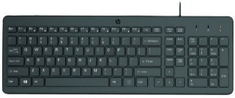
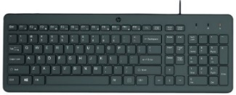

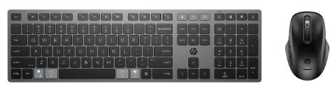
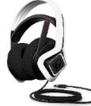


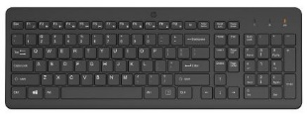


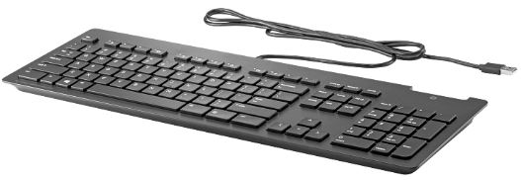
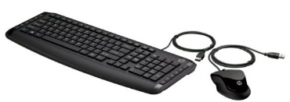
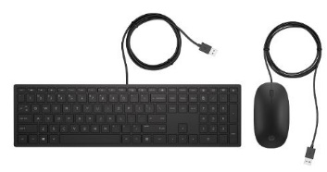
HP ACCESSORIES & OPTIONS
KEYBOARDS & KEYBOARDS /MOUSE SET
HP ACCESSORIES & OPTIONS
HEADPHONES & SPEAKERS
Retail File November 2025 Page 3/4
Go wherever your music takes you with the perfectly portable HP 350 Bluetooth5 speaker. Listen to music or take a call, hands-free, using the built-in mic with noise reduction.
Promo prices are valid until 28/11 or until stock last
HP WIRED KEYBOARDS
Pick up and go with this perfect plug-in-play companion, a comfortable keyboard with all the bells and whistles for wherever your journey takes you.
2D803AA BLUE 24 €
2D802AA BLACK 24 €
HP KEYBOARD & MOUSE 720 WIRELESS
RECHARGEABLE
2D799AA HP SPEAKER 360 BLUETTOTH, WHEREVER YOUR MUSIC TAKES YOU WITH THE PERFECTLY PORTABLE BLUETOOTH SPEAKER, WATER-RESISTANT AND DUST-RESISTANT RATING, BLACK, 24 €
664R5AA HP KEYBOARD 150 WIRED, BLACK, 22 €
240J7AA HP KEYBOARD AND MOUSE 150, WIRED, BLACK, 23 €
9T5A9AA HP KEYBOARD AND MOUSE 720 MULTI-DEVICE RECHARCHABLE, WIRELESS, BLACK, 86 €
6MF36AA HP HEADSET OMEN MIND-FRAME PRIME HEADSET, MICROPHONE, BUILT IN VIRTUAL SURROUND SOUND AUDIO CHIP POWERED BY C-MEDIA XEAR, OMEN'S ACTIVE EAR CUP COOLING TECHNOLOGY, COMPATIBLE WITH PCs WITH USB-A PORT, 1YW, WHITE, 160 €
HP KEYBOARD & MOUSE WIRELESS
1Y4D0UT HP KEYBOARD AND MOUSE 235, WIRELESS, BLACK 28 €
HP KEYBOARD WIRELESS
2V9E6AA HP KEYBOARD AND MOUSE 330, WIRELESS, BLACK 33 €
18H24AA HP KEYBOARD AND MOUSE 230, WIRELESS, BLACK 38 €
HP BUSINESS SLIM KEYBOARD
805T2AA HP KEYBOARD 220 WIRELESS, BLACK, 28 €
Boost your productivity, make a stylish IT choice, and get integrated security features with the HP USB Slim Smartcard Keyboard,
HP PAVILION 200 WIRED KEYBOARD & MOUSE
HP PAVILION 400 WIRED KEYBOARD & MOUSE
3L1E7AA HP KEYBOARD HP KEYBOARD 230 WIRELESS, STYLISH DESIGN WITH COMFORT IN MIND, EASILY ACTIVATES ALL 12 FUNCTION KEYS WITH JUST ONE CLICK, UP TO 16 MONTHS OF POWER, BLACK, 36 €
Z9H48AA HP KEYBOARD BUSINESS CCID WITH SMARTCARD READER BUILT INTO THE KEYBOARD, USB, 39 €
9DF28AA HP KEYBOARD AND MOUSE PAVILION 200, USB WIRED, BLACK , 31 €
4CE97AA HP KEYBOARD AND MOUSE PAVILION SLIM 400, USB WIRED, BLACK, 40 €
Prices, promotions, specifications, availability and terms of offers may change without notice. Despite our best efforts,
a small number of items may contain pricing, typography, or photography errors. Correct prices and promotions are validated at the time your order is placed. Recycling fees are not included in the Dealer & Retail File. Delivery and installation charges are not included. Products' warranty is the warranty given by the manufacturer. VAT is included
Call now on:
Mail on:

Slide 4








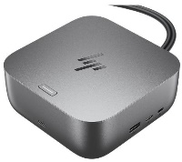





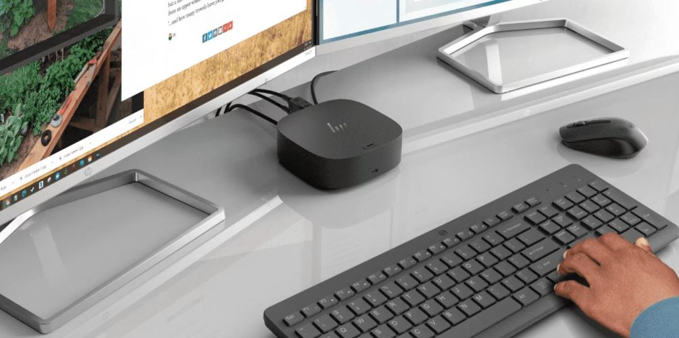






HP ACCESSORIES & OPTIONS
VGA CARDS, DOCKING STATIONS, PEN ,ADAPTORS
HP USB HUBs
5LX63AA HP HUB ENVY USB-C, HOST PORT (USB 3.0 - TYPE C ALT-MODE W/PD 3.0) WITH CABLE, USB 3.0, USB 2.0, HDMI 2.0, TYPE C POWER PASS THROUGH PORT, CAN CHARGE THE NOTEBOOK, 70 €
Retail File November 2025 Page 4/4
Promo prices are valid until 28/11 or until Stock last
HP DOCKING STATIONS
HP DISPLAY ADAPTORS
5TW10AA HP DOCKING STATION USB-C 100W G5, UNIVERSAL, USB TYPE-C, USB 3.0 (SIDE, CHARGING SS), 3X USB 3.0 (BACK CHARGING), 2X DISPLAY PORT, HDMI, RJ-45, 1 X HEADPHONE AND MICROPHONE, 1YW, 133 €
ADAPTORS
FH973AA HP ADAPTER DISPLAY PORT TO DVI-D CONVERTER,
11 €
P7Z54AA HP ADAPTER USB-C TO VGA DISPLAY ADAPTER, 35 €
N8N14AA - HP ADAPTER 45W USB-C, SUPPORT FOR 4 VOLTAGES WITH A SLIMMER CONNECTOR 45 €
HP OPTIONS FOR PRINTERS AND PLOTTERS
HP PENS
3J122AA HP PEN RECHARGEABLE MPP 2.0 TILTI, BLACK 50 €
6TX91A HP STAND FOR PLOTTERS T125, T130, T525, T530, 244 €
6SG43AA HP PEN RECHARGEABLE ACTIVE PEN G3, 3 BUTTONS, ONSCREEN NOTE-TAKING, USB-C, FOR ELITEBOOK SERIES, DRAGONFLY, 1YW, GREY 95 €
9X481UT HP DOCK THUNDERBOLT 180W G6 , 5x USB-A, 2x USB-C, 1x USB-C DP ALT. MODE, 1x THUNDERBOLT 4, 2x DISPLAY PORT 1.4, 1x HDMI 2.1, 1x RJ45, NANO LOCK SLOT, 3YW, 275 €
AW5M5UT HP DOCK THUNDERBOLT 280W G6, 5x USB-A, 2x USB-C, 1x USB-C DP ALT. MODE, 1x THUNDERBOLT 4, 2x DISPLAY PORT 1.4, 1x HDMI 2.1, 1x RJ45, NANO LOCK SLOT, 3YW, 324 €
CF084A HP TRAY 500 SHEET PAPER AND HEAVY MEDIA TRAY FOR M551n, M551dn, M551xh, CP3525, CP3525n, CP3525dn, CP3525x, CM3530, CM3530fs, 353 €
B3Q36A HP SPINDLE FOR DESIGNJET PLOTTER T120 / T520 24IN, 83 €
LOCK FOR LAPTOPS
HP FAN, STAND & BRACKET
6UW42AA HP SURE KEY CABLE LOCK FOR NOTEBOOK, PCS, THIN CLIENTS, WORKSTATION, 35 €
A2Z46AA HP Z4 Z2 FAN AND FRONT CARD GUIDE KIT, 20 €
2JA32AA HP MOUNT STAND FOR DESKTOP MINI SECURITY & DUAL VESA SLEEVE COMPATIBLE WITH HP PC 260 / 400 / 600 / 700 / 800 MINI SERIES ONLY, 23 €
NQ099AA HP OPTICAL BAY HDD MOUNTING BRACKET FOR HP WORKSTATION PCS, 42 €
HP ETHERNET CARD
HP GRAPHICS CARDS – AMD & NVIDIA
1QL49AA HP ETHERNET CARD 10GBASE-T DUAL NIC MODULE FOR HP WORKSTATIONS Z6/Z8 G4 , 198 €
9GC16AA HP VGA CARD AMD RADEON PRO W5500 8GB, 4 DISPLAY PORTS CONNECTS UP TO 4 MONITORS FOR Z SERIES WORKSTATIONS,
636 €
Prices, promotions, specifications, availability and terms of offers may change without notice. Despite our best efforts,
a small number of items may contain pricing, typography, or photography errors. Correct prices and promotions are validated at the time your order is placed. Recycling fees are not included in the Dealer & Retail File. Delivery and installation charges are not included. Products' warranty is the warranty given by the manufacturer. VAT is included
Call now on:
Mail on:
Notes:
Web Cameras

