Slide 1


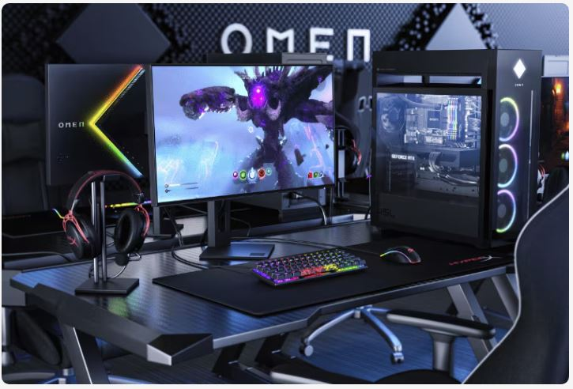
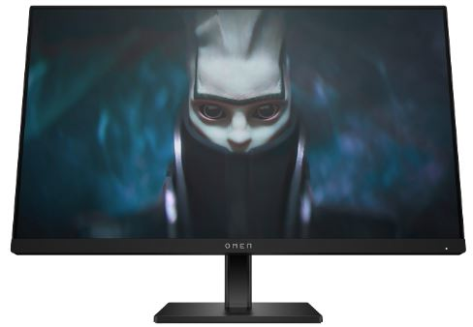
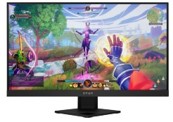
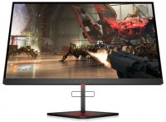
HP Gaming Home
Monitors
Retail File November 2025 Page 1/3
Promo prices are valid until 28/11 or Until Stock Last.
OMEN 24 - 23.8’’ GAMING MONITOR
Reach new possibilities with quick performance and vibrant color that lets you get lost in the game. This display has a sleek design and functions to look and feel great on your desk.
780D9E9 HP MONITOR 23.8'' 24 OMEN GAMING HOME E IPS FHD 1920 X 1080 165HZ 1MS 400 NITS AMD FREESYNC PREMIUM ANTIGLARE HEIGHT ADJUSTABLE TILT 2x HDMI DISPLAY PORT 2YW BLACK, 177 €
OMEN X 25F SERIES – 24.5’’ GAMING MONITOR
Are you ready for true competition? The OMEN X 25f 240Hz Gaming Display with Adaptive Sync was designed specifically for esports, with specs that give you an almost unfair advantage. A lightning-fast 240Hz refresh rate and a 1ms response time mean your grind to the top just got a whole lot easier.
OMEN 25I GAMING FHD 24.5’’ MONITOR
React faster, aim better, and zero in every aspect of your game. We've redefined high definition gaming with 165Hz, 1ms response, AMD FreeSync™ Premium Pro, and more colors than ever before.
4WH47AA HP MONITOR 24.5'', X 25F OMEN GAMING HOME, A, TN LED, FHD 1920 X 1080, 240HZ, 1MS, 400 NITS, AMD FREESYNC & NVIDIA G-SYNC, ADJUSTABLE, SWIVEL, TILT, 2X USB, 2X HDMI, DISPLAY PORT, 1YW, 391 €
22J05E9 HP MONITOR 24.5'', 25i OMEN GAMING HOME, F, IPS, FHD 1920 X 1080, 1MS, AMD FREESYNC 165Hz PREMIUM PRO, 400 NITS, TILT, AUDIO OUT, 2 X USB-A 3.2, USB TYPE-B, HDMI, DISPLAY PORT, 2YW, BLACK, 302 €
Prices, promotions, specifications, availability and terms of offers may change without notice. Despite our best efforts,
a small number of items may contain pricing, typography, or photography errors. Correct prices and promotions are validated at the time your order is placed. Recycling fees are not included in the Dealer & Retail File. Delivery and installation charges are not included. Products' warranty is the warranty given by the manufacturer. VAT is included
Call now on:
Mail on:

Slide 2

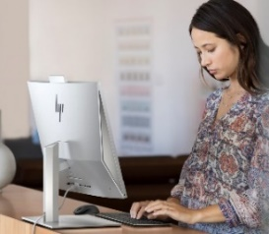
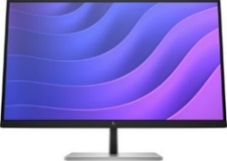
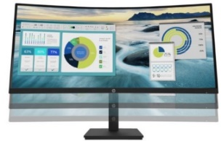
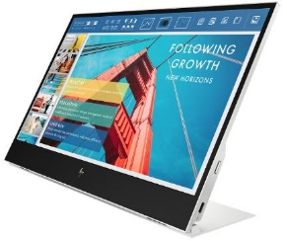
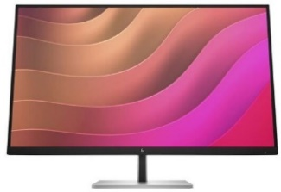
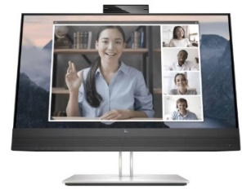
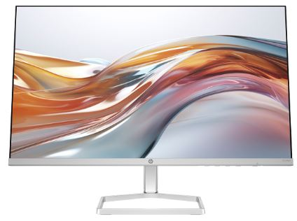
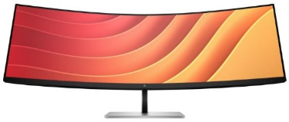
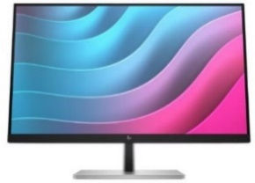
HP E,P & S Series Business Monitors
E27 G5 27’’ BUSINESS MONITOR
P34HC G4 34’’ WQHD CURVED MONITOR
Retail File November 2025 Page 2/3
Intentionally crafted to deliver crisp visuals, personalized comfort, and true flexibility, the HP Monitor redefines comfort, so there's nothing between you and your best. Stylishly designed with the planet in mind, this display is the perfect fit for both the office and home.
The HP P series offers a curved display with Ultrawide resolution,
letting you view your projects perfectly on the big screen. You can also have multiple windows open at the same without limiting readability.
The curved design gives you wider viewing angle to look at your documents.
Promo prices are valid until 28/11 or Until Stock Last.
6N4E2AA HP MONITOR 27'' E27 G5 BUSINESS D IPS FHD 1920 X 1080 5MS 250 NITS ANTIGLARE EYE EASE HEIGHT ADJUSTABLE PIVOT SWIVEL TILT 4 X USB TYPE-A USB TYPE-B HDMI DISPLAY PORT 3YW BLACK/SILVER, 231 €
E14 G4 14’’ PORTABLE MONITOR
Double down on your productivity with the HP E14 G4 Portable Monitor. Connect with just one USB-C™ cable and enjoy a great view indoors or outdoors from an extra-bright screen.
1B065AA HP MONITOR 14'' E14 PORTABLE BUSINESS, B, IPS LED, FHD 1920 X 1080, 5MS, 400 CD/M², ANTIGLARE, 2X USB TYPE-C, 3YW, SILVER, 344 €
E32k G5 32’’ UHD MONITOR
Uniquely designed to deliver incredible visuals and extended flexibility, the HP E32k G5 4K USB-C Monitor redefines precision, so there's nothing between you and your best. Stylishly crafted with your comfort and the planet in mind, this 4K display is a powerhouse of productivity.
21Y56AA HP MONITOR 34'', P34HC G4 BUSINESS CURVED, G, VA LED, WQHD 3440 X 1440, 5MS, 250 NITS, SPEAKER 2 X 3W, ULTRAWIDE, ANTIGLARE, HEIGHT ADJUSTABLE, TILT, USB TYPE-C, 4 X USB 3.2, HDMI, DISPLAY PORT, 3YW, BLACK , 472 €
E24mv G4 23.8’’ FHD MONITOR
Make a great impression on video calls on 23.8-inch full HD conferencing monitor. The integrated, 5MP tilt-adjustable pop-up webcam displays a sharp, detailed picture – even in low light – and the built-in speakers and mic produce clear, life-like sound. Everything you need to present your best self on every call.
S5 HOME 23.8’’, 27” & 31.5” FHD MONITOR
The HP Series 5 23.8-inch FHD White Monitor gives you the flexibility to enjoy entertainment with its sleek, thin-and-light design, vibrant color, deep contrast ratio, and higher refresh rate 1 for a no-screen-tearing experience.
169L0AA HP MONITOR 23.8'', E24mv G4 CONFERENCING BUSINESS , E, IPS, FHD 1920 X 1080, 16:9, 5MS, 250 NITS, SPEAKERS, CAMERA 5MP, HEIGHT ADJUSTABLE, PIVOT, SWIVEL, TILT, VGA, HDMI, DISPLAY PORT, 3YW, BLACK/SILVER, 275 €
6N4D6AA HP MONITOR 32'', E32k G5 BUSINESS, IPS, 4K UHD 3840 X 2160, 5MS, 350 NITS, 3W SPEAKERS, ANTIGLARE, HEIGHT ADJUSTABLE, PIVOT, SWIVEL, TILT, HDMI, DISPLAY PORT, USB-C 65W POWER DELIVERY, LAN, 3YW, BLACK/SILVER, 561 €
E45C G5 45’’ DQHD CURVED MONITOR
E24 G5 23.8’’ FHD MONITOR
Uniquely designed to deliver expansive immersion and flexibility, the HP E45c DQHD Curved Monitor augments what’s possible, so there's nothing between you and your best, all while keeping your comfort and the planet in mind.
Intentionally crafted to deliver crisp visuals, personalized comfort, and true flexibility, the HP E24 G5 FHD Monitor redefines comfort, so there's nothing between you and your best. Stylishly designed with the planet in mind, this display is the perfect fit for both the office and home.
94C21E9 HP MONITOR 23.8'', S5 524SW HOME, E, IPS, FHD 1920x1080, 100Hz, 16:9, 5MS, 300 NITS, ANTIGLARE, TILT, HDMI, VGA, 2YW, WHITE, 158 €
6N6E6AA HP MONITOR 23.8'', E24t G5 BUSINESS, E, IPS, FHD 1920 X 1080 TOUCH, 5MS, 300 NITS, ANTIGLARE, EYE EASE, HEIGHT ADJUSTABLE, PIVOT, SWIVEL, TILT, 4 X USB TYPE-A , USB TYPE-B, HDMI, DISPLAY PORT, 3YW, BLACK/SILVER, 287 €
94F46E9 HP MONITOR 27'', S5 527SW HOME, D, IPS, FHD 1920x1080, 100Hz, 16:9, 5MS, 300 NITS, ANTIGLARE, TILT, 2X HDMI, VGA, 2YW, WHITE, 185 €
6N4C1AA HP MONITOR 45'', E45c G5 BUSINESS CURVED, G, VA, DQHD 5120 X 1440, 3MS, 400 NITS, 3W SPEAKERS, ANTIGLARE, HEIGHT ADJUSTABLE, SWIVEL, TILT, HDMI, DISPLAY PORT, USB-C, LAN, 3YW, BLACK/SILVER, 1,089 €
Prices, promotions, specifications, availability and terms of offers may change without notice. Despite our best efforts,
a small number of items may contain pricing, typography, or photography errors. Correct prices and promotions are validated at the time your order is placed. Recycling fees are not included in the Dealer & Retail File. Delivery and installation charges are not included. Products' warranty is the warranty given by the manufacturer. VAT is included
Call now on:
Mail on:

Slide 3
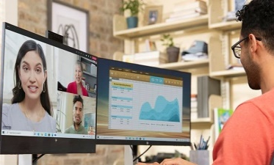
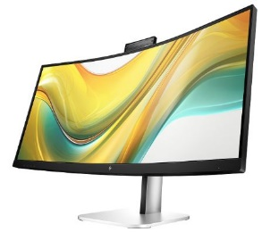
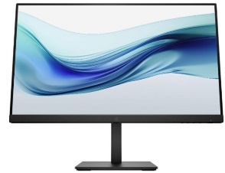
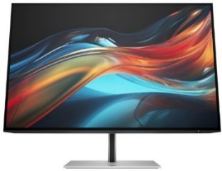
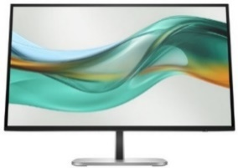
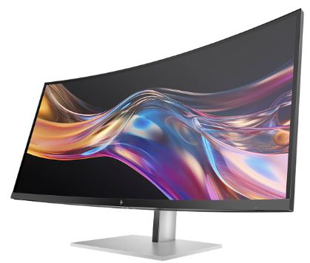
HP S3, S5, S7 and
Z Series Business Monitors
S5 34” PRO BUSINESS CURVED MONITOR
Retail File November 2025 Page 3/3
Collaborate confidently. Featuring a customizable setup, ultra-wide screen, and advanced AI for distraction-free meetings, wherever you work.
Promo prices are valid until 28/11 or Until Stock Last.
9E0Z2UT HP MONITOR 34'' S5 PRO 534PM BUSINESS CURVED, CONFERENCING, IPS, WQHD 3440X1440, 5MS, 400 NITS, CAMERA, SPEAKERS, ANTIGLARE, SWIVEL, HEIGHT ADJUSTABLE, TILT, DISPLAY PORT, HDMI, LAN, USB-C POWER DELIVERY 100W, VESA, 3YW , 647 €
S3 23.8” PRO BUSINESS MONITORS
Make the most out of your workday on this 23.8-inch FHD, energy-efficient monitor. Boost productivity with just the right visual features while also experiencing great comfort with a screen that you can adjust to your ideal position.
B1GM5AA HP MONITOR 23.8'' S3 PRO 324PE, D, IPS, FHD 1920x1080, 100Hz, 5MS, 16:9, SPEAKERS, ANTIGLARE, TILT, HEIGHT ADJUSTABLE, VGA, HDMI, DISPLAY PORT, 3YW, BLACK, 159 €
S7 24”, 27” & 32” PRO BUSINESS MONITORS
Create awe-inspiring work with true-to-life clarity on high-performance displays.
B1GM6AA HP MONITOR 23.8'' S3 PRO 327PE, D, IPS, FHD 1920x1080, 100Hz, 5MS, 16:9, SPEAKERS, ANTIGLARE, TILT, HEIGHT ADJUSTABLE, VGA, HDMI, DISPLAY PORT, 3YW, BLACK, 180 €
8Y2F7AA HP MONITOR 24'', S7 PRO 724PU BUSINESS, E, IPS LED, WUXGA 1920x1200 60Hz, 16:10, 5MS, 350 NITS, HEIGHT ADJUSTABLE, PIVOT, SWIVEL, TILT, HDMI, DISPLAY PORT, USB-C 100W POWER DELIVERY, LAN, 3YW, BLACK/SILVER, 356 €
8J4D8UT HP MONITOR 27'', HP MONITOR 27'', S7 PRO 727PQ BUSINESS, F, IPS BLACK, QHD 2560x1440 120Hz, 16:9, 5MS, 400 NITS, HEIGHT ADJUSTABLE, PIVOT, SWIVEL, TILT, AMD FREESYNC PREMIUM, USB-C, HDMI, DISPLAY PORT, 3YW, BLACK/SILVER, 461 €
S5 23.8” & 27” PRO BUSINESS MONITORS
8J9E6UT HP MONITOR 27'', S7 PRO 727PU BUSINESS, F, IPS BLACK, QHD 2560x1440 120Hz, 16:9, 5MS, 400 NITS, HEIGHT ADJUSTABLE, PIVOT, SWIVEL, TILT, HDMI, DISPLAY PORT, THUNDERBOLT WITH USB-C 100W POWER DELIVERY, LAN, 3YW, BLACK/SILVER, 613 €
Wherever you work, get more out of it with refined visual clarity and adjustable comfort built into a sleek, modern design.
8J9G2AA HP MONITOR 27'', S7 PRO 727PK BUSINESS, F, IPS BLACK, 4K UHD 3840x2160 60Hz, 16:9, 5MS, 400 NITS, HEIGHT ADJUSTABLE, PIVOT, SWIVEL, TILT, HDMI, DISPLAY PORT, THUNDERBOLT, LAN, 3YW, BLACK/SILVER, 695 €
9D9L6UT HP MONITOR 23.8'', S5 PRO 524PF BUSINESS, IPS, FHD 1920 X 1080, 5MS, 100Hz, 350 NITS, ANTIGLARE, HEIGHT ADJUSTABLE, SWIVEL, PIVOT, TILT, DISPLAY PORT, HDMI, 3YW, BLACK, 213 €
8K135AA HP MONITOR 27'', S7 PRO 727PK BUSINESS, F, IPS BLACK, 4K UHD 3840x2160 60Hz, 16:9, 5MS, 400 NITS, CAMERA, SPEAKERS, HEIGHT ADJUSTABLE, PIVOT, SWIVEL, TILT, HDMI, DISPLAY PORT, THUNDERBOLT WITH USB-C 100W POWER DELIVERY, LAN, 3YW, 870 €
8Y2K9AA HP MONITOR 32'', S7 PRO 732PK BUSINESS, G, IPS BLACK, 4K UHD 3840x2160 60Hz, 16:9, 5MS, 400 NITS, HEIGHT ADJUSTABLE, PIVOT, SWIVEL, TILT, HDMI, DISPLAY PORT, THUNDERBOLT WITH USB-C 100W POWER DELIVERY, LAN, 3YW, BLACK/SILVER, 950 €
9D9V7AA HP MONITOR 23.8', S5 PRO 524PU G5 BUSINESS, IPS LED, FHD 1920X1080, 5MS, 350 NITS, ANTIGLARE, PIVOT, SWIVEL, TILT, HEIGHT ADJUSTABLE, LAN, USB-C POWER DELIVERY 100W, HDMI, DP, VESA,JET BLACK,3YW, 280 €
9D9S0UT HP MONITOR 27'', S5 PRO 527PQ BUSINESS, IPS, QHD 2560X1440, 100Hz, 5MS, 350 NITS, ANTIGLARE, PIVOT, SWIVEL, TILT, HEIGHT ADJUSTABLE, HDMI, DISPLAY PORT, 3YW, 296 €
S7 34” & 39.7” PRO BUSINESS CURVED MONITORS
Effortlessly make a great impression through extraordinary collaboration powered by built-in AI conferencing on a dazzling ultrawide display with Thunderbolt.
9E0G5AA HP MONITOR 27'' S5 PRO 527PU BUSINESS, E, IPS, QHD, 2560 X 1440 100Hz, 5MS, RJ-45, USB-C 100W POWER DELIVERY, HEIGHT ADJUSTABLE, TILT, SWIVEL, PIVOT, HDMI, DISPLAY PORT, 3YW BLACK/SILVER, 362 €
8K157UT HP MONITOR 34'', S7 PRO 734PM BUSINESS CURVED, G, IPS BLACK, 4K WQHD 3840x1440 120Hz, 21:9, 5MS, 400 NITS, CAMERA, SPEAKERS, HEIGHT ADJUSTABLE, SWIVEL, TILT, HDMI, DISPLAY PORT, THUNDERBOLT WITH USB-C 100W, LAN, 3YW, BLACK/SILVER, 1,160 €
9E0G9UT HP MONITOR 23.8'', S5 PRO 524PM BUSINESS, IPS, FHD 1920 X 1080,5MS, 350 NITS,5MS, ANTIGLARE, CAMERA 5MP, HEIGHT ADJUSTABLE, SWIVEL, PIVOT, TILT, DISPLAY PORT, HDMI, USB-C 100W POWER DELIVERY, VESA,BLACK, 3YW, 417 €
9E0Y9UT HP MONITOR 27'', S5 PRO 527PM BUSINESS, IPS, QHD 2560 X 1440,5MS, 350 NITS,5MS, ANTIGLARE, CAMERA 5MP, SPEAKERS, HEIGHT ADJUSTABLE, SWIVEL, PIVOT, TILT, DISPLAY PORT, HDMI, USB-C, VESA,BLACK, 3YW, 495 €
8Y2R2AA HP MONITOR 39.7'', S7 PRO 740PM BUSINESS ULTRAWIDE CONFERENCIN CURVED, IPS, 5K2K WUHD 5120x2160 60Hz, 21:9, 5MS, CAMERA, SPEAKERS, HEIGHT ADJUSTABLE, SWIVEL, TILT, HDMI, DISPLAY PORT, THUNDERBOLT WITH USB-C 100W, LAN, 3YW, BL/SILV, 1,617 €
Prices, promotions, specifications, availability and terms of offers may change without notice. Despite our best efforts,
a small number of items may contain pricing, typography, or photography errors. Correct prices and promotions are validated at the time your order is placed. Recycling fees are not included in the Dealer & Retail File. Delivery and installation charges are not included. Products' warranty is the warranty given by the manufacturer. VAT is included
Call now on:
Mail on:

