Slide 1



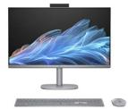
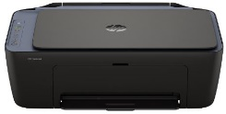
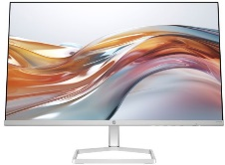
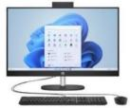
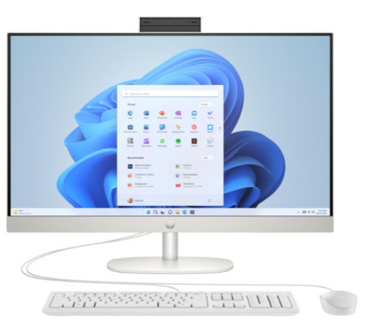



HP Home, Pavilion & All –In One PCs
Retail File November 2025. Page 1/4
Take on demanding tasks with lightning speed with the HP OmniStudio X 27 inch All-in-One Desktop PC featuring built-in AI technology and a powerful Intel® Core™ Ultra Processor. Enjoy immersive visuals, cinema-quality audio and AI-powered comfort and wellness features that help you take on the day your way.
Promo prices are valid until 28/11 or Until Stock Last.
Effortlessly print, scan, and copy with this compact, wireless home printer paired with the best and easiest-to-use print app. From return labels to your favorite recipes, enjoy a seamless experience
C0GC0EA HP PC ALL IN ONE OMNISTUDIO X 27-CS0003NV, 27'' FHD TOUCH IPS, INTEL ULTRA 5-125H AI 2.5-4.5GHz/18MB, 14 CORES, 16GB (2x8GB), 1TB PCIe NVMe SSD, SPEAKERS, 5MP CAM, INTEL ARC GRAPHICS, WIN 11 HOME, 2YW, METEOR SILVER, 1,614 €
A24HWB HP PRINTER ALL IN ONE INKJET COLOR DESKJET HOME 2921 A4, PRINT, SCAN COPY, 7.5PPM (B), 5.5PPM (C), DC:1K, 60P INPUT TRAY, AIR PRINT, WIFI, 1YW, 63 €
BE1N6EA HP PC ALL IN ONE OMNISTUDIO X 27-CS1000NV, 27'' FHD TOUCH IPS, INTEL ULTRA 7-256V AI 2.2-4.8GHz/12MB, 8 CORES, 16GB, 1TB PCIe NVMe SSD, SPEAKERS, 5MP CAM, INTEL ARC GRAPHICS, WIN 11 HOME, 2YW, METEOR SILVER, 1,888 €
94C21E9 HP MONITOR 23.8'', S5 524SW HOME, E, IPS, FHD 1920x1080, 100Hz, 16:9, 5MS, 300 NITS, ANTIGLARE, TILT, HDMI, VGA, 2YW, WHITE, 158 €
Introducing the HP All-in-One Desktop PC a sleek, desktop solution that blends style with sustainability. Powered by a reliable Intel® Processor, upgraded memory, and advanced multitasking features.
From the brand trusted by millions, this HP Desktop PC blends a modern design with proven technology. Take on everyday tasks with a reliable processor and save more of your favorite content with abundant storage.
7Z514EA HP PC M01-F3000NV, AMD RYZEN 7 5700G 3.8-4.6GHz/16MB, 8 CORES, 16GB, 512GB SSD + 1TB HDD, UMA GRAPHICS, DVDRW,WIN 11 HOME, 2YW, DARK BLACK, 965 €
A1LL3EA HP PC ALL IN ONE 24-CR1007NV 23.8’’ FHD TOUCH INTEL ULTRA 5-125U 3.6-4.3GHz/12MB 12 CORES 16GB 512GB NVMe SSD UMA GRAPHICS CAM SPEAKER WIN 11 HOME 2YW JET BLACK, 1,086 €
BG7K4EA HP PC ALL IN ONE 24-CR0013NV, 23.8’’ FHD TOUCH, AMD RYZEN 7-7730U 2.0-4.5GHz/16MB, 8 CORES, 16GB(2x8GB), 512GB NVMe, AMD RADEON GRAPHICS, CAM, SPEAKER, WIN 11 HOME, 2YW, SHELL WHITE, 1,125 €
High volume colour printing at extremely low cost per page. Get up to 8,000 black pages or up to 6,000 colour pages.
A1ZH3EA HP PC ALL IN ONE 27-CR1005NV, 27’’ FHD TOUCH, INTEL ULTRA 5-125U 3.6-4.3GHz/12MB, 12 CORES, 16GB, 1TB NVMe SSD, INTEL UHD GRAPHICS, CAM, SPEAKER, WIN 11 HOME, 2YW, JET BLACK, 1,303 €
BG7K6EA HP PC ALL IN ONE 27-CR0009NV, 27’’ FHD TOUCH IPS, INTEL i5-1334U 3.4-4.6GHz/12MB, 10 CORES, 16GB (2x8GB), 512GB NVMe SSD, CAM, SPEAKER, INTEL IRIS XE GRAPHICS, WIN 11 HOME, 2YW, SHELL WHITE, 1,160 €
1F3Y4A HP PRINTER ALL IN ONE INKJET COLOR SMART TANK HOME - OFFICE 585 A4, PRINT, SCAN, COPY, 22PPM(B),16PPM(C), 4800 x 1200DPI,100P TRAY,DC: 3K,4 BOTTLES INK, BT, WIFI, 1YW, BLUE SCANNER PLATE, 167 €
A1LL2EA HP PC ALL IN ONE 24-CR1002NV, 23.8’’ FHD TOUCH, INTEL ULTRA 7-155U 3.8-4.8GHz/12MB, 12 CORES, 16GB (1x16GB), 1TB NVMe SSD, INTEL IRIS XE GRAPHICS, CAM, SPEAKER, WIN 11 HOME, 2YW, JET BLACK, 1,406 €
A31TBEA HP PC ALL IN ONE 27-CR1004NV, 27’’ FHD IPS, INTEL ULTRA 7-155U 3.8-4.8GHz/12MB, 12 CORES, 16GB, 1TB NVMe SSD, UMA GRAPHICS, CAM, SPEAKER, WIN 11 HOME, 2YW, SHELL WHITE, 1,328 €
6UU48A HP PRINTER ALL IN ONE INKJET COLOR SMART TANK HOME - OFFICE 670 A4, PRINT, SCAN, COPY, 22PPM (B), 21PPM (C), 4800x1200 DPI, DC:3K, DUPLEX, 150P TRAY, USB, BT, WIFI, 1YW, 231 €
A1LL4EA HP PC ALL IN ONE 27-CR1001NV, 27’’ FHD TOUCH, INTEL ULTRA 7-155U 3.8-4.8GHz/12MB, 12 CORES, 16GB (1x 16GB), 1TB NVMe SSD, INTEL IRIS XE GRAPHICS, CAM, SPEAKER, WIN 11 HOME, 2YW, JET BLACK, 1,438 €
Prices, Promotions, specifications, availability and terms of offers may change without notice. Despite our best efforts,
a small number of items may contain pricing, typography, or photography errors. Correct prices and Promotions are validated at the time your order is placed. Recycling fees are not included in the Dealer & Retail File. Delivery and installation charges are not included. Products' warranty is the warranty given by the manufacturer. VAT is included
Call now on:
Mail on:

Slide 2

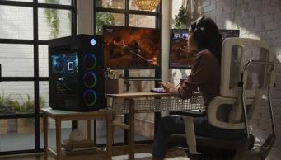
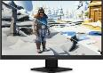







HP Gaming PCs
Retail File November 2025. Page 2/4
Built for extreme performance, the OMEN by HP 45L Gaming Desktop PC is designed for gaming from the ground up. Powered by the latest AMD and Intel Processor, the OMEN by HP gaming desktop takes cooling to incredible heights with a unique cooling chamber. Created for easy tool-less upgradeability with industry standard components to meet your gaming needs.
Promo prices are valid until 28/11 or Until Stock Last.
HP Gaming Peripherals
22J05E9 HP MONITOR 24.5'', 25i OMEN GAMING HOME, F, IPS, FHD 1920 X 1080, 1MS, AMD FREESYNC 165Hz PREMIUM PRO, 400 NITS, TILT, AUDIO OUT , 2 X USB-A 3.2, USB TYPE-B, HDMI, DISPLAY PORT, 2YW, BLACK, 302 €
7Z511EA HP PC OMEN 45L GAMING GT22-1005NV, AMD RYZEN 7 7700X 4.5-5.4GHz / 32MB, 8 CORES, 16GB, SSD WD BLACK 1TB, NVIDIA GEFORCE RTX 3070 TI 8GB, WIN 11 HOME, 2YW, SHADOW BLACK GLASS DOOR, 2,927 €
4WH47AA HP MONITOR 24.5'' X 25F OMEN GAMING HOME A TN LED FHD 1920 X 1080 1MS 400 NITS AMD FREESYNC 240HZ & NVIDIA G-SYNC ANTIGLARE HEIGHT ADJUSTABLE SWIVEL TILT 2X USB 3.0 2X HDMI DISPLAY PORT 1.2 1YW BLACK, 391 €
The OMEN by HP 40L Gaming Desktop is the ultimate companion on your gaming journey. Powered by the latest Intel and AMD processor and advanced graphics, the OMEN Desktop has a superior cooling system that prevents overheating. Designed for easy tool-less upgradeability, the OMEN Desktop will give you the top-tier performance to meet your gaming needs.
B5ZU6EA HP PC OMEN GAMING GT22-3003nv, INTEL ULTRA 7-265K 3.9-5.5GHz/30MB, 20 CORES, 32GB, 1TB GEN4 NVMe M.2 SSD, NVIDIA GEFORCE RTX 4070 12GB, WIN 11 PRO, 3YW SHADOW BLACK, 3,220 €
6MF36AA HP HEADSET OMEN MIND-FRAME PRIME HEADSET, MIC, VIRTUAL SURROUND SOUND, OMEN'S ACTIVE EAR CUP COOLING TECHNOLOGY, USB-A PORT, 1YW, WHITE, 161 €
8BC52AA HP MOUSE OMEN GAMING VECTOR ESSENTIAL USB, 6 BUTTONS, OMEN RADAR 1 SENSOR, CO-DEVELOPED WITH PIXART, OPTICAL SENSOR FOR PRECISE MOVEMENT ON MOST SURFACES, 6 PROGRAMMABLE BUTTONS, BLACK, 24 €
7Z506EA HP PC OMEN 40L GAMING GT21-1009NV, AMD RYZEN 7 7700X 4.5-5.4GHz/32MB, 8 CORES, 16GB (2x8GB), SSD WD BLACK 1TB, NVIDIA GEFORCE RTX 3070 8GB, WIN 11 HOME, 2YW, SHADOW BLACK GLASS DOOR, 2,509 €
8BC53AA HP MOUSE OMEN VECTOR GAMING USB, 6 BUTTONS, OMEN RADAR 3 SENSOR, CO-DEVELOPED WITH PIXART, OPTICAL SENSOR FOR PRECISE MOVEMENT ON MOST SURFACES, 6 PROGRAMMABLE BUTTONS, CUSTOM LIGHTING THROUGH OMEN COMMAND CENTER, BLACK, 37 €
Prices, Promotions, specifications, availability and terms of offers may change without notice. Despite our best efforts,
a small number of items may contain pricing, typography, or photography errors. Correct prices and Promotions are validated at the time your order is placed. Recycling fees are not included in the Dealer & Retail File. Delivery and installation charges are not included. Products' warranty is the warranty given by the manufacturer. VAT is included
Call now on:
Mail on:

Slide 3

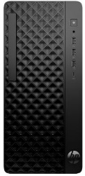
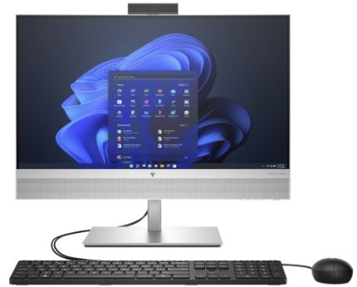
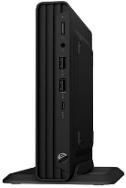
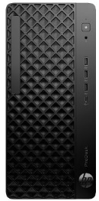


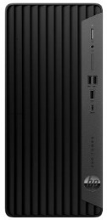


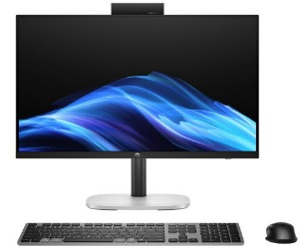
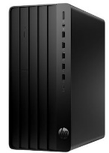
HP Mini, SFF, Tower, and All In One Business PCs
The affordable HP ProDesk 2 Tower G1i is equipped with a powerful Intel® processor 1, security features, and essential tools for business.
The HP EliteOne 840 & 870 AiO empowers your team to be at their best with experiences that delight users and IT. Featuring a new sleek design, the latest Intel® processor, and packed with a new set of premium collaboration tools, it’s ready for all your demanding projects and virtual conferences.
Retail File November 2025. Page 3/4
B6ZC8ET HP PC PRODESK 2 G1i TWR, INTEL i3-14100 3.5-4.7 GHz/12MB, 4 CORES, 16GB (1x16GB), 512GB PCIe NVMe SSD, INTEL UHD GRAPHICS 730, WIN 11 PRO, 3YW, 812 €
Promo prices are valid until 28/11 or Until Stock Last.
B70VSAT HP PC PRODESK 2 G1i TWR, INTEL i5-14500 3.7-5.0 GHz/24MB, 14 CORES, 16GB (1x16GB), 512GB PCIe NVMe SSD, INTEL UHD GRAPHICS, WIN 11 PRO, 3YW, 903 €
An affordable commercial desktop PC. The HP Pro Mini 260 G9 has the perfect combination of power, snappy performance, and value with a 13th gen Intel® Core™ processor to handle multiple work tasks smoothly and reliably with multiple processing cores.
B70VRAT HP PC PRODESK 2 G1i TWR, INTEL i7-14700 4.2-5.4 GHz/33MB, 20 CORES, 16GB (1x16GB), 512GB PCIe NVMe SSD, INTEL UHD GRAPHICS, WIN 11 PRO, 3YW, 971 €
9H6F4ET HP PC PRO 260 G9 MINI, INTEL i5-1335U 3.4-4.6 GHz/12MB, 10 CORES, 16GB, 512GB PCIe NVMe M.2 SSD, INTEL IRIS XE GRAPHICS, DOS, 3YW, 623 €
The future-ready HP ProDesk 4 Tower G1i Desktop AI PC provides customizable productivity features with the added boost of the latest Intel® CPU 2 with 13 TOPS NPU 3 — helping amplify execution of mundane tasks so you can focus on impactful, motivating work.
999X9ET HP PC ALL IN ONE ELITEONE 840 G9, 23.8‘’ FHD IPS, INTEL i5-14500 VPRO 3.7-7.0GHz/24MB, 14 CORES, 16GB (1x16GB), 512GB PCIe NVMe M.2 SSD, INTEL UHD GRAPHICS 770, 5W SPEAKERS, CAMERA, WIN 11 PRO, 3YW, 1,447 €
C78H1ET HP PC PRODESK 4 G1i TWR AI, INTEL ULTRA 5-225 3.3-4.9GHz/20MB, 10 CORES, 16GB, 512GB PCIe NVMe SSD, INTEL UHD GRAPHICS, WIN 11 PRO, 5YW, 1,017 €
Step into the future with the AI-enhanced, highly secure and easy to manage HP Elite 805 Small Form Factor equipped with an AMD Ryzen™ 8000 series processor.
series processor
99A46ET HP PC ALL IN ONE ELITEONE 840 G9, 23.8'' FHD IPS, INTEL i5-14500 VRPO 2.6-5.0GHz/24MB, 14 CORES, 16GB (1x 16GB), 1TB PCIe NVMe M.2 SSD, INTEL UHD 770 GRAPHICS, WIN 11 PRO, 3YW, 1,425 €
C6TQ1AT HP PC ELITE SFF 805 G9, AMD RYZEN 5 8500 3.5-5.0GHz/16MB, 6 CORES, 16GB (1x16GB), 512GB PCIe NVMe SSD, AMD RADEON GRAPHICS, WIN 11 PRO, 5YW, 898 €
C78H3ET HP PC PRODESK 4 G1i TWR AI, INTEL ULTRA 7-265 4.6-5.3GHz/30MB, 20 CORES, 32GB (1x32GB), 1TB PCIe NVMe SSD, INTEL UHD GRAPHICS, WIN 11 PRO, 5YW, 1,374 €
99A52ET HP PC ALL IN ONE ELITEONE 840 G9 24'' TOUCH FHD IPS, INTEL i7-14700 2.1-5.4GHz/33MB, 20 CORES, 32GB, 1TB PCIe NVMe SSD, INTEL UHD GRAPHICS, WIN 11 PRO, 3YW, 1,824 €
The HP ProDesk 4 Mini G1i Desktop AI PC delivers a highly secure and reliable one-liter PC that provides commercial-grade performance and flexible single-cable deployment capabilities for businesses of all sizes.
The HP Pro Tower 400 G9 PC is a powerful professional solution, designed for demanding work environments.
99A59ET HP PC ALL IN ONE ELITEONE 870 G9 27'' QHD IPS, INTEL i7-14700 VPRO 2.0-5.8GHz/36MB, 24 CORES, 32GB (1x32GB), 512GB PCIe GEN4 NVMe TLC M.2 SSD, INTEL UHD GRAPHICS 770, 5W SPEAKERS, CAMERA, WIN 11 PRO, 3YW 2,044 €
C78LGET HP PC PRODESK 4 G1i MINI AI, INTEL ULTRA 5-225T 4.4-4.9GHz/20MB, 10 CORES, 16GB (1x16GB), 512GB PCIe NVMe SSD, INTEL UHD GRAPHICS, WIN 11 PRO, 5YW, 958 €
C6TQ0ET HP PC PRODESK 400 G9 MT, INTEL i5-14500 3.7-5.0GHz/24MB, 14 CORES, 16GB, 512GB PCIe NVMe SSD, INTEL UHD GRAPHICS, DOS, 5YW, 820 €
The HP ProOne 240 & 245 All-in-One provides power and features for productivity and business-grade performance. A great value, with the latest AMD processor, a 23.8-inch diagonal Full HD display, and video-enhancement features in a sleek, stylish design and tiltable camera.
The HP Pro SFF 400 Desktop provides users in hybrid work environments with the commercial-grade configuration options and connectivity in a space-saving design. This PC is powered by the latest Intel® processor and protected with always-on security you can trust.
9H760ET HP PC PRODESK 400 G9, INTEL i7-14700 2.1-5.4GHz/33MB, 20 CORES, 32GB (1x32GB), 512GB PCIe NVMe SSD, INTEL UHD GRAPHICS 770, WIN 11 PRO, 5YW, BLACK, 1,425 €
9H766ET HP PC PRO 400 G9 SFF, INTEL i7-14700 VPRO 2.1-5.4GHz/33MB, 20 CORES, 16GB, 1TB PCIe NVMe M.2 SSD, INTEL UHD GRAPHICS, WIN 11 PRO, 5YW, BLACK, 1,374 €
The HP ProStudio 4 All-in-One G1i Desktop AI PC boosts collaboration and productivity, thanks to business-grade performance features, including an Intel® CPU 2 with a 13 TOPS NPU 3 and a 5 MP camera.
A54ZWET HP PC ALL IN ONE PRO ONE 245 G10, 23.8'' FHD IPS, AMD RYZEN 5 7520U 2.8-4.3GHz/4MB, 4 CORES, 16GB, 512GB PCIe NVMe SSD, AMD RADEON GRAPHICS, CAMERA, MIC, LAN, WIN 11 PRO, 3YW, 961 €
Maximize your investments with the HP Pro Tower 290 G9. Get the perfect combination of power, snappy performance and value.
C6TQ4ET HP PC ALL IN ONE PROSTUDIO 4 G1i AI, 23.8'' FHD IPS, ULTRA 5-225 4.4-4.9GHz/20MB, 10 CORES, 16GB (1x 16GB), 512GB PCIe NVMe SSD, INTEL GRAPHICS, WIN 11 PRO, 3YW, 1,172 €
A54ZRET HP PC ALL IN ONE PRO ONE 240 G10, 23.8'' FHD IPS, INTEL i5-1335 3.4-4.6GHz/12MB, 10 CORES, 16GB, 512GB PCIe NVMe SSD, INTEL IRIS XE GRAPHICS, CAMERA, MIC, LAN, WIN 11 PRO, 3YW, 1,053 €
623Y0ET HP PC PRO 290 G9, INTEL i5-13500 2.5-4.8GHz/24MB, 14 CORES, 16GB (1x16GB), 512GB PCIe NVMe M.2 SSD, INTEL UHD GRAPHICS, DOS, 3YW, 711 €
Prices, Promotions, specifications, availability and terms of offers may change without notice. Despite our best efforts,
a small number of items may contain pricing, typography, or photography errors. Correct prices and Promotions are validated at the time your order is placed. Recycling fees are not included in the Dealer & Retail File. Delivery and installation charges are not included. Products' warranty is the warranty given by the manufacturer. VAT is included
Call now on:
Mail on:

Slide 4


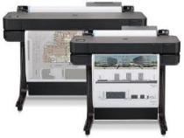
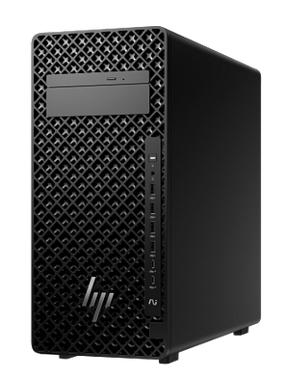
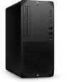





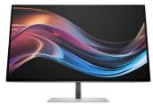


HP Business Workstations PCs
Retail File November 2025. Page 4/4
Experience new levels of performance for professional workflows. The HP Z2 Tower AI workstation is reengineered to support high-end graphics and seamlessly run both single and multi-threaded apps for fast modeling, simulation, and rendering. Enjoy easy expandability to upgrade, when needs evolve.
Promo prices are valid until 28/11 or Until Stock Last.
HP Z1 PCS. Pro-grade performance is now within reach with a desktop built for designing, editing and even gaming. From 2D and 3D CAD to entry VR content creation, gain speed and efficiency across your workflows. Go beyond a commercial PC with a desktop certified for select professional software applications.
C85FQET HP PC WORKSTATION Z1 G1i TWR 700W, INTEL ULTRA 7-265 VRPO 2.4-5.3GHZ/30MB, 13 NPU TOPS, 20 CORES, 32GB (1x32GB), 512GB PCIe M.2 SSD + 2TB HDD, NVIDIA RTX A400 4GB, WIN 11 PRO, 3YW, 1,776 €
5HB09D HP PLOTTER DESIGNJET T630 24'' A1, PRINT, 30 SEC/PAGE ON A1, 76 A1 PRINTS PER HOUR, 2400 X 1200 DPI, 1GB, ROLL, STAND, CUTTER, 4 INKS, USB, WIFI, LAN, 1YW, 1,647 €
C85FPET HP PC WORKSTATION Z2 G1i TWR 700W, INTEL ULTRA 7-265 VRPO 2.4-5.3GHZ/30MB, 13 NPU TOPS, 20 CORES, 32GB (1x32GB), 512GB PCIe M.2 SSD + 2TB HDD, NVIDIA RTX A1000 8GB, WIN 11 PRO, 3YW, 2,264 €
B34N1ES HP PC WORKSTATION Z2 G1i TWR 700W, INTEL ULTRA 7-265K VRPO ENTERPRISE 4.6-5.5GHZ/30MB, 20 CORES, 32GB (1x32GB), 1TB PCIe M.2 SSD, NVIDIA RTX 5060 8GB, WIN 11 PRO, 3YW, 2,410 €
758A9AA HP MOUSE Z3700 WIRELESS, DUAL MODE, 3 BUTTONS, 16-MONTHS BATTERY LIFE, GREAT FOR EITHER HAND, THE SLEEK DESIGN COMPLEMENTS YOUR FAVORITE DEVICES, AND FITS COMFORTABLY ANYWHERE, 1YW, SILVER, 24 €
A40NJET HP PC WORKSTATION Z2 G1i TWR 700W, INTEL ULTRA 7-265 VRPO 2.4-5.3GHZ/30MB, 13 NPU TOPS, 20 CORES, 32GB (1x32GB), 1TB PCIe M.2 SSD, NVIDIA RTX A1000 8GB, WIN 11 PRO, 3YW, 2,429 €
HP Wolf Security strengthens your company’s cyber-resilience. EliteDesk,
Z Workstation
4M0X6AA HP MOUSE 410 SLIM, UP TO 1200DPI, MULTI SURFACE TRACKING, SLIM AND SLEEK, STRONG AND EFFICIENT CONNECTION WITHOUT INTERFERENCE OR LAG, WORKS WITH EITHER HAND, BLUETOOTH, WHITE, 34 €
C85FRET HP PC WORKSTATION Z2 G1i TWR 700W, INTEL ULTRA 7-265 VRPO 2.4-5.3GHZ/30MB, 13 NPU TOPS, 20 CORES, 32GB (1x32GB), 1TB PCIe M.2 SSD, NVIDIA RTX A2000 16GB, WIN 11 PRO, 3YW, 2,499 €
3NZ70AA HP MOUSE 700 SPECTRE RECHARGEABLE, BLUETOOTH WIRELLESS, PAIR WITH 4 DEVISES, WITH 1.200 DPI, THE LASER SENSOR PROVIDES SUPERB ACCURACY AND PRECISION — ON ALMOST EVERY SURFACE, DARK ASH SILVER, 67 €
A40NKET HP PC WORKSTATION Z2 G1i TWR 700W, INTEL ULTRA 7-265 VRPO 2.4-5.3GHZ/30MB, 13 NPU TOPS, 20 CORES, 32GB (1x32GB), 1TB PCIe M.2 SSD, NVIDIA RTX 2000 ADA 16GB , WIN 11 PRO, 3YW, 2,837 €
B34N2ES HP PC WORKSTATION Z2 G1i TWR 700W, INTEL ULTRA 7-265K VRPO ENTERPRISE 4.6-5.5GHZ/30MB, 20 CORES, 64GB (2x32GB), 1TB PCIe M.2 SSD, NVIDIA RTX 5070 12GB, WIN 11 PRO, 3YW, 3,039 €
A40NQET HP PC WORKSTATION Z2 G1i TWR 700W, INTEL ULTRA 9-285 AI 4.6-5.6GHZ 36MB, 13 NPU TOPS, 24 CORES, 32GB (1x32GB), 1TB PCIe M.2 SSD, NVIDIA RTX 4000 ADA 20GB, WIN 11 PRO HIGH END, 3YW, 3,879 €
8J9G2AA HP MONITOR 27'', S7 PRO 727PK BUSINESS, F, IPS BLACK,
4K UHD 3840x2160 60Hz, 16:9, 5MS, 400 NITS, HEIGHT ADJUSTABLE, PIVOT, SWIVEL, TILT, HDMI, DISPLAY PORT, THUNDERBOLT WITH USB-C 100W POWER DELIVERY, LAN, 3YW, BLACK/SILVER, 695 €
Prices, Promotions, specifications, availability and terms of offers may change without notice. Despite our best efforts,
a small number of items may contain pricing, typography, or photography errors. Correct prices and Promotions are validated at the time your order is placed. Recycling fees are not included in the Dealer & Retail File. Delivery and installation charges are not included. Products' warranty is the warranty given by the manufacturer. VAT is included
Call now on:
Mail on:

